Slide 1
Power BI Sales Dashboard Summary
Data Analyst Internship – Task 3
Dataset: Superstore Sales (Kaggle)
Tool Used: Power BI

Slide 2
Objective
Design and develop an interactive dashboard using Power BI to help business stakeholders analyze sales, profit, and performance across regions and product categories.

Slide 3
Key Performance Indicators (KPIs)
- Total Sales
- Total Profit
- Profit Margin (%)
- Total Quantity Sold
- Order Count
- Average Order Value
- Average Discount

Slide 4
Visuals and Features
- KPI Cards for quick stats
- Time-Series Charts: Sales & Profit by Year
- Bar Charts: Sales by Region & Category
- Map View (optional)
- Slicers for interactivity: Region, Category, Segment, Date
- Clean layout and consistent color theme

Slide 5
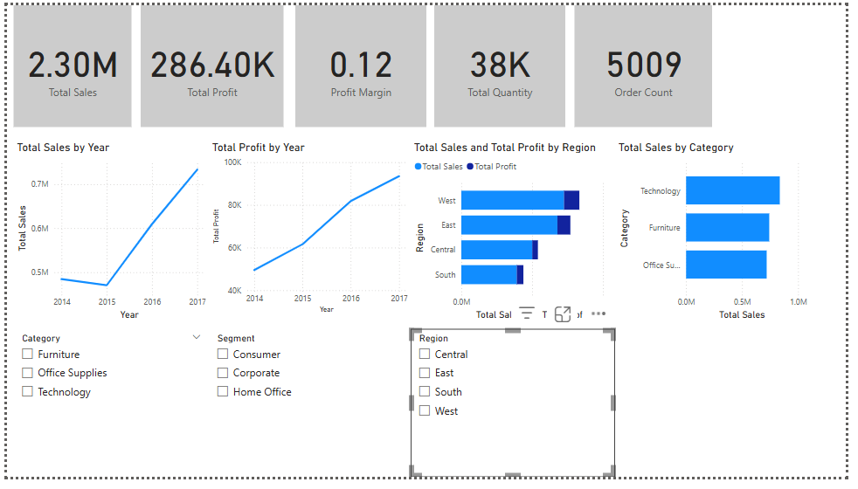
Dashboard Snapshot

Slide 6
Key Insights
- Sales showed consistent growth from 2014 to 2017
- Technology category leads in revenue
- West region contributes the highest sales and profit
- Consumer segment dominates order volume
- Moderate profit margin indicates opportunity for optimization

Slide 7
Learnings
- Built a complete dashboard in Power BI
- Created KPIs using DAX measures
- Designed interactive visuals using slicers
- Applied formatting and navigation features
- Derived insights from real-world business data

Slide 8
GitHub Repository
📁 Repository Includes:
- Power BI (.pbix) file
- Dataset (CSV)
- Dashboard Screenshot
- Summary PPT
- README.md with explanations

Slide 9
Thank You

