Slide 1
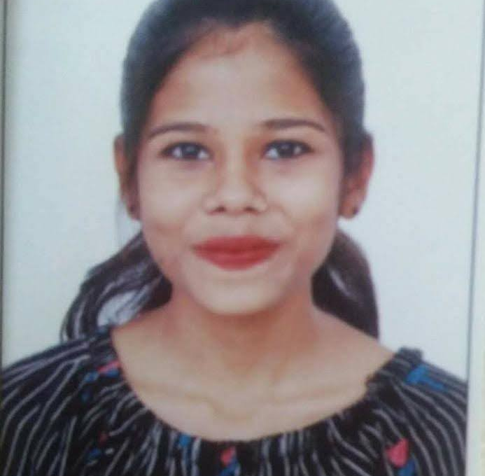
Professional Background
Professional Experience Highlights
Big Data & ETL Development: 3.5+ Years experience working across Big Data ecosystems, including ETL workflows, Hadoop‑based processing, large‑scale data pipelines, and SQL/Scala‑driven transformations. Strong foundation in ingestion, validation, lineage tracking, and data‑quality improvements.
Data Lineage & Quality Assurance:Executed end‑to‑end data lineage investigations, validated transformation accuracy, and ensured compliance with expected data‑flow standards. Strengthened system reliability by resolving inconsistencies across datasets and workflows.
Operational & Production SupportExperience in resolving production issues, validating system behaviours, ensuring timely data processing, and collaborating with teams to maintain smooth daily operations. Improved processes through analysis and continuous optimisation.
Agile Collaboration:
Worked closely with analysts, and developers within Agile/Scrum environments. Actively participated in requirement discussions, sprint activities, and cross‑team coordination to deliver high‑quality features
Banking & Financial Services (Nordea)
Implemented ingest‑date–based controls for ND job execution, ensuring accurate and timely data processing.Automated the monthly NPV workflow, reducing manual effort and improving reporting efficiency.Refactored code by removing deprecated attributes and aligning logic with updated business requirements.
Performed data‑lineage validation to ensure traceability and integrity across transformation pipelines.
Verified SMX document mappings, improving data quality and alignment with expected standards. Supported TRF2 MDP team deliverables through backend enhancements, issue resolution, and Scala‑based workflow improvements.
Internal Platforms & Engineering Initiatives (GenGarage – Capgemini)
Developed backend components for real‑time report fetching, enhancing data accessibility and improving responsiveness for internal stakeholders. Collaborated with cross‑functional teams to refine requirements and deliver stable feature enhancements under rapid development cycles. Optimized workflow logic and transformed data retrieval processes, improving system usability and ensuring quicker access to operational insights.
Policy & Data Processing (Sequel Policy Creation – Internal Project)
Worked on end‑to‑end policy creation flows, including rules, validations, and logic enhancements aligned with evolving business needs.Designed and executed SQL queries supporting policy reporting, audits, and data checks, improving accuracy and reducing repetitive manual tasks.Analyzed existing processes and contributed improvements to reduce errors and strengthen data flow reliability.
Hackathon & Innovation (Capgemini Hackathon Finalist)
Reached the final round of Capgemini’s internal hackathon during bench period, demonstrating rapid prototyping, problem‑solving, and team collaboration.
Contributed to solution architecture, backend logic, and presentation materials under competitive and time‑pressured conditions. Strengthened creative engineering abilities through hands‑on innovation challenges.
Technology & Development (Scala Developer – Nordea)
Transitioned from operations to a Scala development role, contributing to feature enhancements, logical fixes, and code improvements for 3–4 months.
Worked with Bitbucket, Jira, Jenkins, IntelliJ, and Helix to support CI/CD and ensure smooth deployment cycles. Enhanced understanding of distributed workflows and Scala‑based data processing components.
Operational Excellence (Nordea – Operations Team)
Handled workflow monitoring, issue analysis, and daily operational activities to ensure smooth and timely data processing.
SRUSHTI BANSODE
Data Analyst
Core Competencies
Python
BigData:ETL,Hadoop,Scala
Business Intelligence – Power BI
SQL & Database – Query Optimization, Schema Design
CI/CD & DevOps Automation – Git, GitHub,Jenkins
Bachelor’s of Information Technology – Mumbai University India
Education
Mumbai, India

