Slide 1
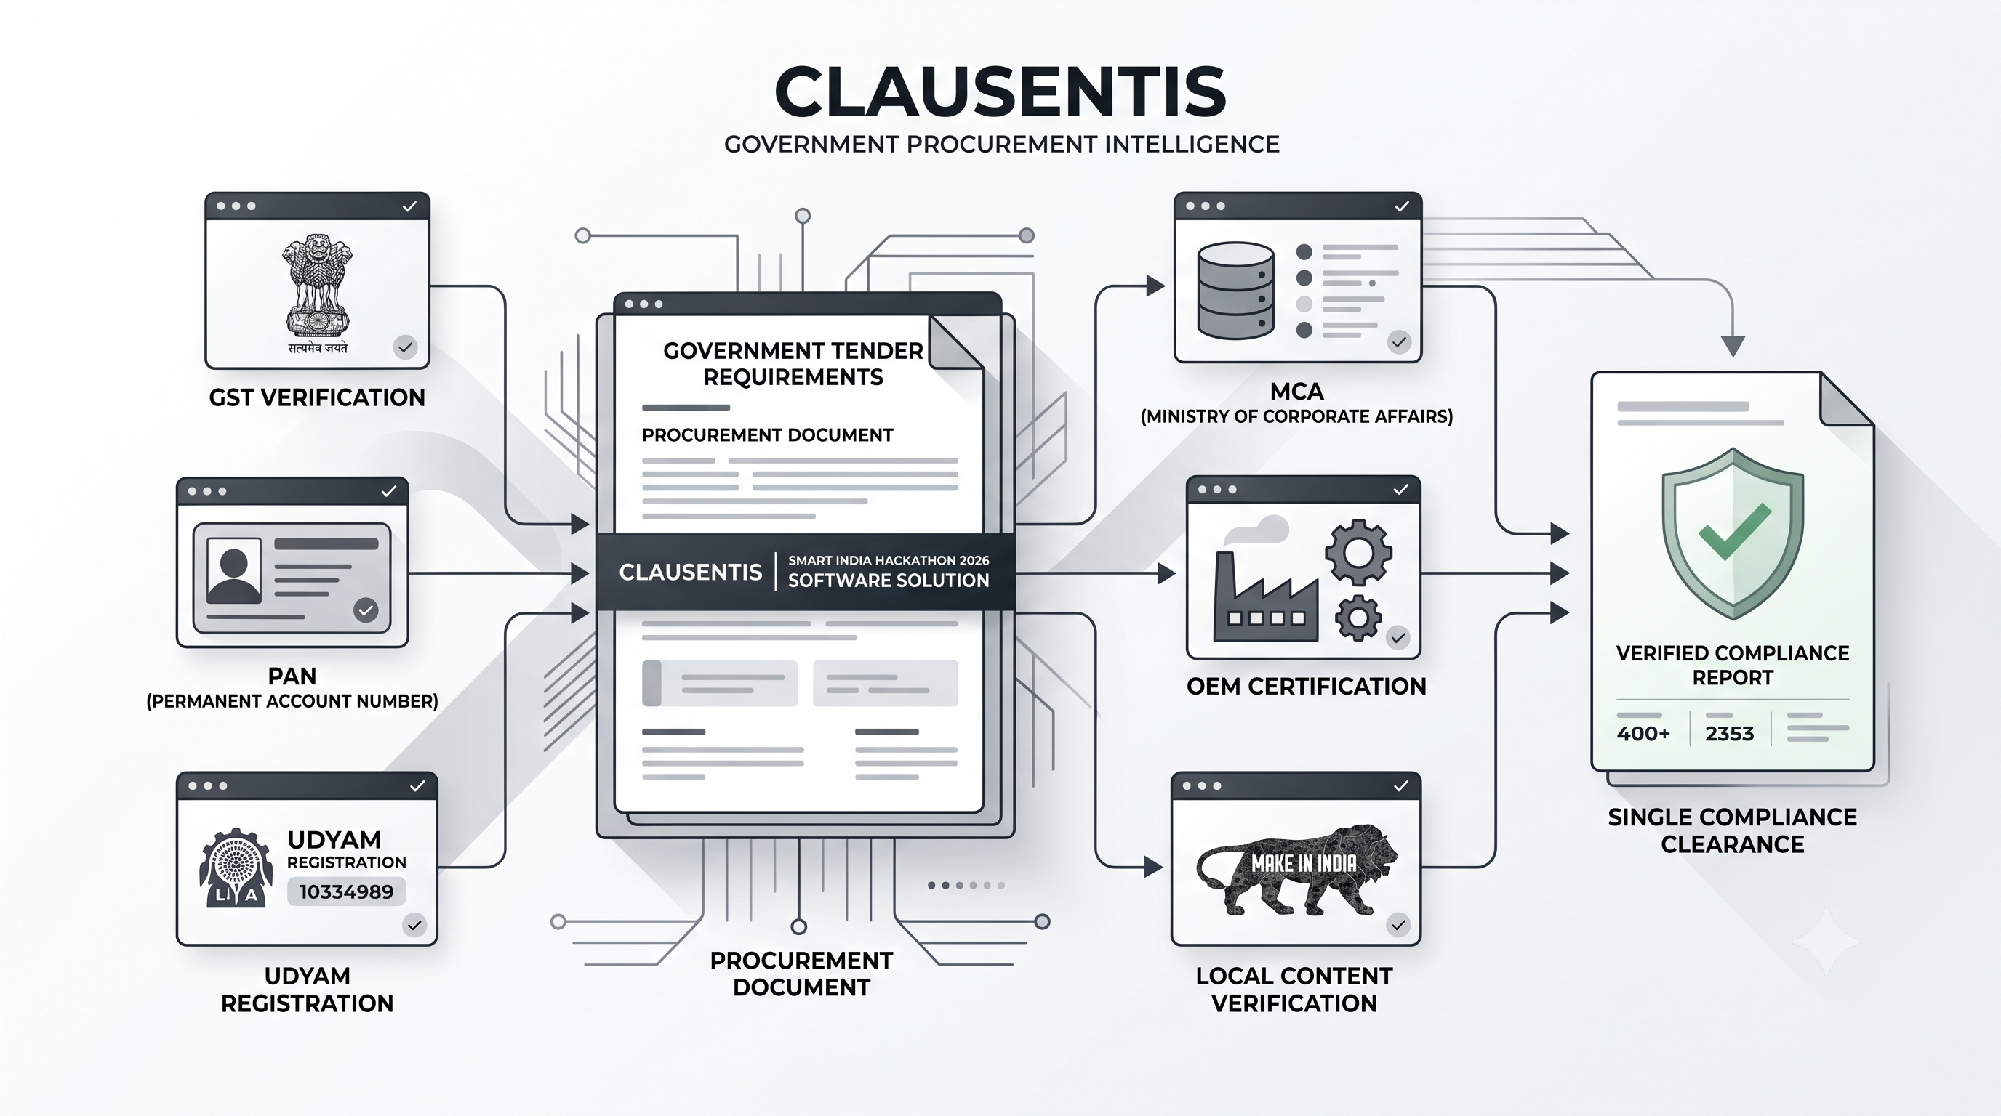
SMART INDIA HACKATHON 2026
CLAUSENTIS – PROCUREMENT INTELLIGENCE, MADE VERIFIABLE
Problem Statement ID : SIH26100
Problem Statement Title : AI –Powered
Integrated Bid Compliance Verification Platform for GeM Procurement
Theme : Smart Automation
PS Category : Software
Team ID :
Team Name :

Slide 2
CLAUSENTIS – PROCUREMENT INTELLIGENCE,
MADE VERIFIABLE
Your Team Name
THE PROBLEM
Today's Challenges
Manual examination of complex bidder documents
Cross-checking across multiple statutory sources
Tender-specific requirements are difficult to track
Missing or inconsistent information can be overlooked
Longer evaluation cycles and human errors in scoring
WHAT MAKES IT DIFFERENT
Tender-Aware: Requirements are extracted and dynamically evaluated per individual tender rules.
Evidence-Backed: Every finding explicitly links to exact document page, line, or statutory source evidence.
Hybrid Intelligence : AI interprets ambiguous text; deterministic rule engines compute exact mathematical compliance.
Decision Support : AI provides clear recommendations while maintaining Procurement Officer decision authority.
Auditable : Every statutory verification and decision point is completely traceable and log-archived.
CLAUSENTIS
Tender
Requirements
Bidder documents
AI Extraction + Source Verification
cross-Document check
Compliance + Risk
AI Recommendation
Officer decision
One unified verification layer across bidder documents + statutory sources + tender rules.

Slide 3
TECHNICAL APPROACH
Your Team Name
1. Technology Stack Overview
Frontend
React / TypeScript
Backend & DB
Supabase PostgreSQL + Storage
AI Layer
Groq LLM Engine
Doc Intelligence
OCR + PDF & AI Extraction
Compliance Engine
Rule-Based Deterministic
Audit & Reports
PDF Generation Dossier
2. Core Implementation Pipeline & Methodology
Tender Document
Ingestion
AI Requirement
Extraction
Structured Tender Rules
Bidder Documents
Upload
AI Document Extraction
Evidence Objects Creation
Statutory Verification
Cross-Doc Check
Deterministic Engine
Compliance Score & Risk
AI Recommendation
Officer & Audit Trail
3. Important Technical Differentiator
AI Layer (Interpretation) : Interprets clause semantics, extracts evidence, points out discrepancies.
Rules Engine (Computation) : Validates numeric thresholds, validity dates, financial & entity criteria.
Officer (Governance) : Retains final legal qualification / disqualification decision authority.

Slide 4
FEASIBILITY AND VIABILITY
Your Team Name
Technically Feasible
Existing AI + Cloud Infrastructure
LLM Requirement Parsing: Semantic clause extraction using Groq LLM.
OCR & Document Extraction: Automatic digitization of scanned bidder PDFs & tables.
Structured Compliance Rules: Deterministic rule-matching engine.
Supabase DB & Storage: Cloud relational storage with strict RLS policies.
Modular Adapters: Extensible integrations for statutory source verification.
Automated PDF Reports: Immediate generation of audit-ready compliance dossiers.
Key Challenges
Operational & Data Bottlenecks
Government API Availability
Different portal endpoints (GSTN, MCA, Udyam) possess distinct access mechanisms and rate limits.
Document Variability
Bidder submissions vary wildly in document quality, scan resolution, formats, and structural layouts.
Verification Reliability
Generative AI models alone cannot be trusted for 100% deterministic mathematical compliance.
Sensitive Procurement Data
Proprietary commercial bids and government tender documents require strict access governance.
Mitigation Strategies
Architectural Safeguards
Provider Architecture
Government source integrations use modular, hot-swappable API abstraction layers.
Hybrid AI + Deterministic Rules
AI interprets clause context; deterministic code strictly validates thresholds & numbers.
Evidence-First Verification
Every compliance finding explicitly retains document, page, line, and source citations.
Secure Access Control
Enforces Role-Based Access Control (RBAC), Row Level Security (RLS), and private storage buckets.
Prototype-Ready Today
Integration-Ready for Authorised Govt Sources
Scalable Across CPSE Procurement Workflows

Slide 5
IMPACT AND BENEFITS
Your Team Name
For Procurement Officers
For Organisations
Faster
Automated document cross-checking speeds up manual evaluation cycles.
Clearer
Evidence-backed compliance findings linked directly to source pages.
Standardized Verification
Consistent, unbiased compliance evaluation rules applied uniformly to all bidders.
Reduced Human Error
Prevents overlooked eligibility criteria, invalid tax filings, or missing certificates.
TARGET EXPECTED IMPACT
60–80%
Transparent Evaluation
Fully explainable evidence objects and automated recommendation reasoning.
Potential reduction in verification effort
Safer
Early identification of hidden risk factors and cross-doc
discrepancies.
Traceable
Complete audit log history protecting officers during statutory reviews.
Derived directly from SIH Problem Statement target evaluation parameters
for public procurement streamlining.
Scalable Procurement
Reusable verification architecture across CPSEs and ministry workflows.
End-to-End Value Delivery Chain
Less Manual Cross-Checking
Faster Evaluation
Fewer Inconsistencies
Better Bidder Screening
Greater Transparency
Complete Traceability

Slide 6
RESEARCH AND REFERENCES
Your Team Name
1. Problem Statement Context
REF 01
2. Government Procurement Ecosystems
REF 02
GeM Portal
Government e-Marketplace public procurement ecosystem standards & rules.
Smart India Hackathon 2026 — SIH26100
AI-Powered Integrated Bid Compliance Verification Platform for GeM Procurement Ecosystems
CPPP System
Central Public Procurement Portal tender guidelines & notice specifications.
3. Statutory & Regulatory Verification Sources
REF 03
REF 04
4. Technical Research Foundations
Udyam
LLM Parsing
GST Portal
MCA21
Startup India
Document Intelligence
MSME Registration
OCR & structured table extraction
methodologies.
Contextual clause parsing &
requirement extraction.
Tax Compliance
Corporate Data
DPIIT Recognition
Deterministic Rules
BIS
NSIC
DigiLocker
DPIIT
Evidence Matching
MSME Ecosystem
Mathematical threshold & financial
validation engines.
Page & line citation for audit traceability.
Product Standards
Local Content Policy
Contextual RAG
Doc Verification
Explainable AI
Transparent reasoning for high-stakes governance.
Tender-specific retrieval augmented decision support.
Design Principle: AI assists verification; evidence and deterministic rules support the decision; the Procurement Officer retains final authority.

Slide 7
IMPORTANT INSTRUCTIONS
Please ensure below pointers are met while submitting the Idea PPT:
Kindly keep the maximum slides limit up to six (6). ( Including the title slide)
Try to avoid paragraphs and post your idea in points /diagrams / Infographics /pictures
Keep your explanation precise and easy to understand
Idea should be unique and novel.
You can only use provided template for making the PPT without changing the idea details pointers (mentioned in previous slides).
You need to save the file in PDF and upload the same on portal. No PPT, Word Doc or any other format will be supported.
Note - You can delete this slide (Important Pointers) when you upload the details of your idea on SIH portal.

