Slide 1
WOMEN EMPOWERMENT

Slide 2
Team Members
Srushti Pathak (Team leader)(10672357)
Nikita Jadhav (10672431)
Anchal Tiwari (10672452)
Hardik Rathod (10672285)

Slide 3
Problem Statement
The objective of our project is to provide a platform for women to make them aware of all schemes and facilities provided by government for their empowerment.
This portal will introduce women to schemes like Sukanya Samridhi Yojana and accomodation facilities as per their convenience.
Interested NGOs can register itself to provide a particular course.
Authenticity of NGO will be checked by admin.
These registered courses can be accessed by women under STEP(Support to Training and Employment Programme).

Slide 4
Literature Survey
Studied all the eligibility of the schemes
Studied all the training sectors that can be provided of NGOs
Studied the policies and funding norms of the organisations
Studied the guidelines of STEP
Found the hostel details which provide accomodation for working women

Slide 5
Technologies
Angular
Spring boot
Rest API
JPA Repository
GitHub

Slide 6
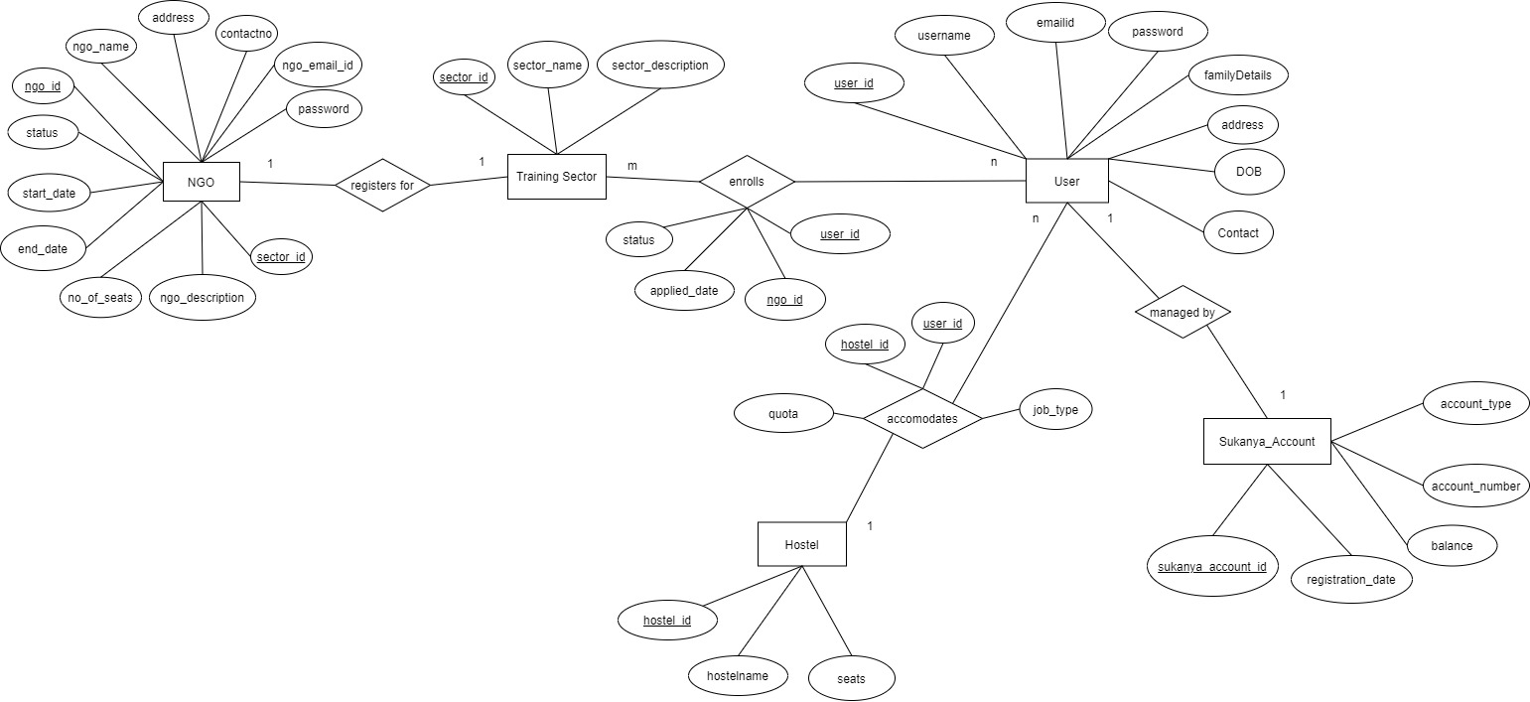
ER Diagram

Slide 7
Modules
Home(Register,Login,Sukanya registration,Working women Scheme registration)
STEP(Training Sectors, Registered NGO Details,Registration for STEP,Display application status)
NGO(NGO Login,Registered NGO Details,Registration for NGO, Application status of NGO)
Admin(Admin login,Status approval of NGO and Trainees)

Slide 8

Home

Slide 9
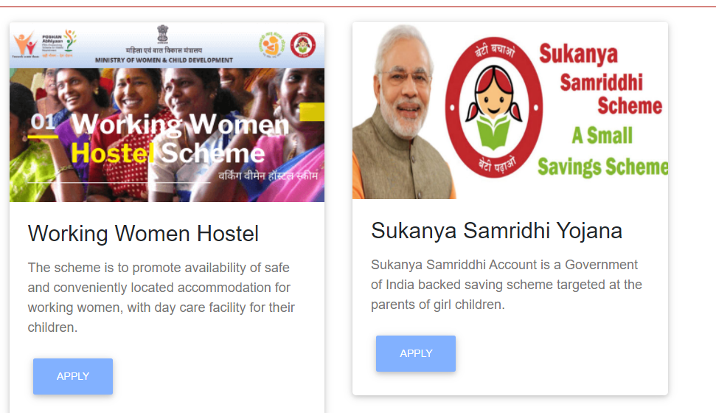
Accomodation and Schemes

Slide 10
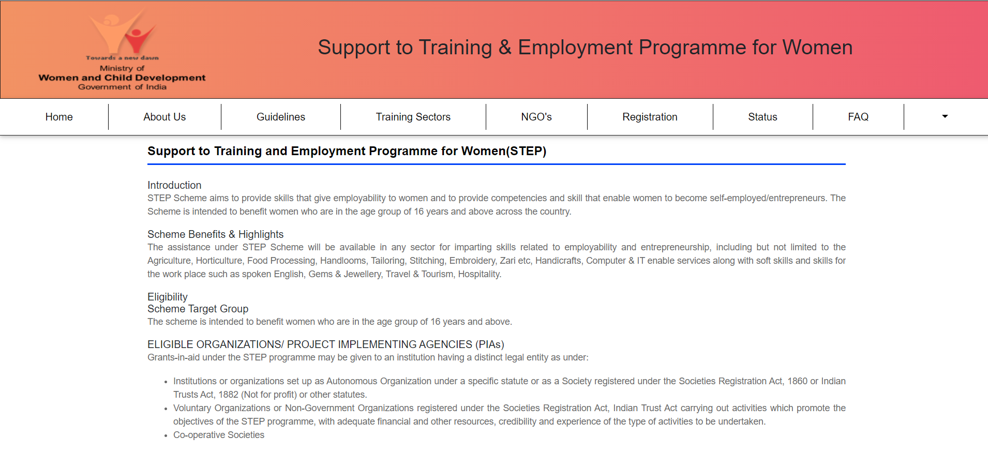
STEP

Slide 11
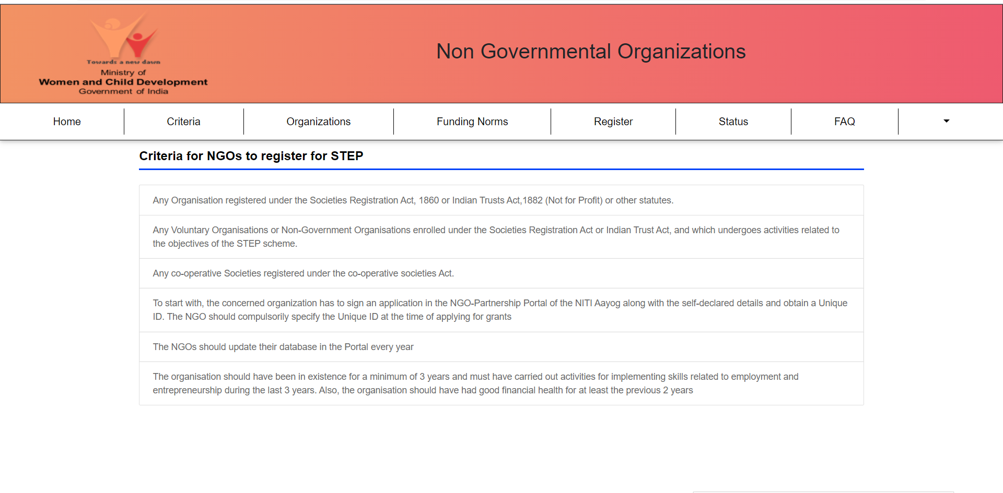
NGO

Slide 12
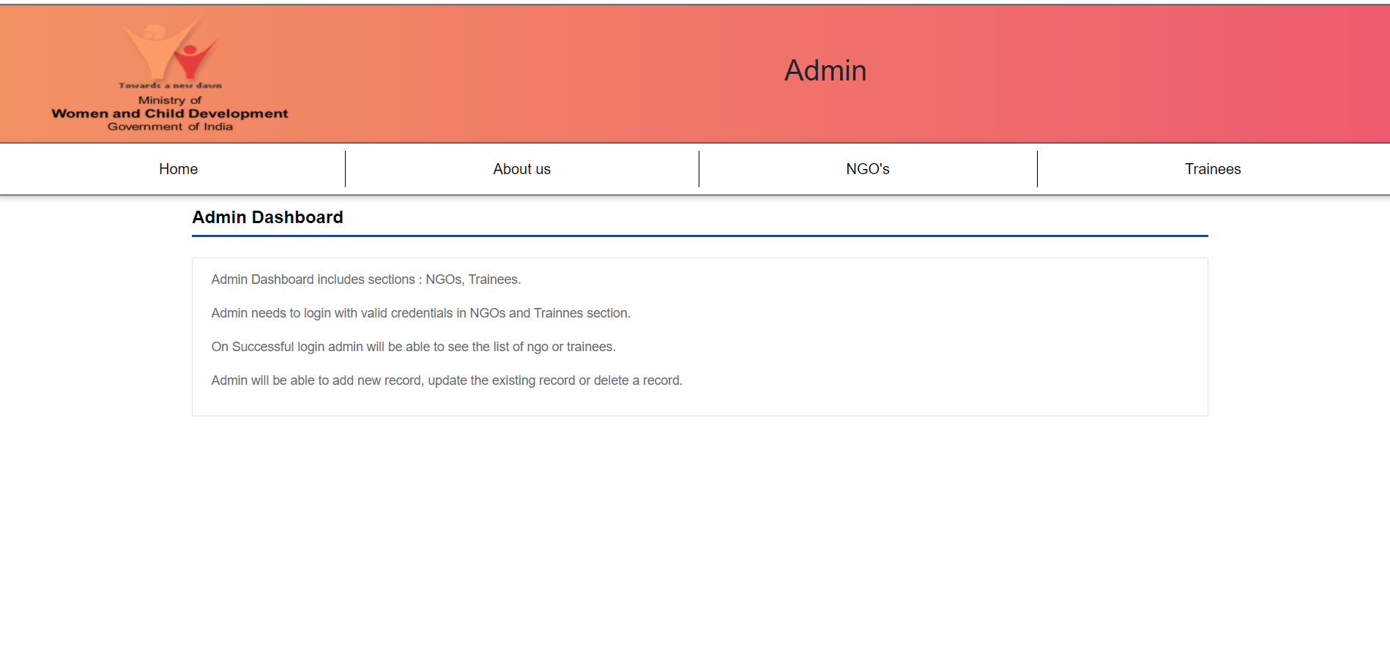
Admin

Slide 13
References
https://wcd.nic.in/sites/default/files/Revised%20schemeof%20STEP_0.pdf
https://www.startupindia.gov.in/content/sih/en/government-schemes/support_to_training_and_employment_programme.html
http://www.nari.nic.in/schemes/vocationalskill-training-support-training-and-employment-programme-step-women

