Slide 1
NovaPay
Financial Performance Dashboard
AI-Enabled FP&A Command Center
Excel · SQL · Python · Power BI
Srushti Mahant Pawar
FP&A Analytics Portfolio Project · 2026
Notes:
Welcome to the NovaPay Financial Performance Dashboard presentation. This project demonstrates an end-to-end FP&A analytics workflow using Excel, SQL, Python, and Power BI for a fictional fintech company.

Slide 2
Project Overview
The Company
What This Project Models
NovaPay is a fictional B2B fintech company offering payment processing and analytics services to enterprise clients.
Revenue streams include subscription fees, transaction fees, premium analytics, and setup charges.
Data covers Jan 2024 – Jun 2024, with customer-level revenue and active customer metrics tracked monthly.
Revenue growth tracking by stream
Budget vs. actual variance analysis
Operating expense monitoring
EBITDA & gross margin profitability
Churn rate & CAC risk assessment
Three-scenario financial forecasting
Notes:
NovaPay is a fictional fintech company created to simulate a realistic FP&A analytics environment. The project covers all major dimensions of corporate finance performance: revenue, costs, profitability, customer metrics, and forward planning.

Slide 3






Business Problem
Leadership lacked a single source of truth for financial performance across revenue, costs, customers, and profitability.
No Revenue Visibility
Cost Overruns Undetected
EBITDA Declining
Revenue by stream tracked manually; no month-over-month trend available
Expense variances vs. budget surfaced only at quarter-end
Operating costs rising faster than revenue; margin pressure building
Churn Not Monitored
CAC Efficiency Unknown
Fragmented Reporting
Customer attrition tracked inconsistently; no risk-flagging in place
No view on customer acquisition cost vs. lifetime value
Finance, ops, and executive teams working from different data sources
Notes:
The core business problem was fragmented financial data with no unified view. This project addresses all six pain points by building an integrated FP&A analytics system.

Slide 4




Tools & Workflow
Excel
SQL
Python
Power BI
Report
FP&A Model
›
Data Analysis
›
Forecasting
›
Dashboard
›
Executive Output
Financial model with Revenue, Expenses, KPIs, Scenarios, and Budget sheets; monthly actuals vs. plan
12 analytical queries: revenue mix, budget variance, expense overruns, EBITDA, churn & CAC risk flags
Pandas/NumPy notebook: scenario forecasting, KPI risk flagging, EBITDA trend, CFO auto-commentary
7-panel interactive dashboard with month slicer, KPI cards, revenue trend, budget vs. actual, and more
Word-format executive summary with key findings, tables, risk flags, and strategic recommendations
Notes:
The project follows a classic FP&A technology stack. Excel is the source-of-truth financial model, SQL performs deep-dive analysis, Python generates forecasts, Power BI visualizes performance, and the executive report delivers insights to leadership.

Slide 5
Data Model & Dataset
7 structured tables · Jan 2024 – Jun 2024 · Monthly granularity
Revenue
Expenses
Budget
KPI Metrics
Month, Customer, Subscription, Transaction Fee, Premium Analytics, Setup Fee, Total Revenue
Month, Department, Category, Vendor, Budget Expense, Actual Expense
Month, Budget Revenue, Budget Expenses, Budget COGS, Budget EBITDA
Month, Active Customers, New, Lost, Churn Rate, CAC, ARPC, NRR, Gross Margin
Monthly Summary
Scenario Inputs
Customers
Month, Actual Revenue, Actual Expenses, COGS, Gross Profit, Gross Margin, EBITDA, EBITDA Margin
Scenario, Growth Rate, Churn Rate, Pricing Change, Payroll Inflation, Marketing Change
Customer ID, Name, Segment, Onboard Date, Plan Type
Notes:
The data model contains 7 relational tables modeled after a real FP&A environment. Revenue, expenses, KPIs, budgets, and customers each live in separate sheets, enabling clean dimensional analysis.

Slide 6
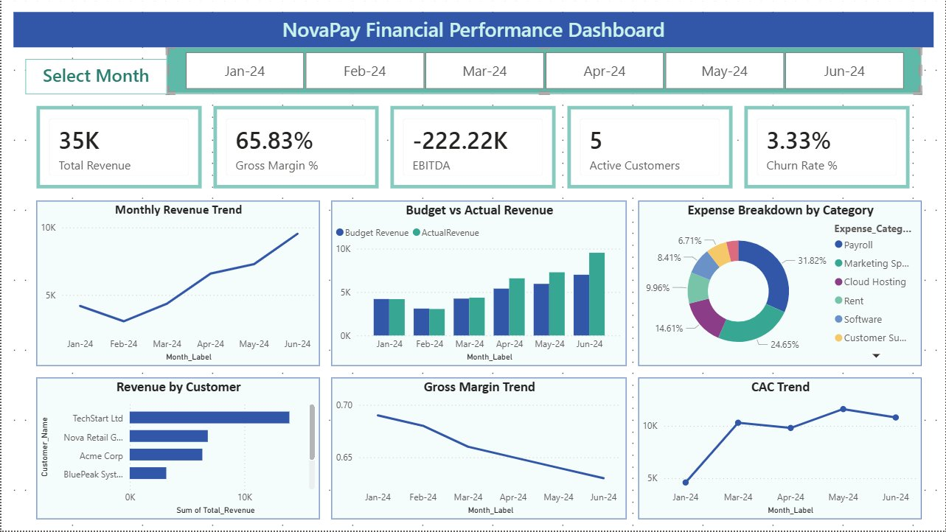
Power BI Dashboard
KPI Cards
Revenue · Margin · EBITDA · Customers · Churn
Month Slicer
Filter all panels by Jan–Jun 2024
Revenue Trend
Monthly growth from Jan to Jun
Budget vs Actual
Bar comparison by month
Expense Mix
Donut chart by category
CAC Trend
Acquisition cost trajectory
Notes:
The Power BI dashboard provides an interactive single-page view of all financial KPIs. The month slicer allows users to filter all panels simultaneously. KPI cards update dynamically with revenue, gross margin, EBITDA, active customers, and churn rate.

Slide 7
Key Insights
01
Revenue Growth
Strong
02
Total EBITDA
–$222K
Jan → Jun 2024
Analysis Period
Monthly revenue increased from around $4.2K in Jan to around $9.5K in Jun, driven by new customer onboarding and transaction volume.
EBITDA remained negative across the analysis period because operating expenses exceeded revenue throughout.
03
Gross Margin Decline
69% → 63%
04
Payroll Dominates
31.8%
6-Month Trend
Share of Expenses
Gross margin declined from 69% to 63%, indicating cost growth outpaced revenue efficiency.
Payroll was the largest expense category at 31.82%, followed by marketing spend at 24.65% and cloud hosting at 14.61%.
05
Customer Concentration
Top 2
06
CAC Rising
>$10K
Customers
Growth Months
TechStart Ltd and Nova Retail Group account for the majority of total revenue — concentration risk is material.
CAC crossed $10K during multiple growth months, so acquisition efficiency should be monitored against LTV.
Notes:
These six insights summarize the most material findings from the financial analysis. The growth story is positive on revenue but the cost structure needs attention. CAC and customer concentration are risk areas requiring strategic action.

Slide 8
Business Recommendations
1
Control Operating Costs
Establish monthly spend reviews for marketing and cloud hosting. Flag any line exceeding 10% of budget for CFO approval. Target 15% reduction in variable costs within two quarters.
2
Expand EBITDA Margins
Push Basic-plan customers toward Premium tiers to improve revenue quality. Premium plan upgrades can improve recurring revenue with limited incremental cost.
3
Track CAC vs. LTV
Implement a monthly CAC-to-LTV dashboard. High-risk months (CAC > $10K) should trigger a marketing mix review. Target a minimum 3:1 LTV:CAC ratio.
4
Reduce Customer Concentration
Diversify the customer base to reduce single-customer revenue dependency. A pipeline of 3–5 new SMB clients per quarter would meaningfully reduce concentration risk.
5
Monthly Management Reporting
Adopt the NovaPay dashboard as the standard executive reporting tool. Monthly business review cadence anchored to KPI cards, revenue trend, and EBITDA performance.
Notes:
These five recommendations translate the data insights into actionable management priorities. They are sequenced by impact and feasibility, with cost control and margin expansion as the highest-priority items.

Slide 9
Forecasting & Analytics Value
Three-Scenario Forecast Model
Analytics Capabilities
Scenario | Growth Rate | Churn Rate | Forecast EBITDA
Base Case | 12% | 3% | Moderate positive
Bull Case | 20% | 1.5% | Strong improvement
Bear Case | 5% | 8% | Deeper loss
Scenario-based revenue & EBITDA forecasting
Automated KPI risk flagging (churn, CAC)
Dynamic expense variance alerts
Month-over-month EBITDA trend tracking
CFO auto-commentary generation
SQL-based ad hoc financial queries
3
12
6
Forecast Scenarios
SQL Analysis
Python Forecasting
Notes:
The Python forecasting engine generates scenario outputs for Base, Bull, and Bear cases by applying growth rate, churn, and payroll inflation assumptions to the latest actuals. SQL queries provide 12 reusable analytical views for ongoing management reporting.

Slide 10
Project Summary
End-to-End FP&A
Analytics Delivered.
Financial Modeling
SQL Analytics
Python Forecasting
Power BI Dashboard
Executive Report
Excel FP&A Model
12 Business Queries
Scenarios & Risk Flags
Interactive Reporting
Leadership-Ready Output
Srushti Mahant Pawar · FP&A Analytics Portfolio · 2026
Excel · SQL · Python · Power BI · GitHub · LinkedIn
Notes:
This project demonstrates a complete FP&A analytics workflow from raw financial data to executive-ready insights. The five-tool stack mirrors real-world analytics engineering practices and makes this portfolio piece relevant for finance, data, and analytics roles.

