Slide 1
NovaPay
Financial Performance Dashboard
FP&A Analytics & Management Reporting
Excel · SQL · Python · Power BI
Srushti Mahant Pawar
FP&A Analytics Portfolio Project · 2026
Notes:
Welcome to the NovaPay Financial Performance Dashboard presentation. This project demonstrates an end-to-end FP&A analytics workflow using Excel, SQL, Python, and Power BI for a fictional fintech company.

Slide 2
Project Overview
The Company
What This Project Models
NovaPay is a fictional B2B fintech company offering payment processing and analytics services to enterprise clients.
Revenue streams include subscription fees, transaction fees, premium analytics, and setup charges.
Data covers Jan 2024 – Jun 2024, with customer-level revenue and active customer metrics tracked monthly.
Revenue growth tracking by stream
Budget vs. actual variance analysis
Operating expense monitoring
EBITDA & gross margin profitability
Churn rate & CAC risk assessment
Three-scenario financial forecasting
Notes:
NovaPay is a fictional fintech company created to simulate a realistic FP&A analytics environment. The project covers all major dimensions of corporate finance performance: revenue, costs, profitability, customer metrics, and forward planning.

Slide 3






Business Problem
Leadership lacked a single source of truth for financial performance across revenue, costs, customers, and profitability.
No Revenue Visibility
Cost Overruns Undetected
EBITDA Declining
Revenue by stream tracked manually; no month-over-month trend available
Expense variances vs. budget surfaced only at quarter-end
Operating costs rising faster than revenue; margin pressure building
Churn Not Monitored
CAC Efficiency Unknown
Fragmented Reporting
Customer attrition tracked inconsistently; no risk-flagging in place
No view on acquisition cost relative to revenue per customer
Finance, ops, and executive teams working from different data sources
Notes:
The core business problem was fragmented financial data with no unified view. This project addresses all six pain points by building an integrated FP&A analytics system.

Slide 4




Tools & Workflow
Excel
SQL
Python
Power BI
Report
FP&A Model
›
Data Analysis
›
Analysis
›
Dashboard
›
Executive Output
Financial model with Revenue, Expenses, KPIs, Scenarios, and Budget sheets; monthly actuals vs. plan
12 analytical queries: revenue mix, budget variance, expense overruns, EBITDA, churn & CAC risk flags
Pandas notebook: EBITDA bridge, budget vs. actual, expense overruns, concentration, scenarios
6-chart interactive dashboard with month slicer, KPI cards, revenue trend, budget vs. actual, and more
Word-format executive summary with key findings, tables, risk flags, and strategic recommendations
Notes:
Excel holds the P&L, budget vs. actual and scenario sheets. SQL queries summarize revenue, variances and customer KPIs. The Python notebook rebuilds the revenue-to-EBITDA bridge, budget vs. actual, expense overruns and one-month scenarios. Power BI presents it, and the executive report summarizes the findings.

Slide 5
Data Model & Dataset
7 structured tables · Jan 2024 – Jun 2024 · Monthly granularity
Revenue
Expenses
Budget
KPI Metrics
Month, Customer, Subscription, Transaction Fee, Premium Analytics, Setup Fee, Total Revenue
Month, Department, Category, Vendor, Budget Expense, Actual Expense
Month, Budget Revenue, Budget Expenses, Budget COGS, Budget EBITDA
Month, Active Customers, New, Lost, Churn Rate, CAC, ARPC, NRR, Gross Margin
Monthly Summary
Scenario Inputs
Customers
Month, Actual Revenue, Actual Expenses, COGS, Gross Profit, Gross Margin, EBITDA, EBITDA Margin
Scenario, Growth Rate, Churn Rate, Pricing Change, Payroll Inflation, Marketing Change
Customer ID, Customer Name
Notes:
The data model contains 7 relational tables modeled after a real FP&A environment. Revenue, expenses, KPIs, budgets, and customers each live in separate sheets, enabling clean dimensional analysis.

Slide 6
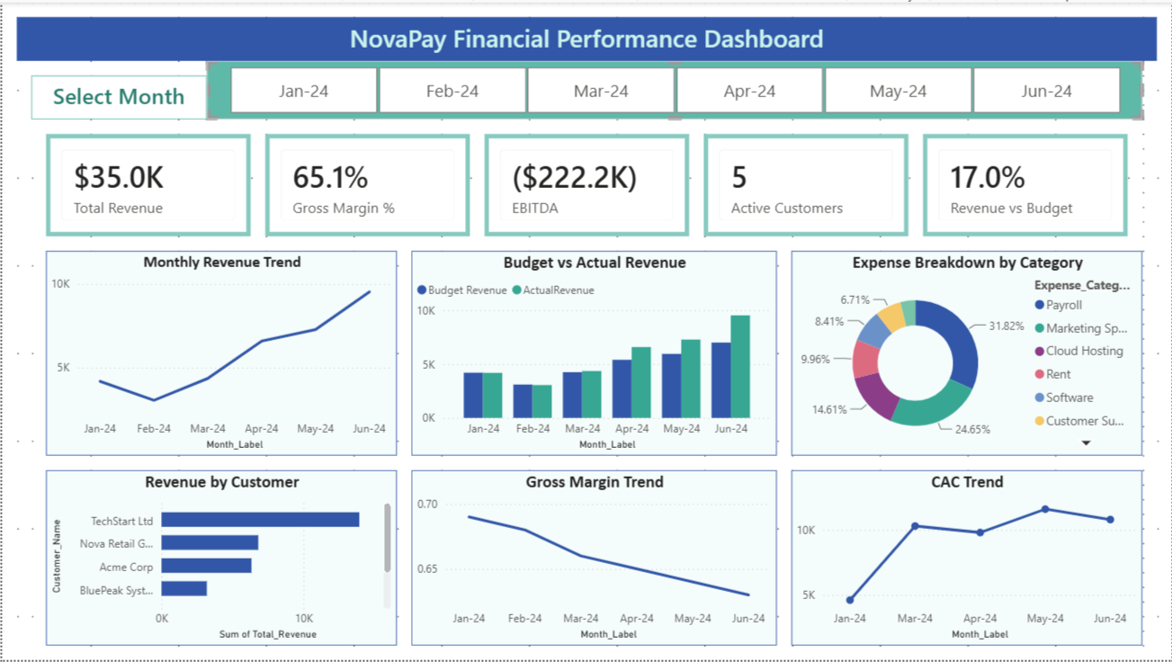
Power BI Dashboard
KPI Cards
Revenue · Margin · EBITDA · Customers · Revenue vs Budget
Month Slicer
Filter all panels by Jan–Jun 2024
Revenue Trend
Monthly growth from Jan to Jun
Budget vs Actual
Bar comparison by month
Expense Mix
Donut chart by category
CAC Trend
Acquisition cost trajectory
Notes:
The Power BI dashboard is a single interactive page. The month slicer filters every panel. KPI cards show revenue, gross margin, EBITDA, active customers and revenue vs. budget.

Slide 7
Key Insights
01
Revenue Up, EBITDA Down
+128%
02
Revenue Beat, EBITDA Missed
+17%
Jan → Jun 2024
Budget vs. Actual
Monthly revenue rose from $4.2K to $9.5K, but EBITDA moved from –$35.0K to –$37.7K. Gross profit rose $3.1K while operating expenses rose $5.9K.
Six-month revenue was $35.0K vs. a $29.9K budget, but opex ran over plan every month (cloud hosting +$5.1K, marketing +$4.9K), so EBITDA missed budget in all six months.
03
Customer Concentration
40%
04
Costly Acquisition
~$10K+
Share of Revenue
CAC, Mar–Jun
TechStart Ltd generated 39.8% of six-month revenue, and the top two customers 59%. Losing one account would materially cut revenue.
Each new customer cost $9.8K–$11.6K in marketing, against under $2K a month in revenue per customer.
Fictional company · Jan–Jun 2024 data · Source: NovaPay FP&A Excel model
Notes:
Four findings: revenue more than doubled but EBITDA got worse; revenue beat budget while EBITDA missed every month because of opex overruns; one customer is about 40% of revenue; and each new customer costs roughly $10K to acquire. All figures come from a fictional six-month dataset.

Slide 8
Business Recommendations
1
Control Operating Costs
Establish monthly spend reviews for marketing and cloud hosting. Flag any line exceeding 10% of budget for CFO approval.
2
Expand EBITDA Margins
Push Basic-plan customers toward Premium tiers to improve revenue quality. Premium plan upgrades can improve recurring revenue with limited incremental cost.
3
Track Acquisition Efficiency
Track CAC against revenue per customer monthly. High-risk months (CAC > $10K) should trigger a marketing mix review.
4
Reduce Customer Concentration
Diversify the customer base to reduce single-customer revenue dependency.
5
Monthly Management Reporting
Adopt the NovaPay dashboard as the standard executive reporting tool. Monthly business review cadence anchored to KPI cards, revenue trend, and EBITDA performance.
Notes:
These five recommendations translate the data insights into actionable management priorities. They are sequenced by impact and feasibility, with cost control and margin expansion as the highest-priority items.

Slide 9
Scenario Analysis & Analytics
Three-Scenario Analysis: July 2024 from June Actuals
Analytics Capabilities
Scenario | Revenue Growth | Payroll Inflation | July EBITDA
Base Case | 8% | 4% | –$39.0K
Upside Case | 12% | 3% | –$38.3K
Downside Case | 4% | 6% | –$40.1K
Scenario-based revenue & EBITDA analysis
Budget vs. actual variance analysis
Revenue-to-EBITDA bridge
Month-over-month EBITDA trend tracking
KPI risk flagging in SQL (churn, CAC)
SQL-based ad hoc financial queries
3
12
6
Scenarios
SQL Analysis
Months of Data
One-month scenario analysis from June actuals, not a statistical forecast. All three scenarios keep EBITDA negative.
Notes:
The scenarios apply the base, upside and downside assumptions to June actuals for a one-month view of July, using the same logic in Excel and Python. Six months of data is not enough for a statistical forecast, so these are what-ifs, not predictions. All three keep EBITDA negative.

Slide 10
Project Summary
End-to-End FP&A
Analytics Delivered.
Financial Modeling
SQL Analytics
Python Analysis
Power BI Dashboard
Executive Report
Excel FP&A Model
12 Business Queries
Variance & Scenarios
Interactive Reporting
Leadership-Ready Output
Srushti Mahant Pawar · FP&A Analytics Portfolio · 2026
Excel · SQL · Python · Power BI · GitHub · LinkedIn
Notes:
This project demonstrates a complete FP&A analytics workflow from raw financial data to executive-ready insights. The five-tool stack mirrors real-world analytics engineering practices and makes this portfolio piece relevant for finance, data, and analytics roles.

