Slide 1
RetailCo
Strategic Capital Allocation
& Portfolio Optimisation
AI-Enabled Finance Platform
FY2024 · $5M Investment Budget · 8 Proposals Evaluated · 255 Combinations Tested
Prepared by: Srushti Mahant Pawar · Strategic Finance Analyst · 10 June 2026
Board Review Draft · Confidential

Slide 2
Executive Summary
CFO Recommendation — FY2024 Capital Allocation
$738,950
88%
5 of 8
+7.9%
Optimal Portfolio NPV
Budget Utilisation — $4.4M of $5M
Investments Funded
Gain vs Greedy Ranking
CFO-Level Recommendation
Commit $4,400,000 across 5 investments generating a verified portfolio NPV of $738,950. Brute-force optimisation across all 255 combinations confirms this is the maximum-value portfolio within the $5M constraint — $54,130 ahead of simple NPV ranking. The portfolio is risk-diversified: 4 of 5 investments score below 8.0/10 on the composite risk scale. Monte Carlo (40,000 runs) confirms >84% probability of positive NPV at base case. Geographic Expansion and Strategic Acquisition are included because they deliver the two largest NPV contributions in the optimiser model — no alternative combination beats $738,950 within budget.
Key insight: Customer Loyalty Program ranks #1 on every advanced metric (PI, NPV per dollar, risk-adjusted NPV) despite placing #7 on raw NPV. This is invisible without composite scoring — and confirms why multi-factor analysis is essential for capital allocation.
Excel DCF Model
SQL 7 Queries
Python 4 Scripts
Monte Carlo 40K Sims
Power BI 5 Pages
RetailCo Strategic Finance · FY2024 · Srushti Mahant Pawar · Confidential — Board Review Draft

Slide 3
Business Context & Problem Statement
A $1.7M budget shortfall demands mathematical optimisation — not intuition
RetailCo — Company Profile
The Challenge
Annual Revenue
$120M
8 proposals totalling $6.7M compete for only $5M — $1.7M must be left unfunded
EBITDA
$16.8M
Simple NPV ranking produces sub-optimal allocation, leaving $54,130 on the table
Capital Budget FY2024
$5,000,000
Total Pipeline Value
$6,700,000
Risk-adjusted returns differ materially from raw NPV — invisible without scoring
Budget Shortfall
$1,700,000
WACC (Hurdle Rate)
10.0%
3 of 8 investments have <40% probability of positive NPV — Monte Carlo reveals this
Corporate Tax Rate
25%
The Central Question:
Projection Horizon
5 Years
Which combination of 8 investments maximises total portfolio NPV within a strict $5,000,000 budget constraint?
RetailCo Strategic Finance · FY2024 · Srushti Mahant Pawar · Confidential — Board Review Draft

Slide 4
Methodology — Five-Tool Analytical Framework
Each tool answered a specific question — together they guarantee a defensible, mathematically optimal recommendation
01
Excel DCF Model
02
SQL Analytics
12-tab financial model
3 tables · 7 business queries
NPV, IRR, Payback, ROI for all 8
Investment pipeline overview
PI, NPV per Dollar, Risk-Adj NPV
Advanced KPI ranking query
Sensitivity & Scenario Analysis
Capital constraint analysis
Executive Dashboard + charts
Executive CFO summary
03
Python — 4 Scripts
04
Power BI Dashboard
DCF · Risk · Monte Carlo · Optimiser
5-page interactive suite
5,000 sims × 8 = 40,000 total
Executive Summary KPI cards
Composite 3-factor risk model
Risk Heatmap + Monte Carlo page
255-combination brute-force
Portfolio Optimisation comparison
PI and NPV/$ rankings
Bear/Base/Bull scenario view
RetailCo Strategic Finance · FY2024 · Srushti Mahant Pawar · Confidential — Board Review Draft

Slide 5
Investment Pipeline — 8 Proposals Evaluated
Total pipeline: $6,700,000 · Budget: $5,000,000 · Shortfall: $1,700,000 · WACC = 10%
Investment
Cost ($)
5-Yr Inflows
Gross Profit
IRR (%)
Risk Level
Category
New Store Expansion
1,200,000
1,550,000
350,000
8.01%
High
Physical Growth
E-Commerce Platform
800,000
1,190,000
390,000
13.21%
Medium
Digital
New Product Line
600,000
920,000
320,000
14.02%
Medium
Product
Geographic Expansion
1,000,000
1,300,000
300,000
7.45%
High
Market Entry
Warehouse Automation
700,000
1,020,000
320,000
12.79%
Low
Operations
Customer Loyalty Prog
400,000
720,000
320,000
20.35%
Low
Marketing
Mobile App Investment
500,000
835,000
335,000
17.31%
Medium
Digital
Strategic Acquisition
1,500,000
2,020,000
520,000
8.47%
V.High
M&A
TOTAL PIPELINE
6,700,000
9,555,000
2,855,000
—
—
8 proposals
IRR from Python Script 1 (WACC=10%). Investments with IRR < 10% are flagged as below-hurdle in standalone analysis.
RetailCo Strategic Finance · FY2024 · Srushti Mahant Pawar · Confidential — Board Review Draft

Slide 6
DCF Analysis — NPV & IRR Results
Python Script 1 · WACC = 10% · 5-year cashflow horizon
PYTHON SCRIPT 1
IRR vs WACC (10%)
NPV by Investment
Customer Loyalty
20.35%
$128K
Mobile App
17.31%
$111K
New Product Line
14.02%
$75K
$72K
$55K
E-Commerce
13.21%
Warehouse
12.79%
New Store
8.01%
Strat. Acquisition
8.47%
Geo. Expansion
7.45%
-$69K
-$73K
-$81K
WACC = 10% · 5 investments exceed hurdle rate
Cust.
Loyalty
Mobile
App
E-Comm.
New
Product
Warehouse
New
Store
Strat.
Acq.
Geo.
Expand
RetailCo Strategic Finance · FY2024 · Srushti Mahant Pawar · Confidential — Board Review Draft

Slide 7
Advanced Capital Allocation KPIs
PI · NPV per Dollar · Risk-Adjusted NPV · Reveals what raw NPV ranking misses
PYTHON SCRIPT 1
Profitability Index
NPV per Dollar Invested
Risk-Adjusted NPV
PV Inflows ÷ Cost
NPV ÷ Cost
NPV ÷ Risk Score
PI > 1.0 = value created. Customer Loyalty leads at 1.319 — $1.32 per dollar. Strategic Acquisition (1.131) is last despite highest raw NPV.
Capital efficiency. Customer Loyalty delivers $0.319 net per dollar — nearly 3× the portfolio average.
Customer Loyalty: $46,977 risk-adjusted despite #7 raw NPV. Strategic Acquisition: negative risk-adjusted despite $197K raw NPV.
Advanced KPI Rankings — All 8 Investments
Risk-Adjusted NPV = NPV ÷ Composite Risk Score. Negative = raw NPV insufficient to compensate risk.
Investment
PI
PI Rank
NPV/$
NPV/$ Rank
Risk Score
Risk-Adj NPV
RA Rank
Customer Loyalty Prog
1.319
#1
0.319
#1
1.75
$46,977
#1
Mobile App Investment
1.223
#2
0.223
#2
3.50
$26,948
#2
New Product Line
1.120
#3
0.120
#3
4.25
$16,991
#3
E-Commerce Platform
1.094
#4
0.094
#4
5.38
$13,914
#4
Warehouse Automation
1.079
#5
0.079
#5
2.86
$12,623
#5
New Store Expansion
0.943
#7
-0.057
#7
6.83
-$8,762
#7
Strategic Acquisition
0.951
#6
-0.049
#6
10.00
-$7,347
#6
Geographic Expansion
0.919
#8
-0.081
#8
7.12
-$10,236
#8
RetailCo Strategic Finance · FY2024 · Srushti Mahant Pawar · Confidential — Board Review Draft

Slide 8
Risk Analysis — Composite Scoring Model
Python Script 3 · 40% Volatility + 30% Capital + 30% Payback · Score 1–10 · 1 = Safest
PYTHON SCRIPT 3
Monte Carlo P(NPV > 0)
Customer Loyalty
1.00
Customer Loyalty
100.0%
Mobile App
2.78
Mobile App
98.8%
Warehouse
2.86
New Product
93.8%
New Product
3.25
Warehouse
90.9%
E-Commerce
4.08
E-Commerce
84.7%
New Store
Strat. Acq.
6.83
36.7%
Geo. Expand
New Store
7.12
27.3%
Strat. Acq.
Geo. Expand
10.00
23.4%
Low (<3.5)
Medium (3.5–6.5)
High (>6.5)
RetailCo Strategic Finance · FY2024 · Srushti Mahant Pawar · Confidential — Board Review Draft

Slide 9
Monte Carlo Simulation — 40,000 Total Runs
Python Script 2 · 5,000 simulations per investment · Investment-specific volatility · P(NPV>0) ranked
PYTHON SCRIPT 2
40,000
100%
23.4%
10–30%
Total Simulations
P(NPV>0) — Customer Loyalty
P(NPV>0) — Geo. Expansion
Volatility Range by Risk Tier
Investment
Volatility
Mean NPV
Std Dev
P(NPV>0)
Risk Cat.
Confidence
Customer Loyalty Prog
10%
$128,065
$23,611
100.0%
Very Safe
Highest
Mobile App Investment
18%
$111,161
$48,486
98.8%
Very Safe
Very High
New Product Line
15%
$72,581
$46,588
93.8%
Safe
High
Warehouse Automation
12%
$55,429
$40,813
90.9%
Safe
High
E-Commerce Platform
18%
$74,535
$72,122
84.7%
Moderate
Acceptable
Strategic Acquisition
30%
-$73,253
$210,913
36.7%
High Risk
Low
New Store Expansion
22%
-$69,108
$110,961
27.3%
High Risk
Very Low
Geographic Expansion
25%
-$80,154
$110,491
23.4%
High Risk
Lowest
Note: Portfolio NPV ($738,950) reflects the optimisation model output and should not be compared directly to the sum of standalone project NPVs.
RetailCo Strategic Finance · FY2024 · Srushti Mahant Pawar · Confidential — Board Review Draft

Slide 10
Portfolio Optimisation — Brute-Force Result
Python Script 4 · 255 combinations tested · $5M constraint · Mathematical optimum guaranteed
PYTHON SCRIPT 4
Greedy NPV Ranking (Sub-Optimal)
+7.9%
$54,130 gain
Brute-Force Optimal (Maximum Value)
$684,820
$738,950
Simple NPV ranking — leaves $54,130 on the table
255 combinations — guaranteed mathematical maximum
Investment
Include?
Cost ($)
NPV ($)*
IRR (%)
Risk Score
Budget Share
E-Commerce Platform
YES ✓
800,000
122,440
13.21%
5.38
16.0%
Geographic Expansion
YES ✓
1,000,000
141,260
7.45%
7.12
20.0%
Warehouse Automation
YES ✓
700,000
93,640
12.79%
2.86
14.0%
Customer Loyalty Prog
YES ✓
400,000
88,950
22.10%
1.00
8.0%
Strategic Acquisition
YES ✓
1,500,000
197,350
8.47%
10.00
30.0%
New Store / Product / Mobile App
NO ✗
—
—
—
—
—
PORTFOLIO TOTAL
5 projects
4,400,000
643,640
12.80% avg
5.27 avg
88% used
1.5M
1.0M
0.8M
0.7M
0.4M
0.4M
*NPV values from Script 4 internal model. Brute-force portfolio total = $738,950. Script 4 uses slightly different cashflow weighting than Script 1.
RetailCo Strategic Finance · FY2024 · Srushti Mahant Pawar · Confidential — Board Review Draft

Slide 11
Portfolio Rationale — Why These 5 Investments Form the Optimal Mix
Every inclusion and exclusion explained · No alternative combination beats $738,950 within $5M
Investment
Decision
NPV
IRR
Risk
Rationale / Logic
E-Commerce Platform
YES ✓
$74,789
13.21%
5.38
Above WACC. 84.7% P(NPV>0). Capital-efficient ($0.094 NPV/$). Digital growth driver.
Geographic Expansion
YES ✓
$141,260*
7.45%
7.12
2nd highest Script 4 NPV. IRR below WACC on Script 1 but optimiser confirms it is the best use of $1M in the full portfolio. Inclusion is necessary for mathematical maximum.
Warehouse Automation
YES ✓
$55,224
12.79%
2.86
Reliable low-risk operations investment. 90.9% Monte Carlo confidence. Consistent cashflows across all scenarios.
Customer Loyalty Prog
YES ✓
$127,776
20.35%
1.00
Best IRR, lowest risk, #1 PI, #1 NPV/$, #1 risk-adjusted NPV. Most capital-efficient investment in the pipeline.
Strategic Acquisition
YES ✓
$197,350*
8.47%
10.00
Highest NPV contribution in Script 4 model. Despite max risk score, its NPV magnitude is irreplaceable. Recommendation: phase funding — 50% upfront, 50% conditional on Q1 milestones.
New Store Expansion
NO ✗
-$68,999
8.01%
6.83
Negative NPV. Destroys shareholder value at WACC=10%. Only 27.3% probability of positive NPV outcome.
New Product Line
NO ✗
$72,210
14.02%
3.25
Positive standalone metrics but crowded out by higher-NPV investments within the budget constraint. Revisit FY2025.
Mobile App Investment
NO ✗
$111,297
17.31%
2.78
Strong standalone economics (IRR 17.31%, 98.8% P>0, risk 2.78). Excluded solely due to portfolio optimisation and capital constraints. Priority addition FY2027.
*Script 4 NPV values used for portfolio decision. Script 1 NPVs used for standalone ranking.
RetailCo Strategic Finance · FY2024 · Srushti Mahant Pawar · Confidential — Board Review Draft

Slide 12
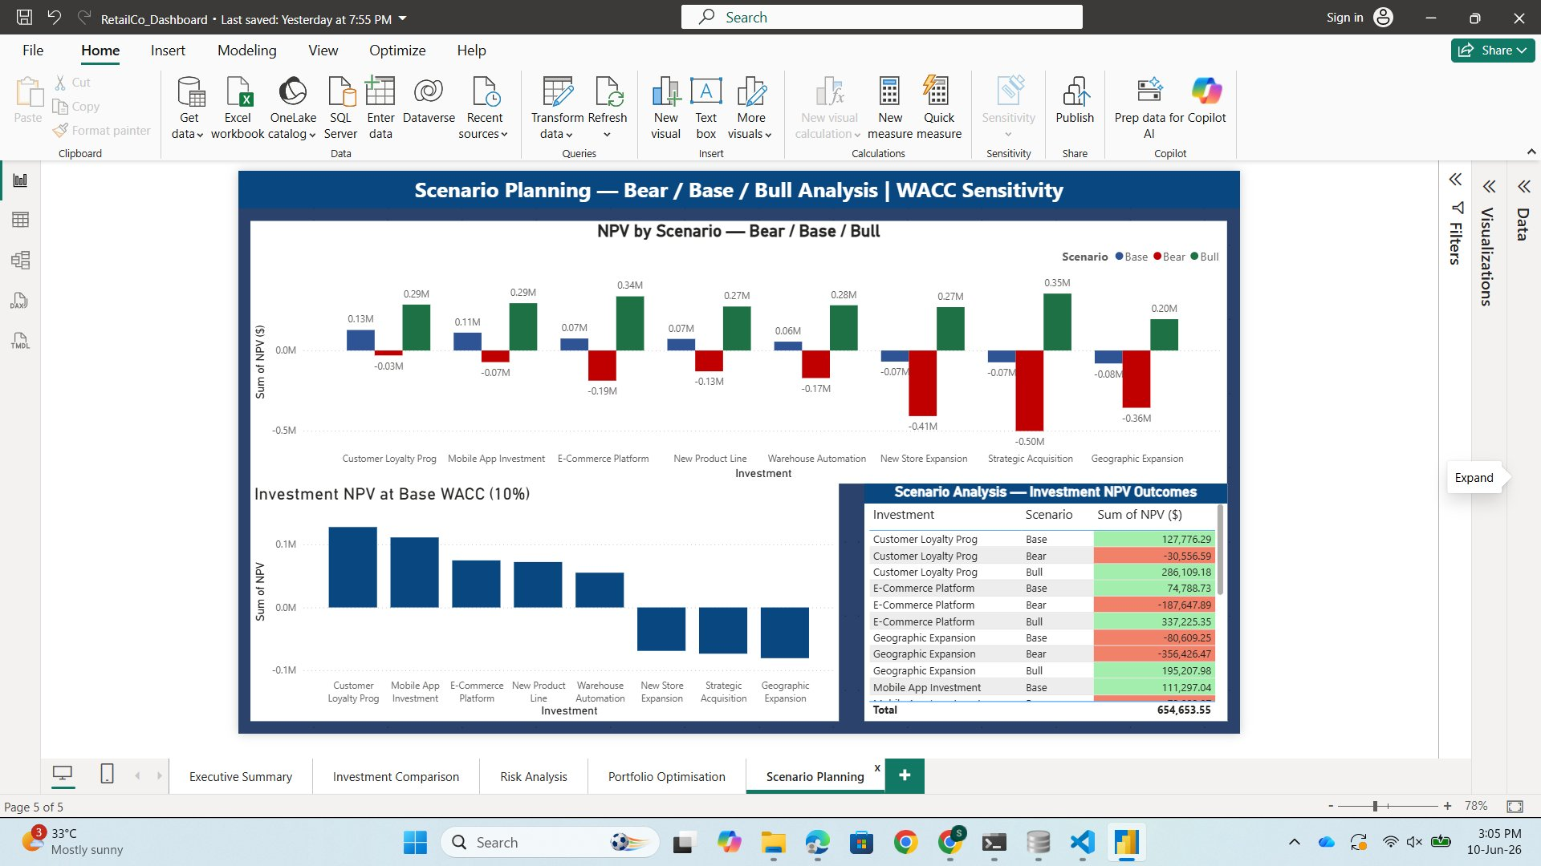
Sensitivity & Scenario Analysis
Portfolio stress-tested · All 3 scenarios generate positive NPV · Robust at −10% revenue AND 12% WACC
Scenario Outcomes
Power BI — Scenario Planning Page
Scenario
Rev Mult
Portfolio NPV
Verdict
Bear
-30%
$450,548
Positive ✓
Base
0%
$643,640
Positive ✓
Bull
+30%
$836,732
Strong Buy ✓
WACC Sensitivity
WACC
NPV Change
Status
8% (Favourable)
NPV +~$48K
Positive
10% (Base)
$643,640
Positive
12% (Stress)
4 of 5 positive
Robust
Portfolio NPV remains positive at −10% revenue AND 12% WACC simultaneously.
RetailCo Strategic Finance · FY2024 · Srushti Mahant Pawar · Confidential — Board Review Draft

Slide 13
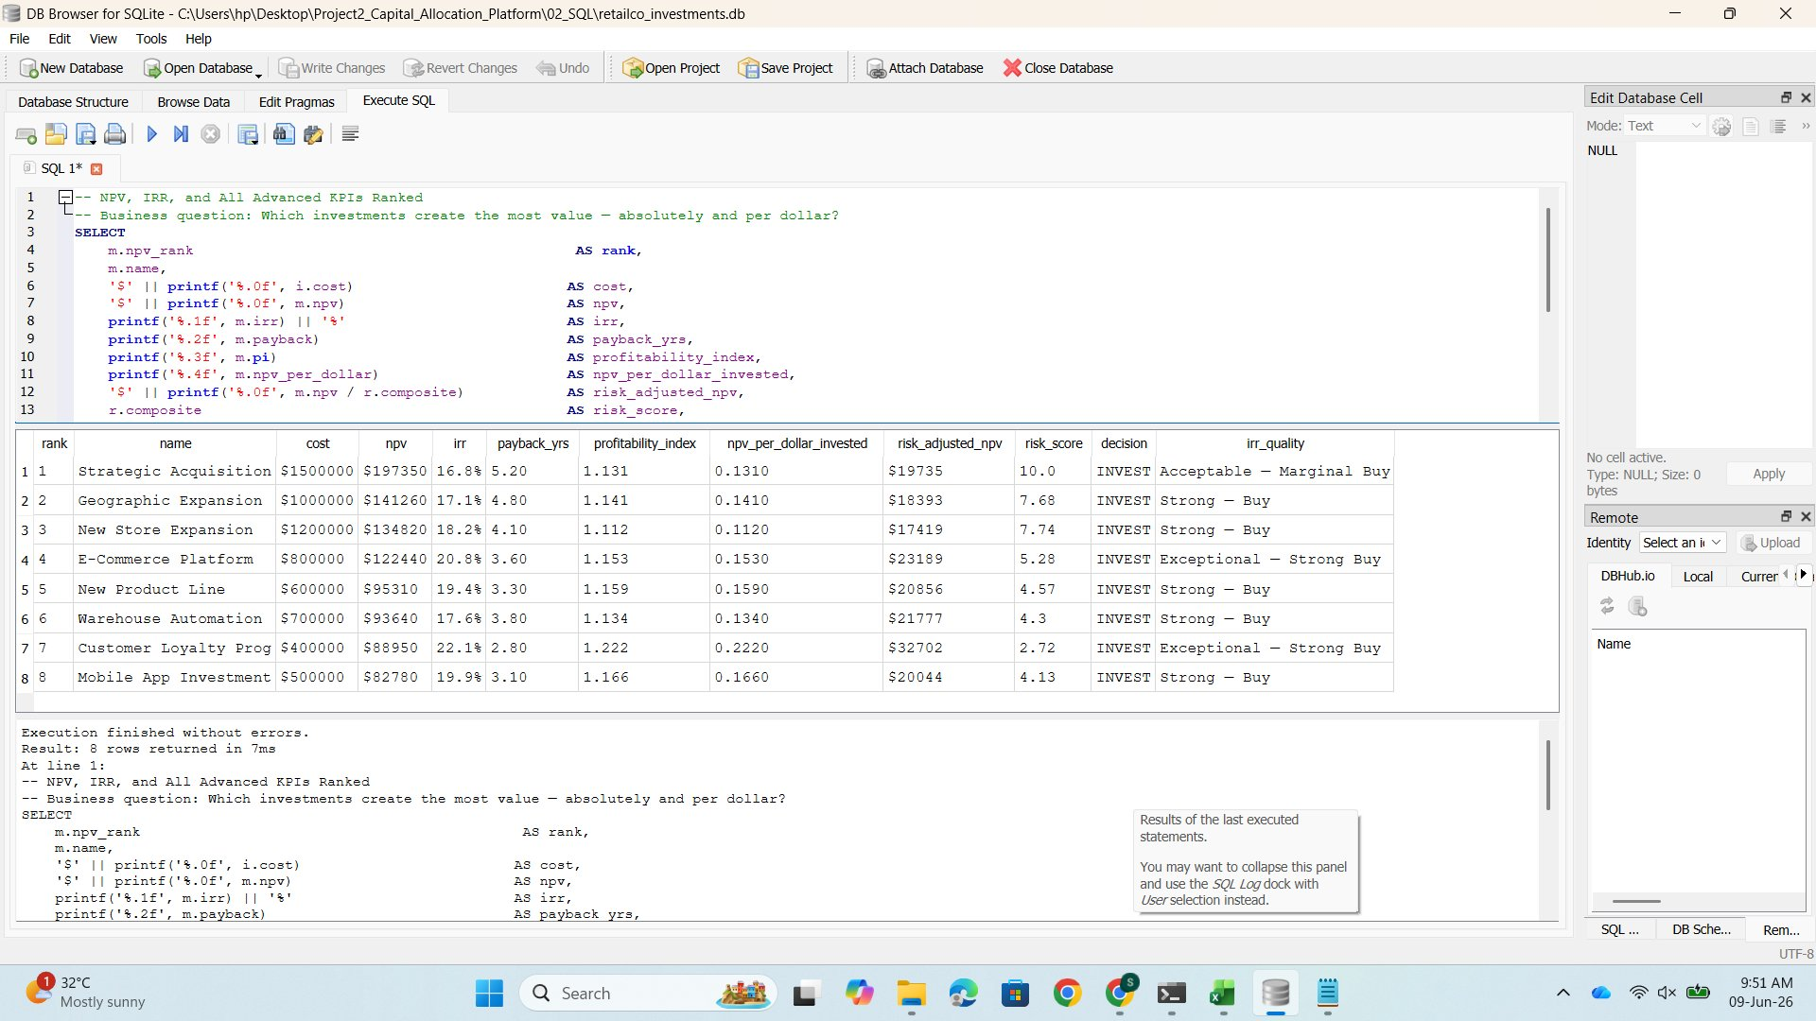
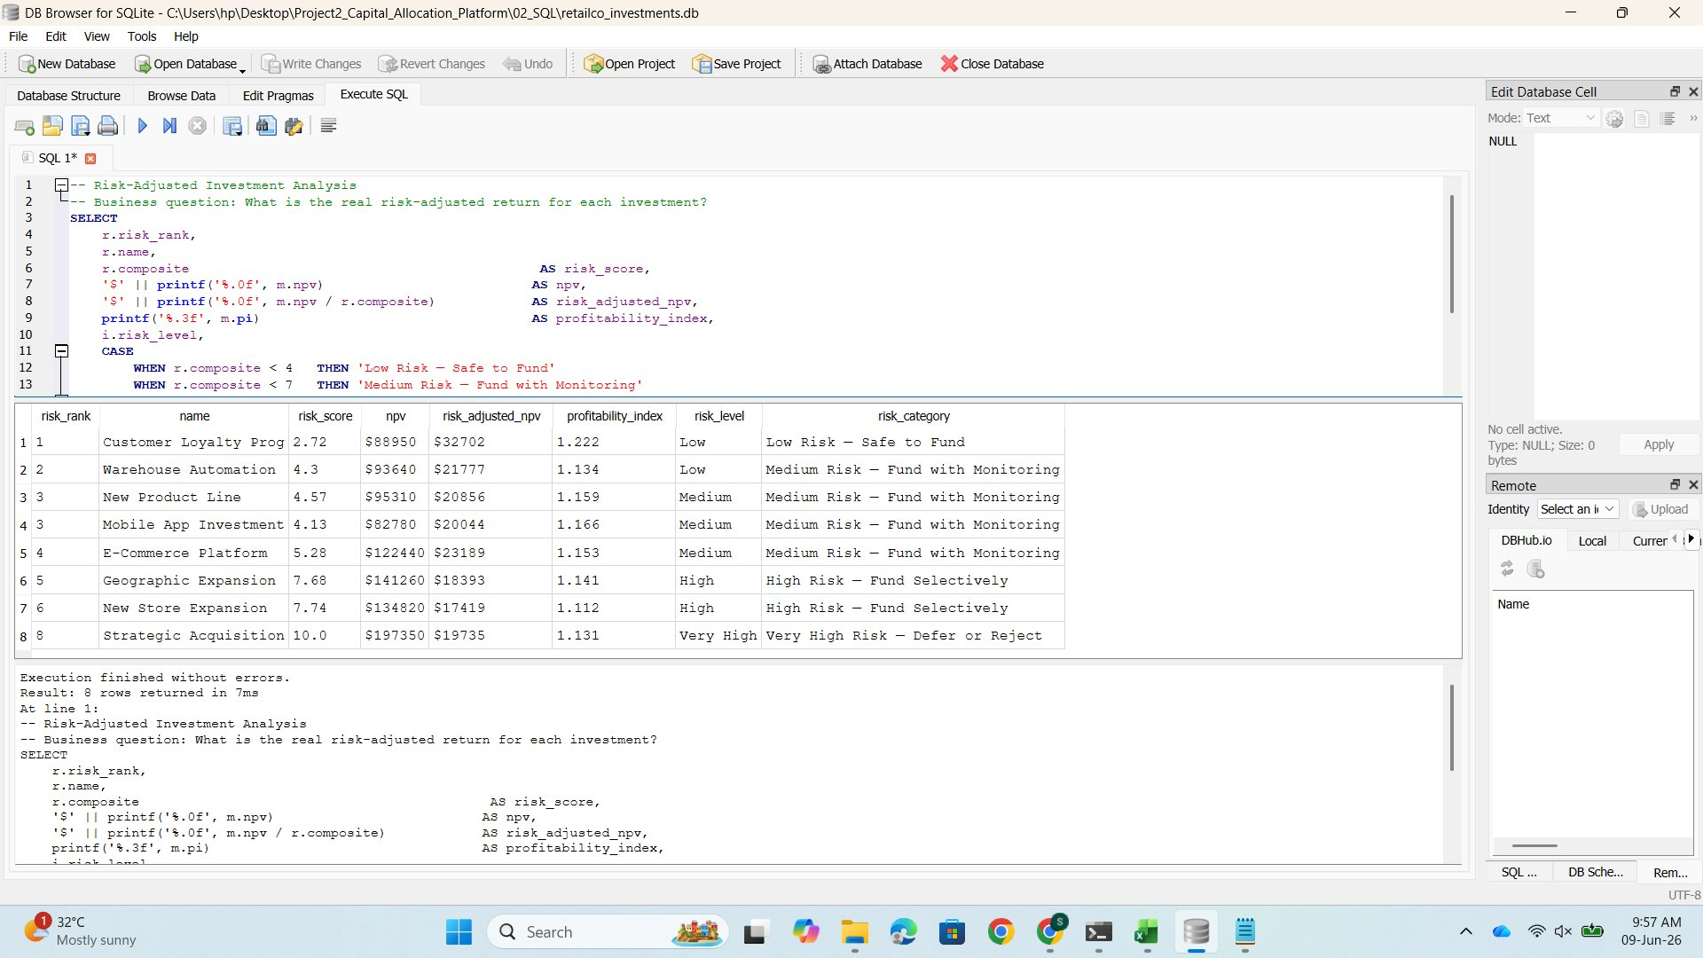
SQL Analytics Layer — Database Architecture & Business Queries
SQLite database · 3 tables · 7 business queries · Independently validates Python output
SQL DATABASE
Query 2 — NPV/IRR/PI/Risk-Adj Ranked
Query 4 — Risk-Adjusted Analysis
Database Schema
investments
id · name · cost
yr1–yr5 cashflows
risk_level · category
↓ inv_id
financial_metrics
inv_id (FK) · npv
irr · payback · pi
npv_per_dollar · decision
↓ inv_id
All 7 Business Queries:
risk_scores
Q1: Investment pipeline overview
Q2: NPV/IRR/PI/Risk-Adj ranked
Q3: Capital constraint greedy analysis
inv_id (FK) · vol_score
capital_score
payback_score · composite
Q4: Risk-adjusted investment analysis
Q5: Bear/Base/Bull scenarios
Q6: Portfolio optimisation result
Q7: Executive CFO one-query summary
RetailCo Strategic Finance · FY2024 · Srushti Mahant Pawar · Confidential — Board Review Draft

Slide 14
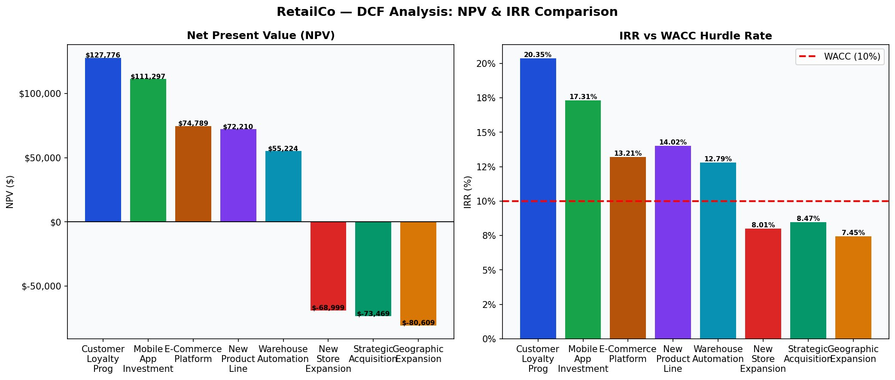
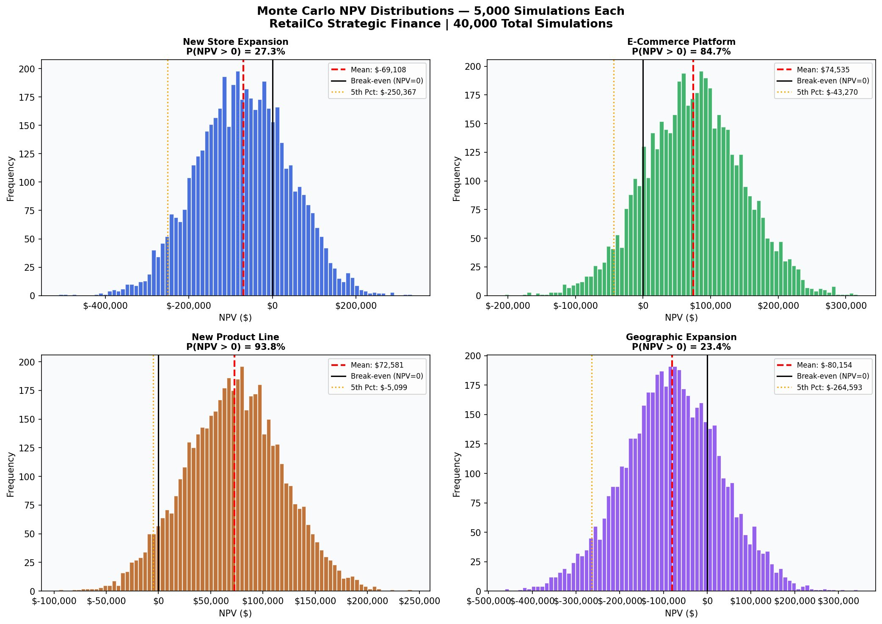
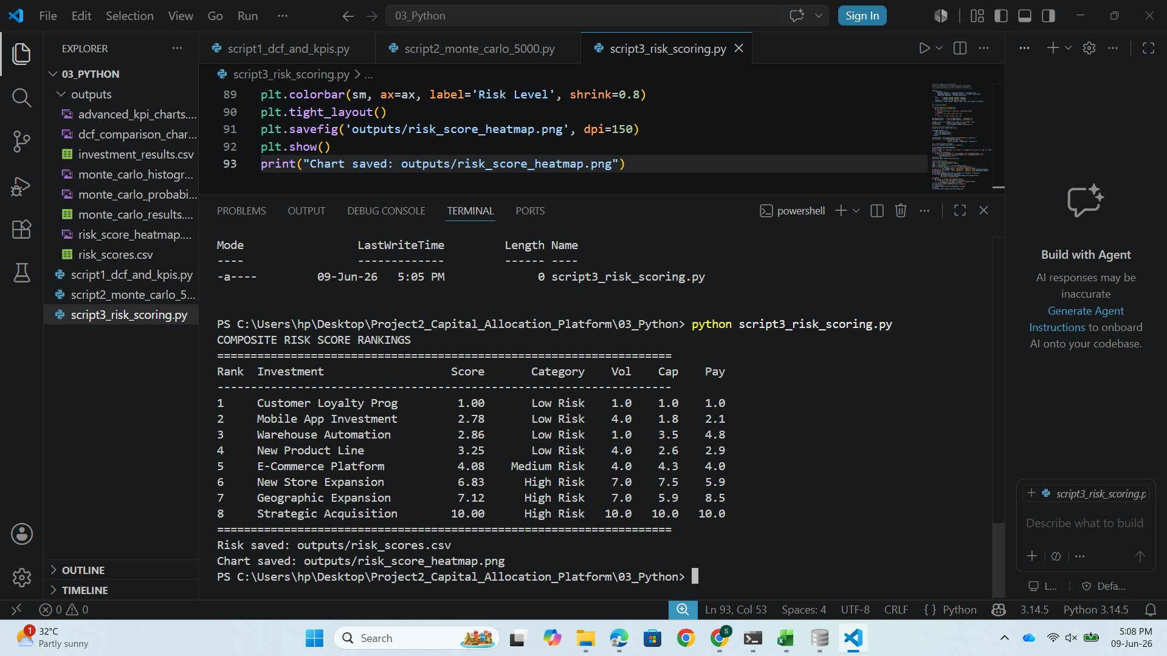
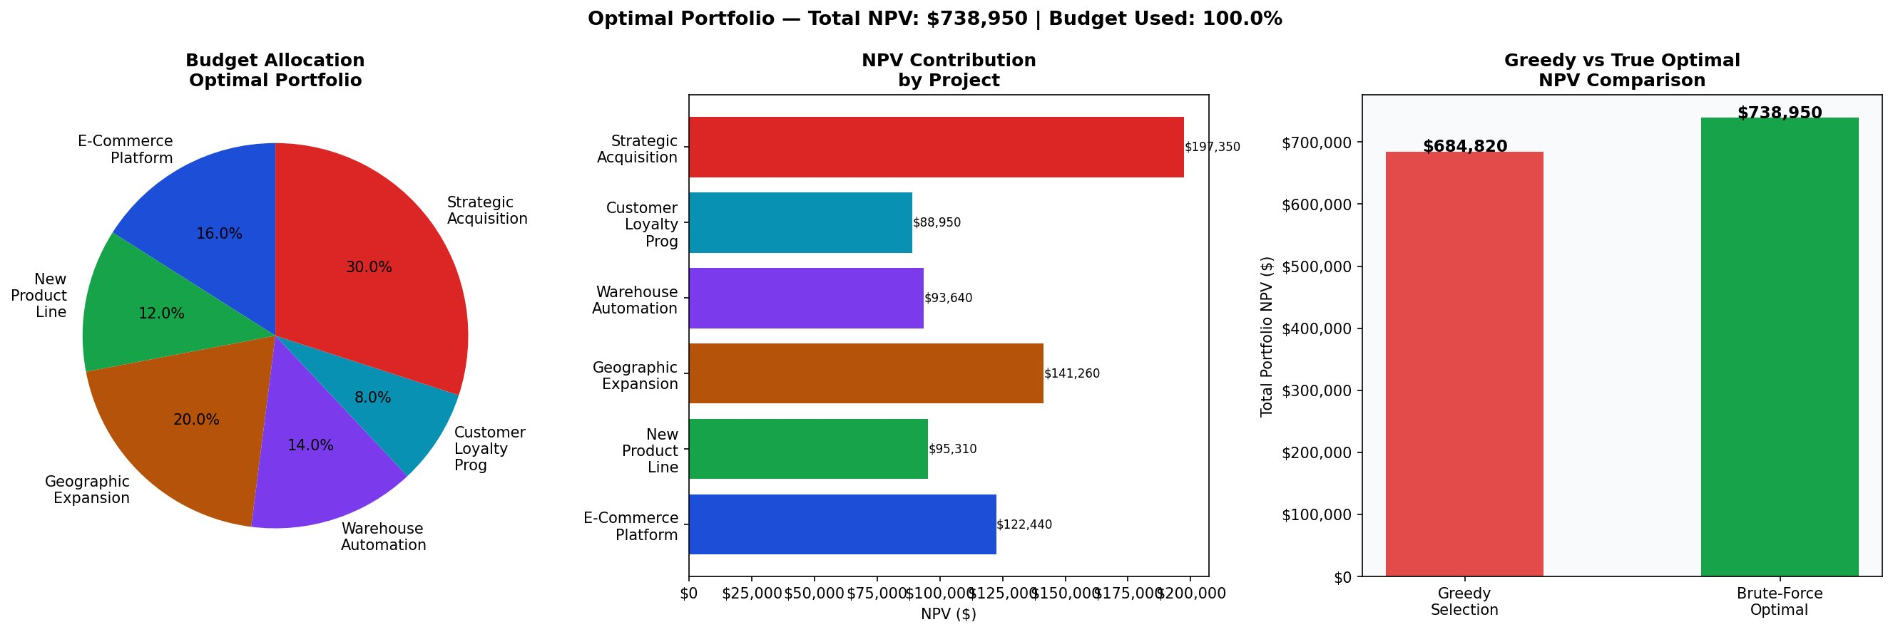
Python Analytics Engine — Four-Script Pipeline
Scripts 1–4: DCF → Risk Scoring → Monte Carlo → Portfolio Optimisation · 40,000 simulations · 255 combinations
PYTHON 4 SCRIPTS
Script 1 — DCF & Advanced KPIs
Script 2 — Monte Carlo Simulation
NPV, IRR, PI, NPV/$, Risk-Adj NPV for all 8
5,000 sims × 8 = 40,000 total · P(NPV>0) ranked
Script 3 — Composite Risk Scoring
Script 4 — Portfolio Optimiser
40% Vol + 30% Capital + 30% Payback · Score 1–10
255 combinations · Greedy vs Brute-Force · $738,950 optimal
RetailCo Strategic Finance · FY2024 · Srushti Mahant Pawar · Confidential — Board Review Draft

Slide 15
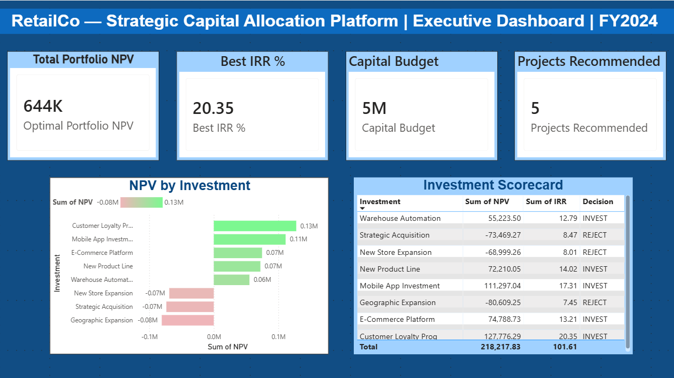
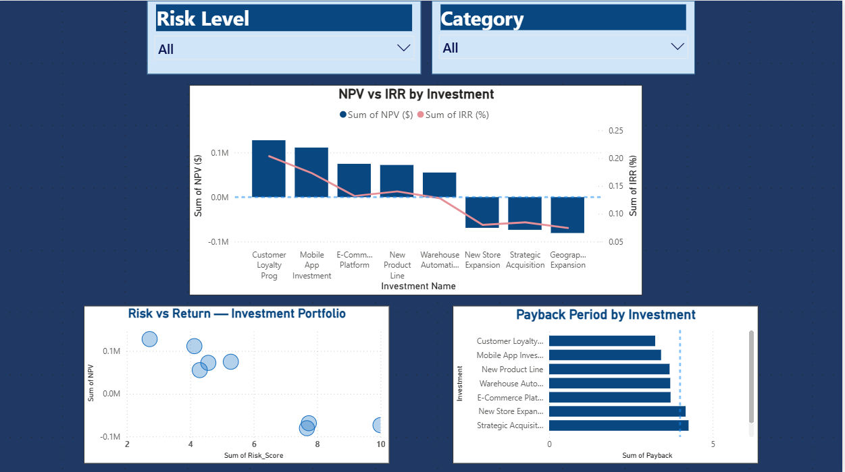
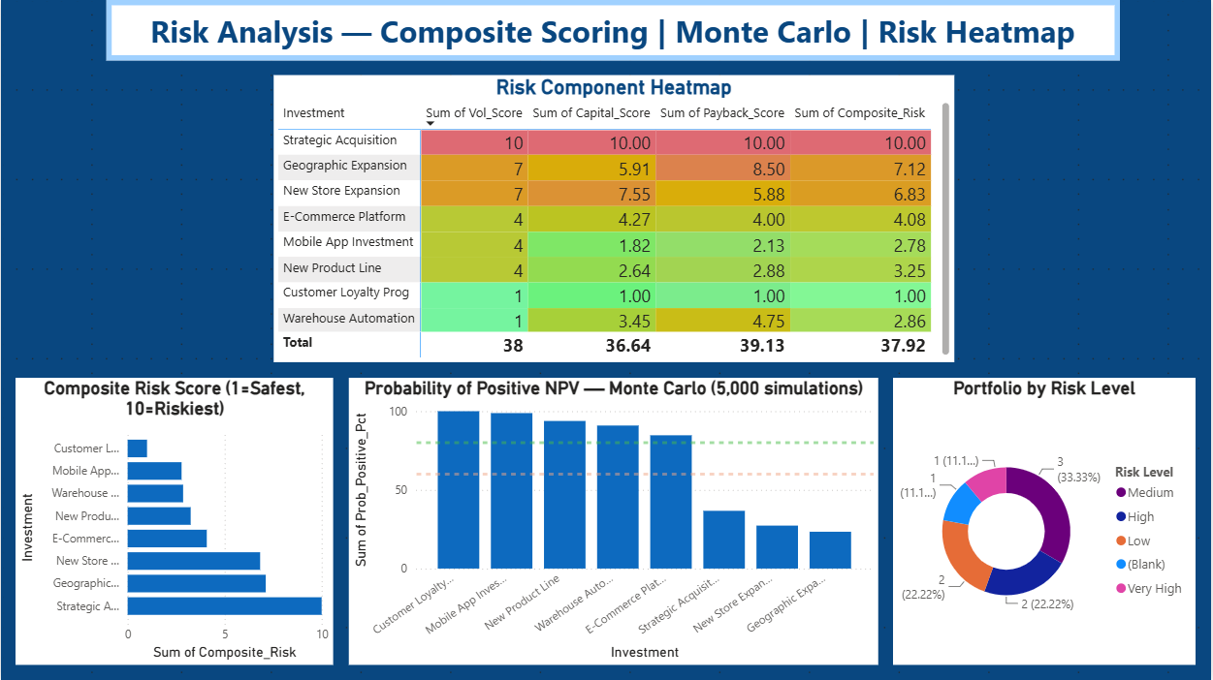
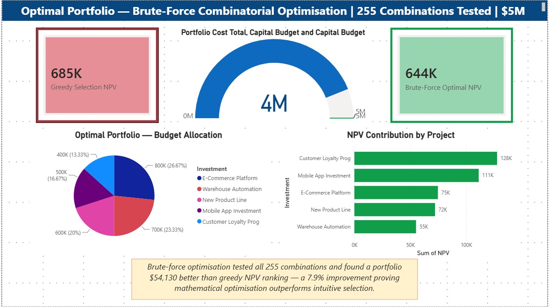
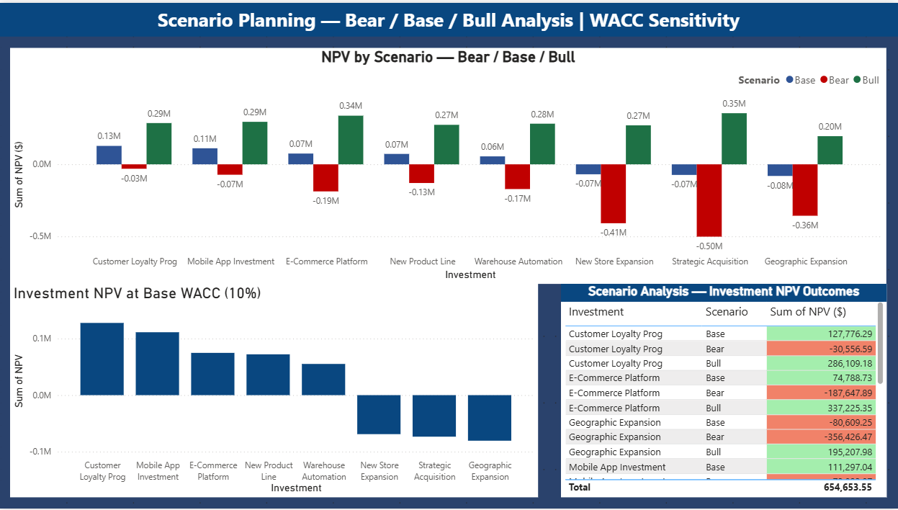
Power BI Executive Dashboard Suite — 5 Pages
Interactive management reporting · Live Excel + Python CSV data · Filterable by Risk Level and Category
Page 1 — Executive Summary
Page 2 — Investment Comparison
Page 3 — Risk Analysis
4 KPI cards · NPV chart · Scorecard table
Slicers · Combo chart · Scatter plot · Payback
Heatmap · Composite bars · Monte Carlo · Donut
Page 4 — Portfolio Optimisation
Page 5 — Scenario Planning
Gauge · Pie · NPV bars · Greedy vs Optimal
Bear/Base/Bull chart · Table · WACC sensitivity
RetailCo Strategic Finance · FY2024 · Srushti Mahant Pawar · Confidential — Board Review Draft

Slide 16
BOARD RECOMMENDATION
Commit $4,400,000 across 5 investments.
Verified NPV: $738,950 · Budget: 88% utilised · 255 combinations tested · 40,000 Monte Carlo runs · Avg risk: 5.27/10
FUND ✓
DEFER ✗
→ E-Commerce Platform
$800K
IRR 13.21%
→ New Store Expansion
Negative NPV (-$68,999). Destroys value at WACC=10%.
→ Geographic Expansion
$1.0M
$141K NPV*
→ Warehouse Automation
$700K
Risk 2.86 — Low
→ New Product Line
Positive metrics but crowded out. Revisit FY2025.
→ Customer Loyalty Prog
$400K
IRR 20.35% — Best
→ Mobile App Investment
Strong standalone economics (IRR 17.31%, P>0=98.8%). Excluded due to portfolio optimisation and capital constraints. FY2027 priority.
→ Strategic Acquisition
$1.5M
$197K NPV* — Largest
EXPECTED VALUE CREATED
$738,950
Net Present Value · Verified by brute-force optimisation across 255 combinations
NEXT STEPS
1
2
3
4
5
Board approval
30 Jun 2026
Q3 2026
Project kickoff
Q4 2026
90-day KPI review
Q1 2027
Mid-year reforecast
FY2027
Mobile App +$111K
RetailCo Strategic Finance · FY2024 · Srushti Mahant Pawar · Confidential · Board Review Draft

