Slide 1

Group 1
Connor Morris, Lane Durst, Shawn Russel, Logan Remondet, Maureen Sanchez, Jack (Yu Joo)

Slide 2
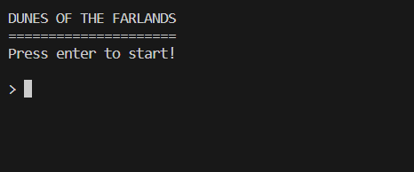
What is our Project?
Our project is a simple Text-Based adventure game called “Dunes of the Farlands”.
The main parts of this program are the user interface, a text input parser, a system for storing and modifying game objects, and a system for outputting gameplay events depending on user choices in the game.

Slide 3
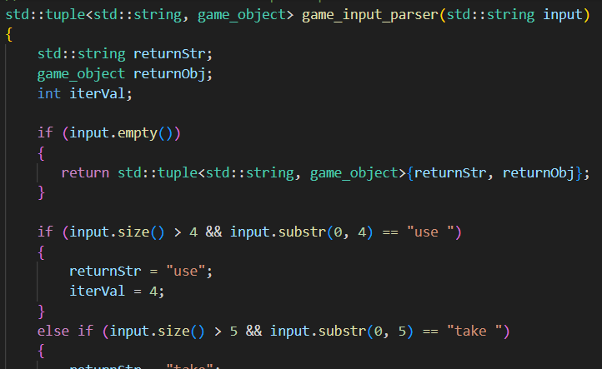
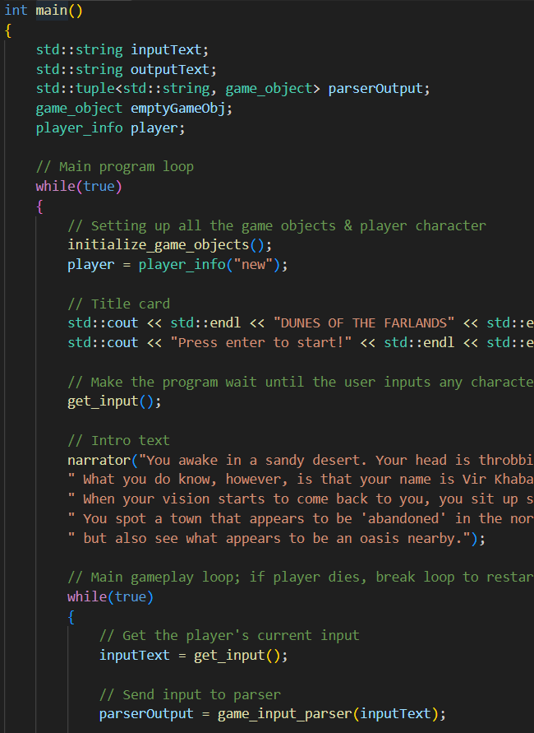
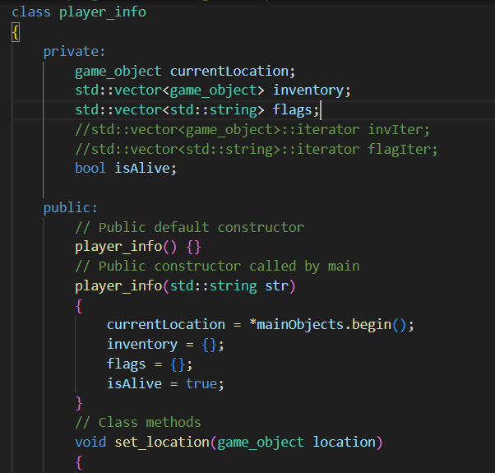
Connor: Leader / Text Parser Designer

Slide 4
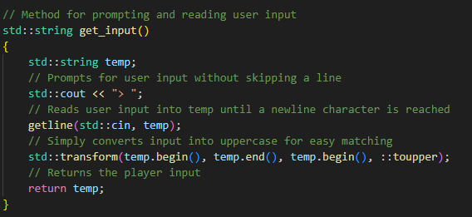
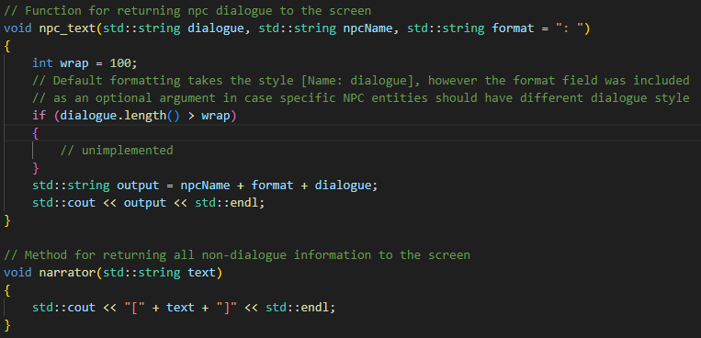
Lane: Vice-Leader / UI Designer
The user_input function takes simply prompts the user for input with a ‘>’ then reads the whole next line to a string. This string is then fully capitalized, for easier matching, and returned by the function.
I was in charge of creating the basic game loop in the main as well as handling how input and output are read too and from the system.
The main loop simply operates by waiting for any input to begin, and then entering an infinte loop that persists until an exit sequence is entered. This loop simply outputs the current story event, takes user input and parses it, and then outputs the next story event.
There are additionally two ‘dialogue’ functions, which simply take a string and output it to the screen. The first of these is the narrator function which puts the text within brackets []. The other is called npc text which outputs to the screen in the format npcName+format+dialogue, with ‘format’ being an optional field default set to ‘: ‘

Slide 5
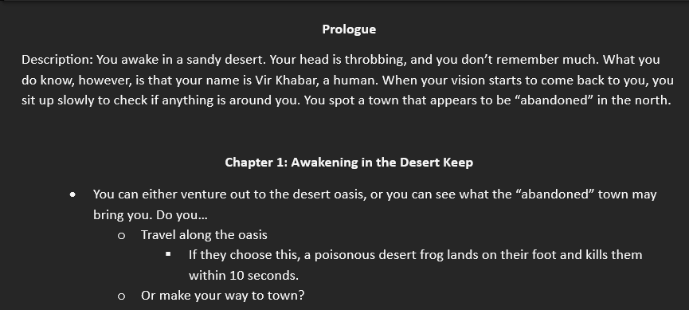
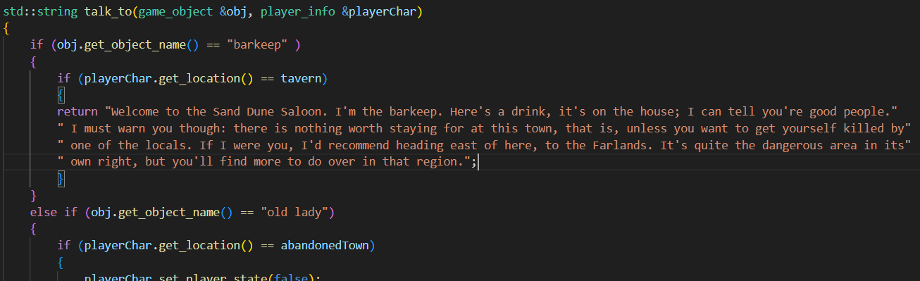
Shawn: Story Lead /
Gameplay Implementation

Slide 6
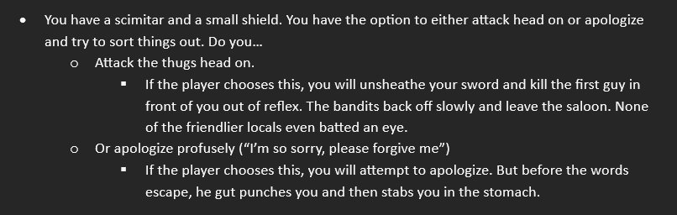
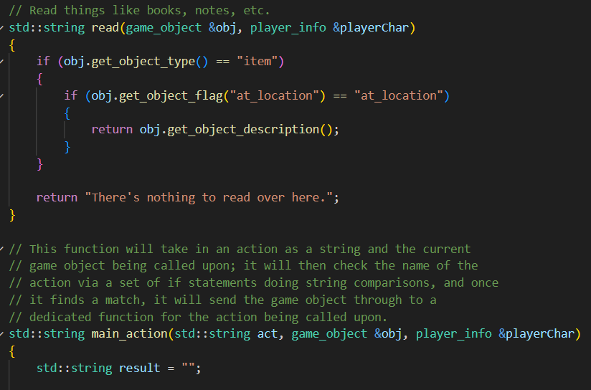
Logan: Story Lead /
Gameplay Implementation

Slide 7
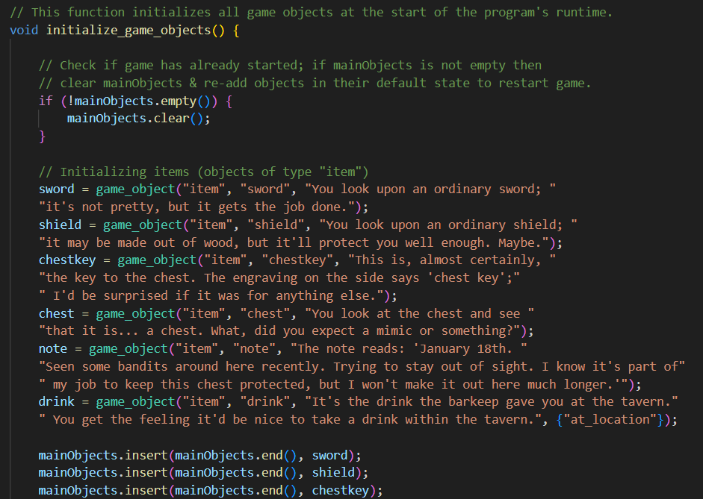
Maureen: Story Implementer /
General Code Helper

Slide 8
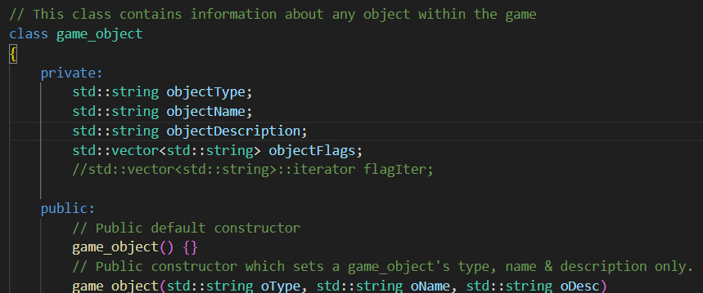
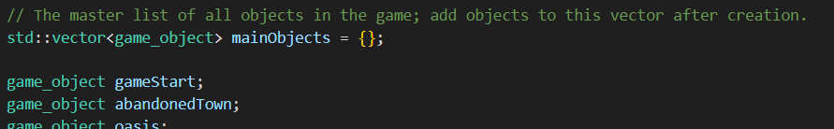
Jack: Story Implementer /
General Code Helper

