Slide 1

2-WEEK INTERNSHIP PROGRAM
House Price Prediction
using Linear Regression
COMPANY
COURSE
DURATION
Star Innovation
Python with ML & AI
2 Weeks
A MACHINE LEARNING PROJECT
scikit-learn • Pandas • Data Science
Sruthi E S
Register No: RCE24CS069 | Computer Science and Engineering
Royal College of Engineering and Technology • Batch 2024–2028

Slide 2

01
PROBLEM STATEMENT
What We're Solving
The Goal
INPUT
Area, Bedrooms, Bathrooms,
Stories, Parking
Build a Machine Learning model that predicts the market price of a house based on its physical attributes — area, bedrooms, bathrooms, stories, and parking availability — using Linear Regression.
5 numeric features
↓
OUTPUT
Why It Matters
Predicted House Price
Helps buyers and sellers make data-driven pricing decisions instead of relying on guesswork or asking prices alone.
Continuous numeric estimate (₹)
House Price Prediction | Linear Regression Project
2

Slide 3






02
PROJECT WORKFLOW
The Six-Step Story of the Project
1
2
3
Load Dataset
Explore & Clean
Visualize
Read Housing.csv with pandas
Check shape, dtypes, nulls
Correlation heatmap & histogram
4
5
6
Train/Test Split
Train Model
Evaluate & Predict
80% train, 20% test (seed 42)
Fit Linear Regression
R², MAE, MSE + new prediction
House Price Prediction | Linear Regression Project
3

Slide 4

03
DATASET OVERVIEW
Housing.csv at a Glance
Loaded and explored using the Pandas library in Python — a core Machine Learning workflow skill.
545
13
0
Also Includes
mainroad
guestroom
basement
hotwaterheating
airconditioning
prefarea
furnishingstatus
Rows (entries)
Columns
Missing Values
Key Features Used
area
bedrooms
bathrooms
stories
parking
price (target)
House Price Prediction | Linear Regression Project
4

Slide 5
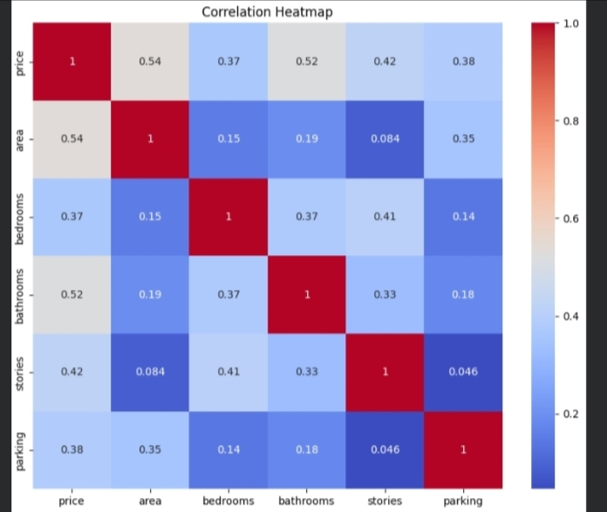
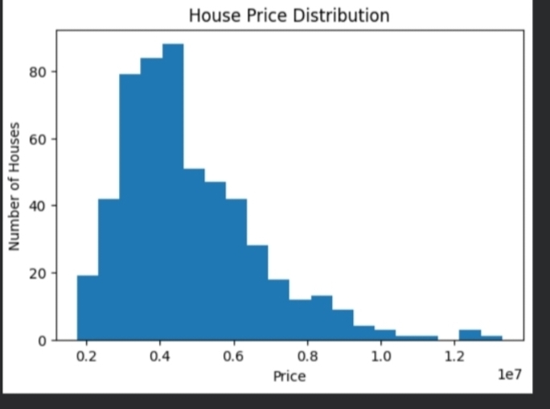
04
EXPLORATORY ANALYSIS
Correlation & Price Distribution
Correlation Insights
Area ↔ Price: 0.54 — strongest correlation
Bathrooms ↔ Price: 0.52
Stories ↔ Price: 0.42
Parking ↔ Price: 0.35
Bedrooms ↔ Price: 0.37 — weakest of the five
Price Distribution
The distribution is right-skewed — most houses fall in the lower-to-mid price range (roughly ₹20L–₹50L), with fewer high-value outliers above ₹1 crore.
House Price Prediction | Linear Regression Project
5

Slide 6


05
MODEL BUILDING
Why Linear Regression?
A Simple, Interpretable Baseline
Data Split
Area, bedrooms, bathrooms, stories, and parking show a roughly linear relationship with price. Linear Regression establishes this relationship directly and is fast to train and easy to evaluate.
Training set: 80% of data
Testing set: 20% of data
random_state = 42
Simple, interpretable model for continuous prediction
Establishes a linear relationship between features and price
Algorithm & Inputs
Fast to train, easy to evaluate with standard metrics
Linear Regression (scikit-learn)
Input Features:
Good baseline before trying more complex algorithms
area, bedrooms, bathrooms, stories, parking
House Price Prediction | Linear Regression Project
6

Slide 7
06
MODEL EVALUATION
Model Performance
54.64%
0.546
₹11.27L
₹15.14L
Accuracy (R²)
R² Score
MAE
RMSE
Interpretation
The model explains about 54.6% of the variance in house prices using area, bedrooms, bathrooms, stories, and parking.
On average, predictions are off by about ₹11.27 lakh (MAE), with an RMSE of ₹15.14 lakh.
Adding more features (location, furnishing status, amenities) could further improve accuracy.
House Price Prediction | Linear Regression Project
7

Slide 8
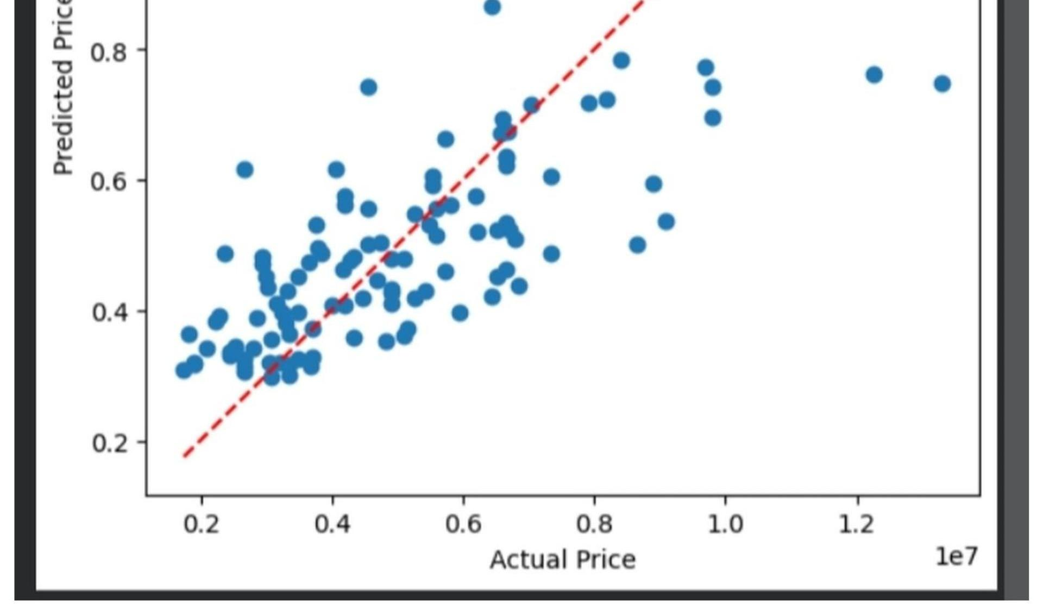
07
VISUAL EVALUATION
Actual vs. Predicted Price
What This Graph Shows
Each blue dot is one house from the test set
The red dashed line marks perfect prediction
Points near the line indicate accurate predictions
Higher-priced houses show more scatter
SAMPLE INPUT
Area: 1000 sq.ft Bedrooms: 1 Bathrooms: 2
Stories: 1 Parking: 1
PREDICTED PRICE: ₹ 37,16,338
House Price Prediction | Linear Regression Project
8

Slide 9






08
REFLECTION
Challenges & Skills Required
Challenges Faced
Skills Required
1
Multicollinearity
Python Programming
Pandas & NumPy
Area, bathrooms, and stories are inter-correlated, making each feature's true effect harder to isolate.
Core syntax, functions, data structures
Loading, cleaning, manipulating data
2
Limited feature set
Only 5 numeric features were used; categorical factors like location and furnishing were left out.
Matplotlib & Seaborn
scikit-learn
Skewed price distribution
Heatmaps and distribution plots
Building and training the model
3
A few high-value outlier homes pulled the distribution right and increased error at the top end.
Statistics Basics
Analytical Thinking
4
Moderate accuracy (R² 0.546)
A linear model only captures straight-line relationships — real pricing has non-linear effects it misses.
Interpreting R², MAE, and RMSE
Reading patterns, debugging results
House Price Prediction | Linear Regression Project
9

Slide 10
09
CONCLUSION
A Working End-to-End ML Pipeline
1
Loaded, explored, and cleaned housing data using Pandas
2
Understood correlation analysis and visualization with Seaborn & Matplotlib
3
Built and trained a Linear Regression model with scikit-learn
4
Evaluated model performance using R², MAE, and RMSE
5
Gained hands-on experience applying ML to a real-world prediction problem
House Price Prediction | Linear Regression Project
10

Slide 11
Thank You
House Price Prediction using Linear Regression
Questions & Discussion

