Slide 1
As a User
I Upload bundle of Consent forms
I expect it to be stored for future use
When I search with key terms(like name, Global Patient ID) I should find the Consent form of the Patient
If I need all the consent forms of opthamology, all the opthamology consent forms should be fetched.

Slide 2
What Kind of Consent Form will be uploaded
There are three major types of consents in FHIR
Privacy Consent Directive: The person agrees, restricts, or prohibits how their medical information is collected, accessed, used, or shared.
Medical Treatment Consent Directive: The person consents or refuses to a specific treatment.
Research Consent Directive: The person consents to participating in research studies and sharing their information.
At this point only the privacy use case is fully modeled, others are being used but no formal modelling exists.

Slide 3
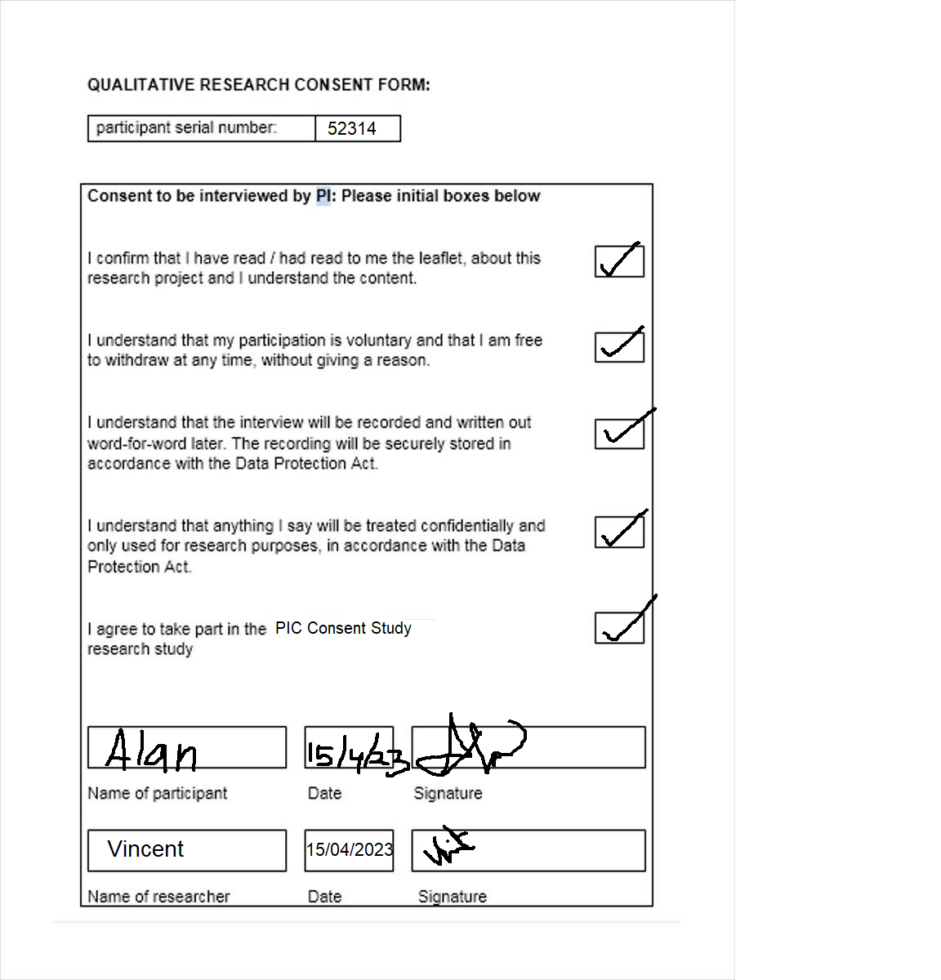
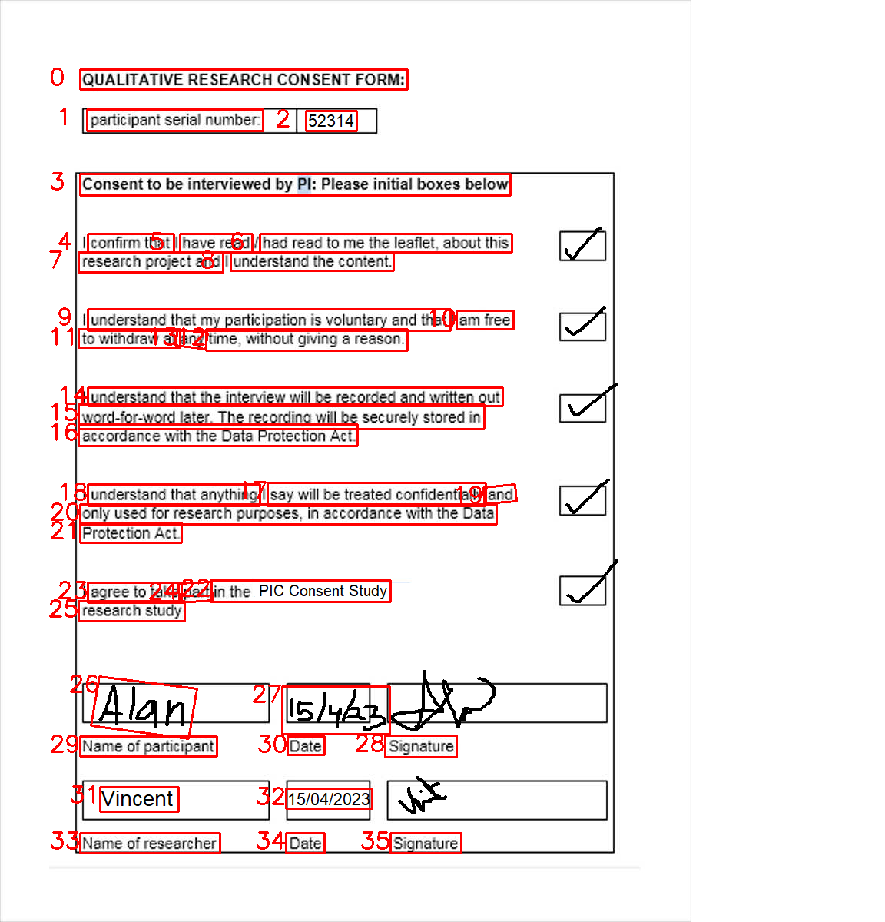
Preprocessing
Push to EasyOCR
Write an API to store the consent forms and retrieve it using the important terms
Find a way to identify the Meta data
Identify the Metadata

Slide 4
PDF
Word
Convert it to JPG Format
JPG

Slide 6
No. | Text | Confident Score
0 | Regional Anesthesia Procedure Form | 0.9951
1 | Time Out (time) | 0.9714
2 | Date | 1.0
3 | ConsultBlock Requested By | 0.7357
4 | Patient Identification Sticker | 0.9908
5 | Pre-op Diagnosis | 0.9389
6 | Surgical Procedure | 0.7425
7 | Purpose of Block | 0.9953
8 | Surgical | 0.7829
9 | Postop Pain | 0.9999
10 | Block Procedure Location | 0.9995

Slide 7
Manual consent form to Semi digital consent form
Identify the key elements: Before digitizing the consent form, identify the key elements that need to be captured electronically. These may include patient information, the procedure or treatment being consented to, the risks and benefits of the procedure or treatment, and the patient's signature.
Mandatory fields in any medical consent forms according to WHO
Patient Details
Witness Details
Researcher Details
Consent Name (will tell about the Diagnosis)
Start Date
End Date
(minor -> assent forms)

Slide 8
Common methods of digitizing a paper data
Document management systems (DMS)
Scanning
Optical Character Recognition (OCR)

Slide 9
Our Approach
File1(abc)
File2(XYZ)
File3(ijk)
Scanned Copy
File Uploaded
OCR Process
Identified meta data is sent to the files
Searching with Keywords
Getting the files

Slide 10
Our Approach
File1(abc)
File2(XYZ)
File3(ijk)
Scanned Copy
File Uploaded
OCR Process
Identified meta data is sent to the files
Searching with Keywords
Getting the files

Slide 11
Search for Key terms
Key Words
Consent Form
API
Key Words
Consent Form
Key Words
Consent Form

Slide 12
scan the filled consent form
Pre-Process
Put it to easyOCR
Retrieve from database
Store in database
Find the meta data
Hospital staff will create a structure
Based on the structure we identify at which position the meta data is present
When we find the position of the meta data we search the same in uploaded consent form

Slide 13
Steps for Uploaded consent form
Create a webpage where we can upload our file.
The uploaded page should be processed
Push the file to AWS S3
When the file is pushed to S3 it should automatically trigger EasyOCR.
Now compare with the blueprint and find the metadata
AWS Lambda

Slide 14
Steps for uploading blueprint consent form
Create a webpage where we will be able to create a blueprint Consent form. (similar to our E-consent forms)
Push it to easyOCR where we can find and store the patterns.

Slide 15
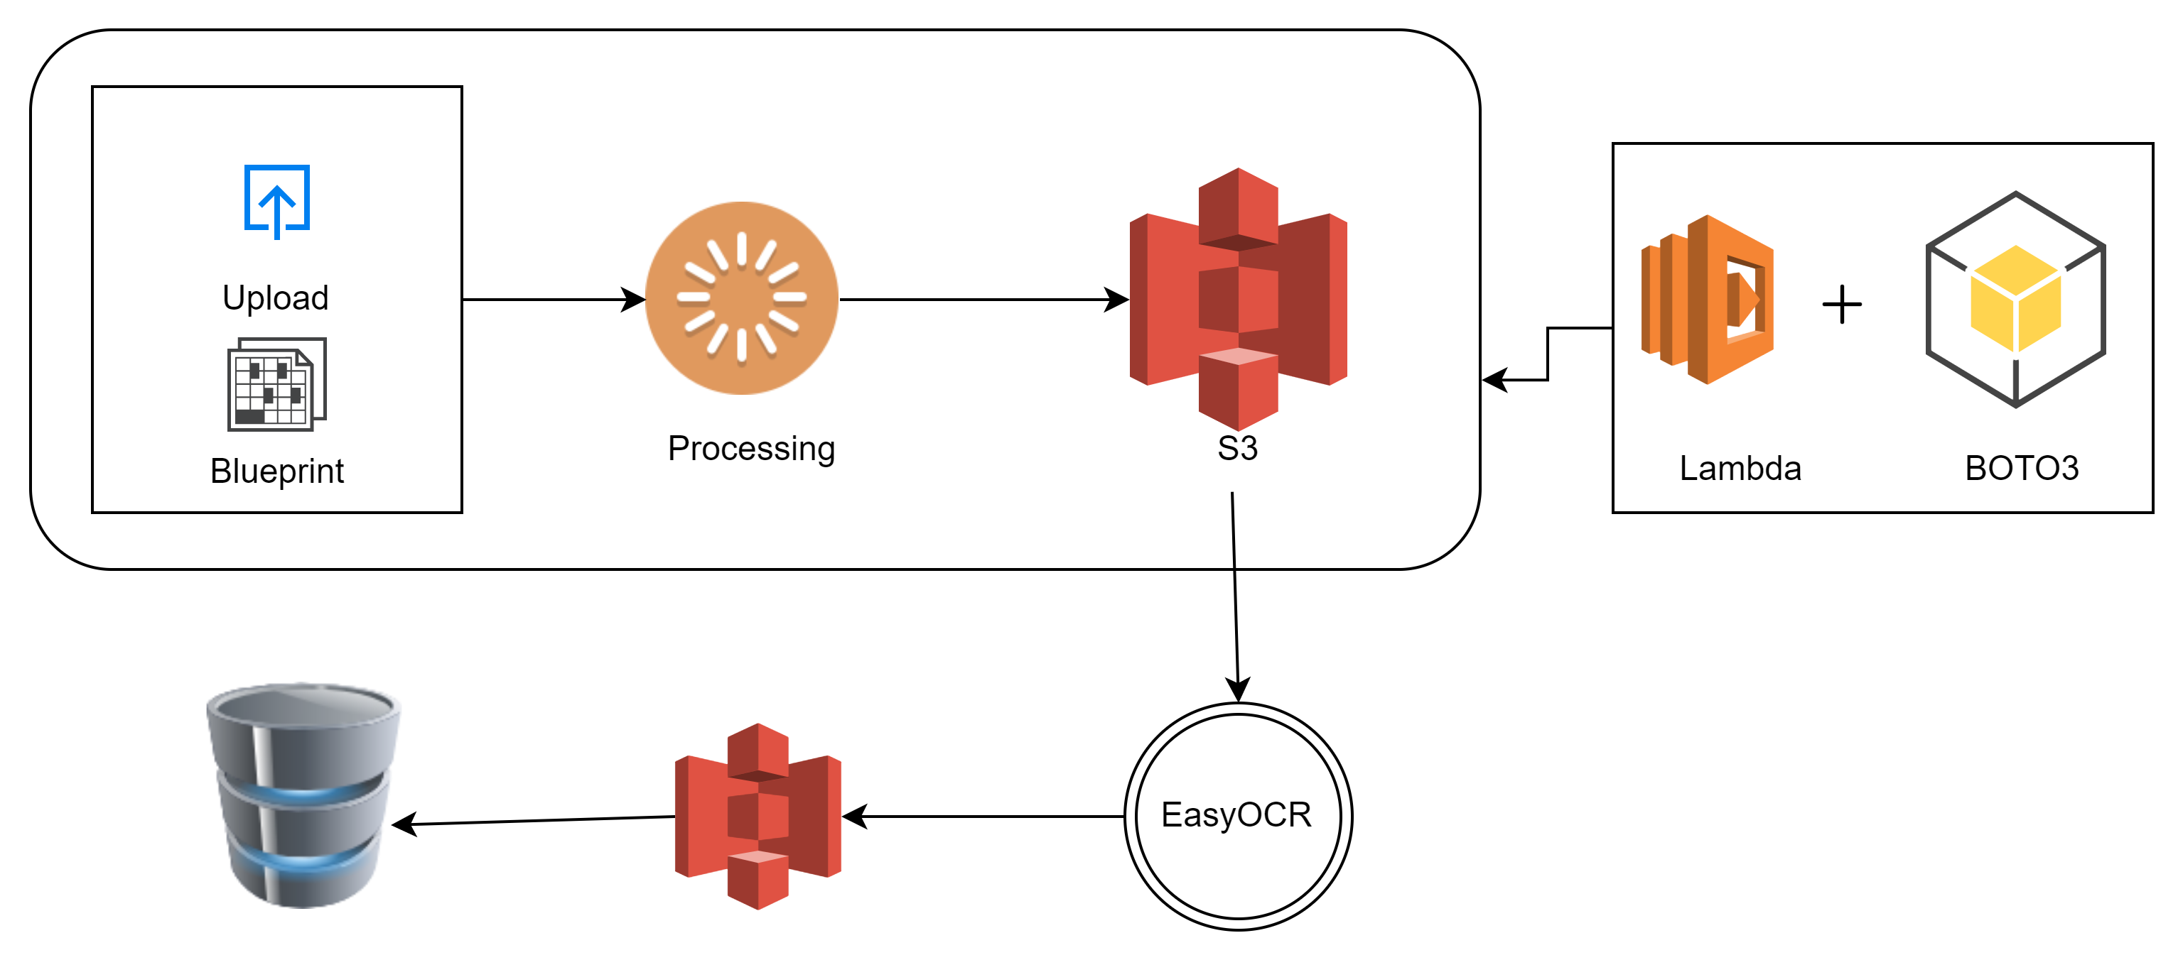

Slide 16
Create a web page in which we can upload a file (frontend, backend)
Convert the file into jpg format and the process the data in the format which EasyOCR will accept
Create a webpage for making a blueprint consent form and upload it
Push the blueprint to EasyOCR and find the positions of the meta data
Store the pattern
Push the uploaded file to EasyOCR
Match the output with patterns found
Get the meta data
Store the file along with metadata

Slide 17
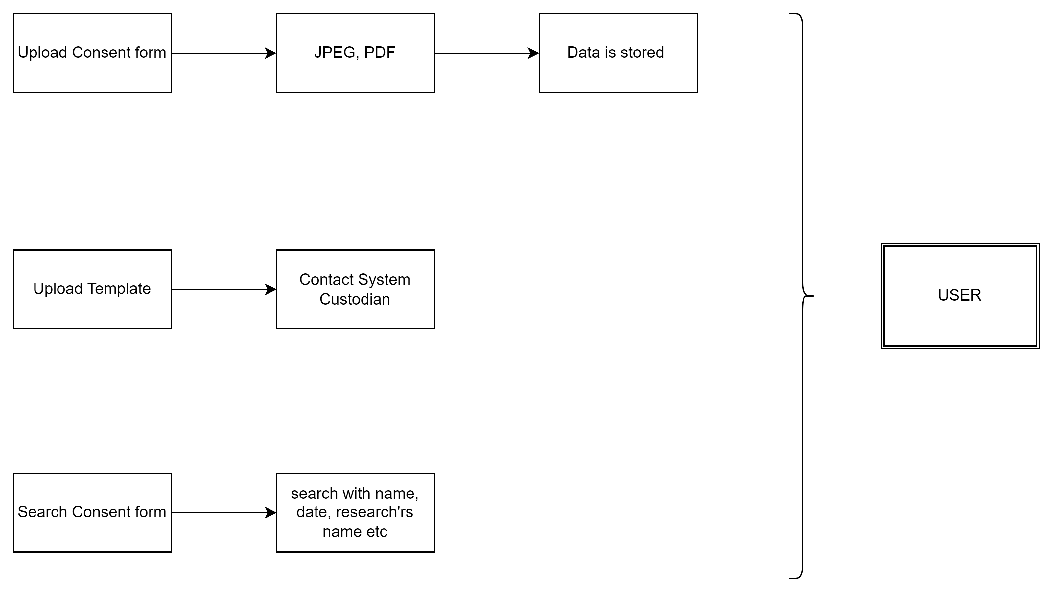
USER Perspective

Slide 18
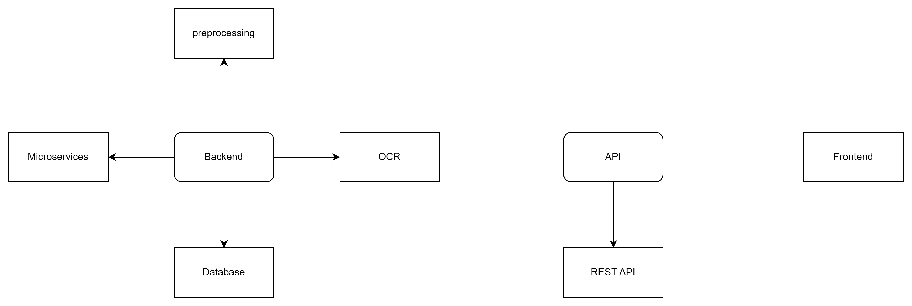

Slide 19
Preprocessing
EasyOCR
Identify the Metadata
Store in a database
Search

Slide 20
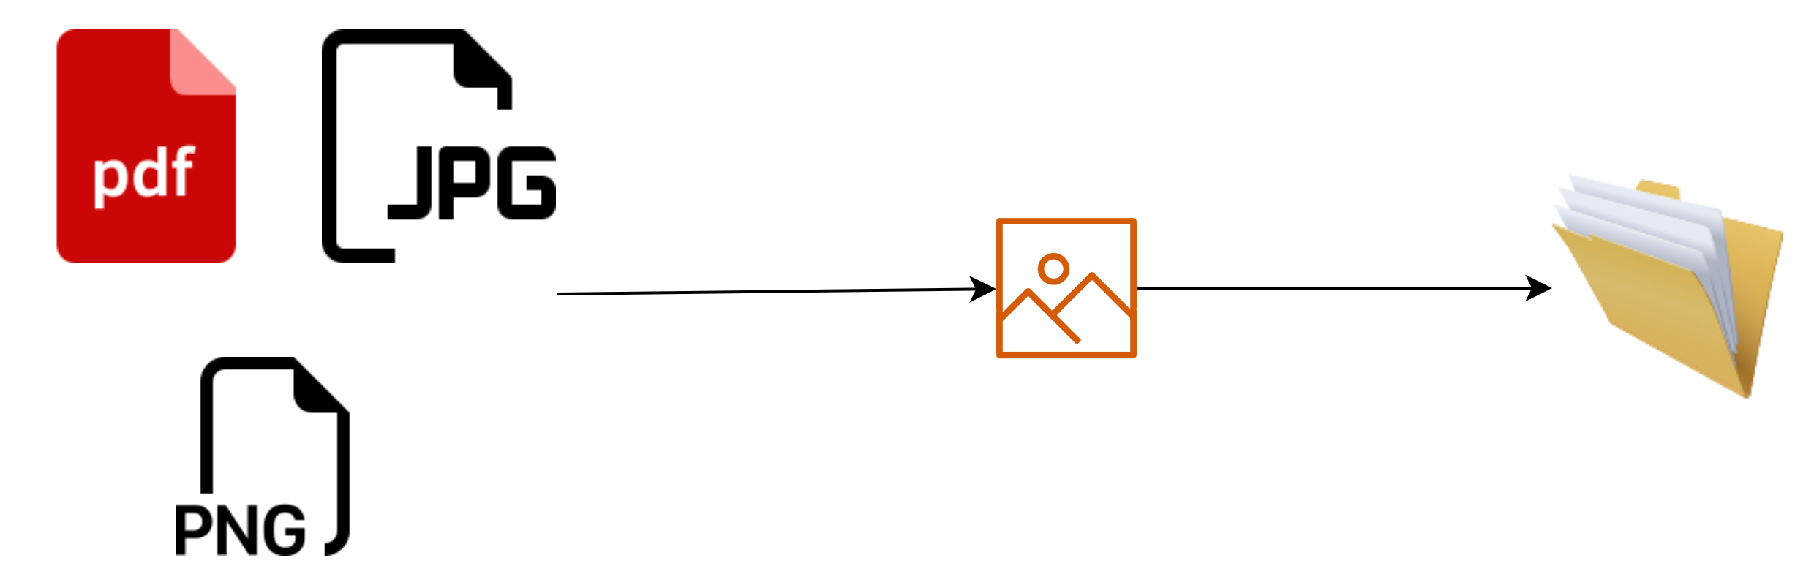
Preprocessing
Using pdf2image library I am converting pdf to jpg format
Using image module in PIL library I convert png jpg
Now the converted image is stored

Slide 22
Image processing
Import the Image
Used pillow but thinking like opencv would be better
Improve the quality
Using opencv
Enhance the image
Image Segmentation
Feature Extraction
Classification
Post-processing

