Slide 1
Digitalizing Paper Consent Forms
Sruthi R
20566805 Intern Data Science & AI CoE
05-06-2023

Slide 2
INTRODUCTION
Research consent forms in healthcare provide individuals with crucial information about a study's purpose, procedures, risks, benefits, and confidentiality.
e-Consent forms, digital alternatives to paper-based forms, streamline the process using electronic platforms. However, managing existing paper consent forms presents a challenge. To address this, digitalizing paper consent forms is proposed. This conversion process transforms paper forms into electronic formats, facilitating efficient data management and integration with electronic systems.
Digitalized consent forms improve storage, searchability, and accessibility of records, allowing seamless integration with research databases. By combining the benefits of e-Consent with the preservation and organization of traditional consent data, digitalization enhances the research process.
It empowers researchers to efficiently manage consent data while ensuring compliance with ethical and legal standards. Ultimately, digitalizing paper consent forms optimizes the consent process, offering efficiency and accuracy in healthcare research.

Slide 3
PROBLEM STATEMENT
In the current healthcare system, there is a lack of efficiency in collecting and managing patient data, leading to significant time and resource investment in data entry and subsequent errors and treatment delays. To address this issue, the development of a mini application is necessary. This application would capture patient data and store it in an efficient manner, facilitating easy retrieval when needed in the future.
By implementing this mini application, the healthcare system would overcome the challenges associated with data collection and management. It would streamline the process, reduce the burden of data entry, and minimize errors. The application would provide a user-friendly interface for healthcare professionals to input patient information accurately and efficiently.
The benefits of this solution include improved data accuracy, reduced administrative workload, and enhanced patient care outcomes. With an efficient and reliable system for capturing and storing patient data, healthcare providers can access and utilize the information effectively, leading to better decision-making and improved treatment outcomes.

Slide 4
Methodology
Submitting Consent Forms:
In this module, we will submit the paper consent forms that need to be stored securely.
Retrieving Consent Forms:
Search for the required consent forms in this section, ensuring efficient access.
Uploading Templates:
Whenever a new consent form needs to be added to the system, we can upload a template for it.

Slide 5
UPLOAD CONSENT FORM
Selection of Consent Form Type: Users are required to choose the specific type of consent form they want to add within the module.
Redirect to Function: Depending on the selected consent form type, users are directed to a specific function designed to handle that particular type of form.
Choosing the Appropriate Template: Once directed to the respective function, users can proceed to choose the appropriate template that matches their selected consent form type.
Individual Upload of Consent Forms: Users are given the ability to upload their consent forms one by one. The supported formats for upload include PDF, JPG, and PNG.
Metadata Extraction: Upon uploading the consent forms, the system extracts relevant metadata from each form. This metadata contains important information associated with the consent form.
Storage in the Database: The extracted metadata is stored in the database in a structured manner. This allows for easy retrieval and organization of consent form data.
New Template Request: In cases where none of the available templates match the user's consent form, users are advised to contact the system custodian. They can request the addition of a new template that aligns with their specific consent form requirements.

Slide 6
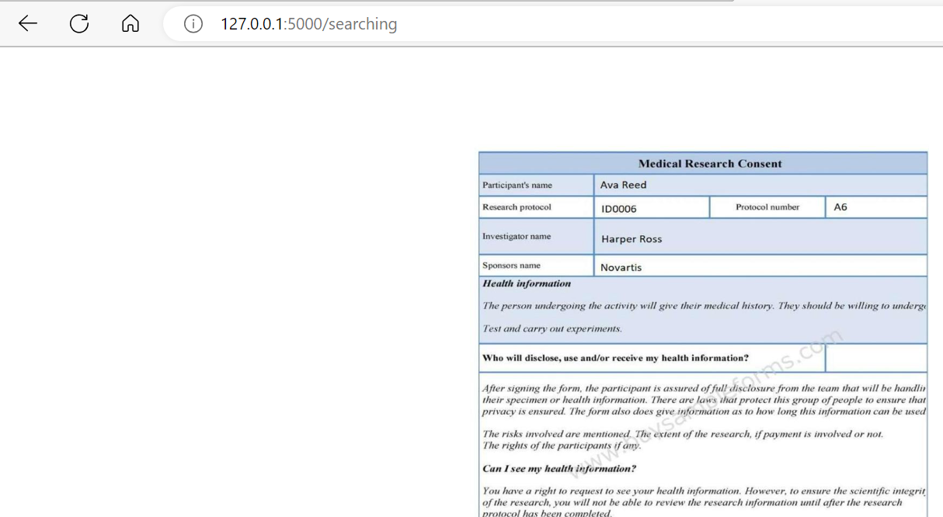
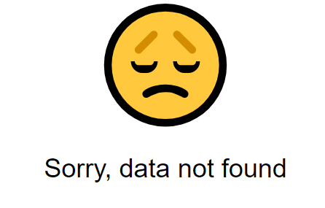

SEARCHING TEMPLATE
Within this module, users have the capability to perform a search for consent forms using various metadata such as name, date, and other relevant information. The search function retrieves and displays the consent form(s) corresponding to the provided metadata. In the event that no consent form matches the search criteria, a "No data found" message will be displayed, indicating the absence of any matching records.

Slide 7
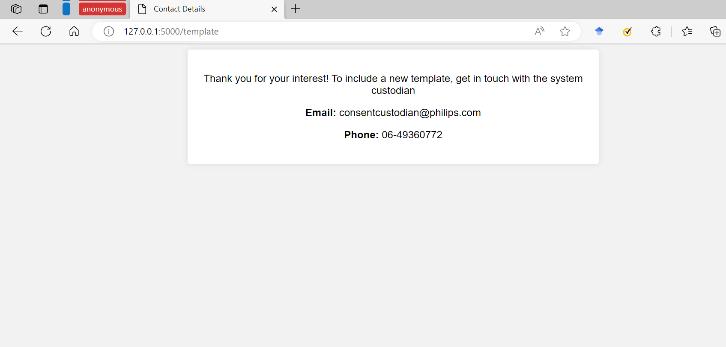
ADD NEW TEMPLATE
If none of the existing templates are suitable for a user's consent form, they are encouraged to reach out to the system custodian. The user can request the creation of a new template tailored to their specific consent form requirements. The system custodian will be able to assist in adding the requested template, ensuring a better fit for future consent form submissions.

Slide 8
UPLOAD CONSENT
Select the consent forms
preprocessing
EasyOCR
Convert the uploaded file
Text match with template
Store the meta data with the image of the consent form

Slide 9
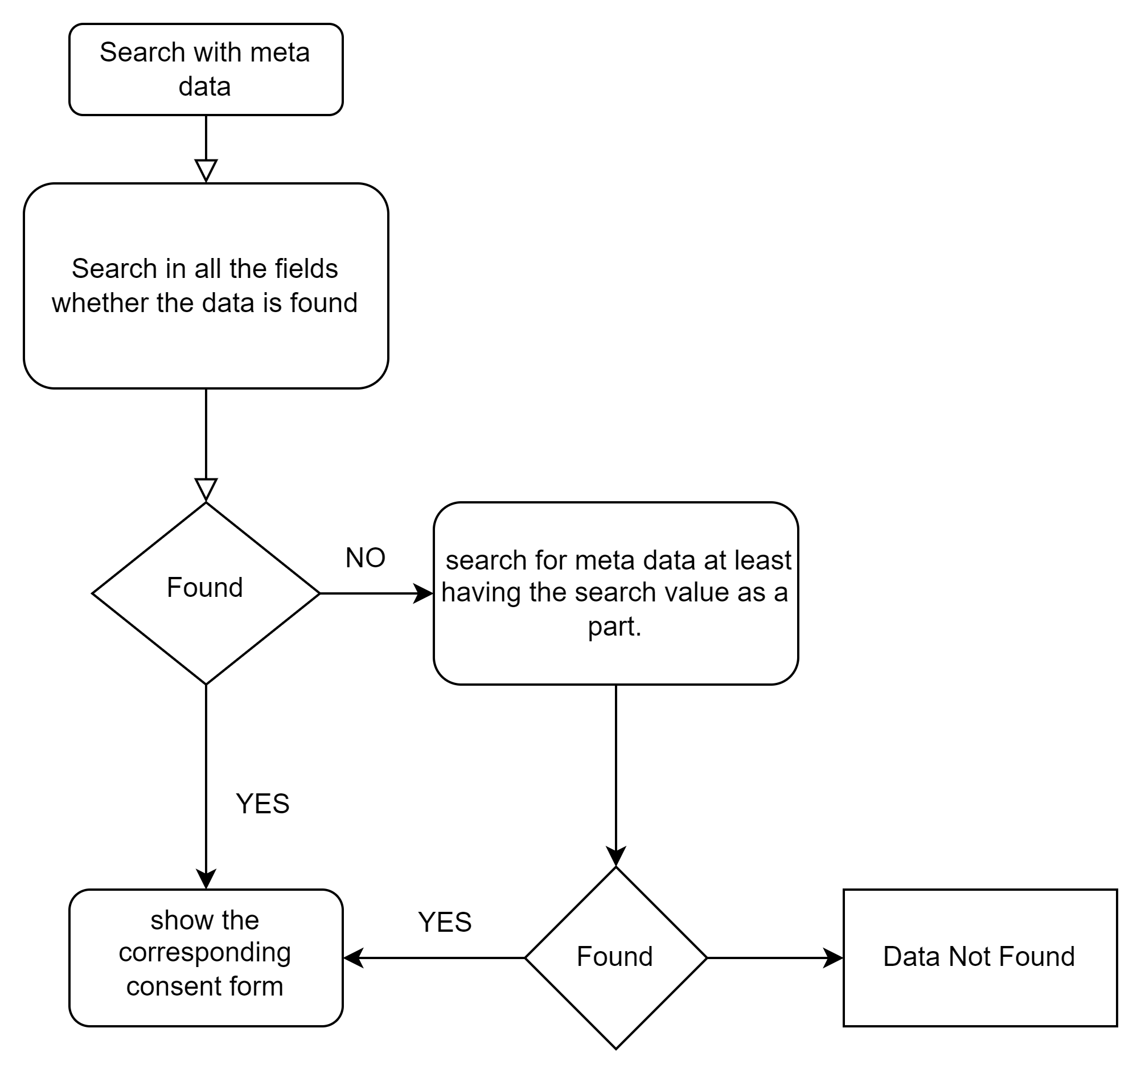
SEARCH CONSENT

Slide 10
UPLOADING CONSENT FORMS
When the user contacted custodian it is redirected to us
EasyOCR
Find the efficient way for the position of the meta data
Discuss with the user what all could be meta data
Write a function and store the function name in a database along with the metadata positions
Assumption

