Slide 1
Create a manifest file for verification job
Sruthi R
07-09-2023

Slide 2
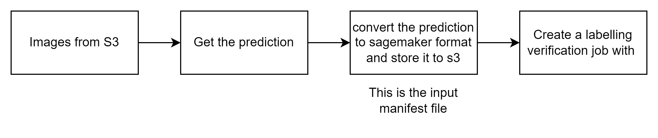
What is My Task?
Write a code, that takes in input -> image s3 file paths and model predictions.
Create a new manifest file for autolabelled verification job in Sagemaker with the input.
After manifest file created write a code which will create a autolabelled verification job in Sagemaker.

Slide 3
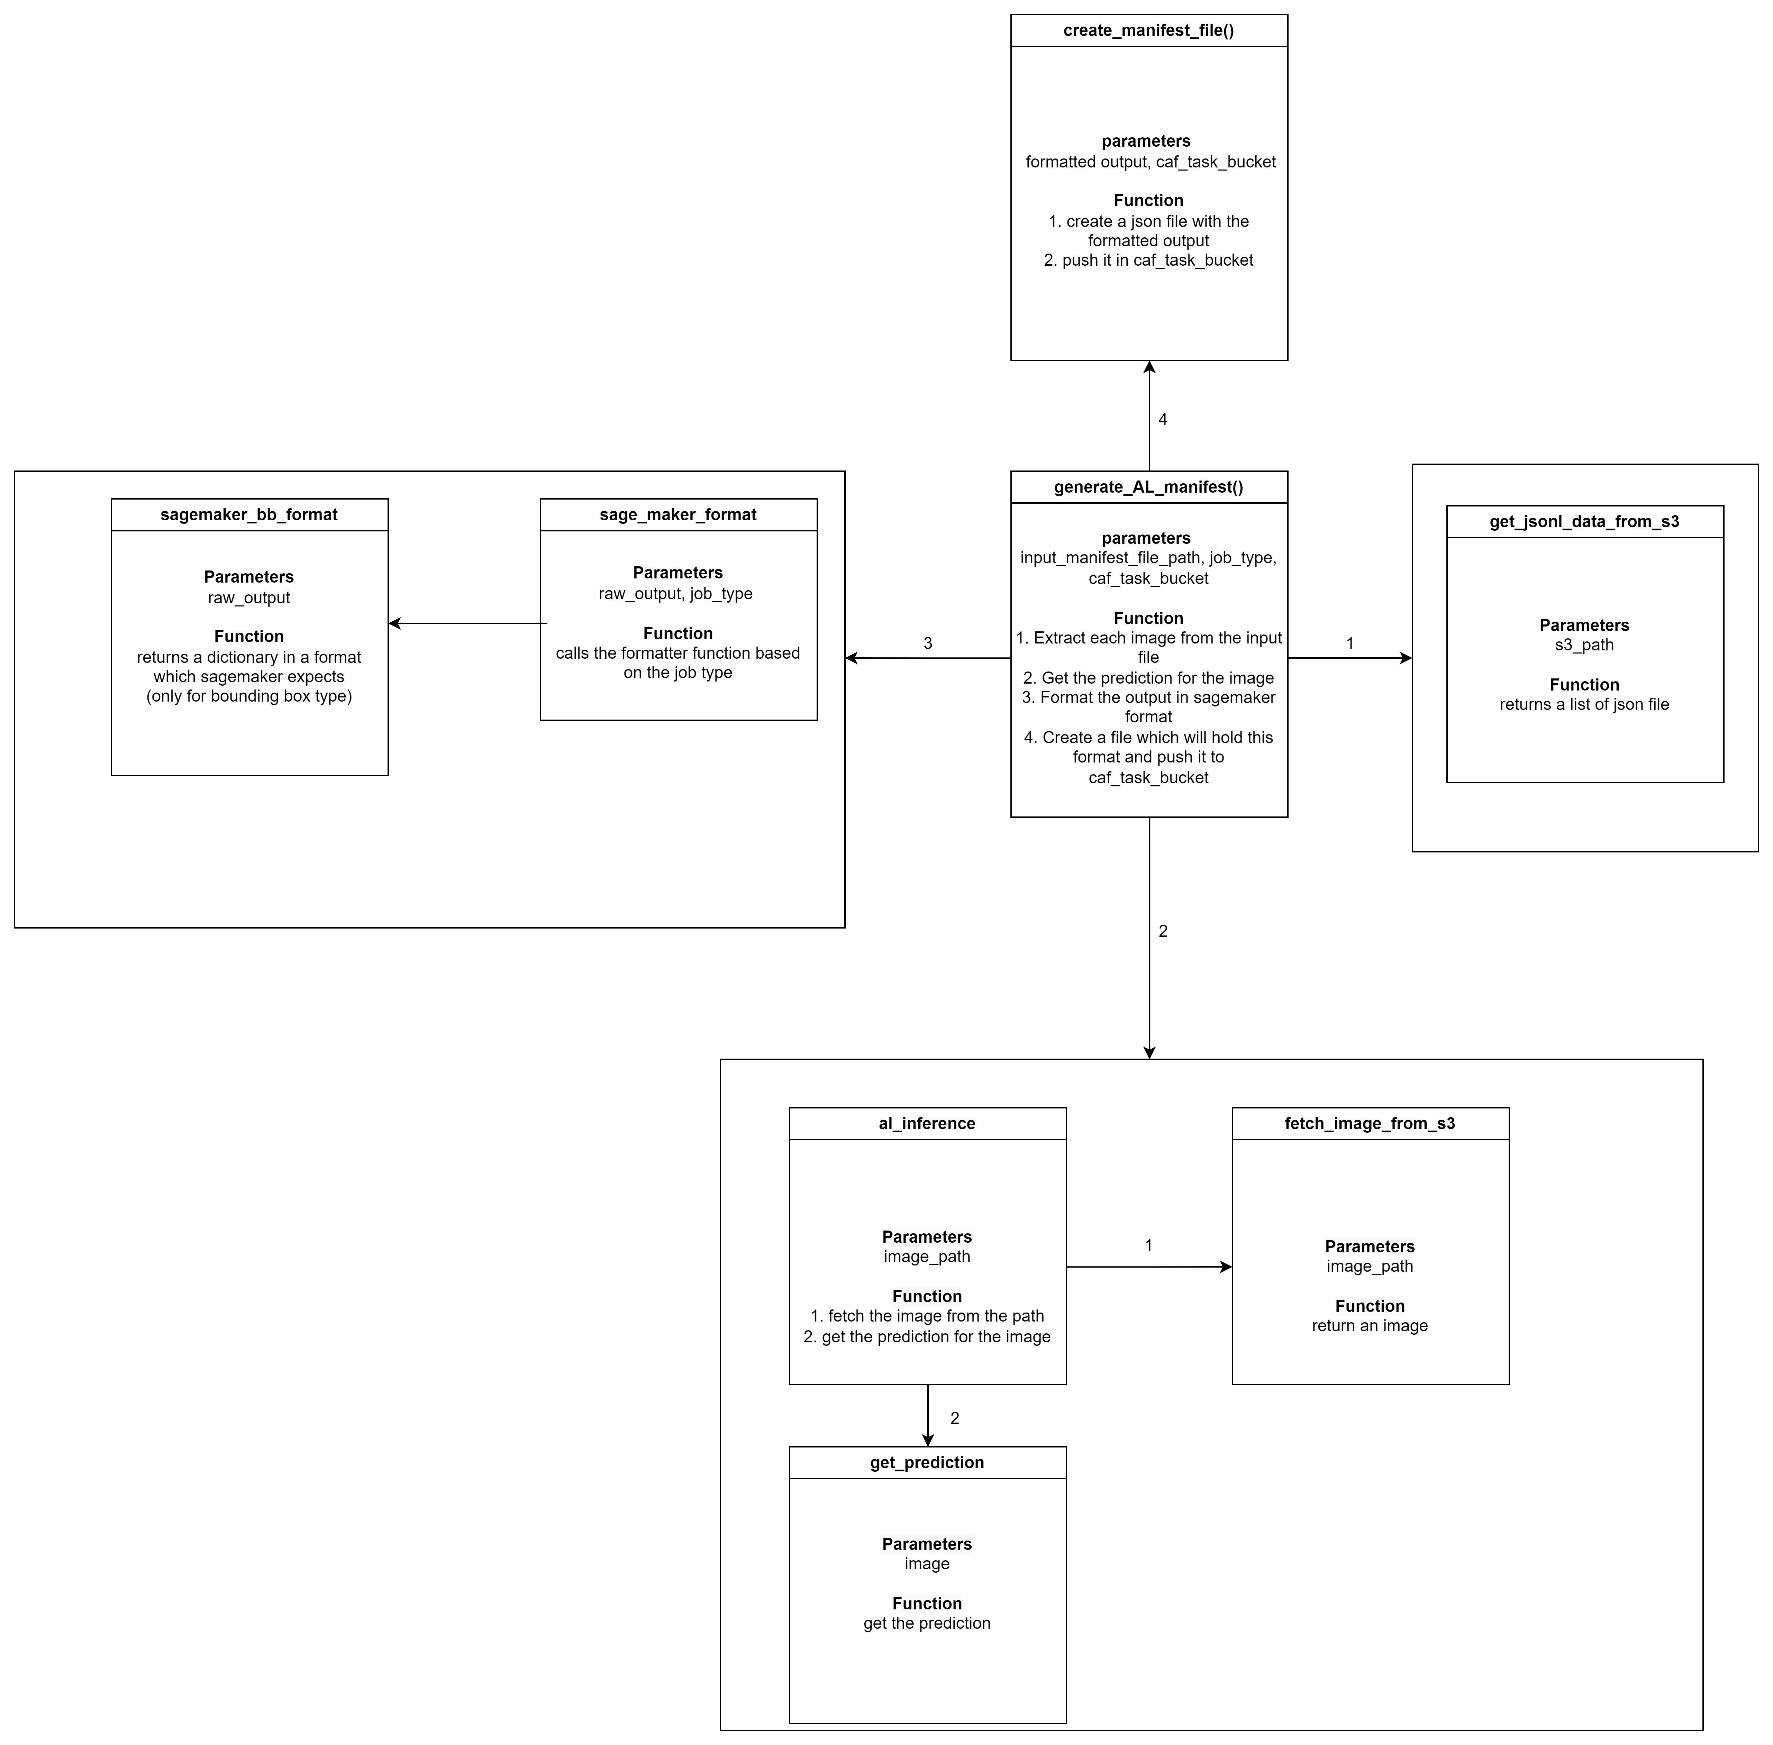
What I did?

Slide 4
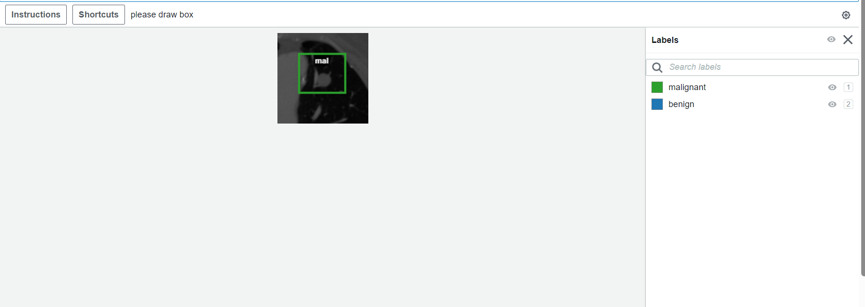
What will be the output?
An API code which will be able to create autolabelling verification job.
Now the work team can view the predicted annotation and make the adjustment needed.

