Slide 1





Slide 2
Question 1
Create a method that takes a string and returns a string in which each character is repeated once.
Examples doubleChar("String") ➞ "SSttrriinngg" doubleChar("Hello World!") ➞ "HHeelllloo WWoorrlldd!!" doubleChar("1234!_ ") ➞ "11223344!!__ " Notes All test cases contain valid strings. Don't worry about spaces, special characters or numbers. They're all considered valid characters.

Slide 3
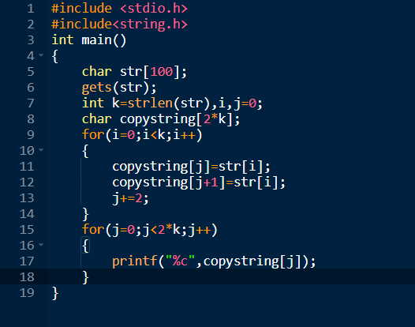
Answer 1

Slide 4
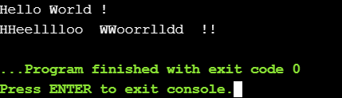
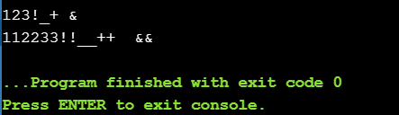
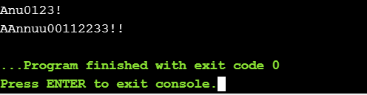
Output

Slide 5
Question 2
Create a method that accepts a string (of a person's first and last name) and returns a string with the first and last name swapped.
Examples nameShuffle("Donald Trump") ➞ "Trump Donald" nameShuffle("Rosie O'Donnell") ➞ "O'Donnell Rosie" nameShuffle("Seymour Butts") ➞ "Butts Seymour" Notes There will be exactly one space between the first and last name.

Slide 6
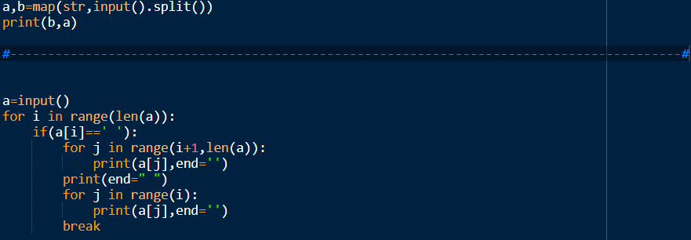
Answer 2

Slide 7


Output

Slide 8
Question 3
Write a function that takes a string as an argument and returns the left most digit in the string.
Examples leftDigit("TrAdE2W1n95!") ➞ 2 leftDigit("V3r1ta$") ➞ 3 leftDigit("U//DertHe1nflu3nC3") ➞ 1 leftDigit("J@v@5cR1PT") ➞ 5 Notes Each string will have at least two numbers.

Slide 9
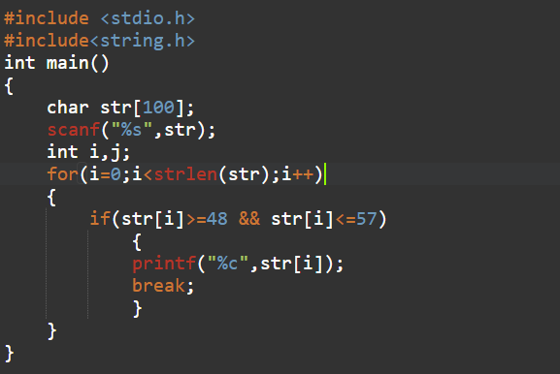
Answer 3

Slide 10
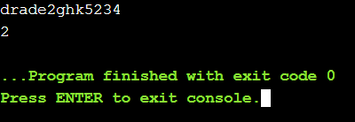
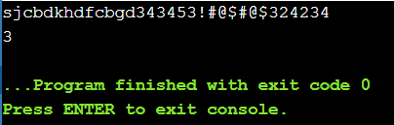
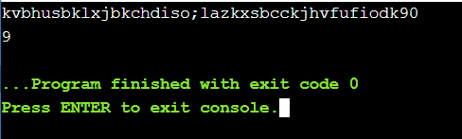
Output

Slide 11
Question 4
Create a function that takes a word and returns true if the word has two consecutive identical letters.
Examples doubleLetters("loop") ➞ true doubleLetters("yummy") ➞ true doubleLetters("orange") ➞ false doubleLetters("munchkin") ➞ false

Slide 12
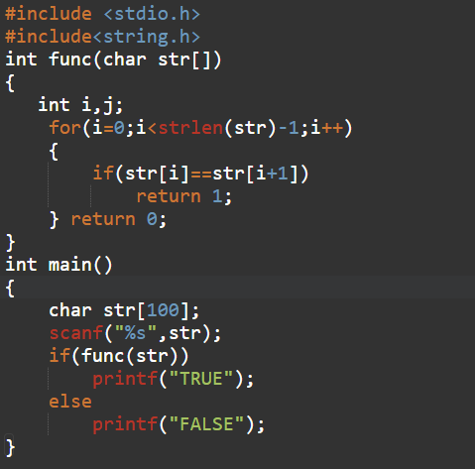
Answer 4

Slide 13
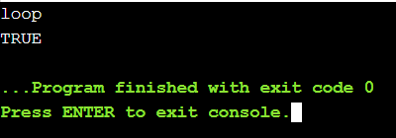
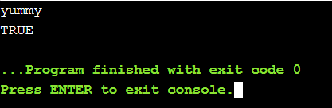
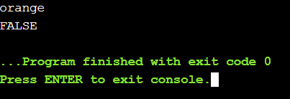
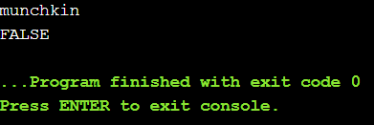
Output

