Slide 1

Tower of hanoi

Slide 2
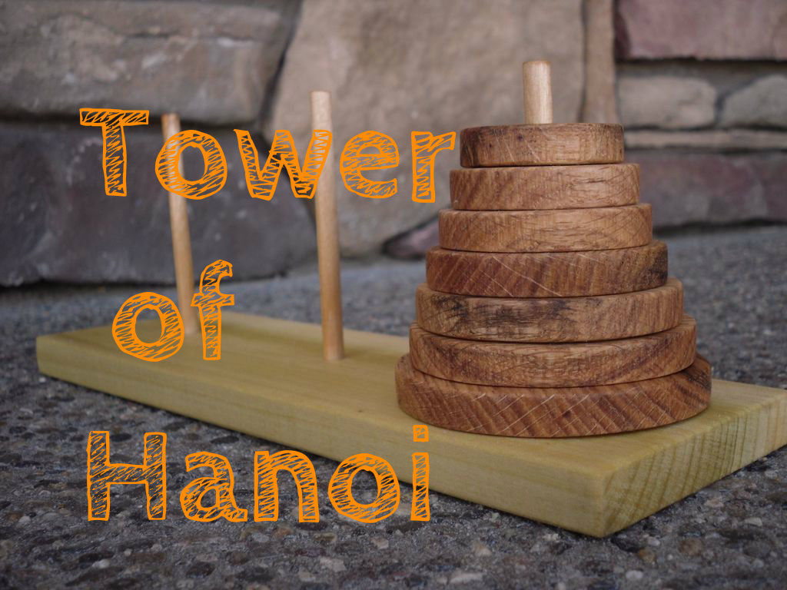
What is tower of hanoi?
Tower of hanoi is a mathematical game or a puzzle.
It has 3 rods and n number of disks each of different sizes.
It is one of the an application of stack

Slide 3
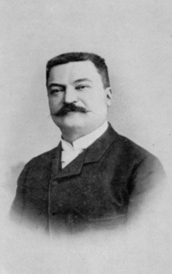
Origin
Name:tower of hanoi
Invented by:Édouard Lucas-a French mathematician
Year:1883

Slide 4
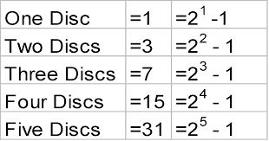
Minimum steps
This puzzle can be played with any number of disks(ie denoted by n).
The minimum number of moves required to solve a Tower of Hanoi puzzle is 2^{n} − 1.
n:number of disks.

Slide 5
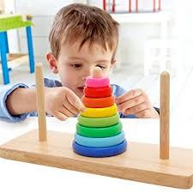
Applications
The main applications of tower of hanoi is
Recursion
Backing up data
Neuropsychologists tests
The online link to play tower of hanoi game is
https://www.mathsisfun.com/games/towerofhanoi.html

Slide 6
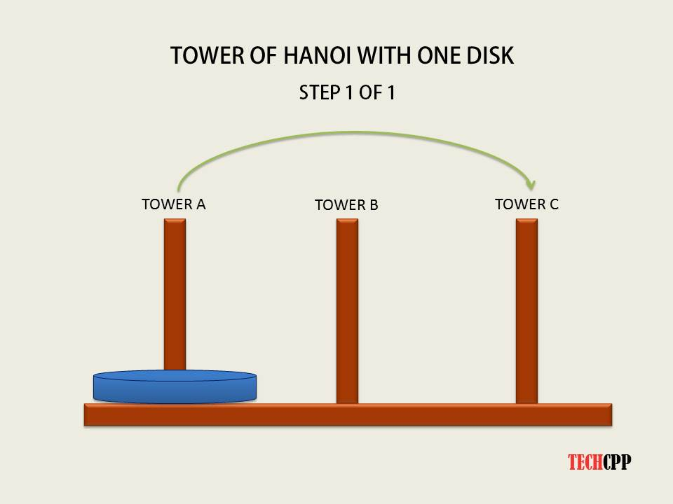
Tower of hanoi using 1 disk

Slide 7
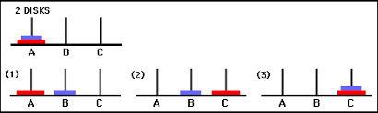
2 disks

Slide 8
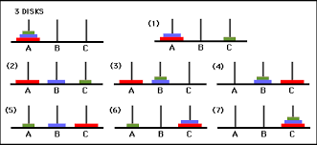
3 disks

Slide 9

Recursive tower of hanoi

Slide 10
3 steps to implement TOH
T(n-1,beg,end,aux)
T(1,beg,aux,end)
T(n-1,aux,beg,end)

Slide 11
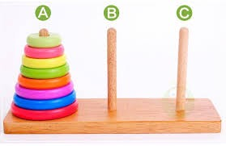
TOH IN QUEUE
DISK 1
DISK 2
DISK 3

Slide 12
TOH IN LINKED LIST

Slide 13
REFERENCE WEBSITES
https://www.geeksforgeeks.org/c-program-for-tower-of-hanoi/
https://www.sanfoundry.com/c-program-tower-of-hanoi-using-recursion/
https://www.tutorialspoint.com/data_structures_algorithms/tower_of_hanoi.htm
https://www.mathsisfun.com/games/towerofhanoi.html

