Slide 1
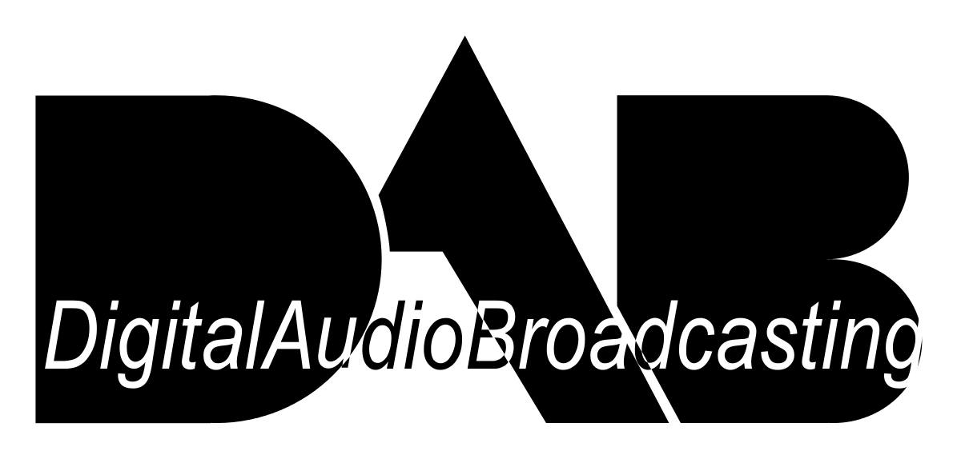
PRESENTED BY,
SRUTHY E
S4B MCA-50

Slide 2
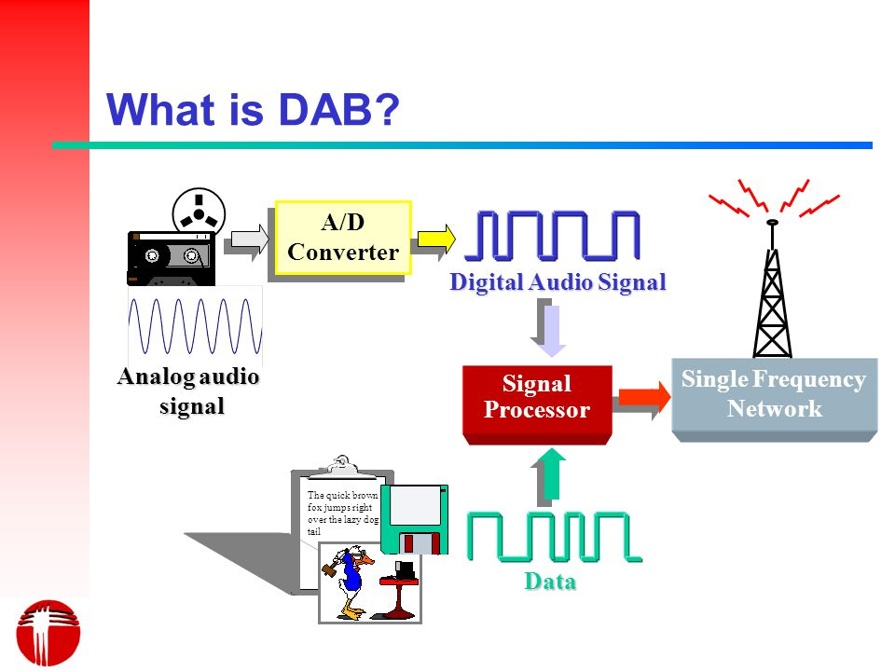
Digital audio broadcasting (DAB) transmits digital signals rather than the analog audio signals traditionally used in broadcast radio. DAB is broadcast on terrestrial networks, with future prospects for satellite broadcasting.

Slide 3
EVOLUTION OF DAB:-
In 1987 the Eureka-147 consoritium was founded. It’s aim was to develop and define the digital broadcast system, which later became known as DAB.
In 1988 the first equipment was assembled for mobile demonstration at the Geneva WARC conference.
By 1990, a small number of test receivers was manufactured.
In 1992, the frequencies of the Large and Small — band were allocated to DAB on a world wide basis.

Slide 4
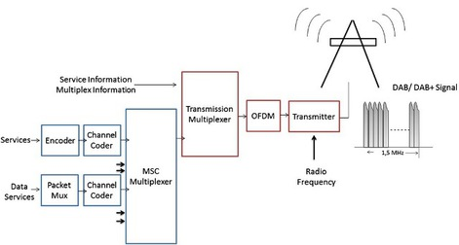
HOW DAB WORKS???
Generation of the DAB Signal

Slide 5
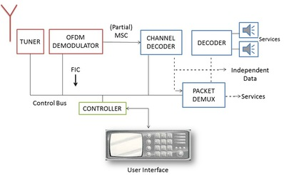
Reception of a DAB signal
The DAB ensemble is selected in the analogue tuner., the digitised output of which is fed to the OFDM demodulator and channel decoder to eliminate transmission errors. The information contained in the FIC is passed to the user interface for service selection and is used to set the receiver appropriately. The MSC data is further processed in an audio decoder to produce the left and right audio signals or in a data decoder (Packet Demux) as appropriate.

Slide 6
ADVANTAGES OF DAB :-
Better quality audio can be obtained.
Digital system requires only low power than regular radio signals.
Error correction is a part of the digital system.
Multipath interference which is the main problem of analog FM is reduced or almost avoided.
Possible for single frequency modulation.
Additional data services

Slide 7
DISADVANTAGES OF DAB :-
Audio quality
Signal delay
Transmission costs
Coverage
Power requirements

Slide 8
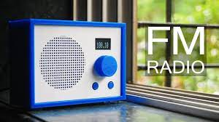
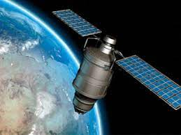
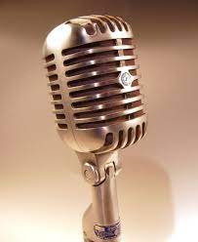
APPLICATIONS:-

Slide 9
THANK YOU…………

