Slide 1
















Digital Portfolio
STUDENT NAME:S.sruthi
REGISTER NO AND NMID:astvu20520524u18036
DEPARTMENT:Computer science
COLLEGE: Indo-American college
UNIVERSITY:Thiruvalluver university
1

Slide 2


PROJECT TITLE
DIGITAL PORTFOLIO
2

Slide 3






AGEND
A
1. Problem Statement
2. Project Overview
3. End Users
4. Tools and Technologies
5. Portfolio design and Layout
6. Features and Functionality
7. Results and Screenshots
8. Conclusion
9. Github Link
3/21/2024AnnualReview
3

Slide 4

PROBLEM
STATEMENT
Many individuals struggle to showcase their skills and projects
effectively using only resumes or social media. To solve this, a
personal portfolio website is needed that highlights personal
details, projects, and contact options in a professional, user-
friendly, and responsive way.
4

Slide 5

PROJECT OVERVIEW
In today’s digital era, having an online presence is essential to showcase
skills and achievements. Traditional resumes and social media profiles
are often limited and fail to present an individual’s work in an engaging
way. A personal portfolio website provides a professional platform to
highlight personal details, projects, and contact information, helping to
create a strong digital identity and better career opportunities.
5

Slide 6

WHO ARE THE END USERS?
Potential employers/recruiters – to evaluate your skills,
projects, and contact you.
Clients – if you plan to do freelancing or project-based work.
Peers, mentors, and collaborators – who may want to view
your work and connect.
General visitors – anyone interested in learning more about
you and your capabilities.
6

Slide 7

.
TOOLS AND TECHNIQUES
•HTML – to create the structure of the website.
•CSS – to design and style the pages.
•JavaScript – to add interactivity, like the contact form.
•Images – used for pro
7

Slide 8
POTFOLIO DESIGN AND LAYOUT
•Home Section – welcome message and introduction.
•About Section – profile photo and personal details.
•Navigation Bar – fixed at the top with links to all sections.
•Projects Section – project cards with images and descriptions.
•Contact Section – contact form for communication.
•Design Style – clean, responsive, and user-friendly with light colors.
8

Slide 9

FEATURES AND FUNCTIONALITY
•Fixed Navigation Bar – easy access to all sections.
•Smooth Scrolling – user-friendly navigation experience.
•About Section – shows profile picture and personal details.
•Projects Section – displays project images with descriptions.
•Contact Form – allows users to send messages easily.
•Success Message – shows confirmation when form is submitted.
•Responsive Design – works on desktop, tablet, and mobile devices.

Slide 10
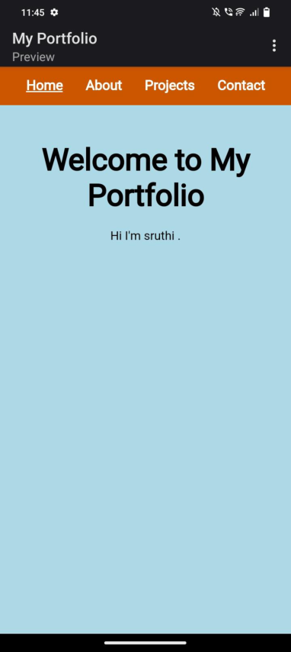
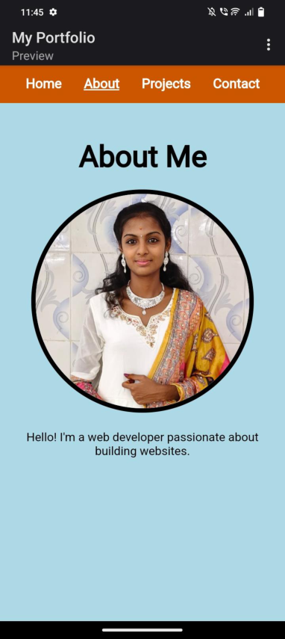

RESULTS AND SCREENSHOTS
3/21/2024AnnualReview
10

Slide 11
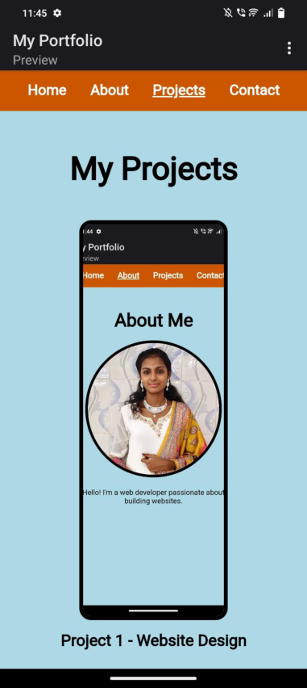
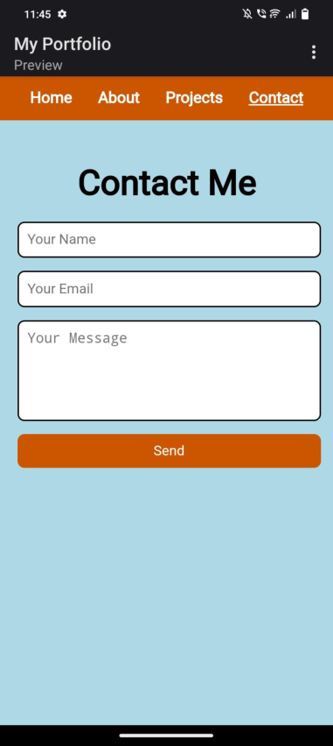

Slide 12

.
CONCLUSION
•Provides smooth navigation with a fixed menu.
•Includes a responsive design for all devices.
•Offers easy communication through the contact form.
•Builds a strong digital presence for career opportunities
11

