Slide 1
SNACK SQUAD:A CUSTOMIZABLE SNACK ORDERING AND DELIVERY APP

Slide 2
PROJECT OBJECTIVES
Develop an intuitive and user-friendly snack ordering application for Android, enabling users to easily browse, select, and place orders for their desired snacks.
Create a secure login and registration system to manage user authentication and enhance the safety of user data.
Facilitate seamless order placement by allowing users to input snack quantity, type of food, and delivery address, ensuring an efficient ordering process.
Incorporate location-based functionality to display popular food options specific to the user's current area, enhancing user engagement and promoting local favorites.
Ensure a modern and visually appealing user interface using XML layouts and Material Design components for smooth navigation and user experience.
Focus on responsive design to make the app adaptable across various screen sizes, ensuring an optimal experience on different Android devices.

Slide 3
FUNCTIONALITIES
User Authentication:
Secure login and registration for user accounts.
Order Placement:
Input for snack type, quantity, and delivery address.
Order confirmation feedback.
Location-Based Recommendations:
Displays popular food items based on the user’s location.
User Interface (UI):
Modern design with easy navigation and a responsive layout.
Input Validation:
Ensures accurate user input with prompts for corrections.
Order Review:
Option to review orders before final confirmation.

Slide 4
DESCRIPTION
The Snack Ordering App is an Android-based mobile application designed to make ordering snacks more efficient and enjoyable. Developed using Android Studio, the app provides a seamless user experience from account creation to placing an order. It offers users a secure and straightforward platform to browse popular snacks, customize their order, and manage delivery information, ensuring convenience at their fingertips.
Core Features:
User Authentication: A secure login and registration system for user data safety.
Order Customization: Users can input snack type, quantity, and delivery address for a personalized experience.
Location-Based Recommendations: Displays the most popular snacks in the user's current area to enhance decision-making.
Modern UI/UX: A user-friendly and responsive interface designed with Material Design for intuitive navigation.
Order Review: Users can confirm and modify orders before final submission to ensure accuracy.

Slide 5
ADDITIONAL REQUIREMENTS
Platform Compatibility: Support Android 5.0 (Lollipop) and above for broader user accessibility.
UI Design: Use Material Design principles for a clean, responsive, and intuitive layout.
Location Services: Integrate location APIs for displaying location-based food recommendations.
Data Storage: Use shared preferences or local storage for user data and order history.
Network Connectivity: Ensure offline functionality for saved data and handle network errors gracefully.
Order Confirmation: Provide visual feedback and notifications for order placement.
Security: Encrypt user passwords and ensure data privacy and protection.
Testing: Conduct thorough device compatibility and user testing.
Performance Optimization: Optimize app for faster load times and smooth performance.

Slide 6
MAINACTIVITY.KT
package com.example.snackordering
import android.annotation.SuppressLint
import android.content.Context
import android.os.Bundle
import android.widget.Toast
import androidx.activity.ComponentActivity
import androidx.activity.compose.setContent
import androidx.annotation.DrawableRes
import androidx.annotation.StringRes
import androidx.compose.foundation.Image
import androidx.compose.foundation.background
import androidx.compose.foundation.layout.*
import androidx.compose.foundation.shape.CircleShape
import androidx.compose.foundation.shape.RoundedCornerShape
import androidx.compose.material.*
import androidx.compose.material.icons.Icons
import androidx.compose.material.icons.filled.*
import androidx.compose.runtime.Composable
import androidx.compose.ui.Alignment

Slide 7
import androidx.compose.ui.Modifier
import androidx.compose.ui.draw.clip
import androidx.compose.ui.graphics.Color
import androidx.compose.foundation.lazy.LazyColumn
import androidx.compose.foundation.lazy.items
class MainPage : ComponentActivity() {
override fun onCreate(savedInstanceState: Bundle?) {
super.onCreate(savedInstanceState)
setContent {
SnackOrderingTheme {
// A surface container using the 'background' color from the theme
Surface(
modifier = Modifier.fillMaxSize(),
color = MaterialTheme.colors.background
) {
FinalView(this)
val context = LocalContext.current
//PopularFoodColumn(context)
}
}
}
}
}

Slide 8
REGISTER ACTIVITY.KT
package com.example.snackordering
import android.icu.text.SimpleDateFormat
import android.os.Bundle
import android.util.Log
import androidx.activity.ComponentActivity
import androidx.activity.compose.setContent
class AdminActivity : ComponentActivity() {
private lateinit var orderDatabaseHelper: OrderDatabaseHelper
override fun onCreate(savedInstanceState: Bundle?) {
super.onCreate(savedInstanceState)
orderDatabaseHelper = OrderDatabaseHelper(this)
setContent {
SnackOrderingTheme {
// A surface container using the 'background' color from the theme
Surface(
modifier = Modifier.fillMaxSize(),
color = MaterialTheme.colors.background
) {
}
}

Slide 9
Log.d("swathi" ,data.toString())
val order = orderDatabaseHelper.getAllOrders()
ListListScopeSample(order)
}
}
}
}
}
fun ListListScopeSample(order: List<Order>) {
Image(
painterResource(id = R.drawable.order), contentDescription = "",
alpha =0.5F,
contentScale = ContentScale.FillHeight)
Text(text = "Order Tracking", modifier = Modifier.padding(top = 24.dp, start = 106.dp, bottom = 24.dp ), color = Color.White, fontSize = 30.sp)
Spacer(modifier = Modifier.height(30.dp))
LazyRow(
modifier = Modifier
.fillMaxSize()
.padding(top = 80.dp),
horizontalArrangement = Arrangement.SpaceBetween
){

Slide 10
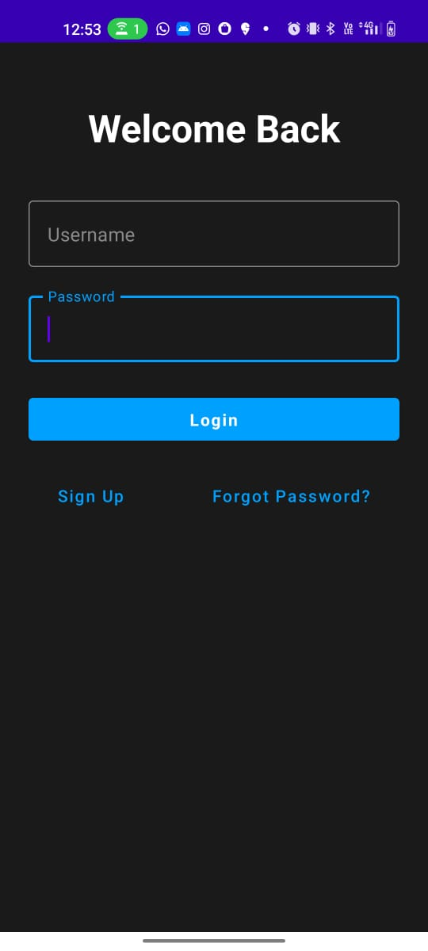
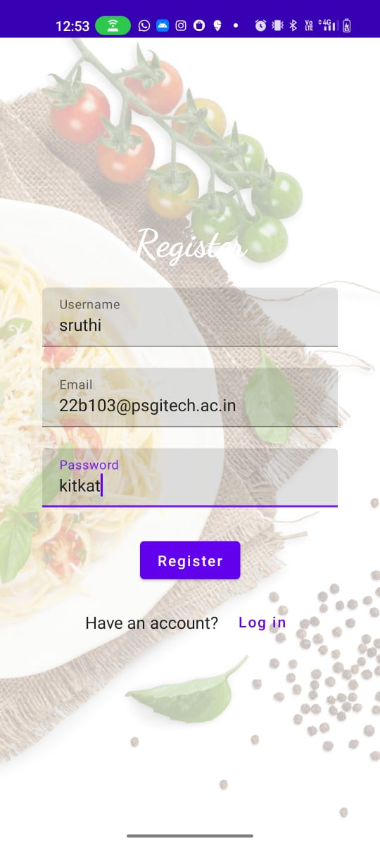
OUTPUT
Fig:1 Login Page Fig:2 Sign up page

Slide 11
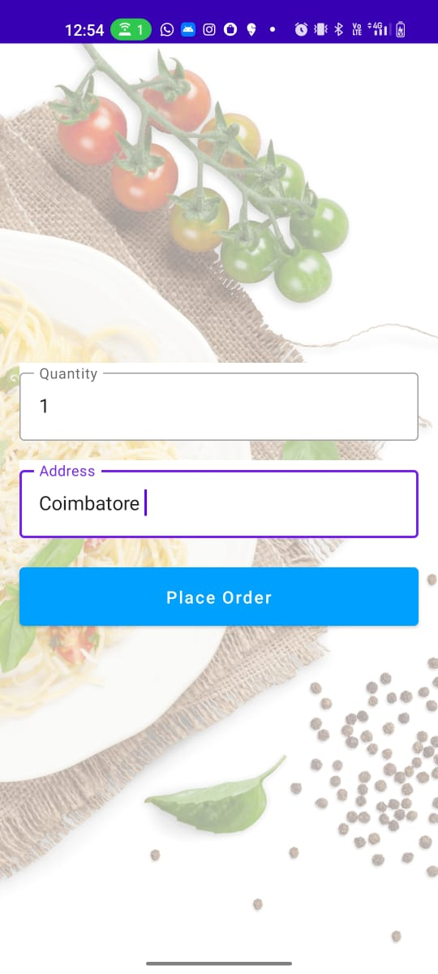
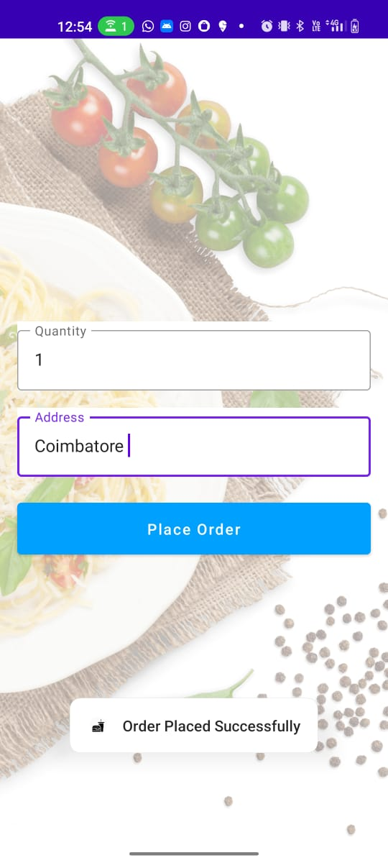
Fig:3 Order Page Fig:4 Order Confirmation Page

Slide 12
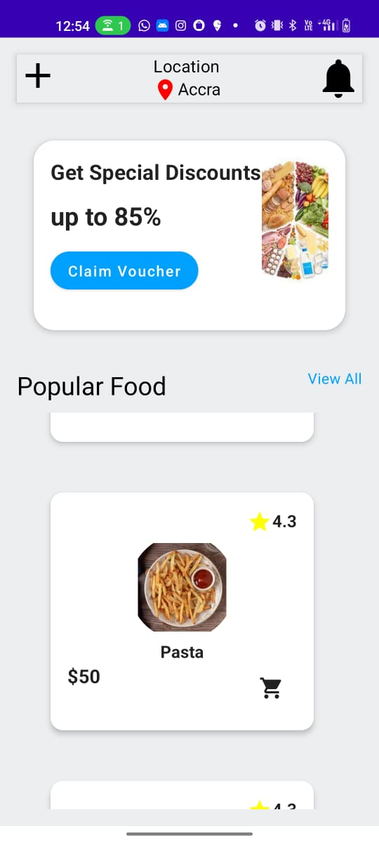
Fig:5 Food Dashboard Page

