Slide 1

ONLINE NEWS POPULARITY
Team Members : Angelin Sorna Swetha, Balaji M,
C G Chandira Prawin, Karthik Raj,
Kazi Tanveer Rehaman, Sruthi P
Mentored by : Mr. Romil Gupta
Batch : DSE JAN2020 – Group 2

Slide 2
INTRODUCTION:
With the rapid growth of online news services and social media, it is very beneficial if we could determine readers’ unseen behavioural patterns.
It is also useful to shed light on reader’s intentions and to predict the popularity of the online news, which means, whether, the online news will receive a significant amount of reader’s attention.
It is important in order to give a pre information to the media workers (authors, advertisers, etc.) to deal with each article according to its popularity without any influence from.
PROBLEM STATEMENT:
We can directly relate online news popularity with the number of shares, number of comments and number of likes of that news that means popularity is directly proportional to number of share, comment and likes.
The aim of this project is to predict the popularity of online articles based on number of shares.
Data set considered:
For this purpose, we have taken a dataset Mashable Inc. — which is considered to be a one-stop shop for social media. This dataset summarises a heterogeneous set of features .

Slide 3
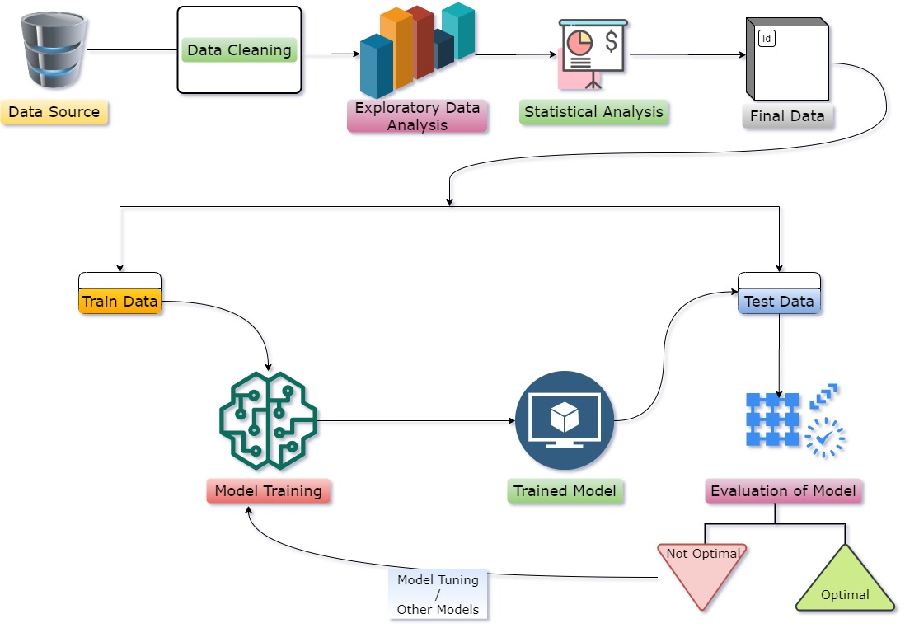
PROCESS FLOW DATASET DESCRIPTION
The dataset required for the analysis contains collection of numerical and categorical features gathered by scrapping ~39,644 articles shared on Mashable website and was obtained from UCI machine learning repository.
These articles were published in the year of 2013 to 2015.
Data url : https://archive.ics.uci.edu/ml/datasets/online+news+popularity
Number of Numerical columns : 59
Number of Categorical columns : 2
Number of records : 39,644
Number of missing values : 0
Target column : Shares

Slide 4
ATTRIBUTE INFORMATION
Aspects | Features
Words | Number of words of the title/content; Average word length; Rate of unique/non-stop words of contents
Links | Number of links; Number of links to other articles in Mashable
Digital Media | Number of images/videos
Publication Time | Day of the week/weekend
Keywords | Number of keywords; Worst/best/average keywords (#shares);
NLP | Closeness to five LDA topics; Title/Text polarity/subjectivity; Rate and polarity of positive/negative words; Absolute subjectivity/polarity level
Target | Number of shares at Mashable
The data set has an attribute ‘url’ which denotes the url of the published news article.
It is ignored for model building. Since, it does not possess any predictive power.
The dataset is already processed and dummified. It has no null and missing values.

Slide 5
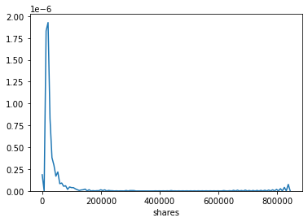
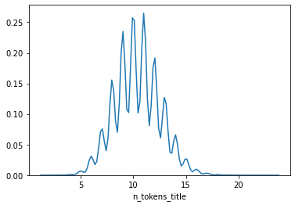
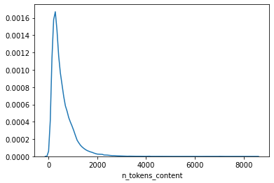
EXPLORATORY DATA ANALYSIS
Univariate Analysis
1.Response Feature(shares)
2.Independent Features
2.1 ‘n_tokens_title’
Maximum number of articles published in Mashable have average of 8 to 12 words in the title.
2.2 ‘n_tokens_content’
Most of the articles on average have content with 0-2000 words.
Shares are highly right skewed.
On average most of the articles have shares between 0 to 200000

Slide 6
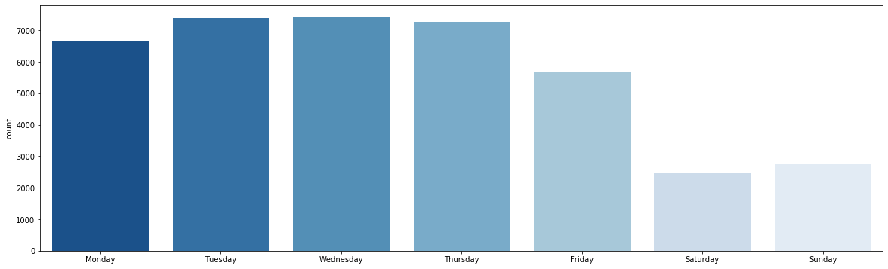
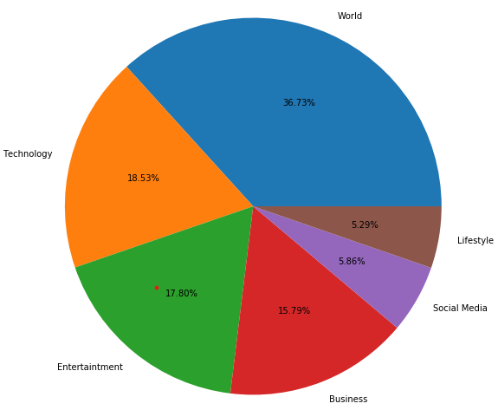
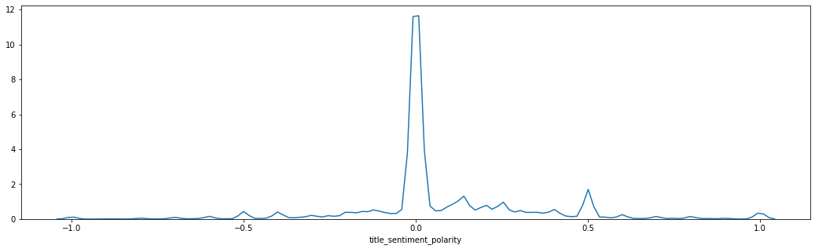
2.3 ‘Publication Time’
Most of the articles are published during weekdays.
During weekends, articles published are less than 3000.
2.4 ‘Data channel’
2.5 ‘title_sentiment_polarity’
World and Technology account for more than 50% of the articles published.
Lifestyle and Social Media have the least number of articles published.
Skewed distribution.
So, neutral sentiment articles are preferred.

Slide 7
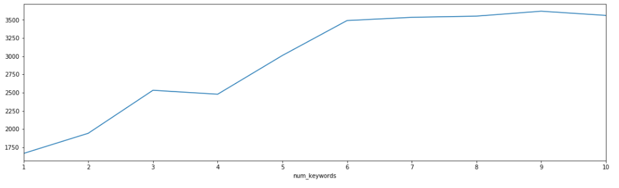
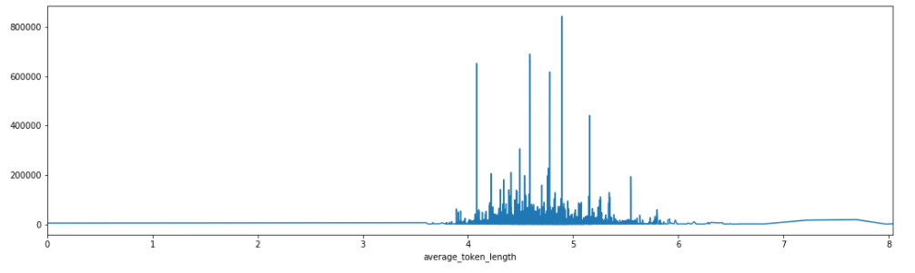
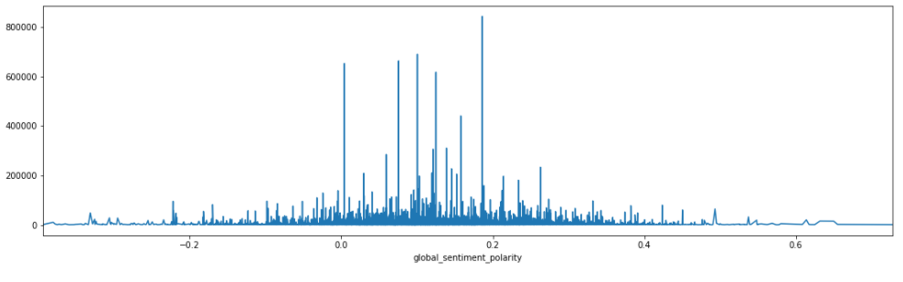
Bivariate Analysis
a. ‘No. of Keywords vs mean Shares’
b. ‘Avg token length vs mean Shares’
c. ‘global sentiment polarity vs mean Shares’
More the keywords in the metadata of the article, more the article is popular(shared more).
We can clearly see that the mean `shares` spikes more at the level of 4-6 length of words.
People prefer to share articles which are generally positive or neutral.

Slide 8
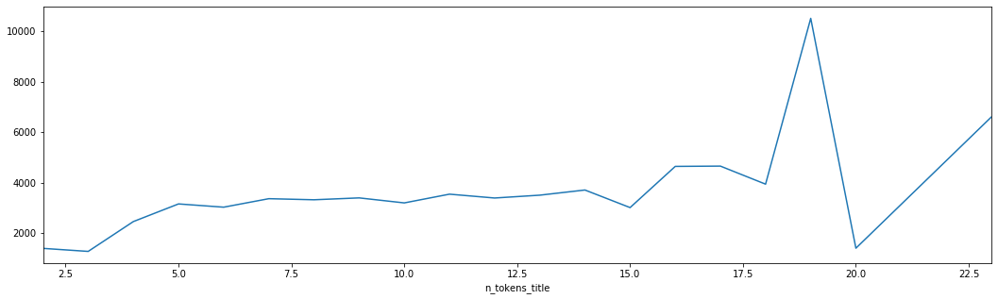
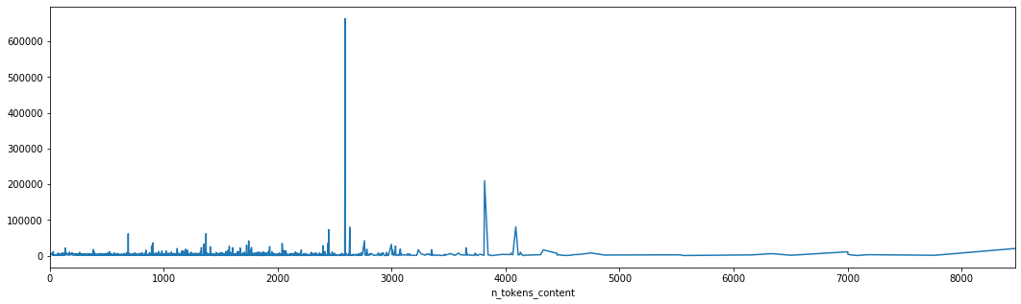
d. ‘No of title token’ vs mean shares’
e. ‘No. of content tokens vs mean shares’
The articles which contains 18-19 words in the title have received the maximum amount of shares.
Longer the article length, lesser is the share. Articles having 2000 to 4000 words are most popular and shared.

Slide 9
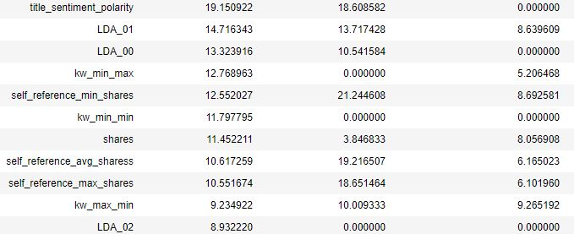
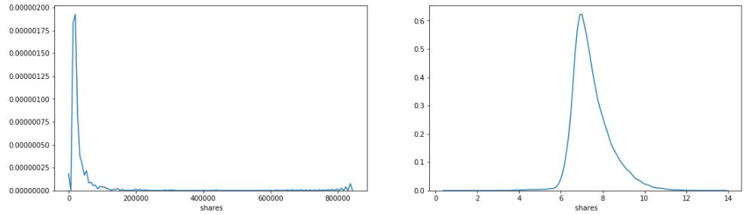
Outlier Treatment
Checking the outlier percentage of all the columns in the dataset by the Inter Quartile Range method.
By using the Square Root transformation and Log(X+1) transformation, we can reduce the outliers to a certain level.
Whichever transformation gives the best effective reduction in outliers, that is applied to that column or if both doesn’t have that much effect in reducing the outliers, the function checks whether removal of those rows can be effective and whether there is huge loss of data (>5%) if the rows are dropped.
Target column Before Treating
Percent: above 11
Target Column After Treating
Percent: below 4

Slide 10
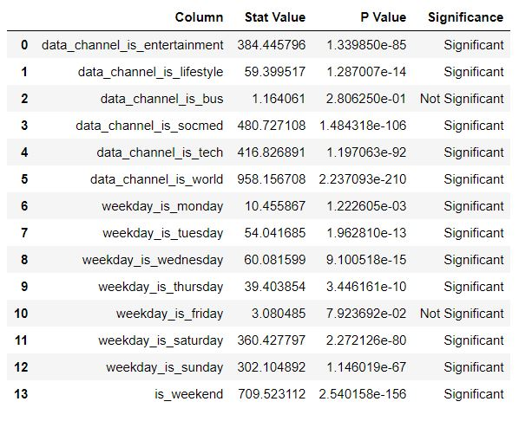
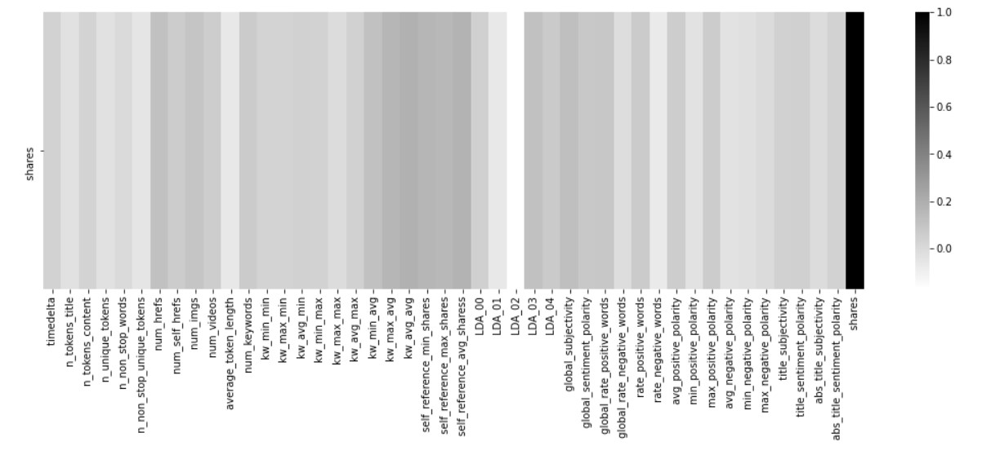
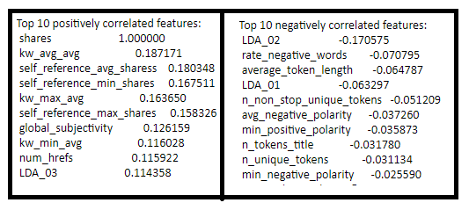
STATISTICAL ANALYSISEL
Statistical Significance Of Independent Variables
Continuous features: Categorical features:

Slide 11

BASE MODEL
The dataset was split into Train and Test such as 70% and 30% of total dataset for train and test respectively.
We applied OLS (Ordinary Least Squares) model initially to understand the performance of the base model.
We got R-square value of 0.141 for the base OLS model and MSE value of 0.709 and 0.6 for test and train data respectively
Assumption of Linear Regression:
Linearity – Residuals follow Linearity.
Normality – No Normality in the residuals of the model.
Homoscedasticity – Variance is found to be uniform and it is homoscedastic.
No Auto-correlation – Durbin-Watson test proved that there is positive correlation.
No Multi-collinearity – High multi-collinearity in the columns is observed.

Slide 12
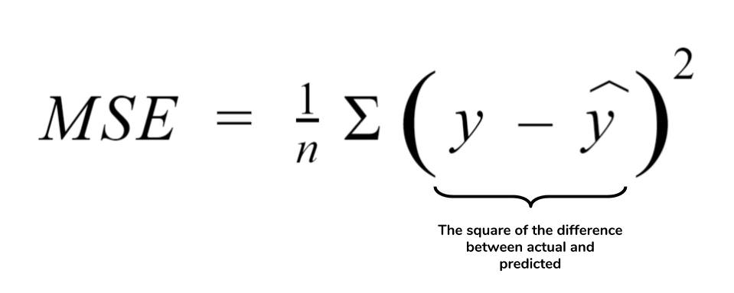
PROPOSED MODELS
Now that we have our dataset prepared and features treated for outliers and false values, we applied some non-linear models with cross-validation to get a baseline understanding of how our models perform and which model perform well on the data.
Models used :
DecisionTreeRegressor
RandomForestRegressor
KNeighborsRegressor
AdaBoostRegressor
BaggingRegressor
GradientBoostingRegressor
XGBRegressor
LGBMRegressor
SVR
MODEL EVALUATION
Metric used : mean squared error.
The mean squared error (MSE) of an estimator measures the average of the squares of the errors—that is, the average squared difference between the estimated values and the actual value.
The mathematical equation that will give us the mean squared error is,
Where:
n-no. of observations
y-actual value of y
y’-predicted value of y

Slide 13
By comparing the MSE scores of various models in both Train and test set, we identified that XGBoost model (even without tuning) was better than others as it gave the least MSE value.
MODEL EVALUATION

Slide 14
XGBoost Model
XGBoost is an implementation of gradient boosted decision trees designed for speed and performance.
XGBoost stands for extreme Gradient Boosting.
Before Tuning:
Best Parameters from Randomized Search CV with 7 folds:
After Tuning:

Slide 15
CONCLUSION
Number of Keywords and images can be increased from mean value
Words in the title between should be in the range of 8 to 12.
Words in the content should be between 2500 to 4000.
Global Sentiment somewhere between neutral to positive polarity.
Articles with positive and neutral words in the content and title are preferred by readers.
We can see that none of the features greatly impact the target variable. In fact, the highest correlated value is only 0.18.
Various other variables on the reader’s front such as reader demographics, socio-economic features such as Age, Income, Location, Career and time period relevance of the article’s news gives better reader/customer segmentation and further help us in understanding and predicting the shares better.
*All the inferences are based on this model and dataset

Slide 16
THANK YOU !

