Slide 1
Healthcare Analytics II
Analytics Vidhya Hackathon about Healthcare Analytics
GROUP 11
Sruthi Mallarapu ID:015355405
Yixin Huang ID: 014561690
Jingwen Shi ID:015254057
Nataliya Sobol ID: 014634477
Minh-Tam Pham ID: 015403518

Slide 2
Agenda
Introduction
Data exploration and transformation
Model training & Prediction
Tuning
Evaluate models
Conclusion
Lessons learned
Difficulties Met

Slide 3
Introduction
Covid-19 pandemic has adversely affected the Healthcare Industry and is time to optimize it.
Health Care Management has many aspects and among them length of stay of patients (LOS) is the critical parameter.
Predicting LOS of patients can help the hospital management to optimize the resources allocation and provide better treatment.

Slide 4
Data Exploration & Transformation

Slide 5
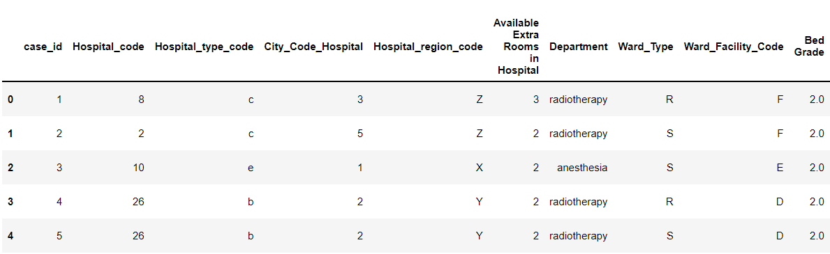
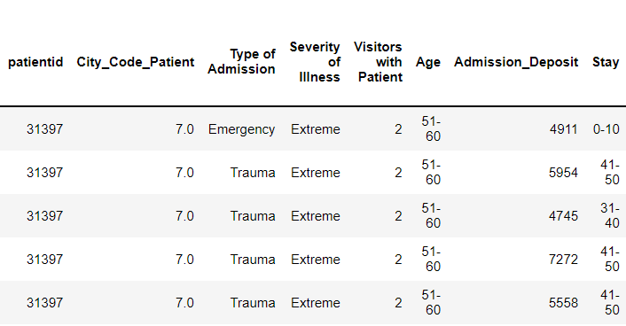
Data Exploration
original dataset
Target column

Slide 6
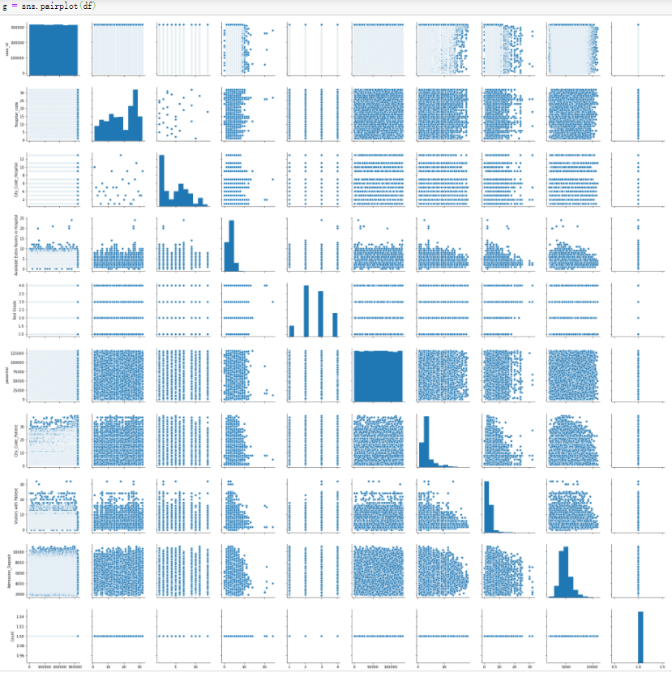
Checked the distribution of each feature
Checked the outliers of each feature
Checked the relationship between each two features

Slide 7
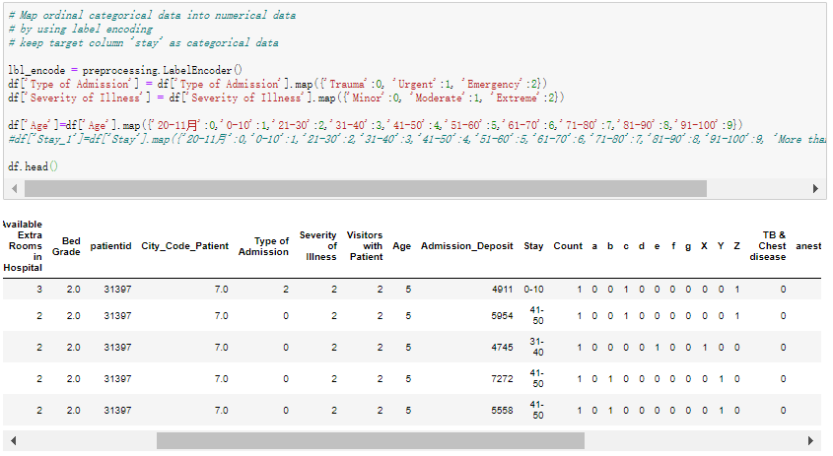
Data Transformation
Label encoding
for
ordinal columns
Label encoding
Dummy encoding

Slide 8
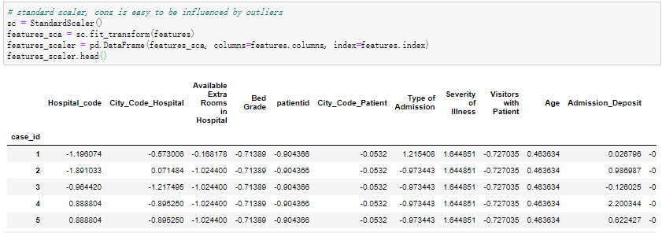
Data Scaling
Scale all the data
-1 to 1

Slide 9
Model Training & Prediction

Slide 10
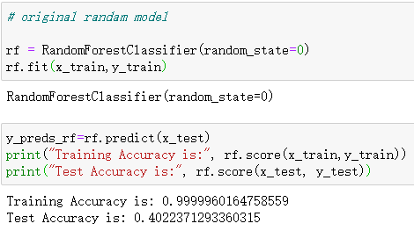
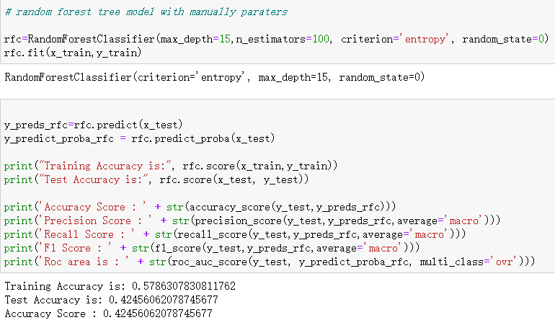
Random Forest Trees Model
Original model
Manual setting model

Slide 11
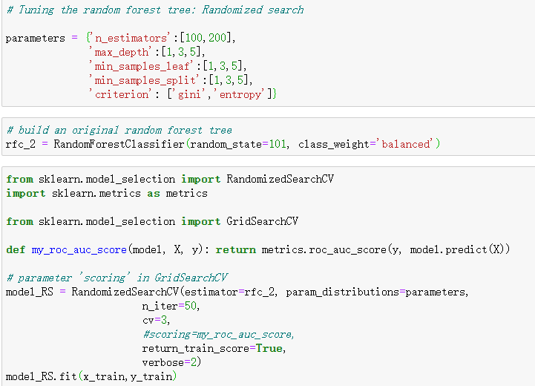
Tuning:
Randomized Search

Slide 12
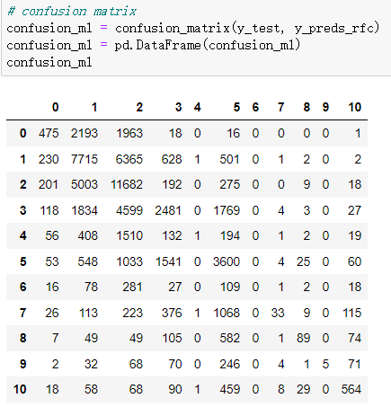
Evaluation:
Confusion Matrix

Slide 13
Model Performance
Model Settings | Accuracy | Precision | Recall | F1 | ROC
default setting | 0.4023 | 0.3730 | 0.2583 | 0.2765 | 0.8003
manual setting | 0.4245 | 0.4564 | 0.2347 | 0.2371 | 0.8000
manual setting + random grid search | 0.3820 | 0.1371 | 0.1574 | 0.1399

Slide 14
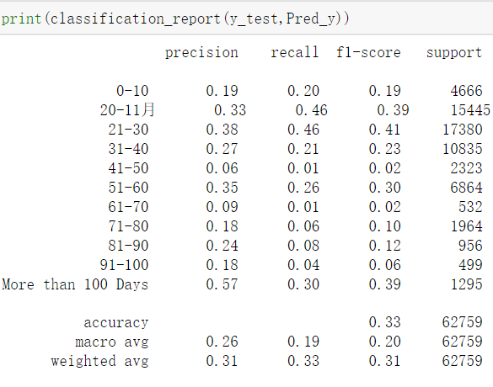
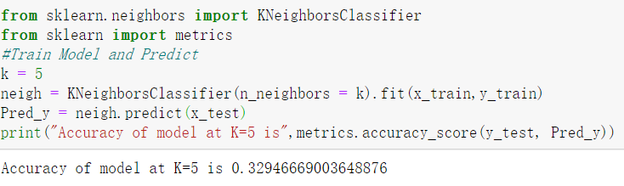
KNN Model
Evaluation
Original model with K=5

Slide 15
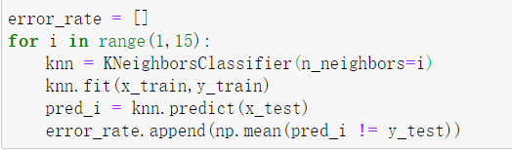
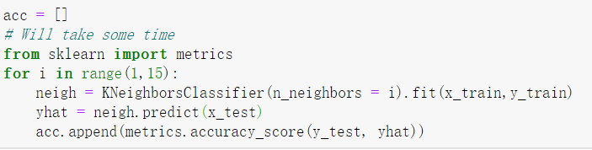
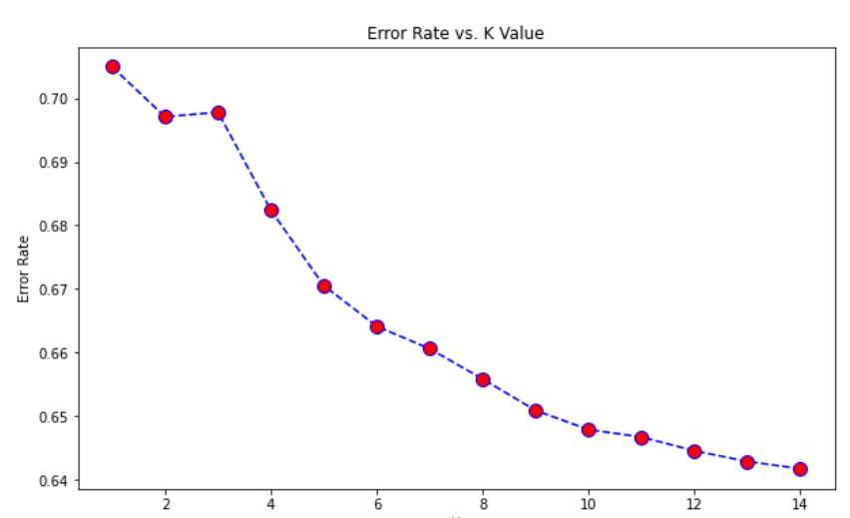
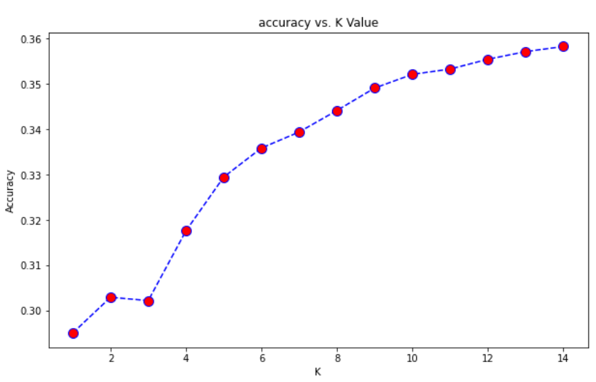
Tuning:
Find optimal K

Slide 16
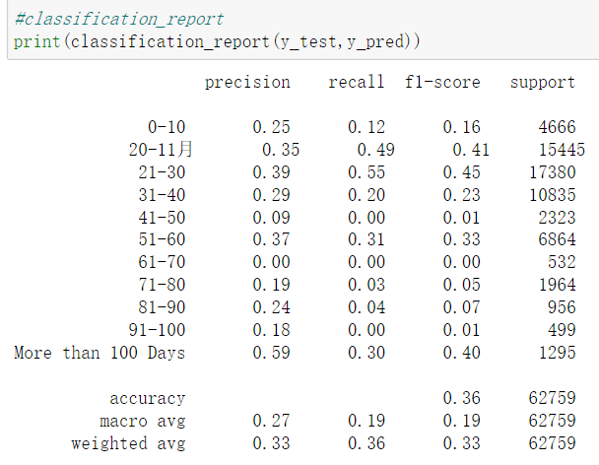
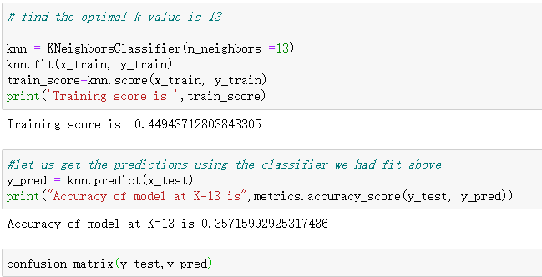
Evaluation
Tuning model with K=13

Slide 17
Model Performance
Model Settings | Accuracy | Precision | Recall | F1 | ROC
default model | 0.4023 | 0.3730 | 0.2583 | 0.2765 | 0.8003
manual setting | 0.4245 | 0.4564 | 0.2347 | 0.2371 | 0.8000
manual setting + random grid search | 0.3820 | 0.1371 | 0.1574 | 0.1399
Default model | 0.33 | 0.26 | 0.19 | 0.2
manual setting With K=13 | 0.36 | 0.27 | 0.19 | 0.19
Random forest trees
KNN

Slide 18
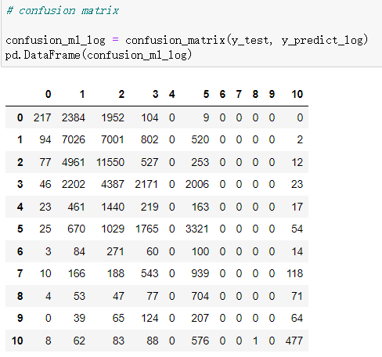
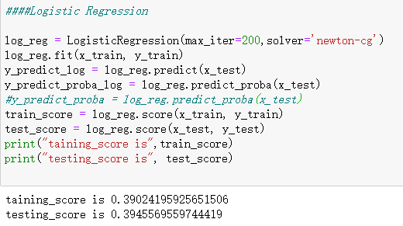
Logistic Regression Model
Confusion Matrix
Original model

Slide 19
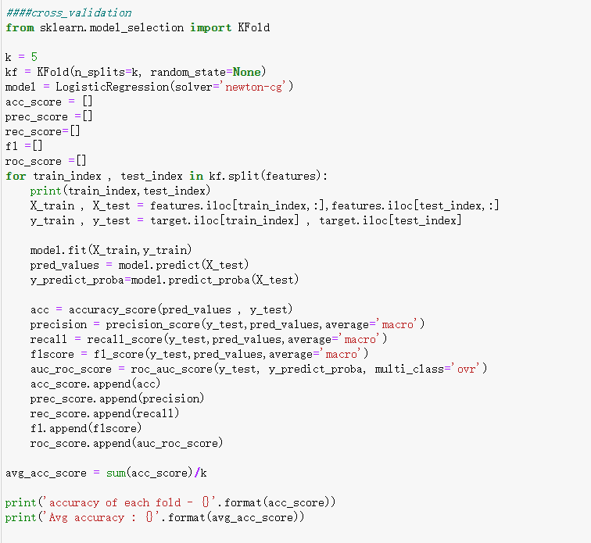
Tuning:
Cross Validation

Slide 20
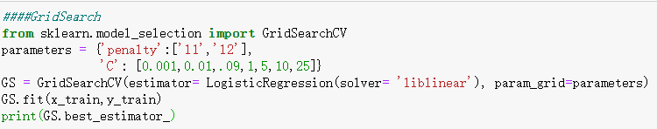
Tuning:
Grid Search

Slide 21
Model Performance
Model Settings | Accuracy | Precision | Recall | F1 | ROC
default model | 0.4023 | 0.3730 | 0.2583 | 0.2765 | 0.8003
manual setting | 0.4245 | 0.4564 | 0.2347 | 0.2371 | 0.8000
manual setting + random grid search | 0.3820 | 0.1371 | 0.1574 | 0.1399
Default model | 0.33 | 0.26 | 0.19 | 0.2
manual setting With K=13 | 0.36 | 0.27 | 0.19 | 0.19
Default model | 0.3946 | 0.2273 | 0.2017 | 0.1937 | 0.7615
Default model + Cross validation | 0.38 | 0.2185 | 0.095 | 0.08 | 0.7414
Default model + Grid Search
Random forest trees
KNN
Logistic
Regression

Slide 22
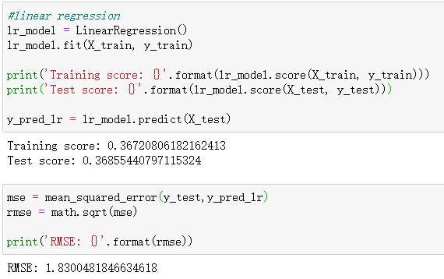
Linear Regression Model
Original model

Slide 23
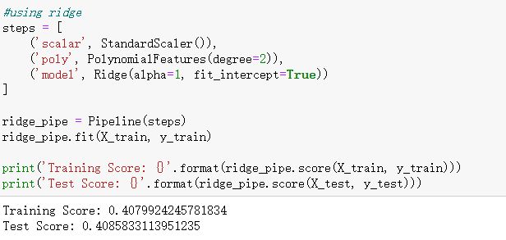
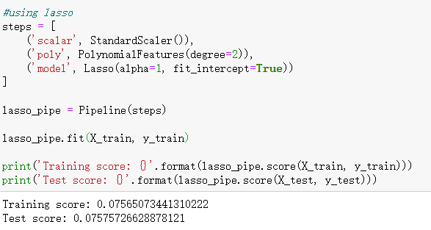
Ridge Regularization
Lasso Regularization

Slide 24
Model Performance
Model Settings | Accuracy | Precision | Recall | F1 | ROC
default model | 0.4023 | 0.3730 | 0.2583 | 0.2765 | 0.8003
manual setting | 0.4245 | 0.4564 | 0.2347 | 0.2371 | 0.8000
manual setting + random grid search | 0.3820 | 0.1371 | 0.1574 | 0.1399
Default model | 0.33 | 0.26 | 0.19 | 0.2
manual setting With K=13 | 0.36 | 0.27 | 0.19 | 0.19
Default model | 0.3946 | 0.2273 | 0.2017 | 0.1937 | 0.7615
Default model + Cross validation | 0.38 | 0.2185 | 0.095 | 0.08 | 0.7414
Default model + Grid Search | 0.37 | 0.20 | 0.08 | 0.07 | 0.71
Default model | 0.3685
Default model + Regularization | 0.4086
Random forest trees
KNN
Logistic
Regression
Linear
Regression

Slide 25
Conclusion
&
Lessons Learned

Slide 26
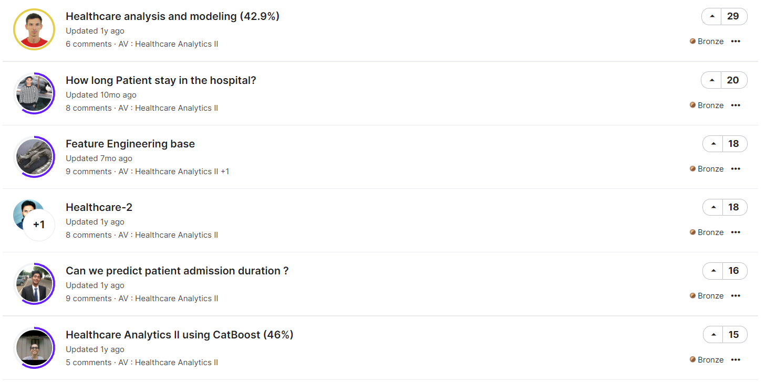
Result compared to Kaggle’s

Slide 27
Conclusion
Random Forest > Logistic Regression > KNN > Linear Regression
However, all the scores are not good enough by surpassing 0.5, we guess the main reason is that too many categories are included in the target
Fine tuning the hyperparameters and Grid search has not significantly improved the model performance

Slide 28
Lessons Learned
Explored the machine learning algorithms namely Random forest tree,
K Nearest Neighbors, linear regression and logistic regression in python.
Explored different techniques like k fold cross validation, fine tuning the hyper parameters of machine learning models to improve the accuracy of the model.
Explored the one-hot encoding technique for converting categorical features into numerical features.
Explored Gridsearch and Random Search methods to find the optimal hyperparameters for the machine learning model.
Explored different Evaluation Metrics for each machine learning model and evaluated the model.

Slide 29
Difficulties Met
There are many categoricals variables and hence can result in too many dummy variables. This will increase the complexity and slow down the calculating speed of our models
Tuning Parameters and performing Grid Search is Memory intensive and Time consuming Process

Slide 30
References
[1] Stephenie C. Lemon, Jason Roy, Melissa A. Clark, Peter D. Friedmann, William Rakowski, “Classification and regression tree analysis in public health: Methodological review and comparison with logistic regression”, 2003, 26:172–181. DOI: https://link.springer.com/article/10.1207%2FS15324796ABM2603_02
[2] Osisanwo F.Y., Akinsola J.E.T. , Awodele O., Hinmikaiye J. O., Olakanmi O., Akinjobi J., “Supervised Machine Learning Algorithms: Classification and Comparison”, International Journal of Computer Trends and Technology (IJCTT) – Volume 48 Number 3 June 2017. DOI:
https://www.researchgate.net/profile/J-E-T-Akinsola/publication/318338750_Supervised_Machine_Learning_Algorithms_Classification_and_Comparison/links/596481dd0f7e9b819497e265/Supervised-Machine-Learning-Algorithms-Classification-and-Comparison.pdf
[3] R. Williams Batista and R. Sanchez-Arias, "A Methodology for Estimating Hospital Intensive Care Unit Length of Stay Using Novel Machine Learning Tools," 2020 19th IEEE International Conference on Machine Learning and Applications (ICMLA), 2020, pp. 827-832. DOI:https://ieeexplore-ieee-org.libaccess.sjlibrary.org/document/9356186
[4] Vucenovic, A., Ali-Ozkan, O., Ekwempe, C., & Eren, O. (2020). Explainable AI in decision support systems : A case study: Predicting hospital readmission within 30 Days of discharge. 2020 IEEE Canadian Conference on Electrical and Computer Engineering (CCECE). https://doi.org/10.1109/ccece47787.2020.9255721
[5] Fei Ma; Limin Yu; Lishan Ye; David D. Yao; Weifen Zhuang (2020), Length-of-Stay Prediction for Pediatric Patients With Respiratory Diseases Using Decision Tree Methods. Published in: IEEE Journal of Biomedical and Health Informatics ( Volume: 24, Issue: 9, Sept. 2020)

Slide 31
Questions?

Slide 32
Thankyou!!!

