Slide 1

DATALUATION
DATA 228
PROJECT
NYC TAXI & BIKE DATA ANALYSIS
TEAM
Abinaya Seshadre
Neelima Jagtap
Rishikumar Ravichandran
Sruthi Mallarapu
GUIDE
PROFESSOR ANDREW BOND

Slide 2
SJSU News
Exam week for graduates is beginning
Vaccine is mandatory for in-person classes
SJSU Joins National Alliance to Redesign the Future of Higher Education

Slide 3
Flash News
Immersive fall learning with
Professor Andrew Bond
Data 230 – Data Visualization – Professor Bond
Data 245 – Machine Learning – Professor Bond

Slide 4
Agenda
Motivation
Requirements gathering
Implementation
Demo
Conclusion

Slide 5
Motivation
Why this data? Why NYC?
Rich dataset
NYC Visit!!
Data Sources
1. New York Yellow Taxi data
Rows : 26.6 Million
Duration : March 2019 - May 2019 and March 2020 - May 2020
2. Citi bike data
Rows : 5.01Million
Duration : March 2019 - May 2019

Slide 6
Requirements Gathering
Our planning
Decisions
Probing the internet for open datasets
Discussed about our goals and requirement of the project
Chose the datasets
Chose tools
Chose our methodology
Class lectures, homework and online resources were most helpful
AWS services
Combined analysis of Citi bike and Taxi data in NYC
NYC TLC Data Analysis for insights on peak hour, areas and times of services

Slide 7
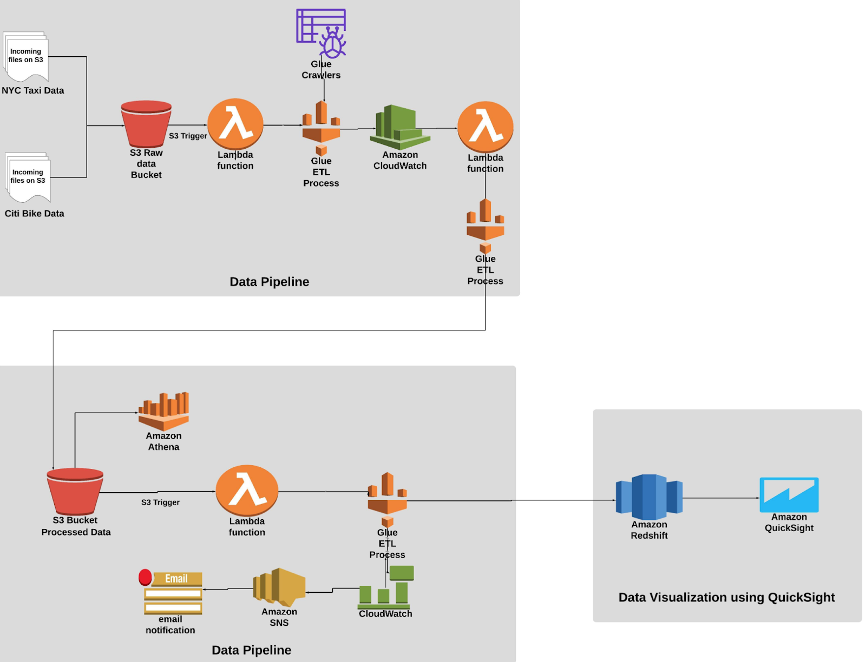
Implementation

Slide 8
Process Overview
● Imported Data to S3 buckets using AWS CLI.
● Created a S3 Trigger that invoked the Lambda function which crawls the data in S3.
● Created Cloud Watch Event that triggers another Lambda function which perform the
ETL job and stores the processed data in S3.
● Created a S3 Trigger in processed bucket that invoked the Lambda function that
performed the ETL job of transferring processed data from S3 to Redshift.
● Created Cloud Watch Event which invokes AWS SNS and sends email notification.
● Connected Redshift to Quicksight and created dashboards.

Slide 9
DEMO

Slide 10
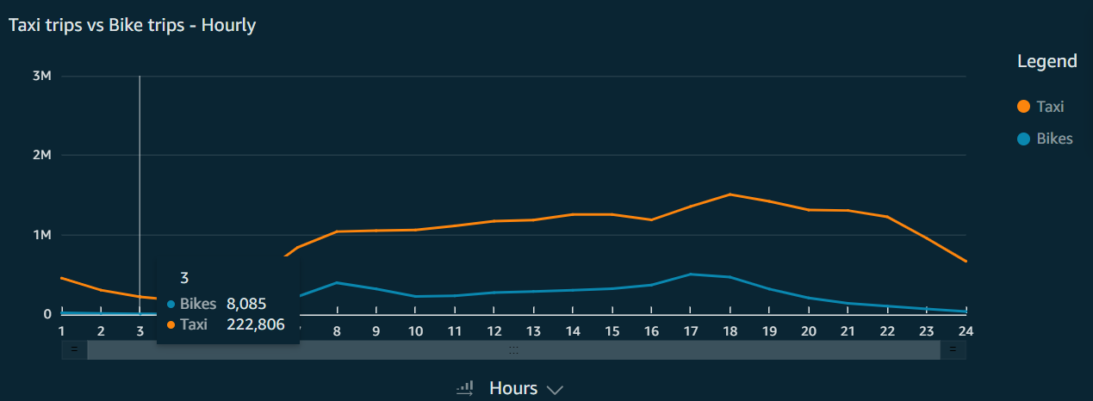
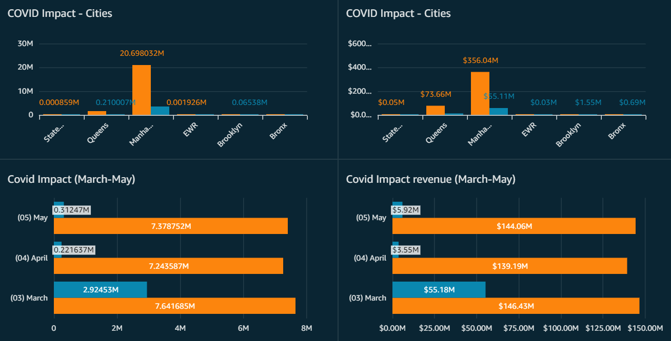
Visualization

Slide 11
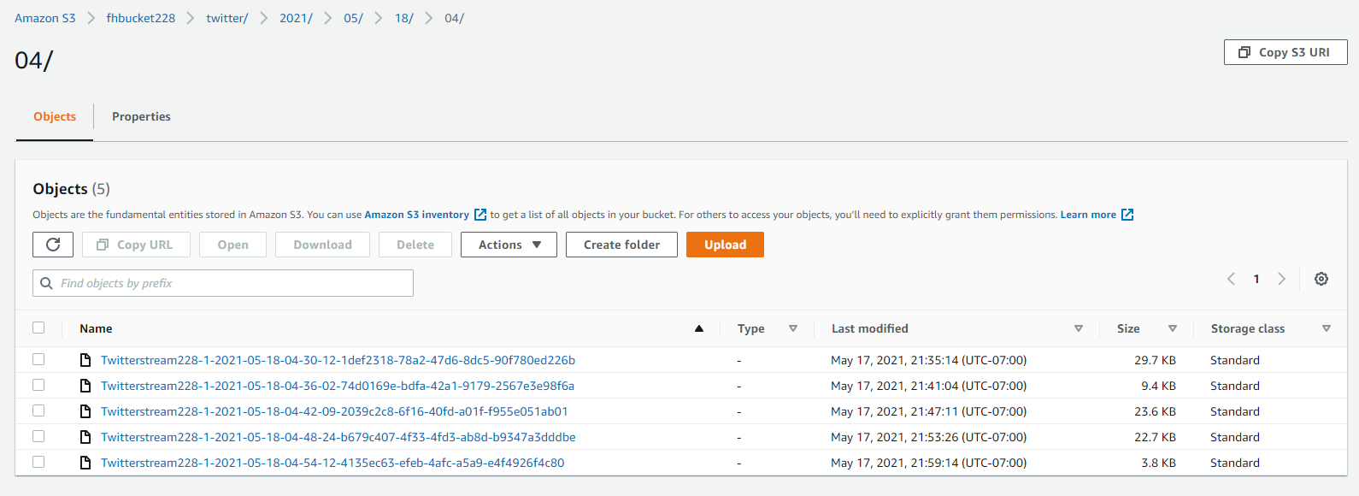
Future Roadmap
Real-time NYC TLC Twitter data has been fetched into S3, using Kinesis.
Can be used for further analysis using Elasticsearch and Kibana

Slide 12
Other interesting NYC/TLC Facts
License provider to other taxi businesses
In NYC, TLC provides licenses to all other providers like Uber who are competitors.
Roadmap for Electric Cars
Food Delivery
Analysis about charging infrastructure and breaks for driver.
TLC was used for food delivery during COVID-19
Vision Zero initiatives to reduce accidents
Default speed of NYC changed to 25 mph
https://vzv.nyc/

Slide 13
Conclusion
This project helped us significantly in
Exploring plethora of AWS services like automated ETL jobs that saves the time and manual effort and applies to huge datasets.
Exploring analytics and visualization in the cloud
We thank the professor greatly for this opportunity and his every lecture and guidance.

Slide 14
References
https://www1.nyc.gov/site/tlc/index.page
https://zacks.one/aws-athena-lab/
https://docs.aws.amazon.com/code-samples/latest/catalog/code-catalog-python-example_code-kinesis.html
https://docs.aws.amazon.com/ses/latest/DeveloperGuide/event-publishing-redshift-firehose-stream.html

Slide 15
Thank You!!

