Slide 1
VAE-GAN: Identifying VAE-GAN Model for latent Representation learning

Slide 2
TABLE OF Contents
Abstract
Introduction
Problem Statement
What is AE, VAE, GAN?
VAE-GAN – Usage, Algo, Loss function, Introduce Batch Norm
Time Complexity
Architecture
Analysis
References
Future Work

Slide 3
ABSTRACT
As we know the unsupervised learning often requires the features to be trained, coming to VAEGAN which is one of unsupervised learning, which requires the model to be trained to obtain the realistic and good pixel quality data. The observation we get to notice is, the dataset need to be more trained which often consumes huge time to get stabilized and to generate prolific quality images. Inducing a regularization technique actually reduces the test set loss and also model gets trained quickly to get clutched to a stabilization procuring a adequate quality data as outcome. This process is introduced to denoise the given noisy dataset, generating to achieve impactful results quickly by removing the noise to extract good pixel oriented output.

Slide 4
Introduction
As we find the approach of unsupervised learning involves a machine to be trained for analyzing and providing out the distributed data sets, which is actually becomes strenuous. In general sense the process requires latent representation which allows in simplifying the data on statistical inference. Introducing the Auto Encoders, which actually encodes allows in encoding the data from huge dimensional to put into a smaller dimensional than the original format. So, the decoder maps the lossy version of data into to get back to original high dimensional output. Variational Autoencoders allows to explain: Instead of mapping to fixed inputs, you want to map the inputs as a distribution, the difference is replaced by two separate vectors one representing mean of the distribution and the other one representing standard deviation of the distribution. This VAE is merged with GAN which is Generative Adversarial Network to pull out the real image with high dimensional pixel quality.

Slide 5
Problem statement
VAE - GAN often suffers from overfitting, which actually performs training of data very poorly. Introducing regularization helps out to prevent overfitting to produce out simpler model. This would be helpful in controlling the complexities of representations. Through this we can achieve semi supervised learning where features can be contemplated easily during distribution in the latent space. So, here the main motivation involves in enhancements in latent space to control. This enables in high pixel quality data reconstructions.

Slide 6
What is AE, VAE, GAN?
The autoencoder encode the image into latent space Z through encoder and reconstruct the image through decoder. The latent space Z is usually low dimensional. We can explain in simple terms as, it is a process of compressing input data by encoding it, and then reconstructing it as an output, autoencoders allow you to reduce dimensionality and focus only on areas of real value.
VAE allows to map to a fixed vector, where the input you want to map is a distribution, the distributions are mean and standard deviation which are taken to represent the latent space Z.
When training begins, the generator produces obviously fake data, and the discriminator quickly learns to tell that it's fake: As training progresses, the generator gets closer to producing output that can fool the discriminator. Finally, if generator training goes well, the discriminator gets worse at telling the difference between real and fake. It starts to classify fake data as real, and its accuracy decreases.

Slide 7
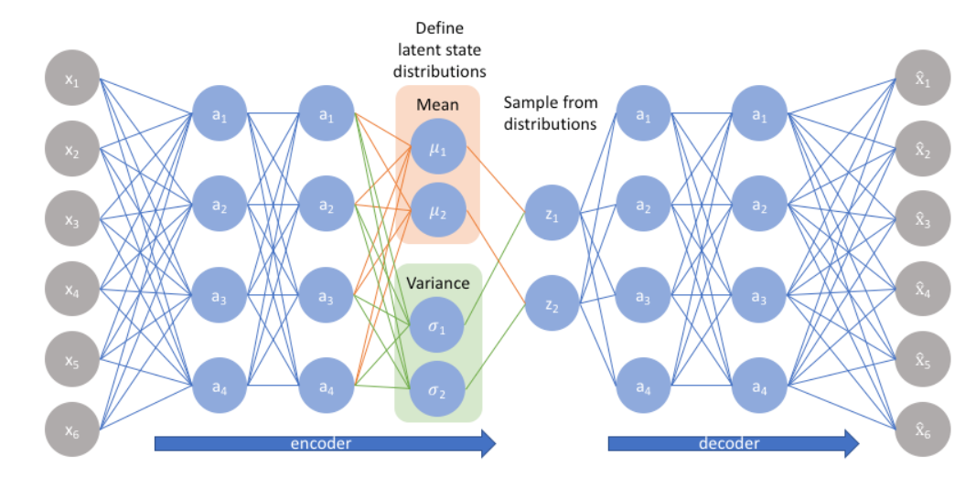
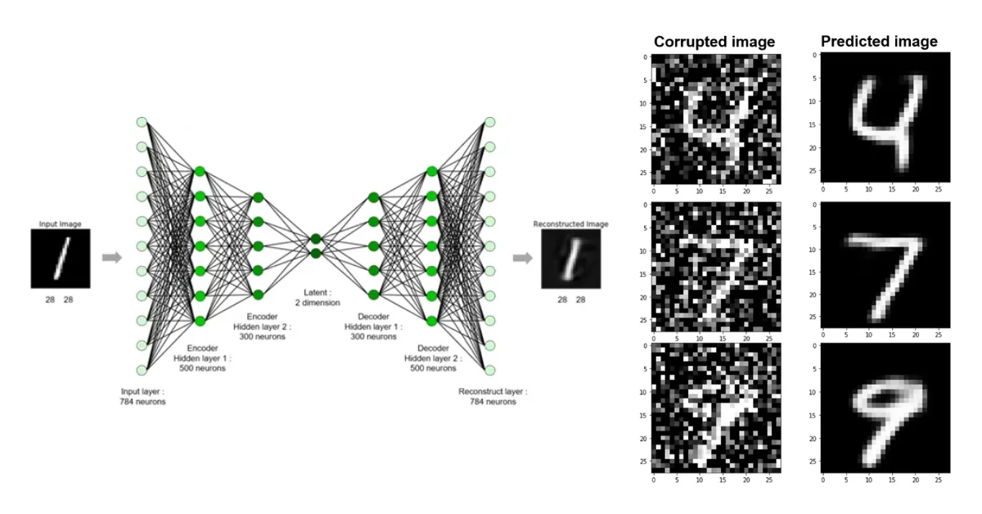
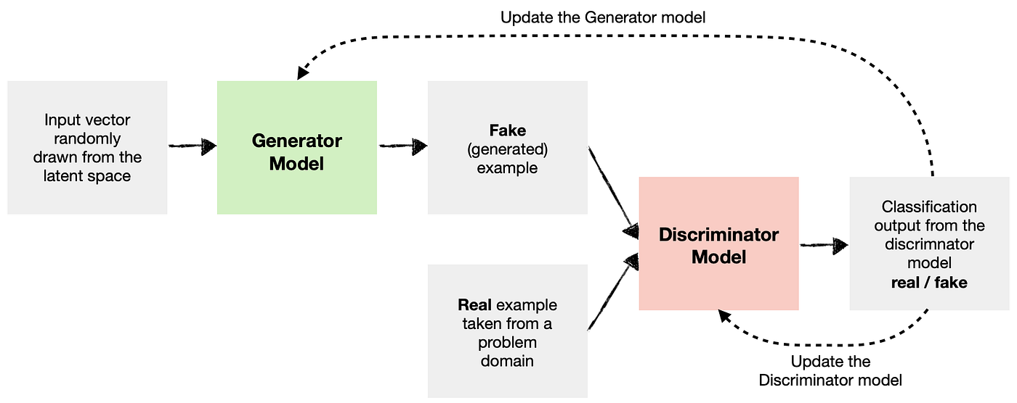
What is AE, VAE, GAN?

Slide 8
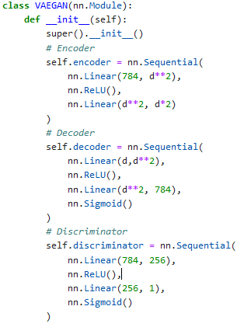
VAE-GAN algorithm And its Usage
A VAE-GAN combines the concepts of VAE and GAN in an attempt to leverage the benefits of both models. VAE-GANs have been applied in various domains, including image generation and they are often used when a balance between structured latent representations and high-quality data generation is required.
Neurons Mapping in Encoder, Decoder
784 – 400 – 40 , 20 – 400 – 784

Slide 9
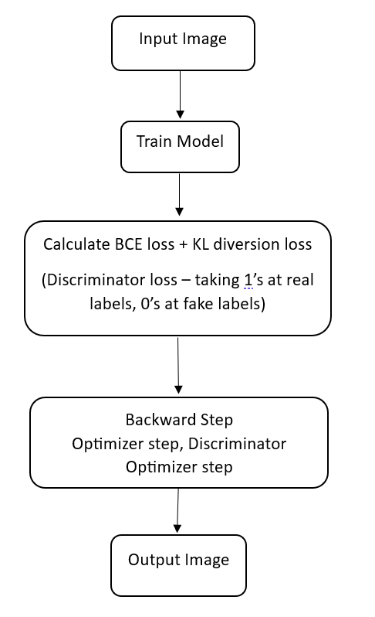
VAE-GAN LOSS FUNCTION, TRAINING THE MODEL
Binary Cross Entropy: BCE( x, y ) = - ( x log( y ) + (1 – x) log( 1 - y ) ) where x = Quality of Real Image ; y = Quality of Reconstructed Image ; Example: x = 0.8 ; y = 0.6 => BCE( x, y ) = 0.59191 x = 0.8 ; y = 0.2 => BCE( x, y ) = 1.3321
KLD Kullback-Leibler Divergence: KLD = −0.5(1+log(σi^2​)−(μi)^2​−(σi)^2​) This gives the average loss, the overall loss
From BCE Loss, we can actually tell that loss is inversely proportional to the quality of reconstructed image, i.e, in simpler words loss function directly effects the generated image, the more is the loss – the losser version of quality is observed, the less is the loss – the more is the quality of image.

Slide 10
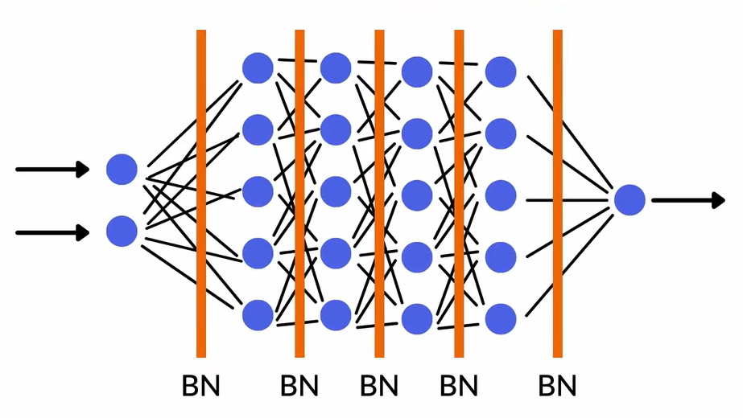
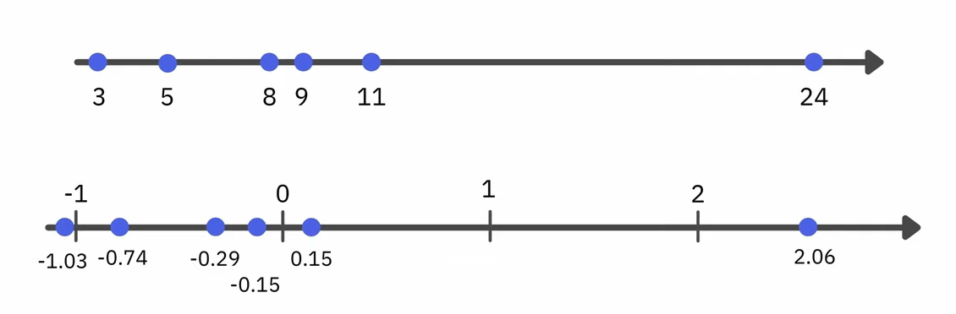
VAE-GAN (Introducing Regularization - batch-Normalization To avoid overfitting)
Batch Normalization – commonly abbreviated as Batch Norm – is one of these methods. Currently, it is a widely used technique in the field of Deep Learning. It improves the learning speed of Neural Networks and provides regularization, avoiding overfitting.
Advantages: accuracy – faster, better performance, standardization layer, good transformation of values, so that model can easily deluge the data set

Slide 11
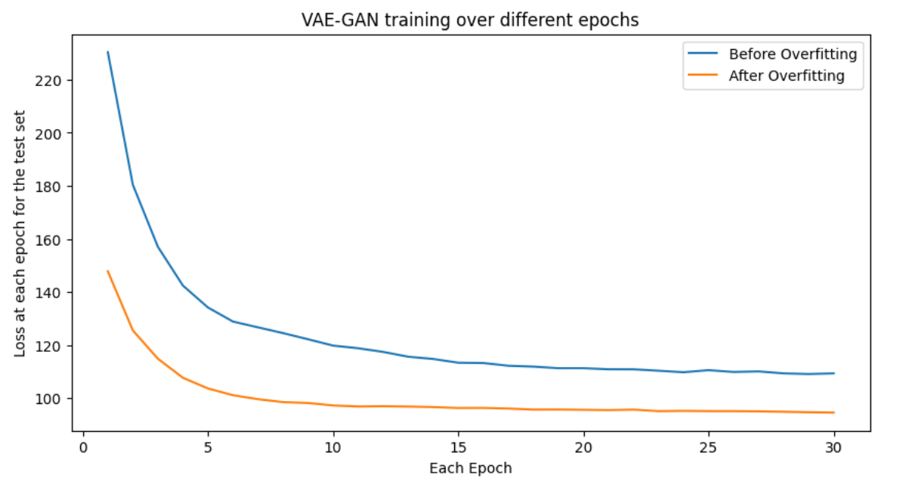
Time complexity
The time complexity is often dependent on dimension of neural networks, size of input data set, training iterations (the test sets – number of epochs), though the VAEGAN introducing batch normalization gives a predominant change during training than before, increase in dimensionality of neural networks and input set actually requires a dedicated resources.

Slide 12
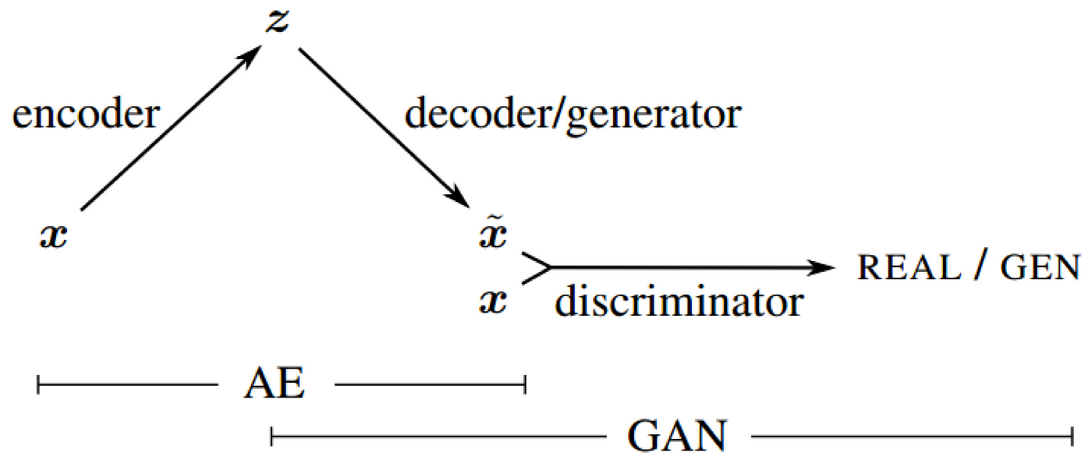
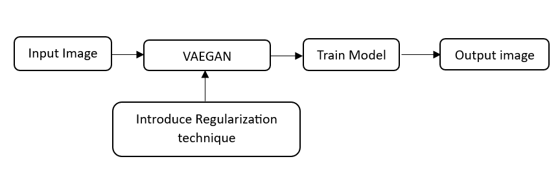
VAE-GAN Architecture

Slide 13
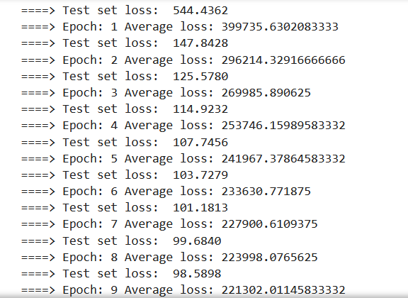
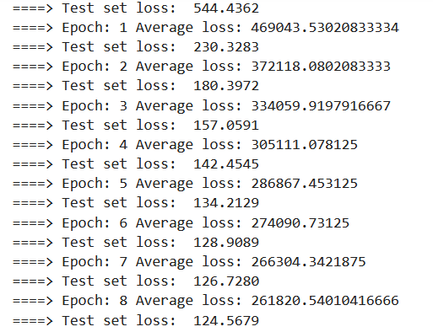
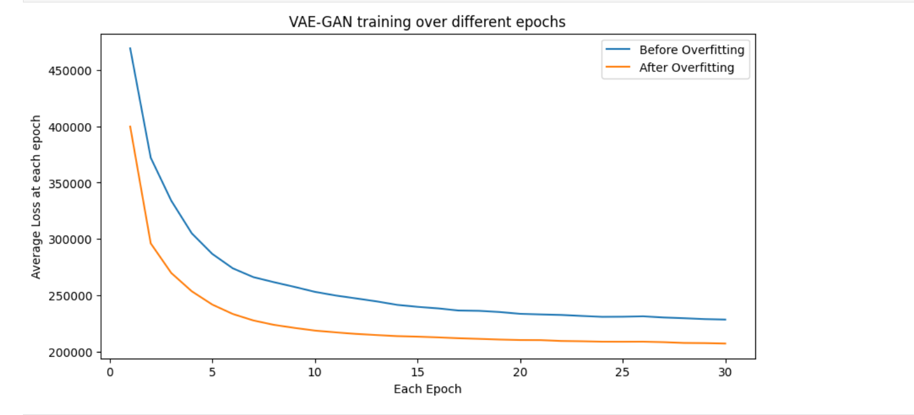
Analysis – reconstructed images
After avoidance of overfitting problem
Before implementing regularization technique
Comparison of before and after overfitting problem on test set
Comparison of before and after overfitting problem on average loss

Slide 14
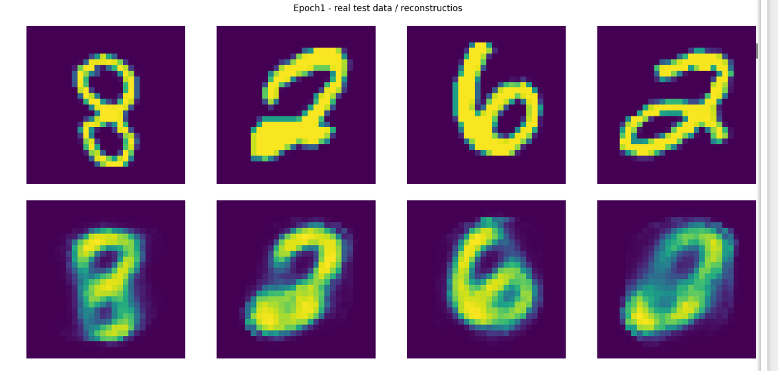
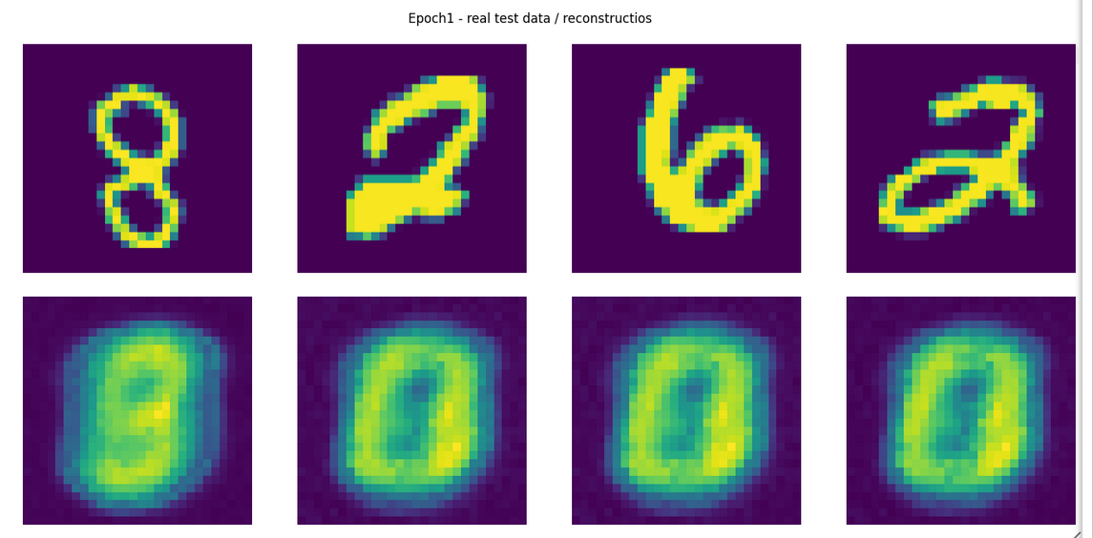
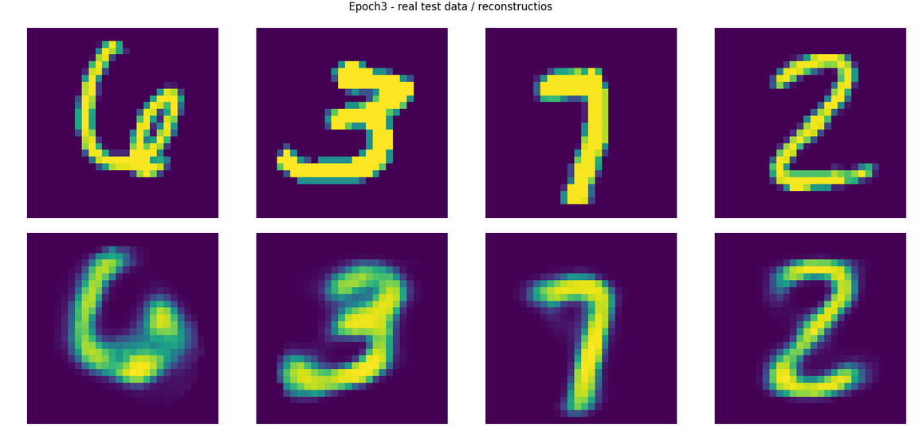
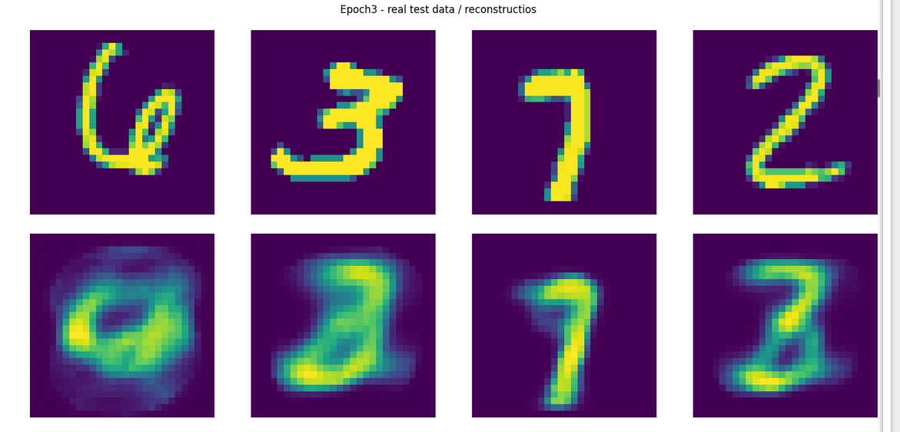
Analysis – reconstructed images
After avoidance of overfitting problem for epoch1
Before implementing overfitting problem for epoch1
After avoidance of overfitting problem for epoch3
Before implementing overfitting problem for epoch3

Slide 15
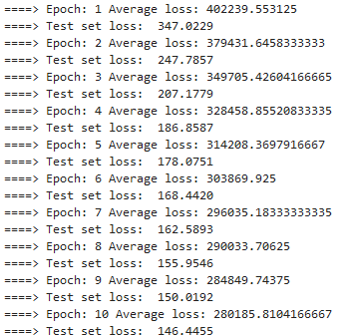
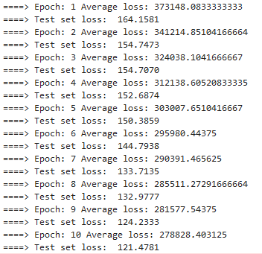
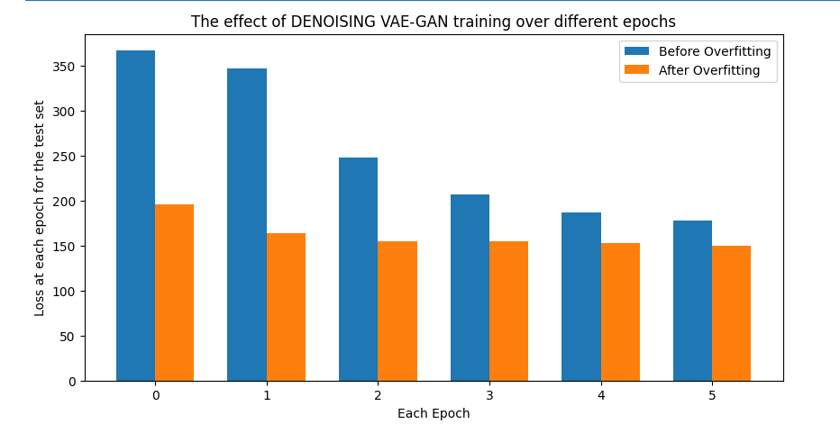
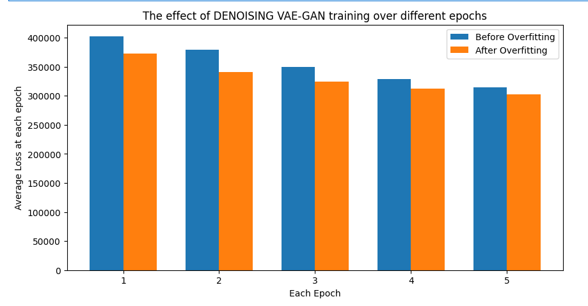
Analysis – denoising images
Before avoidance of overfitting problem
After implementing overfitting problem
Comparison of before and after overfitting problem on test set
Comparison of before and after overfitting problem on average loss

Slide 16
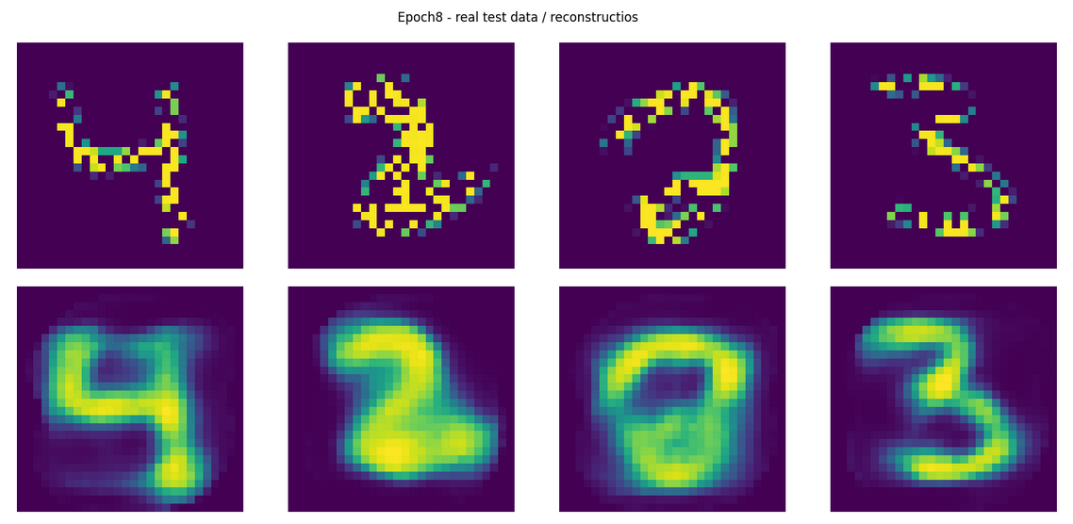
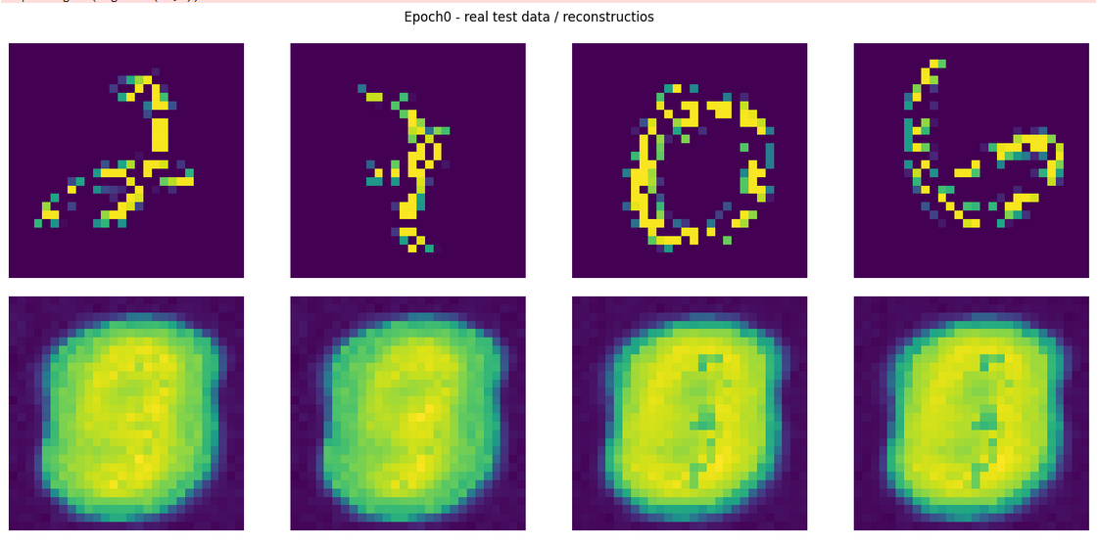
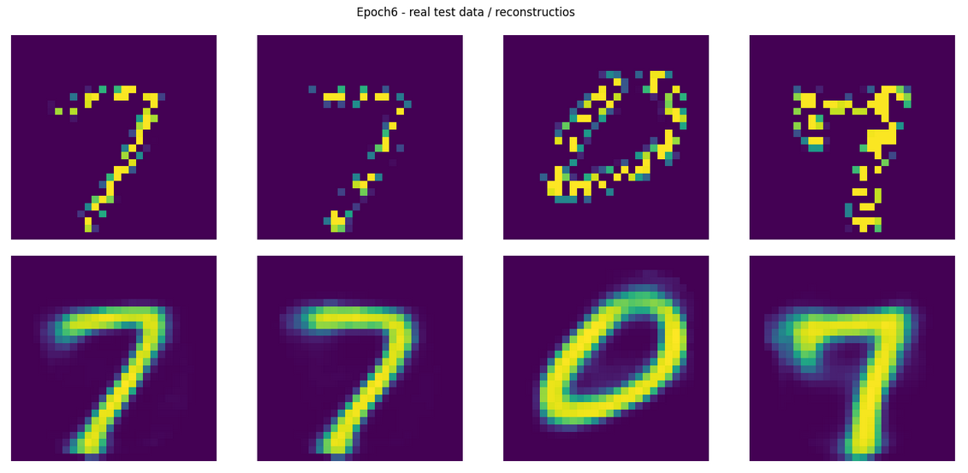
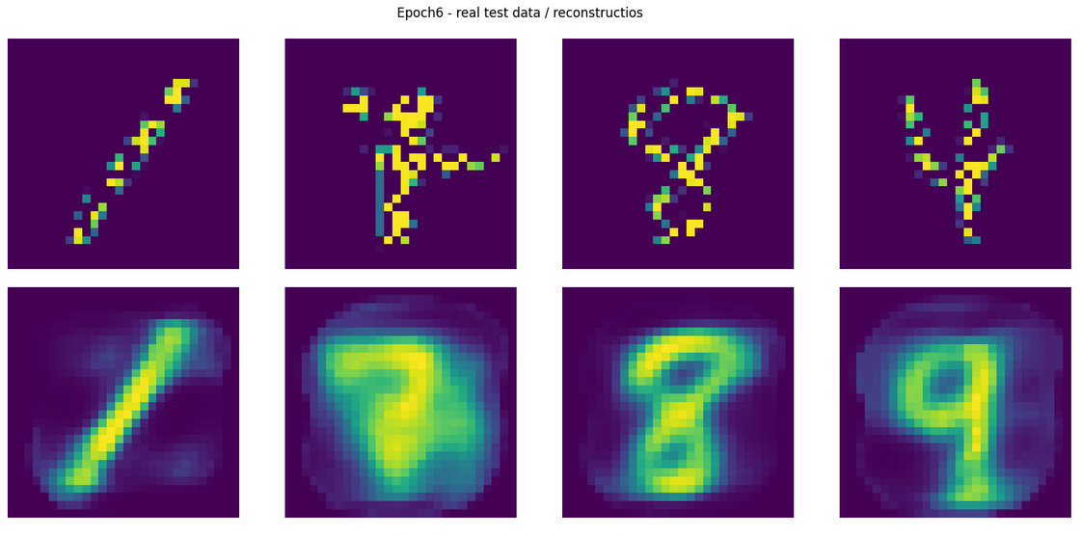
Analysis – denoising images (for low dimensionality)
After avoidance of overfitting problem for epoch0
Before implementing overfitting problem for epoch0
Before implementing overfitting problem for epoch6
After avoidance of overfitting problem for epoch6

Slide 17
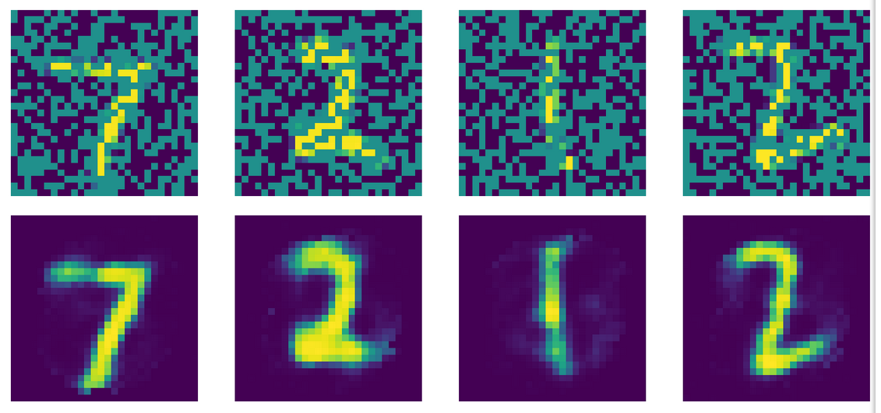
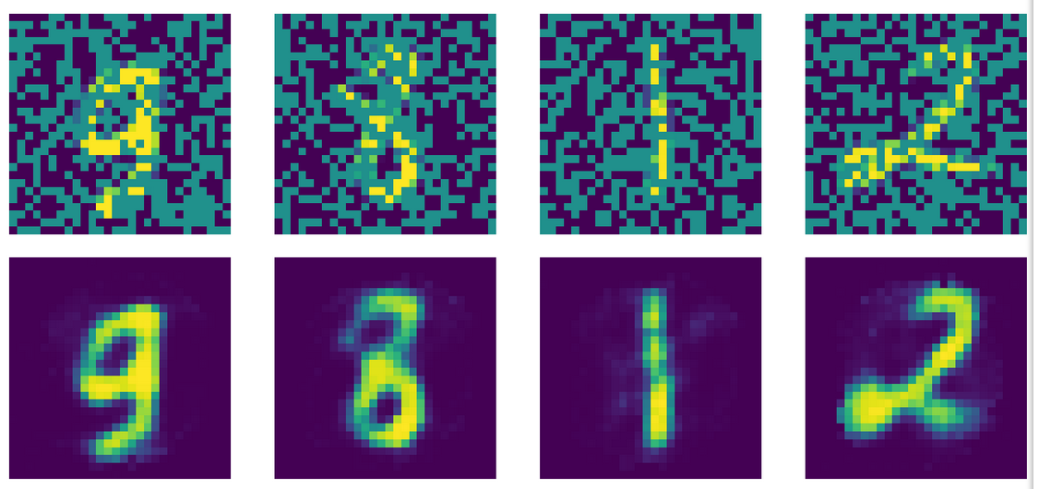
Analysis – denoising images (for HIGH dimensionality)

Slide 18
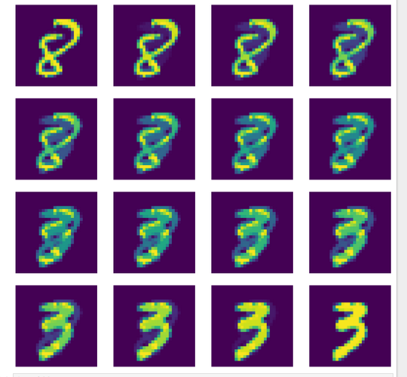
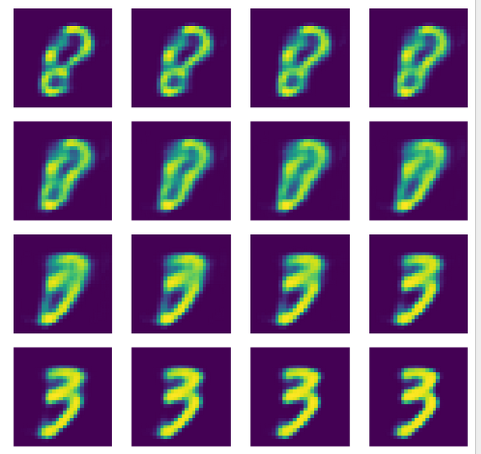
ANALYSIS – Representation on latent space

Slide 19
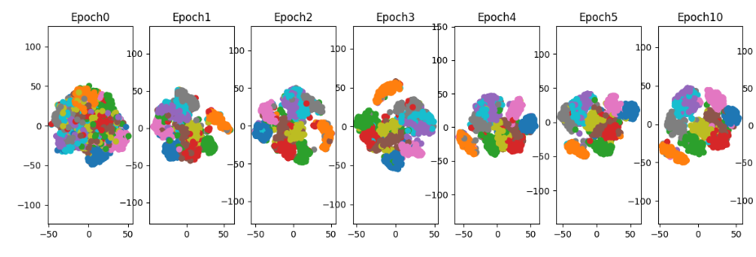
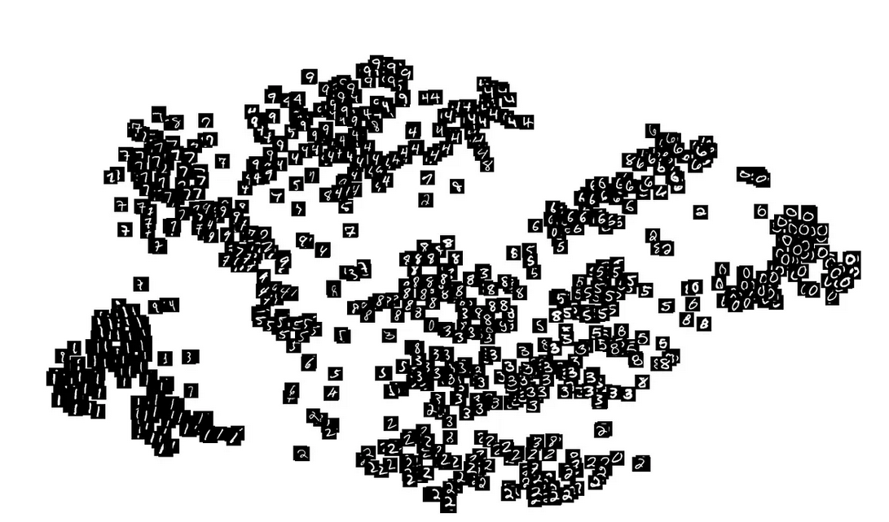

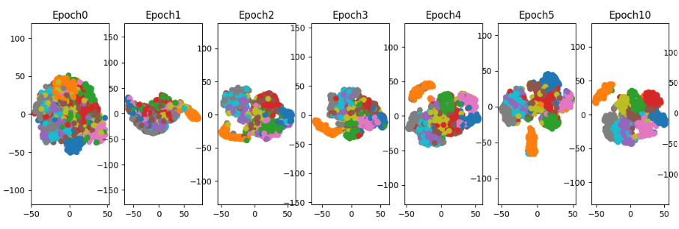
ANALYSIS – Representation on latent space
on implementing regularization
on normal training

Slide 20
References
https://ieeexplore.ieee.org/document/9053087
https://pravn.wordpress.com/category/vae-gan-vaegan/
https://ieeexplore.ieee.org/document/9528594
https://www.sciencedirect.com/science/article/abs/pii/S000145752031770X
https://ieeexplore.ieee.org/document/9766338

Slide 21
Future work
In future there is a scope to implement this model introducing noise directly in the latent space such that the model learns to generate samples that are less sensitive to small variations in the latent representation. Adding noise prevents the model from memorizing the training data and encouraging it to learn more abstract and generalizable features.

Slide 22
THANK YOU

