Slide 1
Securing Federated Learning: A Cryptographic defense against Privacy attack - MIA
Charishma Rathan Bala – R11908154
Keerthiga Kalidas – R11903641
Neha Bollu – R11903528
Sruthi Mandalapu – R11906160

Slide 2
Problem statement
In day-to-day life data privacy really concerns, and also putting the data on the central server really matters. In this scenario the federated learning concept comes into picture. Federated learning offers a solution by enabling decentralized model training, where clients keep their data local and only share model updates.
However, while federated learning enhances privacy, attackers can still attempt to exploit shared model updates. One such attack is the Model Inversion Attack, where an adversary reconstructs the original data based on the model's gradients or outputs.

Slide 3
Motivation
Federated Learning (FL) provides privacy benefits by keeping data local, but it remains vulnerable to Model Inversion Attacks (MIA), where attackers use model updates to reconstruct sensitive data. This poses significant privacy risks, especially when clients communicate with the server.
One such common implication to protect data in fl is differential privacy. It does also carry out certain trade-offs. That is, when it aims to provide strong privacy guarantees by adding noise to the data, this noise can significantly degrade the utility of the data for analysis. We can demonstrate as, the amount of noise added to ensure privacy is often inversely related to the accuracy of the results.
To address these challenges, we leverage Homomorphic Encryption (HE) which encrypts model updates. This ensures data privacy, prevents data reconstruction attacks, and enables secure collaborative learning by protecting sensitive information during model training without exposing individual data.

Slide 4
Related work
Fredrikson et al. (2015): This study demonstrated how attackers can use model outputs (like confidence scores) to reconstruct facial images in recognition systems. With only a few queries to the model, attackers were able to reconstruct high-fidelity images from the training data. The authors also suggested defense strategies such as limiting information disclosure, using differential privacy, and output regularization to protect against such attacks [1]
Zhu et al. (2019): This work extended model inversion attacks to federated learning, showing that attackers could still infer sensitive information despite decentralized training. By analyzing the model updates (gradients) shared between clients and the central server, attackers could reconstruct portions of the original data. The study demonstrated this attack on datasets like MNIST and proposed countermeasures like differential privacy and output perturbation to mitigate the risk [2]
Shokri et al. (2017): Shokri’s research connected model inversion and membership inference attacks, proposing a framework to assess the risks associated with these attacks on different deep learning architectures. Through queries and analysis of output confidence levels, attackers could reconstruct sensitive data points. The study found that overfitting models are particularly vulnerable. To address these threats, the authors recommended privacy-preserving techniques like differential privacy and secure aggregation to protect sensitive information from being exposed during model training [3]

Slide 5
Main Contributions
Secure Model Updates: Introduces encrypted model updates for clients, ensuring secure aggregation at the central server without revealing sensitive data, thereby preserving privacy during the learning process.
Robust Collaborative Learning: Enhances secure and efficient collaboration among clients in FL by preventing data reconstruction, enabling privacy-preserving learning environments for sensitive datasets.
Practical Threat Model for MIA: Demonstrates a realistic threat model for MIAs, highlighting how attackers exploit vulnerabilities in FL and showcasing the robustness of the proposed defense.

Slide 6
dataset
In federated learning each client has different data, so we have used:
Client1 Model uses first half of the labels
Client2 Model used remaining half labels
Dataset Used:
MNIST
CIFAR10 (Used for testing the attack)
Data Splitting:
Train set: 85%
Test set: 15%
Data Loading:
Client1 – Loaded with classes 0,1,2,3,4 MNIST numbers
Client2 – Loaded with classes 5,6,7,8,9 MNIST numbers
CIFAR10 is also taken just like MNIST – but converted the data into grey scale representation (to perform effectively on attack)

Slide 7
Federated Learning setup
Elements
Number of Clients: 2
Number of Rounds: 5
Components
Client 1: Works with the first 5 labels of the MNIST dataset (e.g., 0-4).
Client 2: Works with the last 5 labels of the MNIST dataset (e.g., 5-9)
Global Model: A shared model stored at the central server, which gets updated using FedAvg.
Iterative Approach
Step1: Local Training
Step2: Uploading Model Updates
Step3: Model Aggregation (FedAvg)
Step4: Repeat the process until 'n' number of rounds

Slide 8
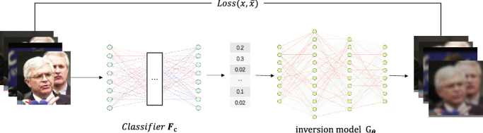
Mia attack and its impact
It involves in using the output of a model to infer some of its parameters or architecture. This can be done by querying the model and using the output to infer some of its parameters.
Attackers can use the model to reconstruct parts of the original training data, allowing them to potentially identify specific individuals within the dataset

Slide 9
Threat Model
Initialize Attack Parameters: target class ytarget (e.g., "cat", "dog", digit 3, etc.). Initialize the input x_init as a random image that matches the data format (e.g., random pixel values for an image).
Define Loss Function: loss function (L) as the difference between the model’s prediction and the target class.
Feed the Input into the Model: Pass the initialized input x_init into the model f, which produces a prediction f(x_init)
Calculate Loss: Calculate the gradient of the loss with respect to the input. This gradient shows the direction in which the input should be adjusted to make the model’s prediction closer to the target class.
Update the Input: Update the input using the gradients to make it closer to the target class.
Repeat for Multiple Iterations: Repeat above steps for multiple iterations (e.g., 1000 iterations) to progressively refine the input. After each iteration: Feed the updated input back into the model, Recompute the loss and gradients, Update the input accordingly.
Terminate process: The process can be terminated after a fixed number of iterations or once the loss converges to a minimal value, meaning the model is classifying the generated input as the target class with high confidence.
Output the Reconstructed Data: The final output x_reconstructed is the input after optimization, which the model classifies as the target class.

Slide 10
Usage of ART Tool in MIA
Import ART Module:
from art.attacks.inference.model_inversion.mi_face import MIFace
Instantiating the attack:
attack = MIFace(model, max_iter=num_iter, threshold=threshold_val)
Executing the attack
x_infer = attack.infer(x_init, y)
x_init – can be black image, white image, grey image, random image, average image

Slide 11
Data Samples initialized for attack
Black Image: defined as x_init_black = np.ones((10, 28, 28, 1)), this creates a set of 10 images, where each image is a 28x28 pixel black image, initialized with ones
White Image: defined as x_init_white = np.zeros((10, 28, 28, 1)), this creates a set of 10 images, where each image is a 28x28 pixel white image, initialized with zeroes
Random Image: defined as x_init_random = np.random.uniform(0, 1, (10, 28, 28, 1)), this creates 10 images where each pixel is randomly initialized with values between 0 and 1
Grey Image: defined as x_init_grey = np.zeros((10, 28, 28, 1)) + 0.5, this creates 10 images, each being a 28x28 pixel image with all pixels set to a mid-grey value of 0.5
Average Image: defined as x_init_average = np.zeros((10, 28, 28, 1)) + np.mean(x_test, axis=0), this creates 10 images where each image is initialized with the average pixel values across the entire test set (x_test)

Slide 12
Defense – Homomorphic encryption
HE enhances Federated Learning by Data privacy, Secure Aggregation, Protection from Malicious attacks, Efficient collaboration.
Each client has sensitive data, they encrypt data using HE, each client uses their encrypted data to train a local model, after training the local model and sends its encrypted model updates to a central server.
The central server collects model updates from all clients, but all the updates are still encrypted. The server performs aggregation of the encrypted model updates using Homomorphic Encryption. Once the server finishes aggregating the updates, it sends the encrypted aggregated model back to the clients.
Finally, the clients receive the encrypted global model from the server, and they use their private keys to decrypt it.
This is the essence of using Homomorphic Encryption in Federated Learning – allowing collaborative machine learning while keeping data private and secure!

Slide 13
Why Homomorphic Encryption?
Homomorphic encryption allows calculations on encrypted data without needing to decrypt it.
The results of these computations, when decrypted, are the same as if the operations were performed on the plaintext data.
This allows in protecting data during processing, ideal for sensitive tasks like cloud computing.
It is useful cause of its privacy, security and no need to share raw data.

Slide 14
He in mathematical terms
Encryption: Each client encrypts their data using Homomorphic Encryption (HE).
Server Aggregation: The server computes the average of the encrypted values directly without knowing the actual values.
Decryption: The clients decrypt the final aggregated result to obtain the average weight.
Example :
Client1 Weight = 10 (Encrypt using HE) = E(10)
Client2 Weight = 20 (Encrypt using HE) = E(20)
Server = (E(10)+E(20))/2 = E(Server)
Both Clients – (Decrypts using HE) = D(E(Server)) = 15

Slide 15
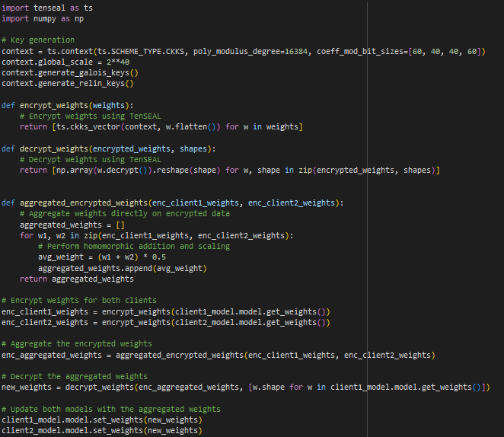
Usage of tenseal module
Below is the functionality of the TENSEAL module used to implement HE as a defense:
The main usage for Tenseal module, it is designed to handle encrypted vectors.
Data is encrypted using the secret key (which is implicit in TenSEAL's context object)
Galois keys do not encrypt or decrypt but enable specific mathematical operations while the data remains encrypted.
Relinerization keys are used to manage the growth of ciphertext size after homomorphic multiplications.
w.flatten() takes this matrix and converts it into a 1-dimensional array (a vector) by flattening the values. This is necessary because TenSEAL expects the input to be in the form of a vector (1D array).
.decrypt() is a method in TenSEAL that decrypts the encrypted vector w, converting it from encrypted form back into the plaintext (raw numerical data). After decryption, w will be a regular umPy array (or list) of the original floating-point values.

Slide 16
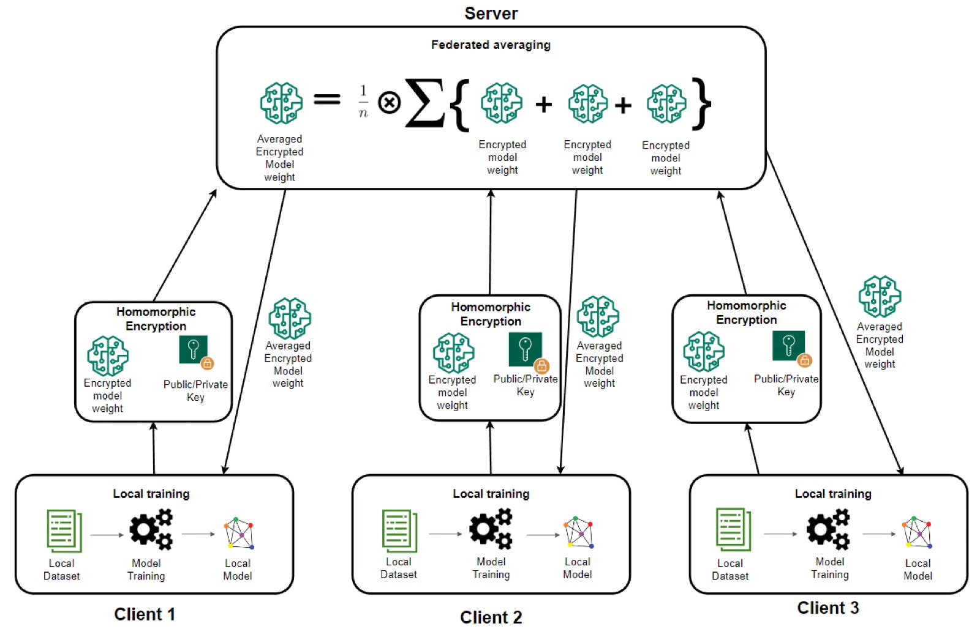
Homomorphic encryption In FL

Slide 17
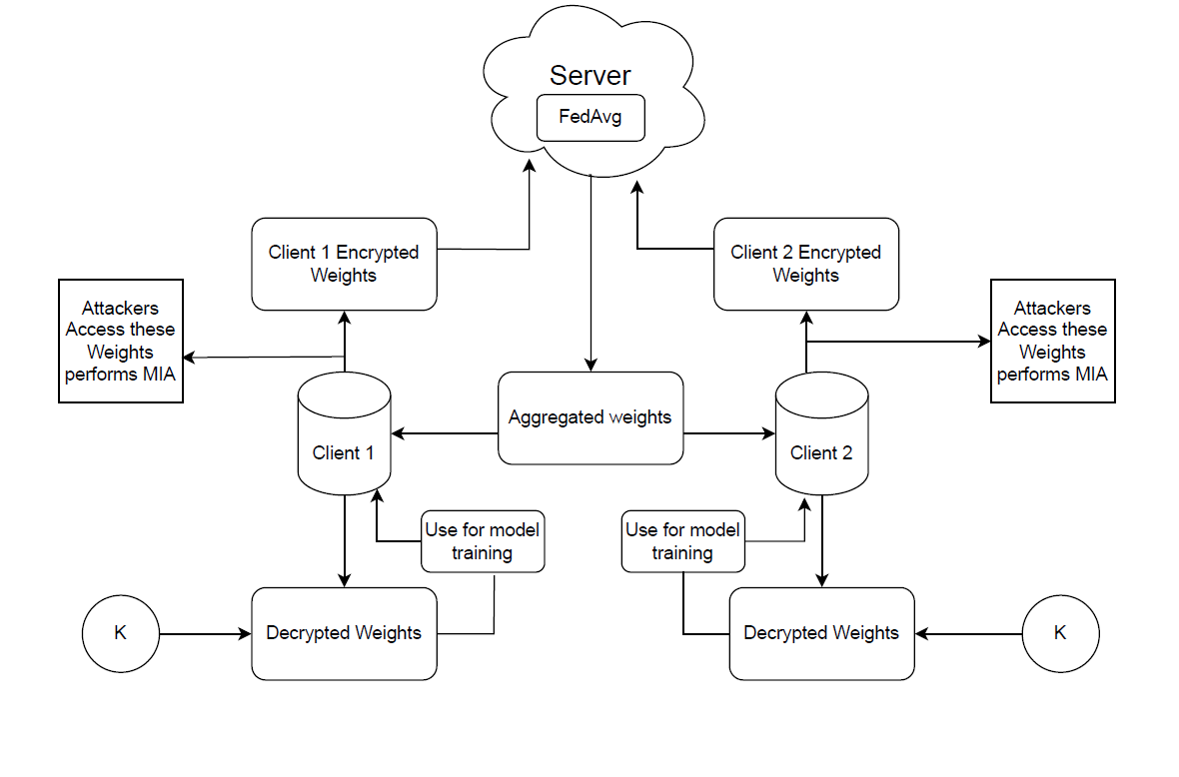
Overall Architecture

Slide 18
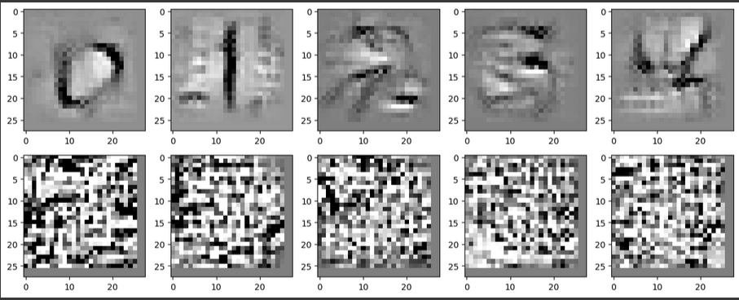
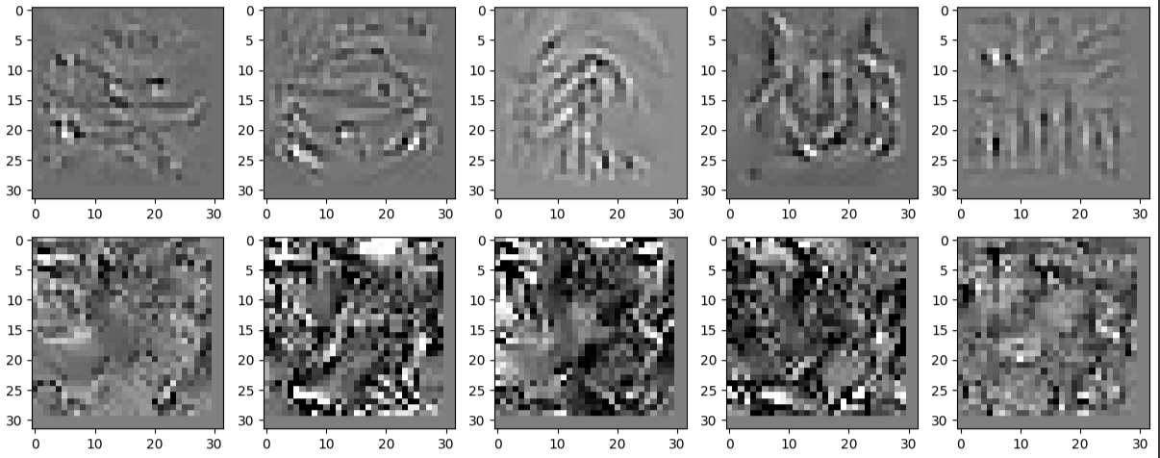
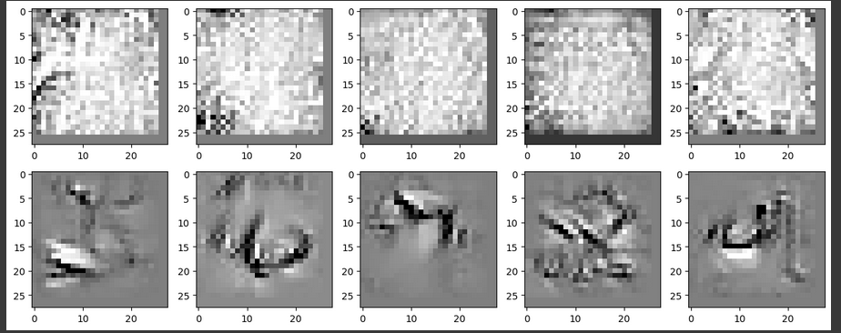
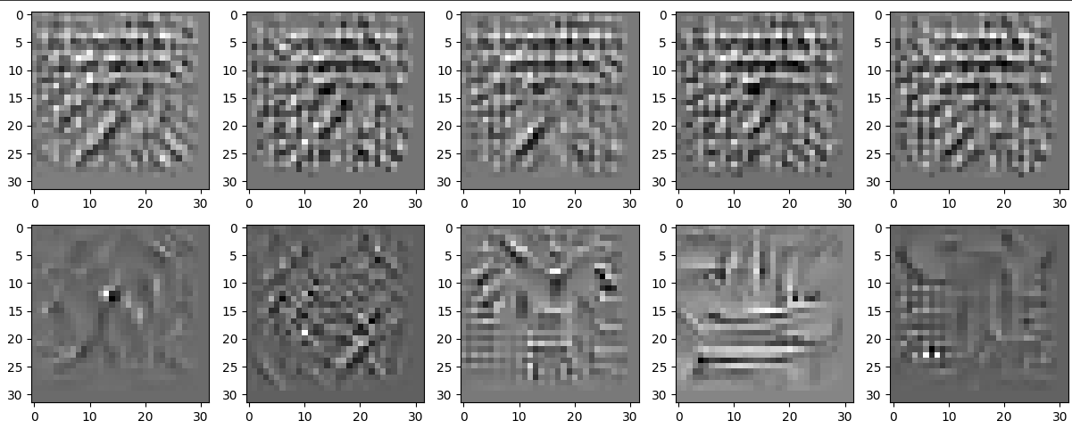
Before FL training – attack on individual clients
Labels for CIFAR10 dataset:
First 5 labels – airplanes, cars, birds, cats, deer​
Remaining 5 labels – dogs, frogs, horses, ships, trucks​
Client1 Model is trained over – 0,1,2,3,4 labels
Client2 Model is trained over – 5,6,7,8,9 labels

Slide 19
Results of accuracies – before and after fl setup
Clients | Client1 Model | Client2 Model
Client1 Test Set – before FL | 99.6% | 0%
Client2 Test Set – before FL | 0% | 99.4%
Client1 Test Set – after FL | 99.88% | 99.51%
Client2 Test Set – after FL | 99.45% | 99.78%

Slide 20
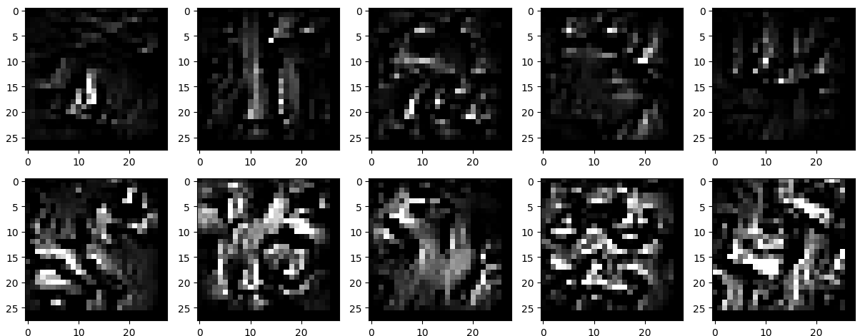
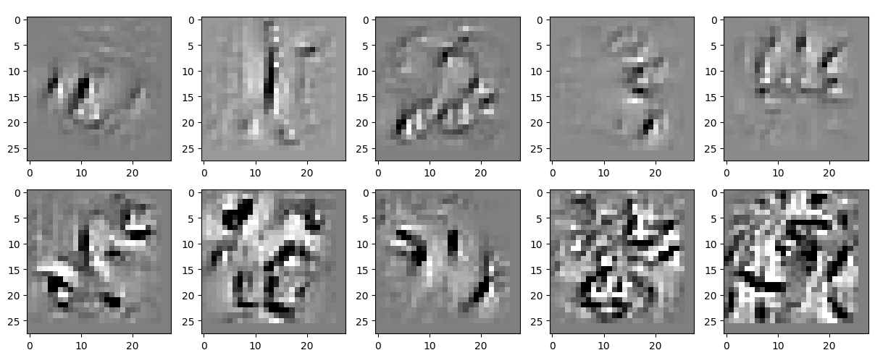

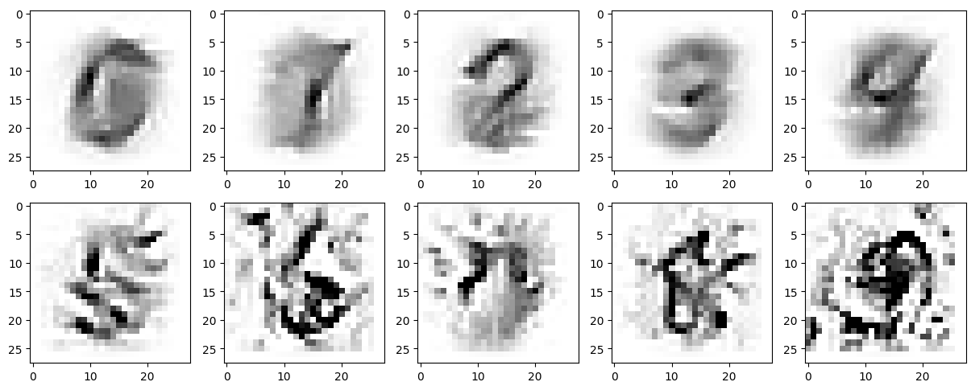
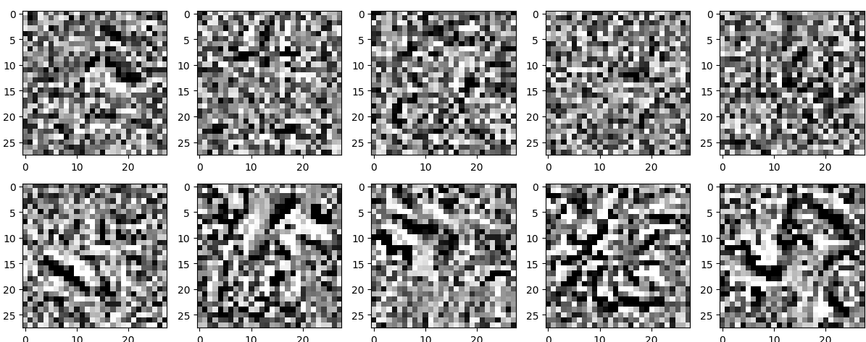
FL with MIA attack - Client1
Client1 Model tested on Black Image, White Image, Random Image, Grey Scale Image, Average Image

Slide 21
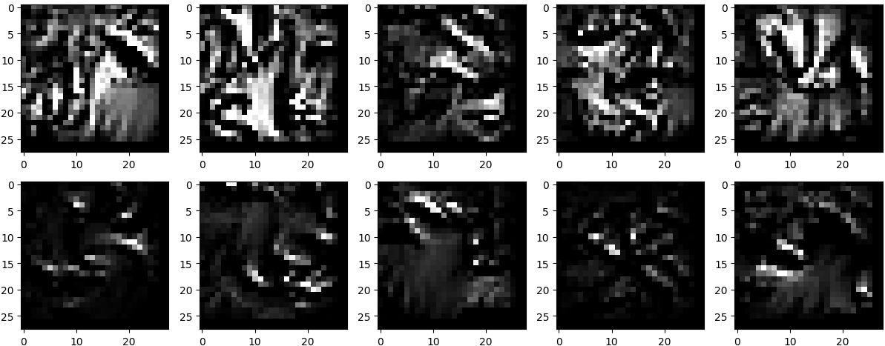
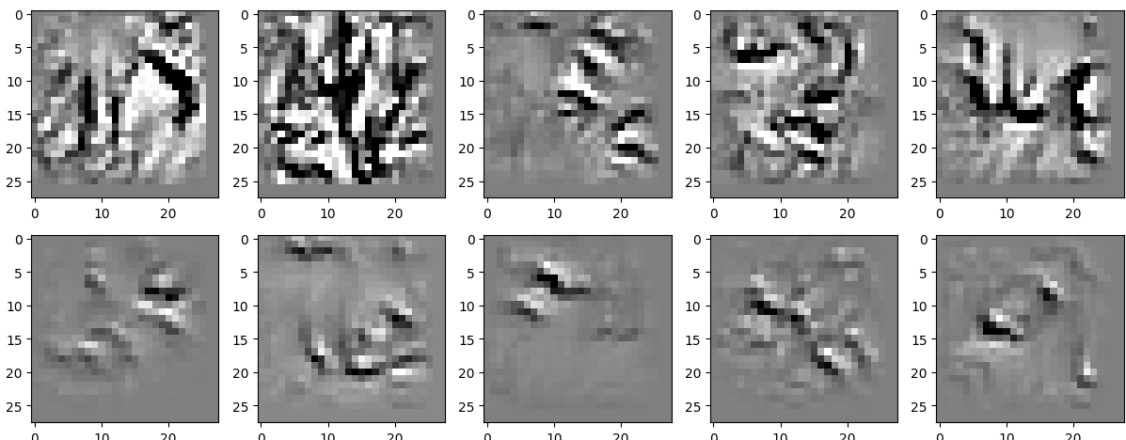
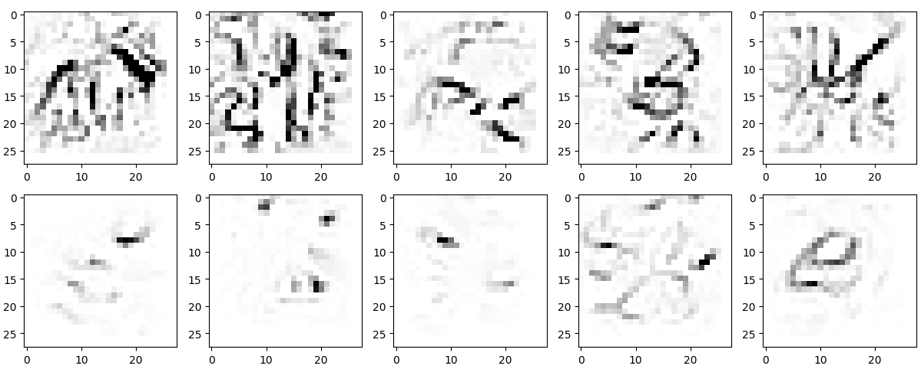
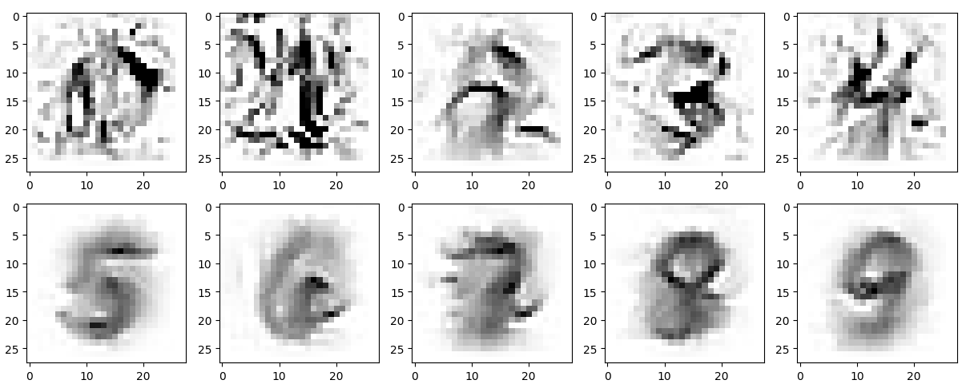
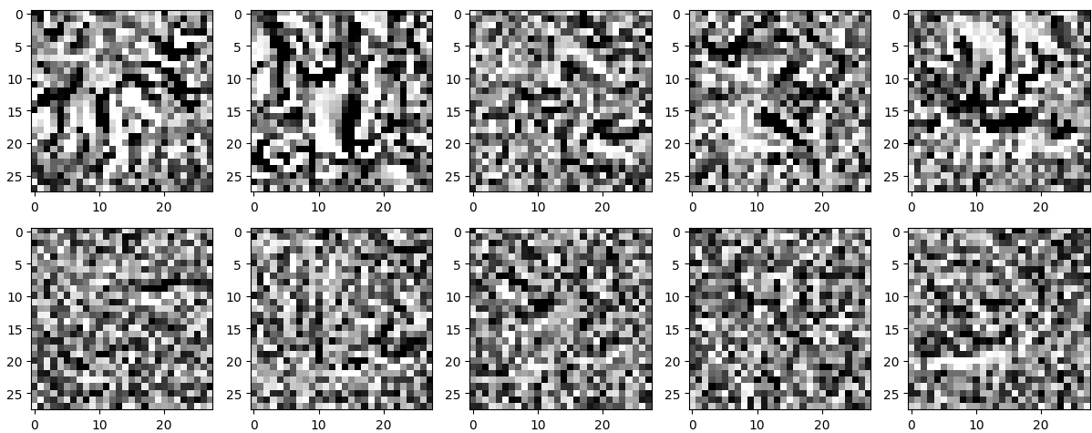
FL with MIA Attack - client2
Client2 Model tested on Black Image, White Image, Random Image, Grey Scale Image, Average Image

Slide 22
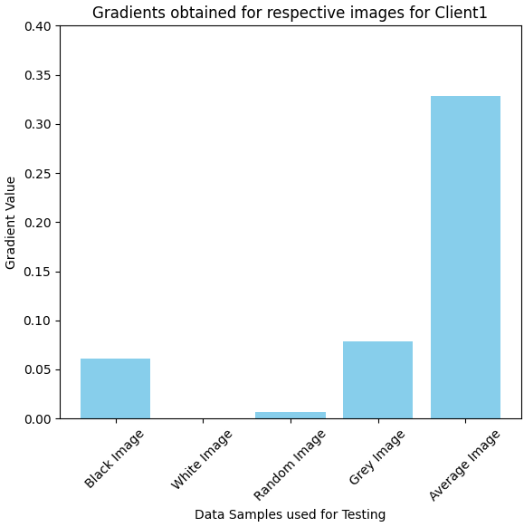
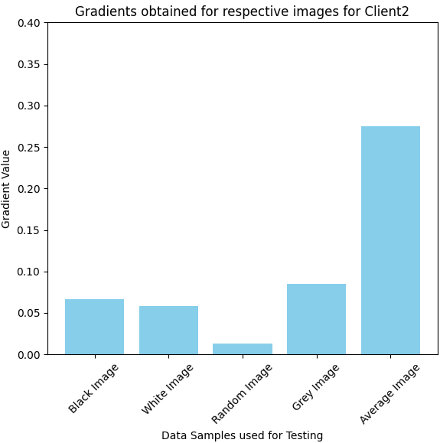
Analysis on gradients

Slide 23
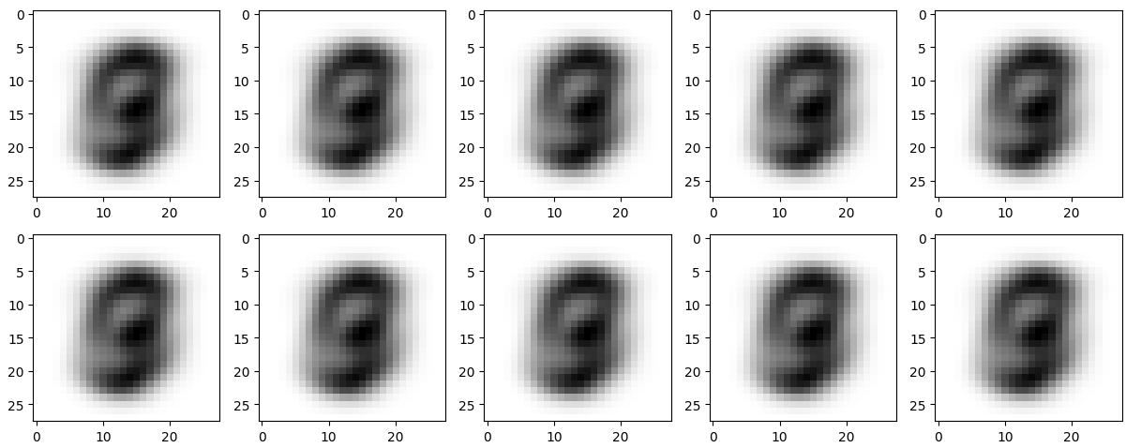
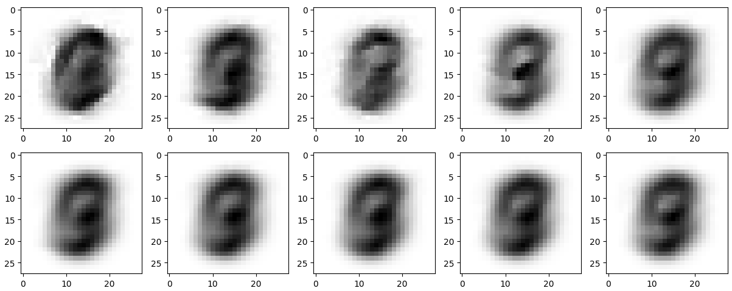
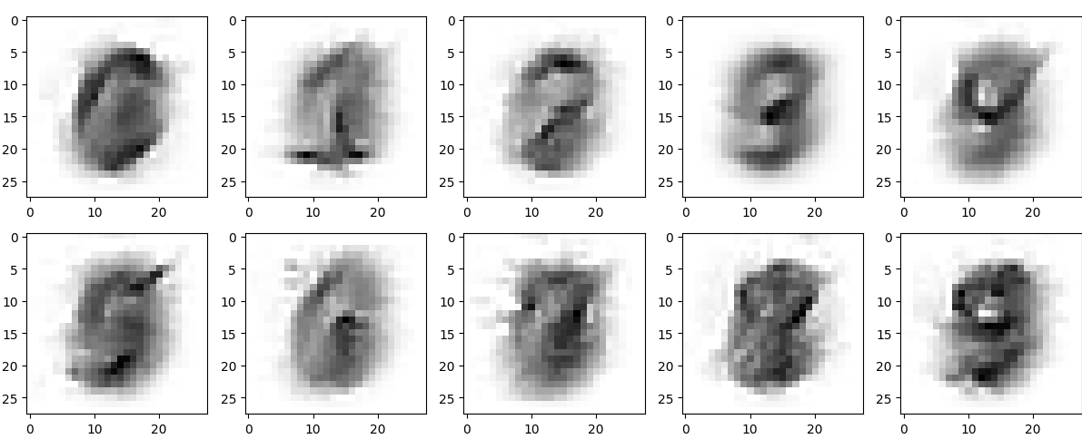
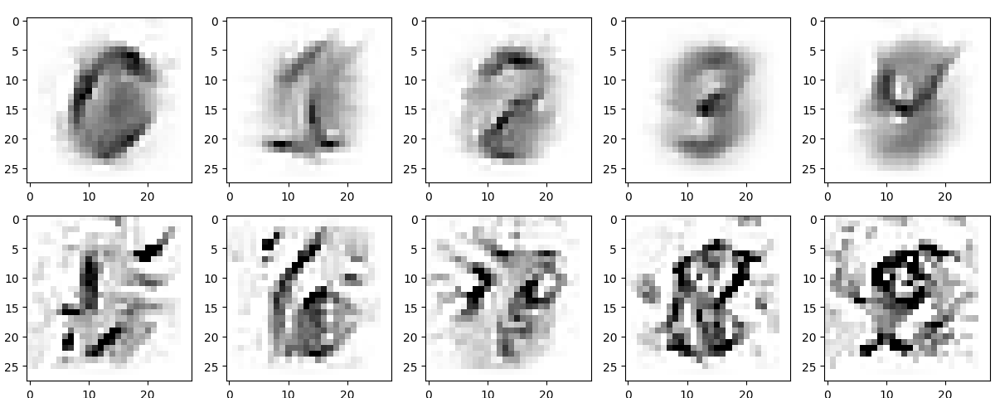
MIA ATTACK – with different Iterations
At iter=0, iter=10, iter=100, iter=1000

Slide 24
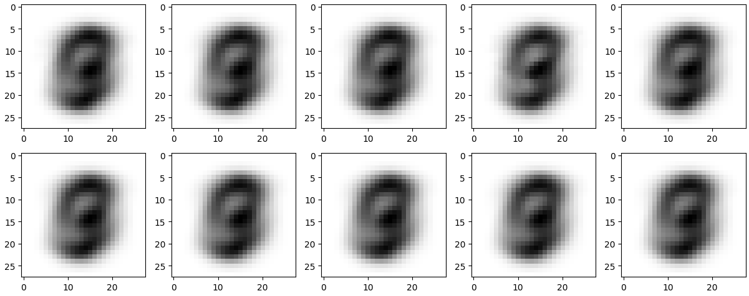
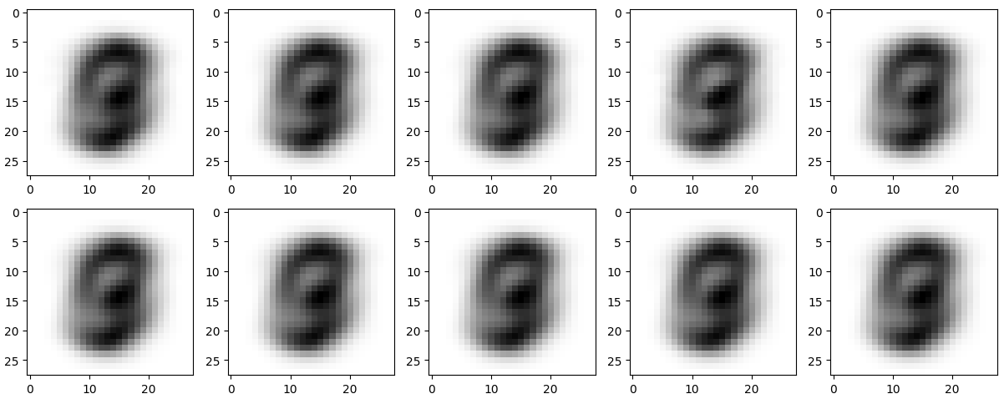
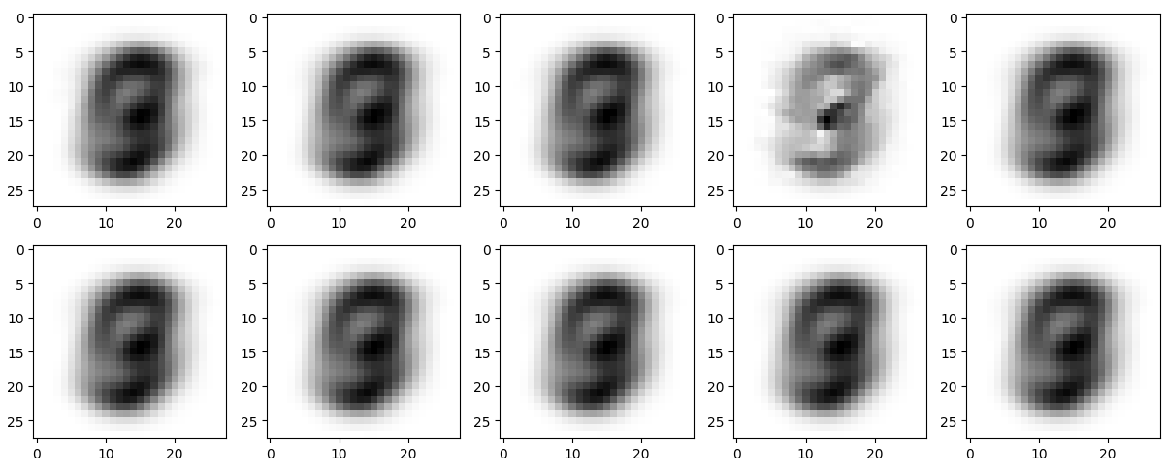
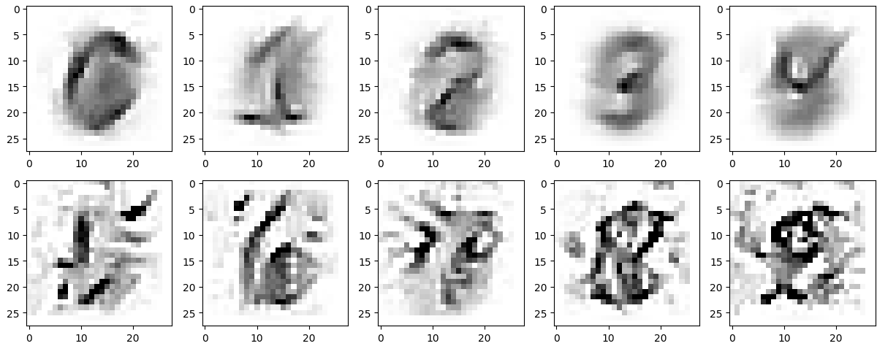
MIA Attack – with different thresholds
At threshold=0.1, threshold=0.2, threshold=0.5, threshold=1

Slide 25
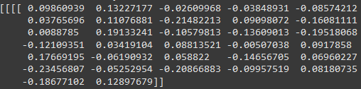
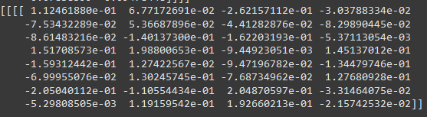
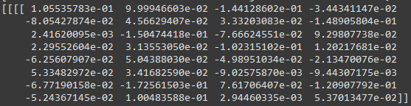
Defense – Homomorphic encryption
Picture1 – Client1 weights before encryption
Picture2 – Client2 Weights before encryption
Picture3 – Client1, Client2, Aggregated - Encrypted Weights
Picture4 – Combined weights of Client1 and Client2 after decryption

Slide 26
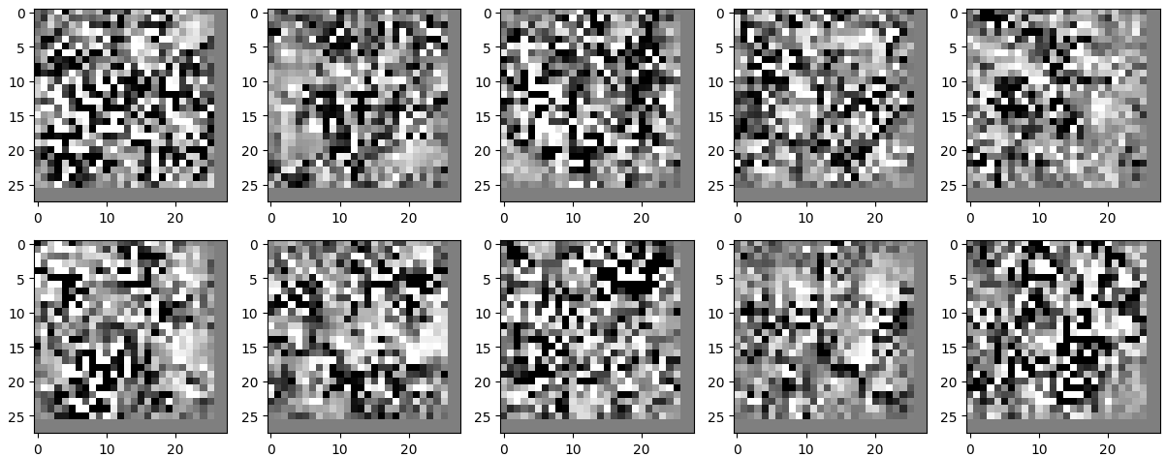
HE Defense
If attacker has no idea on model updates, the attack failed

Slide 27
Evaluation
From bar charts, we can explain the more gradient, the model is more sensitive towards the attack.
From the above results, we observe that increasing the number of iterations enhances the effectiveness of the attack.
In the similar scenario, increasing the threshold, improves the attack performance.
Coming through the HE, HE allows to prevent the data from the attack, allowing the attacker to access only the encrypted information, putting data preserved.

Slide 28
challenges
When model is trained too much – we couldn't able to establish the attack as expected.
While performing the attack the CIFAR10 dataset, the data reconstruction could be viewed but couldn't able to get as expected.
Keras Classifier uses tensorflow, which is inaccessible in latest version of python on 3.13, which is available only on the older versions below 3.11. Windows installer is not available for these older versions.
Port localhost:8888 – default port for jupyter notebook, had raised issues, changed to another port

Slide 29
Possible extensions
The CKKS scheme in TenSEAL supports approximate arithmetic and works with additions and multiplications. Division is not supported natively and must be approximated using multiplications and inverses.

Slide 30
references
Fredrikson, M., Jha, S., & Ristenpart, T. (2015). Model inversion attacks that exploit confidence information and basic countermeasures. In Proceedings of the 22nd ACM SIGSAC Conference on Computer and Communications Security (pp. 1322–1333). ACM Press. [1]
Zhu, L., Liu, Z., & Han, S. (2019). Model inversion attacks against federated learning systems. In Advances in Neural Information Processing Systems (NeurIPS). Accessed from NeurIPS proceedings. [2]
Shokri, R., Stronati, M., Song, C., & Shmatikov, V. (2017). Membership inference attacks against machine learning models. In Proceedings of the IEEE Symposium on Security and Privacy, pages 3–18. [3]

