Slide 1
Data Table
A DataTable is very similar to your physical database table
It consists of several columns with particular properties
Might have zero or more rows of data
Zero or more constraints
DataTable consists of
DataRowCollection which is a collection of DataRow instances
DataColumnCollection which is a collection of DataColumn instances
The Constraints collection can be populated with either unique or primary key constraints

Slide 2
Data Column
A DataColumn object defines properties of a column within the DataTable , such as the data type of that column, whether the column is read - only, and various other facts
A column can be created in code, or it can be automatically generated by the runtime
The data type of the column can be set either by supplying it in the constructor or by setting the DataType property
Data columns can be created to hold the following .NET Framework data types
Boolean, Decimal, Int64, TimeSpan, Byte, Double, Sbyte, UInt16, Char, Int16, Single, UInt32, DateTime,Int32,String , UInt64

Slide 3
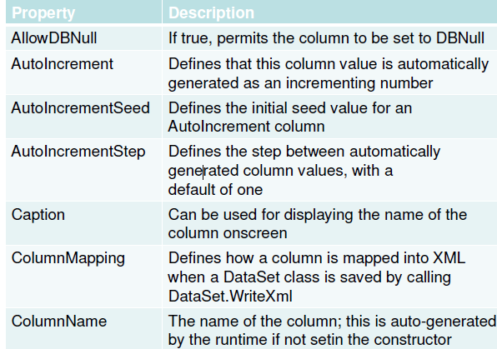
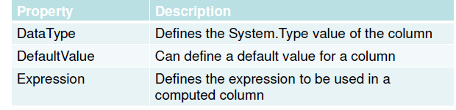
Data Column Properties

