Slide 1
Data Adaptor
Dataadaptor is a acts like mediator b/w Dataset and database.
Dataadaptor will transfer data between Dataset and database.
Dataadaptor will perform 2 things
a. Placing data from database into dataset
b.applying dataset changes to database.

Slide 2
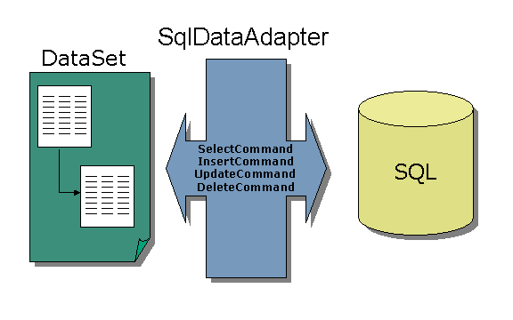

Slide 3
Data Adaptor
Declaration:
SqlDataadaptor da=new SqlDataadaptor("Sql_statement", connection object)
Methods:
fill(): it will perform following things
open the connection
execute the query on database
close connection[After getting the data to the dataset]
store the table data into dataset.
da. Fill(ds, ” tablename”)
da.Fill(ds)

Slide 4
Data Adaptor
update()-it will update dataset changes to database table
da. Update(ds,” tablename”)
Placing Data into Dataset:
Create Connection Object.
Creating Data Adaptor object by attaching select stmt and connection object.
SqldataAdaptor da=new SqlDataAdaptor(“selectstatement”,conobject)
Creating Dataset Object
Dataset ds=new Dataset()
Placing data into dataset using data adaptor
da. Fill (ds) or Da. Fill (ds,” talbe_name”)

Slide 5
Command Builder
command builder class:
Command builder is a predefined class which is used to generate the syntax of DML syntax automatically[insert, update, delete]
Commandbuilder is used to only to create syntax but not execute
Command builder works with the help of data adaptor
command builder will not attach delete and update statements to data adaptor, if the database table is not having primary key column.
SqlCommandBuilder cb=new SqlCommandBuilder(da)

