Slide 1
Transactions
A transaction is a set of operations that must either succeed or fail as a unit
Transactions are required when you work with inter-relation queries.
Goal of a transaction is to ensure that data is always in a valid and consistent state
For Ex: Consider a transaction that transfers funds from one account A to another account B.
Should deduct amount from Account A
Should add amount to Account B
If the application completes step 1 successfully and while executing step2 suppose there occurs an error, then there would exist inconsistent data
Transactions help avoid these problems by ensuring that changes are committed only if all steps are successful
So a system stays in one of two valid states, initial state with no money transferred and the final state with money debited from one account and credited into another account

Slide 2
Transactions
Most ADO.NET providers support for database transactions
Transactions are started through the connection object by calling the BeginTransaction() method
This method returns a provider specific Transaction object, that would manage the transaction
All Transaction classes implement the IDbTransaction interface.
For Ex: SqlTransaction : IDbTransaction
Transaction class provides two key methods
Commit(): Identifies that the transaction is complete and that pending changes should be stored permanently
RollBack(): Indicates that the transaction was unsuccessful. Pending changes are discarded and the database state remains unchanged

Slide 3
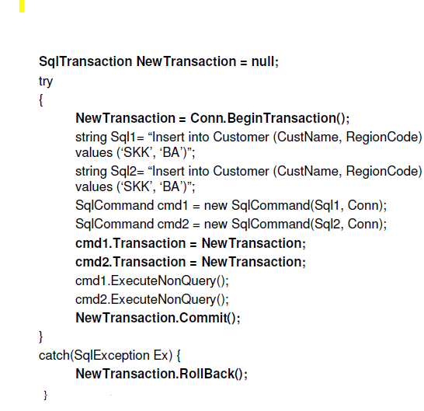
Transactions

