Slide 1
Delegates
Delegates are similar to function pointers in c++
It is a mechanism by which methods can be passed as method parameters instead of data.
But unlike C’s function pointer, delegates are type-safe and object oriented.
Delegates are used to implement call-backs.
A method can call another method through the delegate that is passed to it . This is known as an asynchronous callback.
Like class and interface it is also a type and its references are also created and instantiated.
A Delegate is an object that refer to a method.
Delegates are general-purpose mechanism for indirectly calling methods at runtime.
When we call a Delegate all the methods associate with the Delegate object will executes.

Slide 2
Delegates
To implement delegate in our application we need to declare delegates, instantiate delegates and call delegates.
We can declare delegates by using delegate keyword.
Declaration:
access-modifier delegate return-type delegate-name(parameter-list);
Ex: delegate void Mydelegate(string s);
Instantiation
delegate-name object-name=new delegate-name(method-name)
Or
delegate-name object-name=method-name
Invocation
object-name();
Note: The delegate can refer to the methods, which have the same signature and return type of the delegate .

Slide 3
Types of Delegates
Delegates are two types.
Single- cast Delegate
Multi cast Delegate

Slide 4
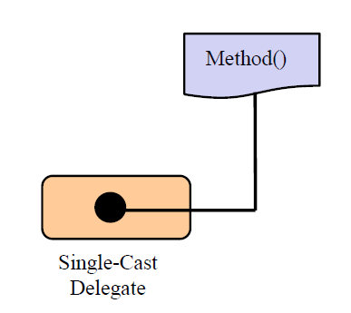
Types of Delegates[Contd.]
Single cast Delegate:
Single-cast delegate refer to one method at a time.
A single-cast delegate derived from System.Delegate class

Slide 5
Multicast Delegate
A Multicast delegate can invoke multiple methods at same time.
A Multicast delegate refers from the System.MulticastDelegate Class
When a multicast delegate is called ,it executes all the methods it wraps in the calling order.
The methods called by the multicast delegate should not have a return value.

Slide 6
Multicast Delegate
add a method to the delegate object , you simply make use of the overloaded += operator.
remove a method from the delegate object you make use of the overloaded operator -=
multicast delegates calls a sequence of methods in the specified order.
If one of the methods in the sequence throws an exception, the iteration stops there!

Slide 7
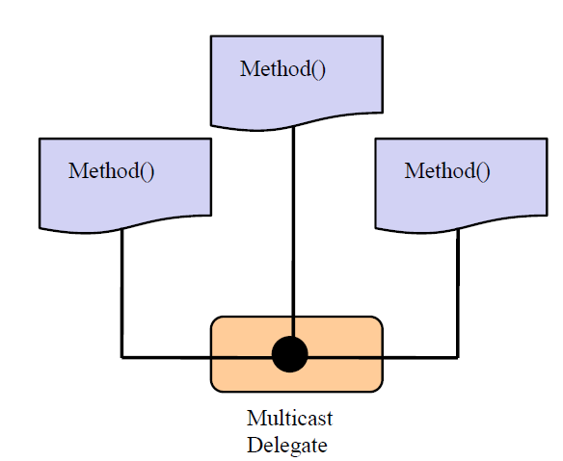
Multicast Delegate

Slide 8
Delegates
why delegates:
Delegates are type-safe
In Event handling mechanism to know which method to call when the event occurs.
In multithreaded programming to supply the starting point of the thread execution.

Slide 9
Anonymous Methods
Anonymous method is a new feature added in C# 2.0
An anonymous method is an unnamed block of code that is used as parameter for the delegate.
Public delegate void Mydelegate();
Mydelegate d=delegate
{
----------------------
-------------------- Anonymous code
};
d()

Slide 10
Care with anonymous methods
Cannot use break, goto or continue statements.
ref and out parameters of the enclosing method cannot be accessed.
Code is slower.
Advantage of anonymous method come when you have to write a piece of code which will be used only in a single context.

Slide 11
Lambda expression
A lambda expression is an anonymous function that can be used to create delegates or expression tree types.
=> is the lambda operator, which is read as "goes to".
many LINQ expressions can be written using Lambda expression.
It is very easy to use aggregate functions with lambda expression.

Slide 12
Lambda expression example
using System;
class X
{
delegate int cube(int i);
static void Main(string[] args)
{
cube myDelegate = x => x*x*x;
int j = myDelegate(5);
Console.Write(j);
}
}
//Prints 125

