Slide 1
HTML
HTML stands for Hyper Text Markup Language.
HTML is a presentation Language to present data on webpage.
HTML is not case sensitive language.
HTML standards are provided by W3C[World Wide Web Consortium]
HTML is a error free language.
HTML is useful to develop static web pages.
HTML comes with predefined tags and entities.
Extension of HTML is .html or .htm

Slide 2
HTML Sturcture
<html>
<head>
<title>
Title of the webpage
</title>
</head>
<body>
--------
</body>
</html>
<head>
Declare JavaScript
Declare styles
Declare external styles files
Declare js files
Declare meta info
</head>
<Body>
To declare all predefined Tags
</Body>

Slide 3
HTML
Html comes with predefined tags and entities
The general format for a HTML tag is:
<tag_name>string of text</tag_name>
Heading Tags
h1,h2,h3,h4,h5,h6
<h1>Welcome to HTML</h1>
<p></p> for paragraphs
<span>EmpID</span>
Adding Images
<img src="peter.jpg" width="200" height="150" alt="My friend Peter">
The alt attribute is used to give the short description

Slide 4
Overview
Adding links
<a href="peter.html">Peter's page</a>
<a href=“home.html"><img src="logo.gif" alt="home page"></a>
Adding lists
a) unordered list.
<ul>
<li> the first list item</li>
<li> the second list item</li>
</ul>

Slide 5
Overview
b) ordered list.
<ol type=1> (type=1 or a or i)
<li> the first list item</li>
<li> the second list item</li>
</ol>
Note:<br> is use to line brakes

Slide 6
Tables
Tables are used for information as well as for layout.
<table border="1"> <tr><th>Year</th><th>Sales</th></tr> <tr><td>2000</td><td>$18M</td></tr> <tr><td>2001</td><td>$25M</td></tr> <tr><td>2002</td><td>$36M</td></tr>
</table>
<table border="1" cellpadding="10">
<table border="1" cellpadding="10" cellspacing="10">
<table border="1" cellpadding="10" width="80%">

Slide 7
Overview
Entities:
&nbsp; | Blank space
&copy; | ©
&reg; | ®
&#8482; | ™

Slide 8
Forms
Form tag is used to create controls on the page
<form>
<input type=“text” name=“txtuser”>
<input type=“password” name=“txtpass”>
<input type=“submit” value=“Login”>
</form>
Form tag attributes
method- specifies the way how the data is to be sent to the server (request from client to server)
most important values for method attribute are;
get, post
Other values are- delete, options, trace, put, head
action – specifies the file to be invoked on submitting the form to the server

Slide 9
Forms
Input Controls.
TextBox:
<input type=“text” name=“txtuser”>
Password:
<input type=“password” name=“txtpass”>
Button
<input type=“button” value=“clickme”>
<input type=“submit” value=“Login”>
<input type=“reset” value=“reset”>
Checkbox
<input type=“checkbox” value=“clickme”>
Radio
<input type=“Radio” value=“clickme”>

Slide 10
Forms
Combo Box(only one selection at a time)
<select name=“country”>
<option value="India"> India </option>
<option value="China"> China </option>
</select>
List Box(one/many selection allowetd)
<select name=“country” multiple=multiple>
<option value="India"> India </option>
<option value="China"> China </option>
</select>

Slide 11
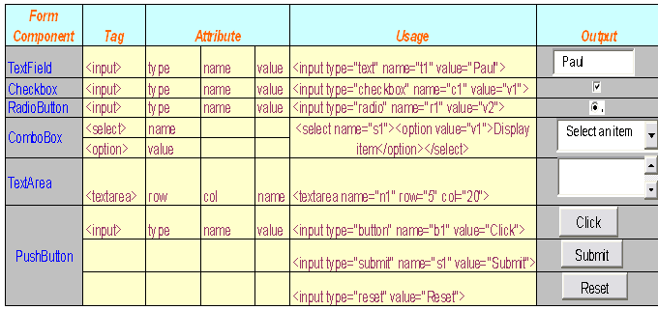

Slide 12
Html
Some other formatting tags
<b> </b> - makes the text bold
<i> </i> - makes the text italics
<p> </p> - creates a paragraph
<center> </center> -aligns the text center
<HR> - draws a horizontal line
<font> </font> - specifies type and size of font
face=“Times New Roma” size=29

