Slide 1
What is the Internet?
Network: a group of connected computers/devices
internet: a network of networks
Internet: the world wide web

Slide 2
Internet address
Used to identify a computer connected to the Internet.
Every address must be unique, since the computer represented by that address is unique to the Internet.
The Internet Corporation for Assigned Names and Numbers (ICANN) is an internationally organized, non-profit corporation that has responsibility for Internet Protocol (IP) address space allocation, protocol identifier assignment.

Slide 3
Internet address
Internet addresses can be represented in terms of textual domain names, such as www.yahoo.com and mapped to corresponding IP addresses. The IP for www.yahoo .com is 205.132.48.237.

Slide 4
Protocol
A protocol is a set of rules for communicating across the Internet. Both parties know and follow the rules for sending and receiving information, making meaningful communication possible.
Ex;
Hypertext Transfer Protocol (HTTP)
File Transfer Protocol (FTP)
HTTPS

Slide 5
HTTP
This protocol, the backbone of the World Wide Web, enables users to send and receive information from Internet servers in the form of documents, or pages, written using the Hypertext Markup Language (HTML). The user who receives the document, often called the client, can then use a browser or other form of software that recognizes the HTML language to view the contents of the document.

Slide 6
WWW (World Wide Web)
An information system that brings together data from many of the other Internet services under one set of protocols.
W3 Consortium was created for continuing to develop the standards. The consortium put together a set of protocols for the World Wide Web.

Slide 7
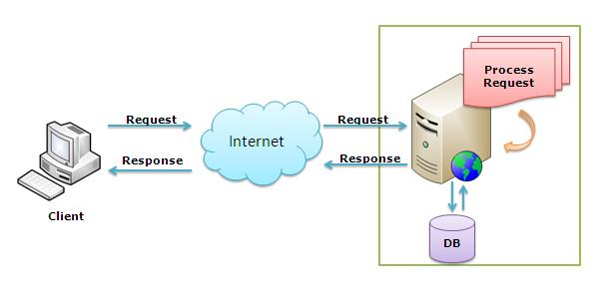
Basic Process

Slide 8
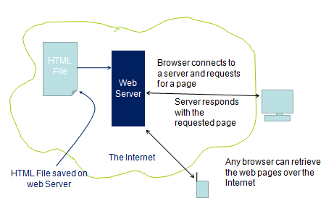
Basic Process

Slide 9
Behind the Scene!!!
The browser breaks the URL into three parts:
The protocol ("http")
The server name ("www.rediff.com")
The file name (“index.html")
The browser communicates with a name server to translate the server name "www.rediff.com" into an IP Address, which it uses to connect to the server machine.
The browser then establishes a connection with the server at that IP address on port 80.

Slide 10
Behind the Scene!!!
Following the HTTP protocol, the browser sends a request to the server, asking for the file http://www.rediff.com/index.html
The server then sends the HTML text for the Web page to the browser.
The browser reads the HTML tags, formats the page and displays it onto your screen.

