Slide 1
Overview
There are two ways to store data in computer system
Using file system
Ex: text file(.txt, .doc),spreadsheets(Excel file)
Using database
Ex: MsAccess,Sql Server, Oracle

Slide 2
Disadvantages with file system
For data entry and retrieval large special programs need to be written.
Programs must make sure that there is no redundant data.
Programs must ensure that data is consistent when different user manipulates the same data concurrently .
Retrieval of particular data from a large volume will require complex coding.
Different users in different system may store the data on different files. This leads to data isolation .Writing programs to merge the data, retrieve data etc. becomes extremely difficult.
No way to check the integrity of data.
There is no way to check if some inappropriate values (like negative salary) is entered in the file.

Slide 3
Database system
Database is a collection of meaningful and related data.
The software that manages this data is database management system (DBMS) or database system.
Advantages of database system
Easy storage and retrieval
Data integrity
Controlled Redundancy
Data Consistency
Security
Transaction and Concurrency
Crash Recovery
Administration

Slide 4
Database Models
Hierarchical Model
This database model organises data into a tree-like-structure, with a single root, to which all the other data is linked.
The heirarchy starts from the Root data, and expands like a tree, adding child nodes to the parent nodes.
In this model, a child node will only have a single parent node.
This model efficiently describes many real-world relationships like index of a book, recipes etc.

Slide 5
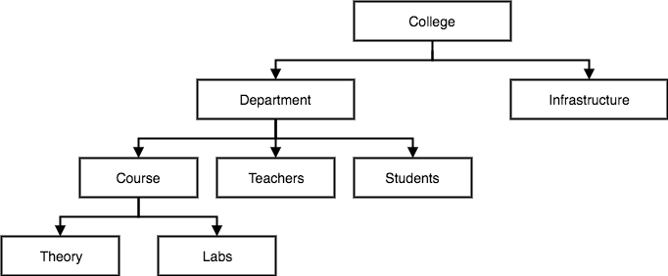
Database Models
In hierarchical model, data is organised into tree-like structure with one one-to-many relationship between two different types of data, for example, one department can have many courses, many professors and of-course many students.

Slide 6
Database Models
Network Model
This is an extension of the Hierarchical model. In this model data is organised more like a graph, and are allowed to have more than one parent node.
In this database model data is more related as more relationships are established in this database model. Also, as the data is more related, hence accessing the data is also easier and fast. This database model was used to map many-to-many data relationships.
This was the most widely used database model, before Relational Model was introduced.

Slide 7
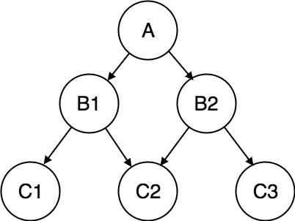
Database Models
Network Model

Slide 8
Database Models
Relational Model(widely used database model)
Most database system use this model.
In this model, data is organised in two-dimensional tables and the relationship is maintained by storing a common field.
The basic structure of data in the relational model is tables. All the information related to a particular type is stored in rows of that table.
Relationship is maintained by the common attributes in the tables. Can be one-one or one to many or many to many.
An example of representation of a relation Student is:
Student(studid integer, name string)
Marks(studid integer semester:integer, marks:double)

Slide 9
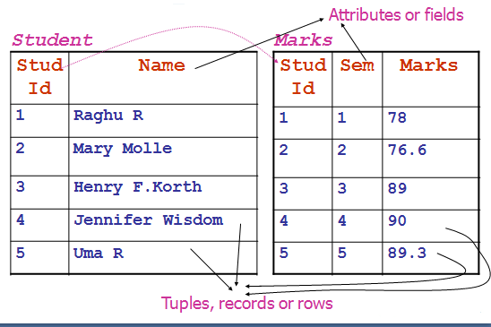

Slide 10
RDBMS Products
MS-SQL Server
Oracle
MySQL
Sybase
DB2

