Slide 1
Multi-Country Retail Analytics Pipeline
Electronics Retail | End-to-End AWS Data Pipeline
ITC Capstone Project
Presented by Sruthi
Sruthi | ITC Capstone Project
1

Slide 2
Contents
1.
Objective
3
2.
Problem Statement
4
3.
Data Source
5
4.
Architecture
6
5.
Dimensional Data Modelling
7
6.
Challenges
8
7.
Limitations & Improvements
9
8.
Live Results
10
Sruthi | ITC Capstone Project
2

Slide 3
Objective
What I set out to build with this project:
A fully automated pipeline
Ingest, clean, and transform multi-country sales data without manual steps in between.
A unified view across currencies
Normalise revenue across currencies so performance can genuinely be compared country to country.
A reliable, historically accurate data model
Model the data properly so reporting reflects what was true at the time, not just today's state.
End-to-end orchestration with monitoring
Automate the full pipeline with built-in alerting, so failures and data-quality issues are caught immediately.
A business-ready dashboard
Surface country, product, and brand-level insights that leadership can actually act on.
Sruthi | ITC Capstone Project
3

Slide 4
Problem Statement
An electronics retailer runs sales across multiple countries, but every transaction sits in a single PostgreSQL database with no way to analyse it meaningfully by country.
United Kingdom
Germany
Italy
Netherlands
France
FRAGMENTED BY DESIGN
NO COMMON CURRENCY
The transactional database was built to run day-to-day operations, not to be queried for analysis. Getting a straight answer to a business question meant querying production directly or waiting on a manual export.
Prices are stored in each country's local currency. Without converting everything onto a common footing first, there's no honest way to compare revenue or performance across markets, let alone see a true global picture.
Leadership is not asking for one global number. It needs to compare market against market, on equal terms.
Sruthi | ITC Capstone Project
4

Slide 5
Data Source
Roughly 10,000 sales records, along with the associated customer, product, and brand data behind them. Going in, the raw data had real quality problems.
WHAT NEEDED CLEANING
HOW IT ARRIVES
Null values scattered across key fields
Incorrect data types on numeric and date fields
Records with no valid link back to related tables
Leading and trailing whitespace in text fields
Invalid numeric values, such as non-whole quantities
Inconsistent formatting and casing in text fields
Ingestion runs as a batch process. AWS Database Migration Service continuously monitors the source PostgreSQL database for changes and reloads automatically whenever something changes, so the pipeline always works from current data rather than a stale snapshot.
Every field that fails validation downstream is rejected with a reason, not dropped silently, and rolled up into an automated exception report after each run.
Sruthi | ITC Capstone Project
5

Slide 6
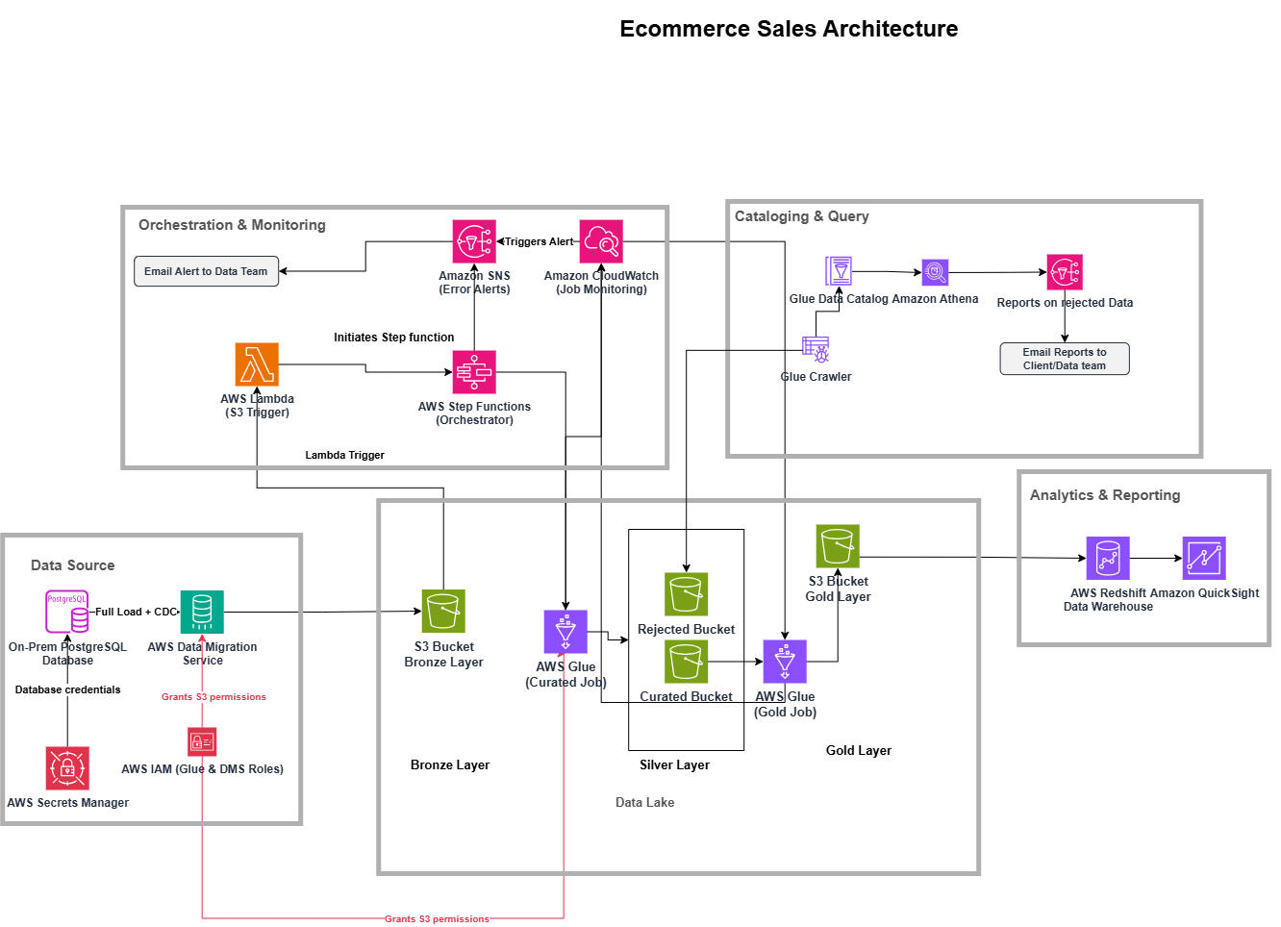
Architecture
Sruthi | ITC Capstone Project
6

Slide 7
Dimensional Data Modelling
STAR SCHEMA
A central fact table for sales, surrounded by dimension tables for stores, dates, customers, products, and exchange rates.
dim_customers
dim_products
Type 2
Type 2
TYPE 1 vs TYPE 2
Customers and products use Type 2 slowly changing dimensions, every historical version is preserved, so a record's state at the time of the sale is what a report actually sees.
Stores, dates, and exchange rates use Type 1, only the current version matters for these, so they're simply overwritten in place.
fact_sales
grain: order line
dim_stores
dim_date
Type 1
Type 1
dim_exchange_rates
A 2016 order joins to the customer address and product price that applied in 2016, not to today's values.
Type 1
9,038 fact rows | 2,850 customers | 2,577 products | 63 stores
Sruthi | ITC Capstone Project
7

Slide 8
Challenges
Lambda or Glue for the first layer
Append vs overwrite
Which service should run the raw to curated transformation?
Duplicate Parquet files piling up in the curated layer.
Lambda suits short, event-driven work. This is a schema-based batch job over full history, so I put the transformation in Glue and narrowed Lambda's role to triggering it when new files land.
Each run reprocesses the full load plus every CDC file, so overwrite is what keeps curated correct. Append was stacking a second copy of the entire history on every run.
Handling CDC in the curated layer
Type 2 SCD with no starting history
DMS writes a separate row for every change, so one customer appears many times.
No initial version existed for customers or products, and every key came back NULL.
I keep every insert, update and delete as its own row in curated, deliberately, so nothing is lost. The gold job then resolves that history, latest wins for Type 1 and versioned for Type 2, so only the correct row reaches the warehouse.
Version start dates came from the CDC capture timestamp, always recent, while orders dated back to 2016, so no join ever matched. I anchored each entity's first version to a far-past date.
Sruthi | ITC Capstone Project
8

Slide 9
Limitations & Improvements
LIMITATIONS
IMPROVEMENTS
Every stage other than the DMS ingestion step reprocesses the full dataset from scratch on each run, rather than incrementally.
Incremental processing
Move to Glue Job Bookmarks so each run only handles new or changed records instead of reprocessing everything, directly addressing the limitation on the left.
At the current scale of about 10,000 records, this keeps the logic simple, reliable, and self-correcting. As the dataset grows significantly, though, it would become slower and more resource intensive with every run.
Retry and timeout policies
Add retries in the orchestration layer so transient errors don't stop the whole workflow on the first failure.
Deeper dashboard interactivity
Drill-downs, cross-filtering, and richer views for customer and product behaviour.
Sruthi | ITC Capstone Project
9

Slide 10
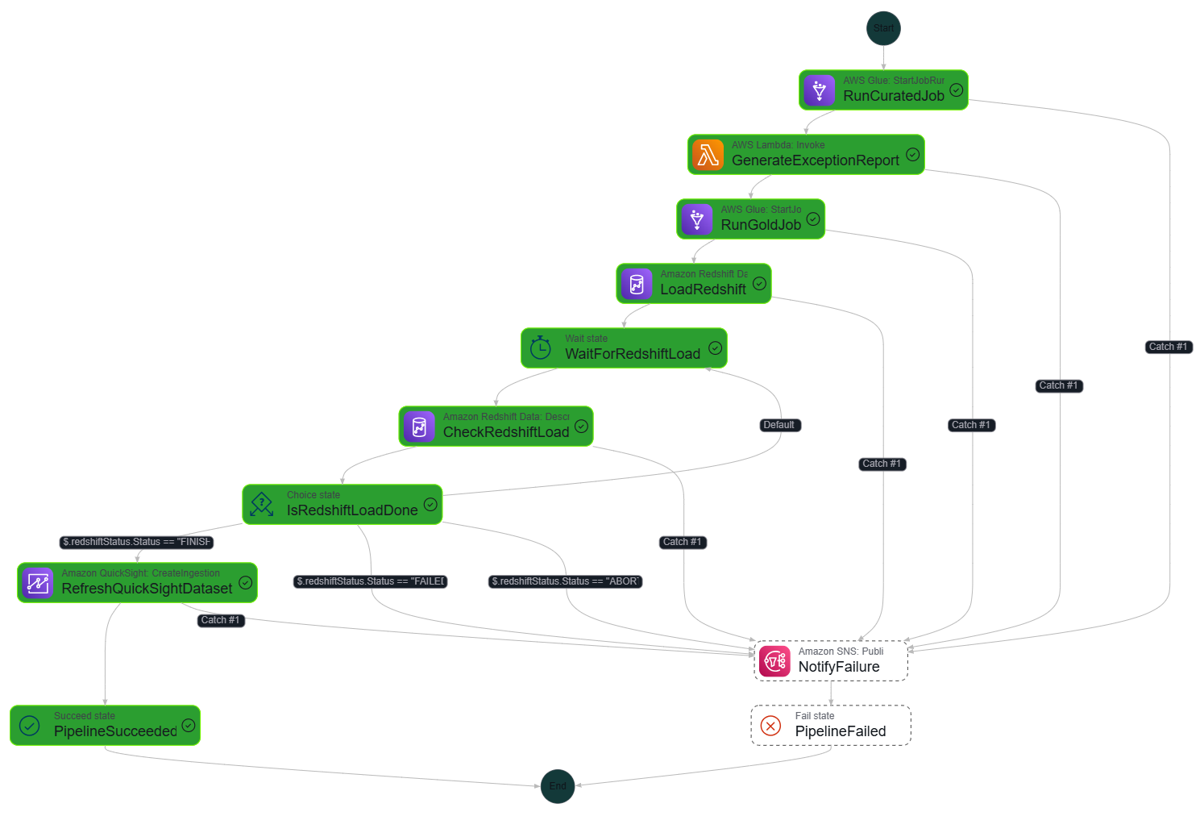
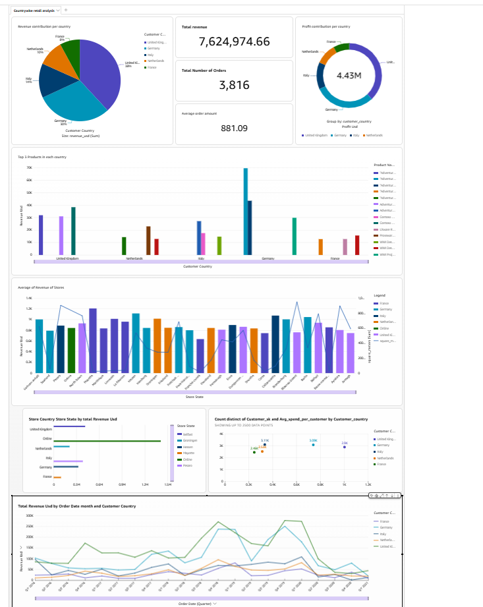
Live Results
PIPELINE RUN
DASHBOARD
Sruthi | ITC Capstone Project
10

