Slide 1

Understanding Obsessive-Compulsive Disorder (OCD): A Comprehensive Analysis of Demographics, Clinical Profiles, and Treatment Approaches

Slide 2

Project Description
The project aims to conduct a comprehensive analysis of the "OCD Patient Dataset: Demographics & Clinical Data" using SQL and Power BI. This dataset contains detailed information on 1500 individuals diagnosed with Obsessive-Compulsive Disorder (OCD), encompassing demographic, clinical, and treatment-related parameters.

Slide 3

Demographic Analysis: Explore the demographic characteristics of the sample population including age distribution, gender representation, ethnicity, marital status, and education level.
Clinical Profile Examination: Analyze clinical information such as the date of OCD diagnosis, duration of symptoms, previous psychiatric diagnoses, and co-occurring mental health conditions (e.g., depression, anxiety).
Symptom Analysis: Investigate the specific nature of OCD symptoms, categorizing them into obsession and compulsion types, and assess the severity using Yale-Brown Obsessive-Compulsive Scale (Y-BOCS) scores.
Treatment Approach Evaluation: Examine the medications prescribed to patients, identifying common medications and their frequencies. Investigate any trends in treatment approaches based on demographic or clinical factors.
Family History Exploration: Analyze the presence of family history of OCD among patients and explore its association with demographic and clinical variables.
Visualization and Reporting: Utilize Power BI to create interactive visualizations and dashboards to present key findings effectively, enabling stakeholders to gain insights into the complex interplay of demographic, clinical, and treatment-related factors in OCD.

Slide 4

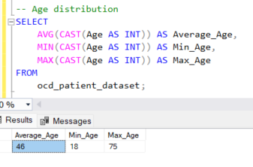
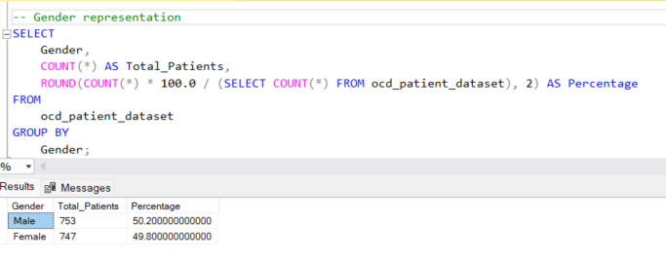
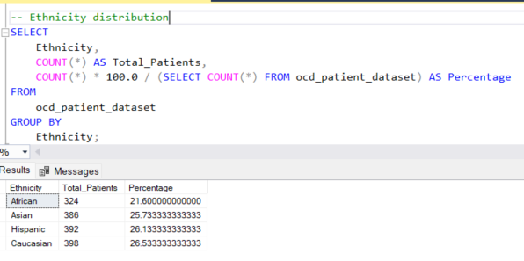
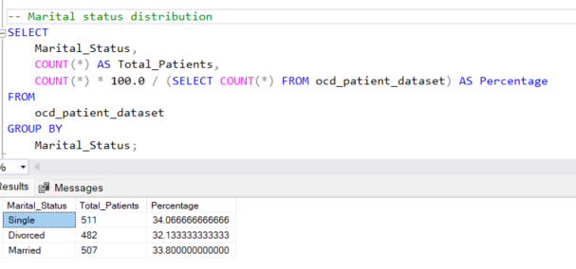
Demographic Analysis
Exploring the demographic characteristics of the sample population including age distribution, gender representation, ethnicity, marital status, and education level.

Slide 5
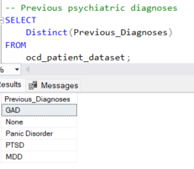

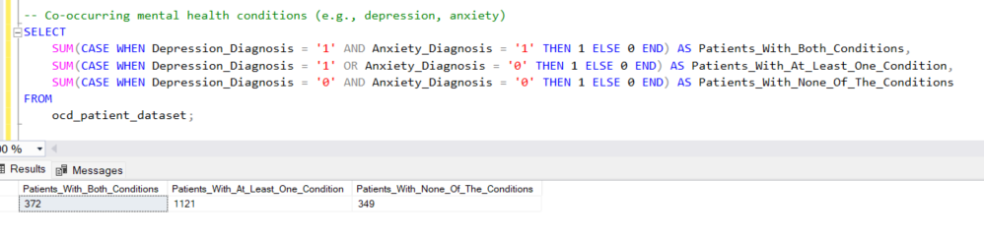
Clinical Profile Examination
Analyzing clinical information such as the date of OCD diagnosis, duration of symptoms, previous psychiatric diagnoses, and co-occurring mental health conditions (e.g., depression, anxiety).

Slide 6
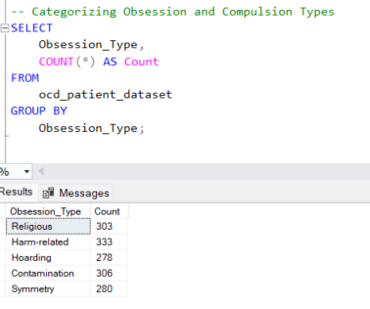
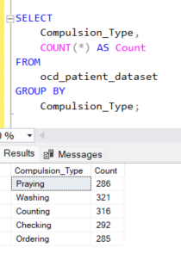
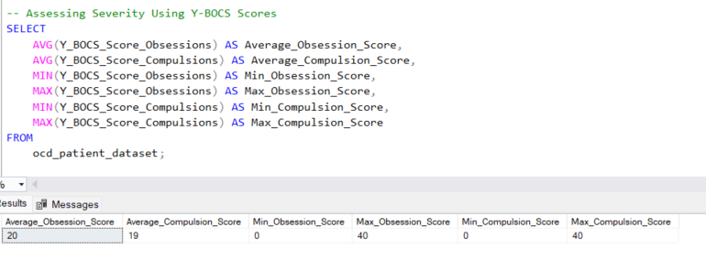
Symptom Analysis
Investigating the specific nature of OCD symptoms, categorizing them into obsession and compulsion types, and assess the severity using Yale-Brown Obsessive-Compulsive Scale (Y-BOCS) scores

Slide 7
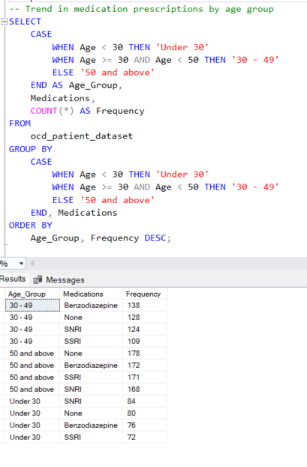
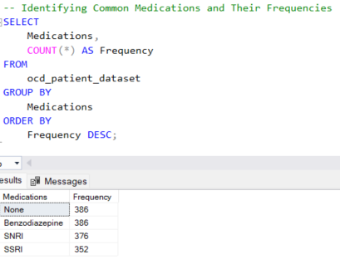
Treatment Approach Evaluation
Examining the medications prescribed to patients, identifying common medications and their frequencies. Investigate any trends in treatment approaches based on demographic or clinical factors.

Slide 8
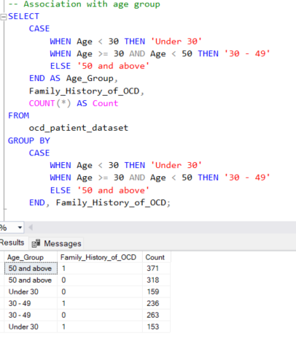
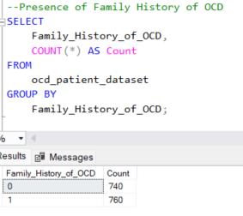
Family History Exploration
Analyzing the presence of family history of OCD among patients and explore its association with demographic and clinical variables

