Slide 1
Design Discussion 1
Chisel tips and RISCV

Slide 2
Core Design Thus Far and RISCV overview
ALU
ALUcontrol
Memory
Modified Forwarding unit
General RISCV instruction set pointers

Slide 3
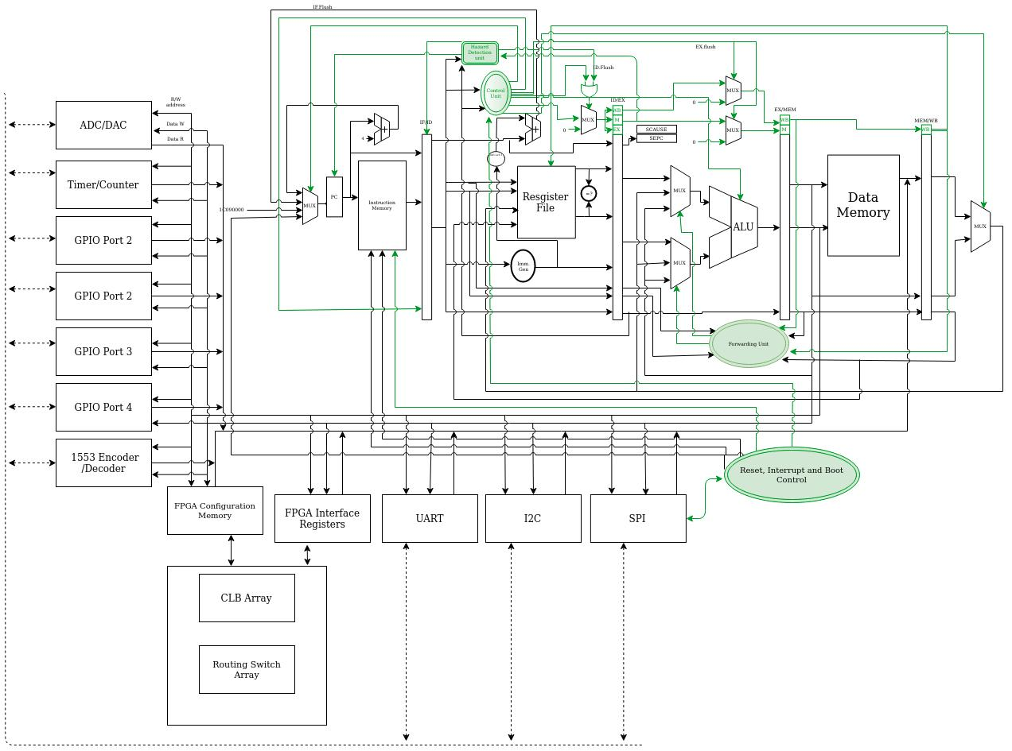

Slide 4
ALU
Supports &,|, ^, +,-, >>,<<, >>(a), mul(h&L), mulhU, mulhsu, signed and Usigned versions of DIV and REM
Has zero detection

Slide 5
ALU Control
Refer Design Doc.
A purely combinational approach.
Relies on Control unit to decode only instruction type.

Slide 6
MEMORY
SyncReadMem
Is ussually elaborated to be compatible with SRAM in foundry.
Will form both I and D memories.
I memory is written only by boot manager

Slide 7
Forwarding and hazard deetction
Additional Writeback forwarding to be included as registers cannot be written to and read from in the same clock cycle.
Branch detection to be included in execusion stage. Predictor predicts always taken.
Stall happens when branch is dropped.

Slide 8
Chisel Conventions and Best Practices
Use of immutable data types in scala: iterators and the like.
Managing multiple clock domains.
Parametrization
Identifying sub components of a design : abstraction.

Slide 9
Immutables
List, Vec, Seq.....
Cannot be redefined once initialized.
Hence can be used to initialize hardware that is readOnly or create a template

Slide 10
Clock domains.
withClock(clock: Clock){ .......}
withClockandReset(clock: Clock, reset: Bool()){....}
For interfaces use Queue modules: refer Cheatsheet

Slide 11
Parametrization
abstract class Params{......}
Use Integers (generally scala types) as parameters for synthesis. Better flexibility and scalbility.

Slide 12
Abstraction
General approach to deisgn can vary but scala allows for easier expressibility. Hence need for less no. Of submodules.
Code functionally not objectively.

