Slide 2
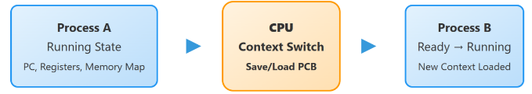
THREAD
Thread: Smallest execution unit within a process → Enables parallelism, responsiveness, better CPU use
Multithreading Suitability Independent / I-O task
Sequential / tightly dependent tasks → Not all tasks benefit (overhead + complexity)
Context & Switching
Context = thread state (PC, registers)
Context switch = CPU switches threads (costly if frequent)
Shared Resources
Threads share memory → fast but risky
Issues: race conditions
Solution: synchronization (locks)
Thread States New → Ready → Running → Waiting → Terminated

Slide 3
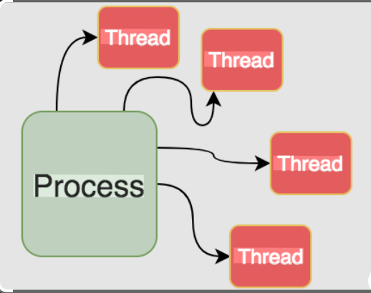
PROCESS VS THREAD
Process
Independent program in execution
Has separate memory space (high isolation)
Heavyweight (more resource usage)
Communication via IPC (Inter-Process Communication)
Slower context switching
Thread
Smallest unit within a process
Shares memory & resources of process
Lightweight (faster execution)
Communication is easy (shared memory)
Faster context switching

Slide 4
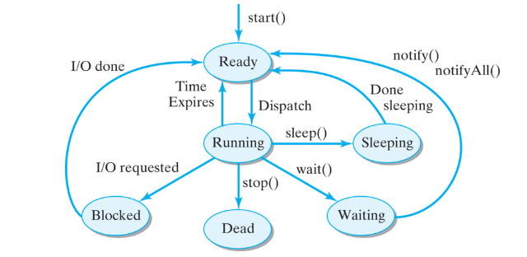
THREAD LIFE CYCLE
Start → Thread is created
Run (Time Slice) → Executes for allotted CPU time
Pause (Blocked/Waiting) → Waiting for I/O or resource.
Resume → Moves back to ready/running state
Stop (Terminated) → Execution completed
Order of Execution (Scheduling)
FIFO (First In First Out) → Executes threads in arrival order
Priority Scheduling → Higher priority threads run first
Shortest Job First (SJF)
→ Thread with least execution time runs first

