Slide 1
STUDY SYNC
A Student Productivity and Task Management System
Presented By:
Sruthi.Vemula

Slide 2
AIM:
The main aim of the Student Task Manager is to help students organize, manage and track their daily academic activities efficiently.

Slide 3
Objectives:
To add and manage daily study tasks.
To edit and delete tasks easily.
To mark tasks as completed.
To display total, completed and pending tasks.
To save task information for future use.

Slide 4
Project Explanation
Student Task Manager is a web-based application developed to help students manage their daily activities.
Working Process:
Students enter their tasks in the input box.
The frontend sends requests to the backend.
The backend processes the requests using Express.js.
Task details are stored in a JSON file.
The updated task list is displayed on the webpage.

Slide 5
Source Code:
<!DOCTYPE html>
<html>
<head>
<title>Student Task Manager</title>
<style>
*{box-sizing:border-box;margin:0;padding:0}
body{font-family:Arial;background:#eef3f9;color:#26344a}
.container{max-width:900px;margin:40px auto;padding:20px}
header{background:#2457a7;color:white;padding:30px;text-align:center;border-radius:12px}
header p{margin-top:10px}
.stats{display:flex;gap:15px;margin:20px 0}
.card,.task-box{background:white;padding:22px;border-radius:10px;flex:1;text-align:center}
.card h2{color:#2457a7;margin-top:10px}
.task-box{text-align:left}
.add-task{display:flex;gap:10px;margin:20px 0}
input{flex:1;padding:12px;border:1px solid #ccc;border-radius:7px}
button{padding:10px 14px;border:0;border-radius:7px;background:#2457a7;color:white;cursor:pointer}
.task{display:flex;justify-content:space-between;align-items:center;background:#f3f6fb;padding:12px;margin-top:10px;border-radius:7px;gap:10px}

Slide 6
.done{text-decoration:line-through;color:gray}
.actions{display:flex;gap:5px}
.edit{background:orange}
.delete{background:#dc4444}
footer{text-align:center;padding:20px;color:gray}
@media(max-width:600px){
.stats{flex-direction:column}
.add-task,.task{flex-direction:column}
}
</style>
</head>
<body>
<div class="container">
<header>
<h1>Student Task Manager</h1>
<p>Organize your studies and achieve your goals.</p>
</header>
<div class="stats">

Slide 7
<div class="card">Total Tasks<h2 id="total">0</h2></div>
<div class="card">Completed<h2 id="completed">0</h2></div>
<div class="card">Pending<h2 id="pending">0</h2></div>
</div>
<div class="task-box">
<h2>Manage Your Tasks</h2>
<div class="add-task">
<input id="taskInput" placeholder="Enter your study task">
<button onclick="addTask()">+ Add Task</button>
</div>
<h3>My Tasks</h3>
<div id="taskList"></div>
</div>
<footer>Student Task Manager | FSD Mini Project</footer>
</div>
<script>
let tasks=JSON.parse(localStorage.getItem("tasks"))||[];
function save(){
localStorage.setItem("tasks",JSON.stringify(tasks));
}
function addTask(){

Slide 8
let done=document.createElement("button");
done.textContent=t.completed?"Undo":"Done";
done.onclick=()=>{t.completed=!t.completed;save();display()};
let edit=document.createElement("button");
edit.textContent="Edit";
edit.className="edit";
edit.onclick=()=>{
let n=prompt("Edit task:",t.title);
if(n&&n.trim()){t.title=n.trim();save();display()}
};
let del=document.createElement("button");
del.textContent="Delete";
del.className="delete";
del.onclick=()=>{
if(confirm("Delete this task?")){
tasks=tasks.filter(x=>x.id!==t.id);
save();display();
}
};

Slide 9
actions.append(done,edit,del);
item.append(title,actions);
list.append(item);
});
if(!tasks.length)list.innerHTML="<p>No tasks yet. Add your first task!</p>";
let completed=tasks.filter(t=>t.completed).length;
document.getElementById("total").textContent=tasks.length;
document.getElementById("completed").textContent=completed;
document.getElementById("pending").textContent=tasks.length-completed;
}
display();
</script>
</body>
</html>

Slide 10
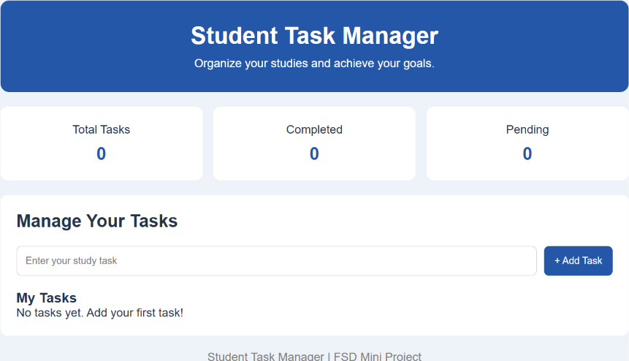
Expected Output:

Slide 11
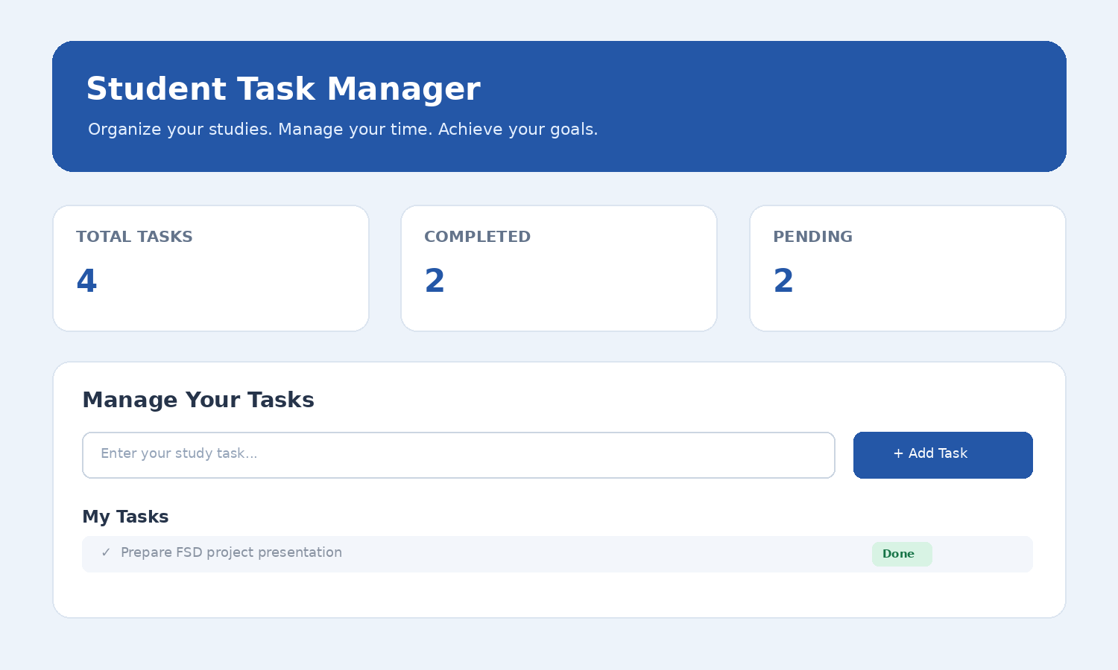
Output and Result:

