Slide 1

Instacart Marketing strategy for an online grocery store Project Brief
The task is to perform an initial data and exploratory analysis of some of their data in order to provide insights into how this strategy may be implemented to ensure that Instacart targets the proper client profiles with the right products.
Project Goals
The dataset comprises of information on the following parameters: Orders, Products & Departments
The data used is an open-source data by Instacart from 2017 and is available here and also used a customer data set created and included for the purpose of this project
Data
Python, Anaconda, Jupyter Notebook
Libraries ( Pandas, Numpy, Seaborn, Matplotlib, Scipy)
Excel
Clean & wrangle Data
Merging datasets
Deriving Variables
Grouping, aggregating & Crosstab functions
Visualization with Matplotlib & seaborn
Tools used
Data Wrangling & Merging
Deriving Variables
Grouping & Aggregating Data
Reporting in Excel & Population Flows
Visualization & Storytelling with Matplotlib & seaborn
Skills

Slide 2
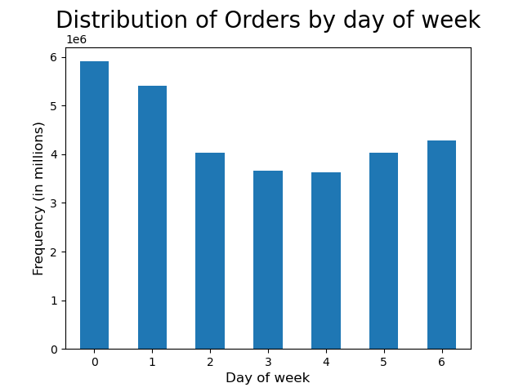
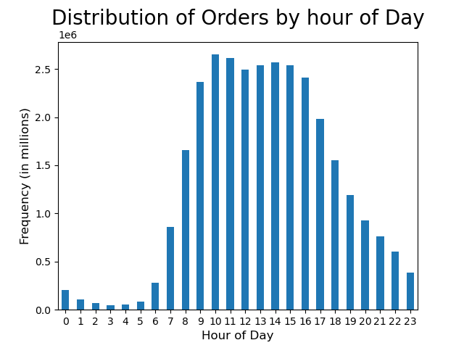
Analysis What the busiest days of the week and hours of the day?
The busiest days of the week are Saturday and Sunday.
The hours between 9am and 4pm had the highest number of orders, with 10am being the peak hour for orders

Slide 3
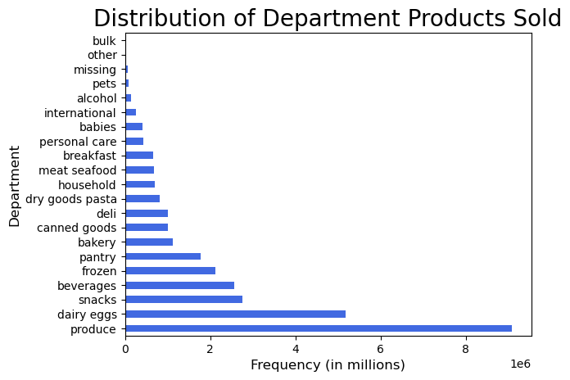
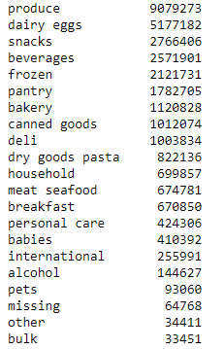
Products that are more popular than others?
The following are the top 5 departments in terms of the frequency of product orders:
Produce
Dairy eggs
Snacks
Beverages
Frozen

Slide 4
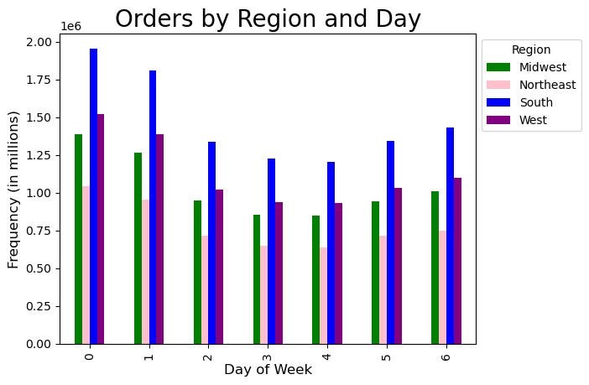
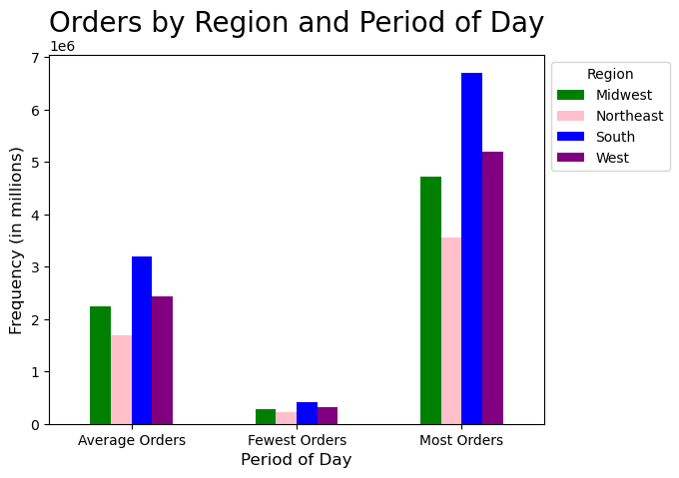
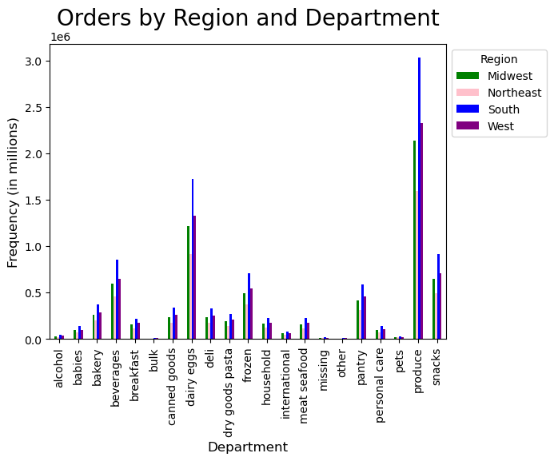
Orders by Region
The South region places the most orders, followed by the West region. Northeast region places the least orders.
The orders placed across the day, the hours, and the department have not significantly changed buyer's purchasing habits.

Slide 5

Insights from Data & Recommendations
Busiest days of the week are Saturday and Sunday
Busiest hours of the day are between 9am to 5pm
Top performing departments are Produce and Dairy Eggs
Southern region has the highest amount of purchasing orders
To encourage people to keep using Instacart's services, a loyalty/rewards program needs to be established. Based on the factors mentioned, it is also recommended to improve advertising and promotions.
To ensure Instacart's sustained success, a further marketing campaign for certain criteria will result in an increase in purchases.
Click below to view detailed Report, Scripts & Visualizations

Slide 6



Let's connect and explore how I can help you achieve your business objectives
sruthysreekanth@gmail.com
https://www.linkedin.com/in/sruthy-sreekanth/
https://github.com/sruthysreekanth
https://public.tableau.com/app/profile/sruthy.sreekanth

