Slide 1
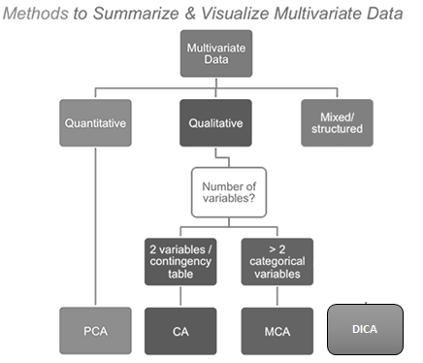
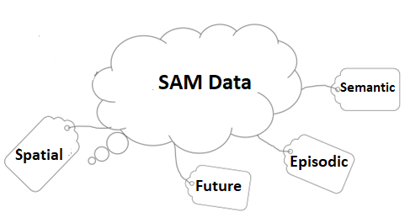
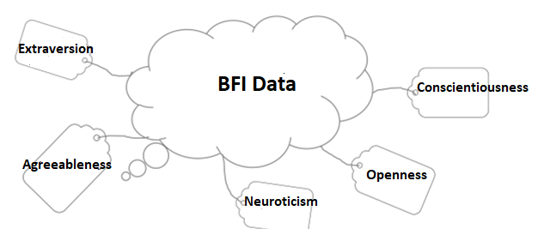
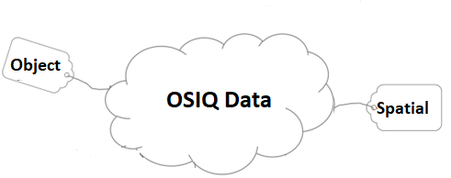

Data Analysis
BADA
MFA
PLS
Dataset Analysis
Advanced Research Methods: 12-04-2017
Sruti Jain

Slide 2

Introduction: Dataset information
Datasets Analyzed:
The survey of autobiographical memory (SAM) Dataset
Object-Spatial Imagery Questionnaire (OSIQ) Dataset
BIG 5 personality questionnaire (BFI) Dataset
Rows: Total participants of 144 after excluding the mystery group.
Supplementary Observations: 9 (mystery group)
Columns:
Design: memoryGroups, Sex, Age
26 variables (SAM), 30 variables (OSIQ) & 44 variables (BFI)
Research Question:
How the questions are related to memory & how is behavior and memory related to one another?

Slide 3
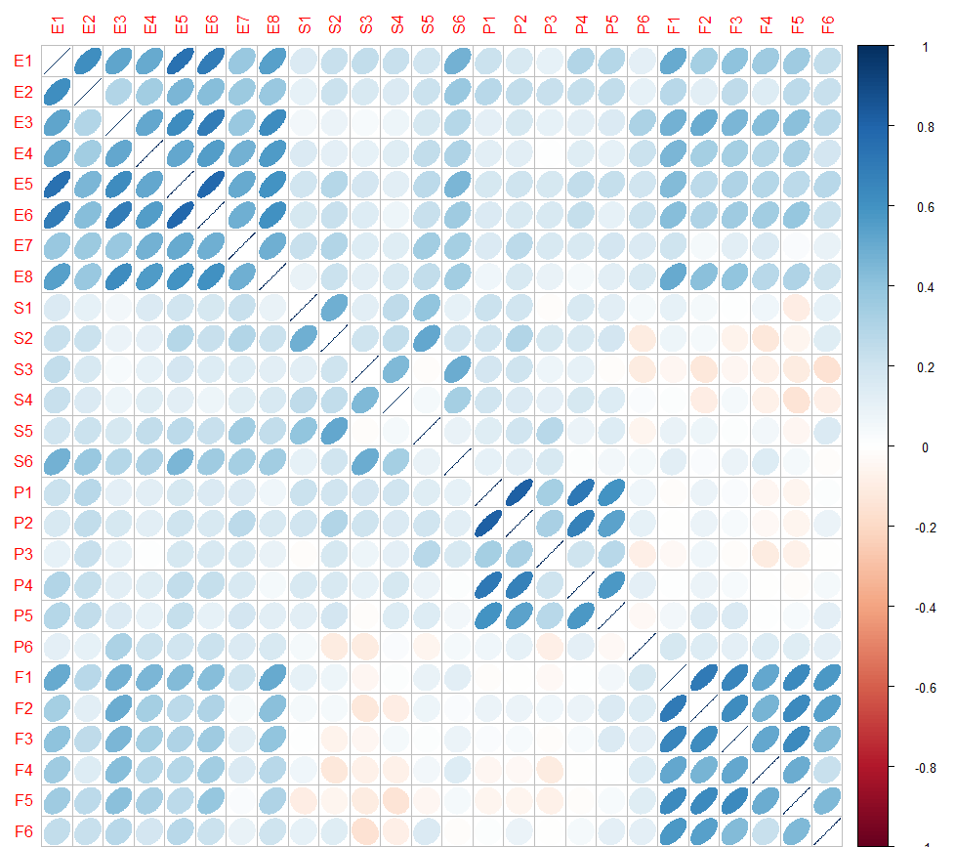
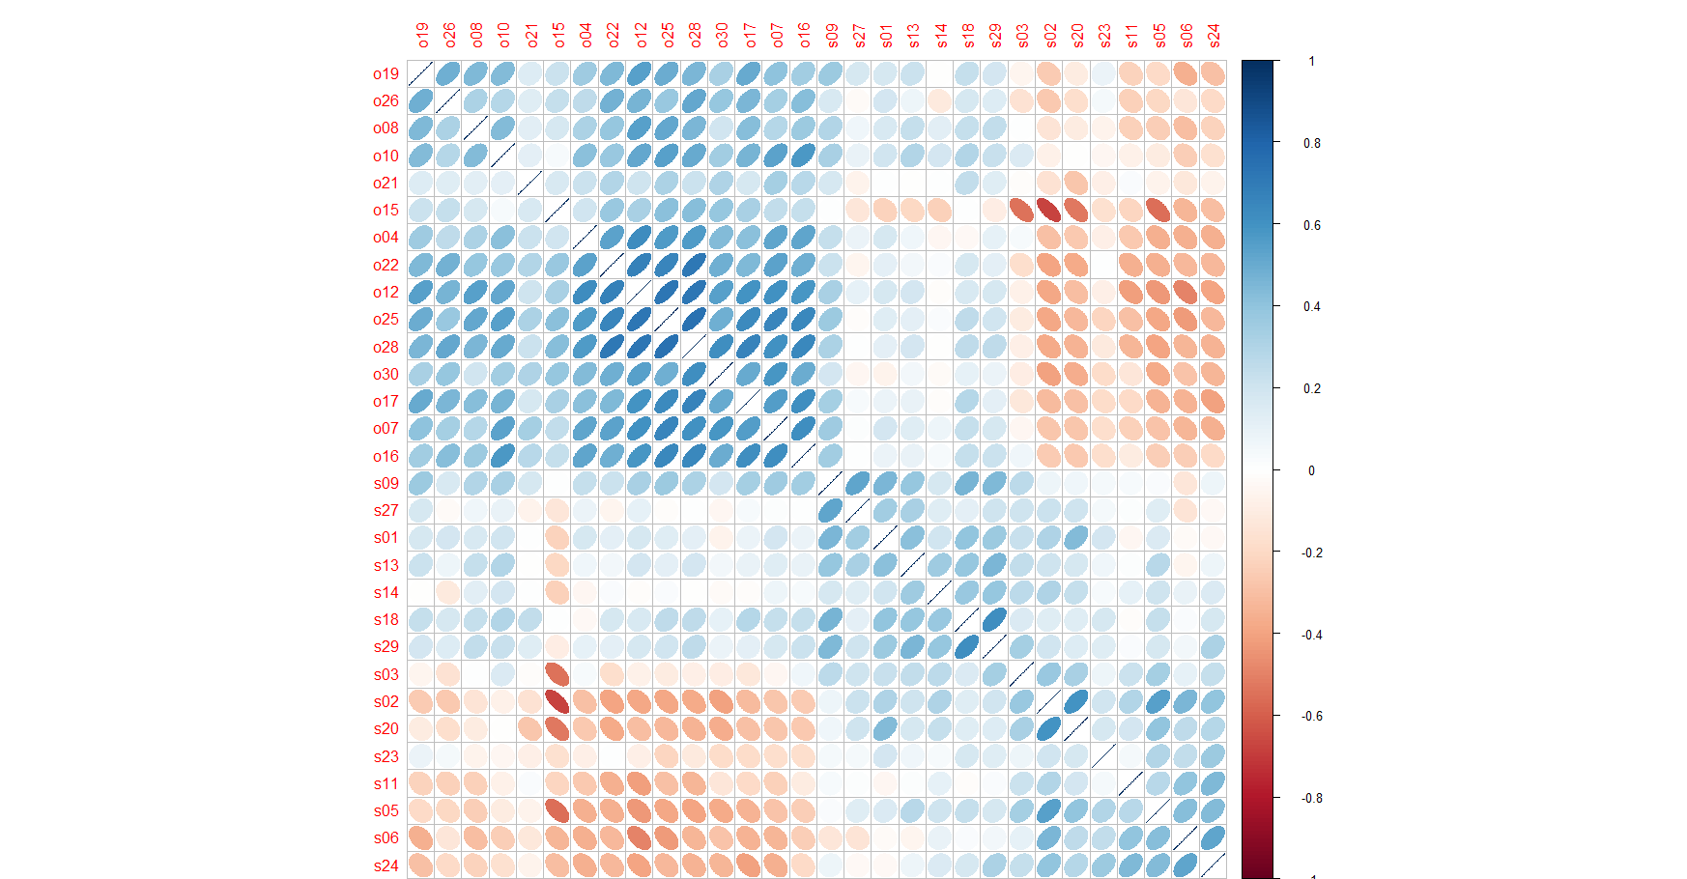
Correlation Plots (1/3)
Episodic
Semantic
Spatial
Future
Object
Spatial
SAM Dataset
OSIQ Dataset

Slide 4
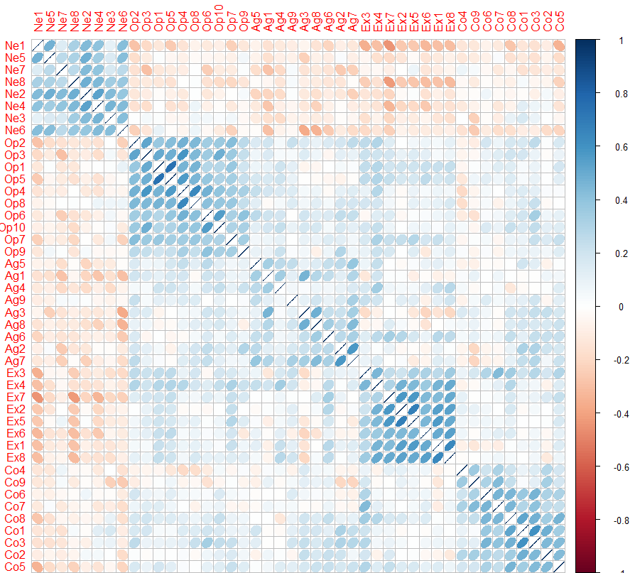
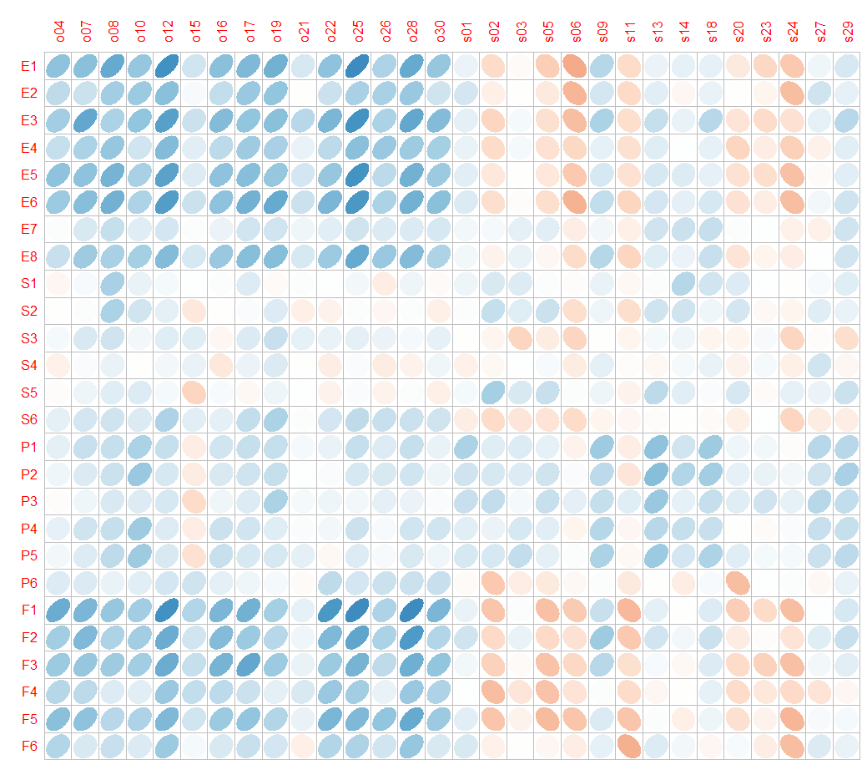
Correlation Plots (2/3)
Neuroticism
Openness
Agreeable
Extraversion
Conscientiousness
Object
Spatial
BFI Dataset
SAM & OSIQ Combined

Slide 5
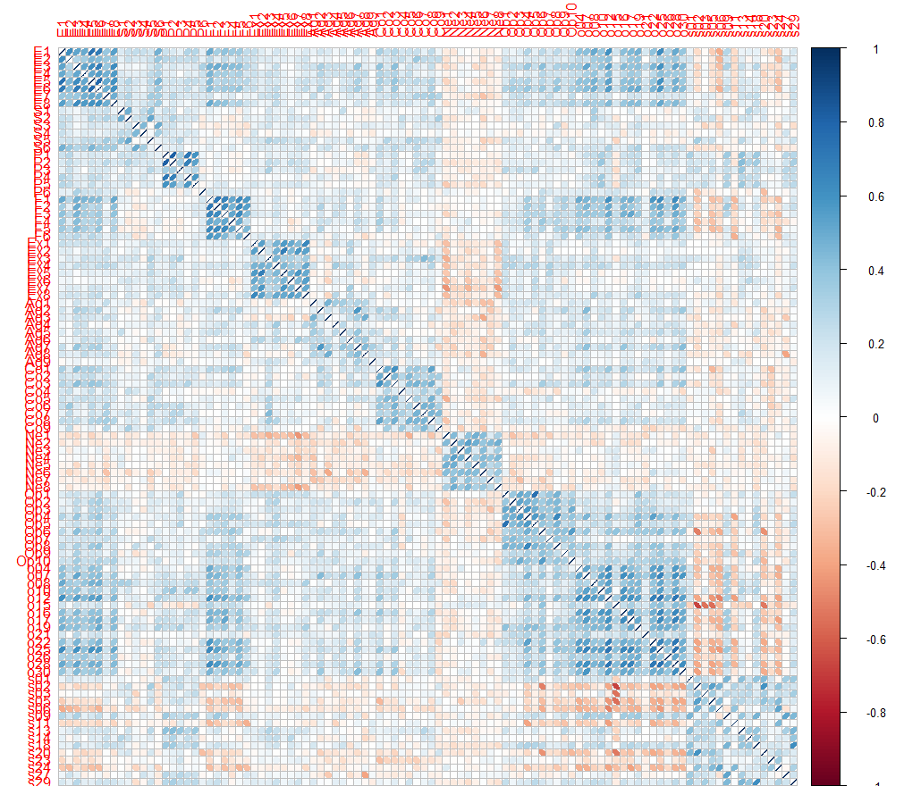
Neuroticism
Spatial Imagery
Correlation Plots (3/3)

Slide 6
Data Analysis
BADA
MFA
PLS
Principal Component Analysis (PCA)

Slide 7
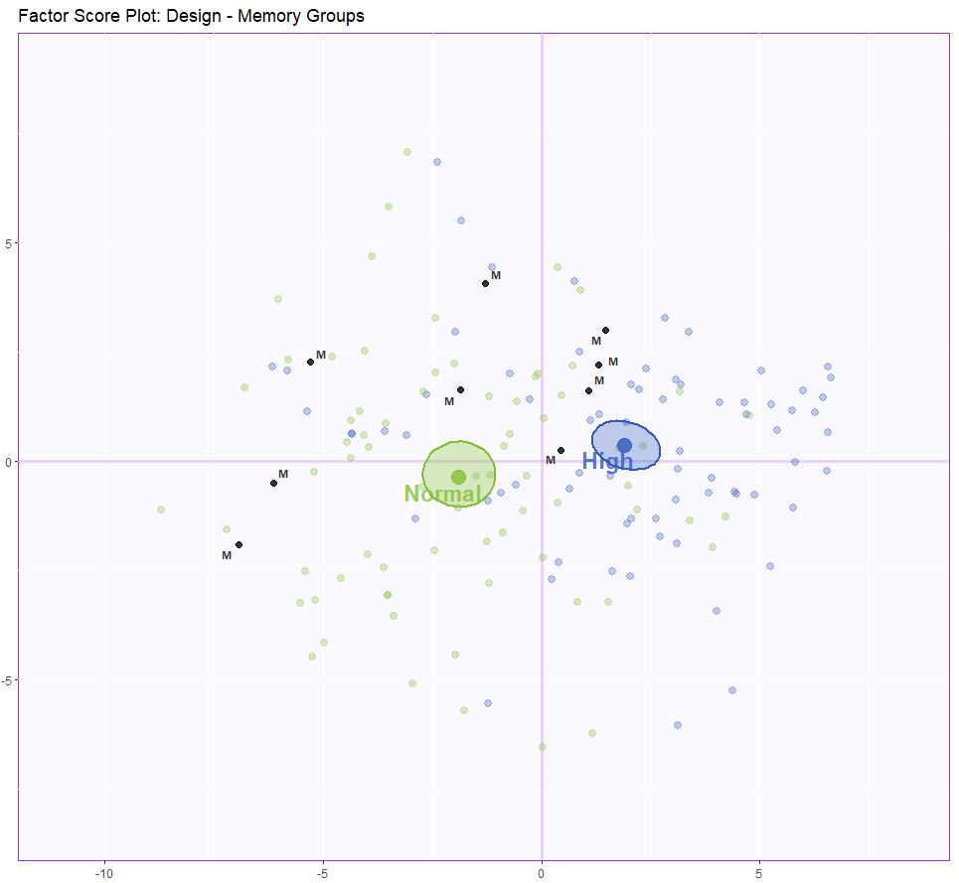
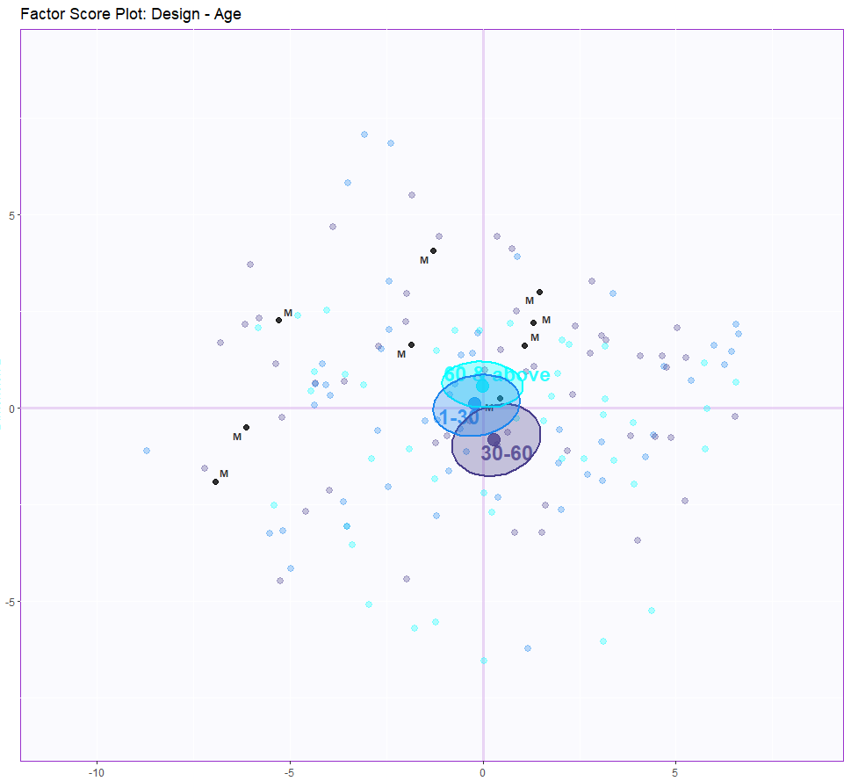
Results (PCA): Factor Scores

Slide 8
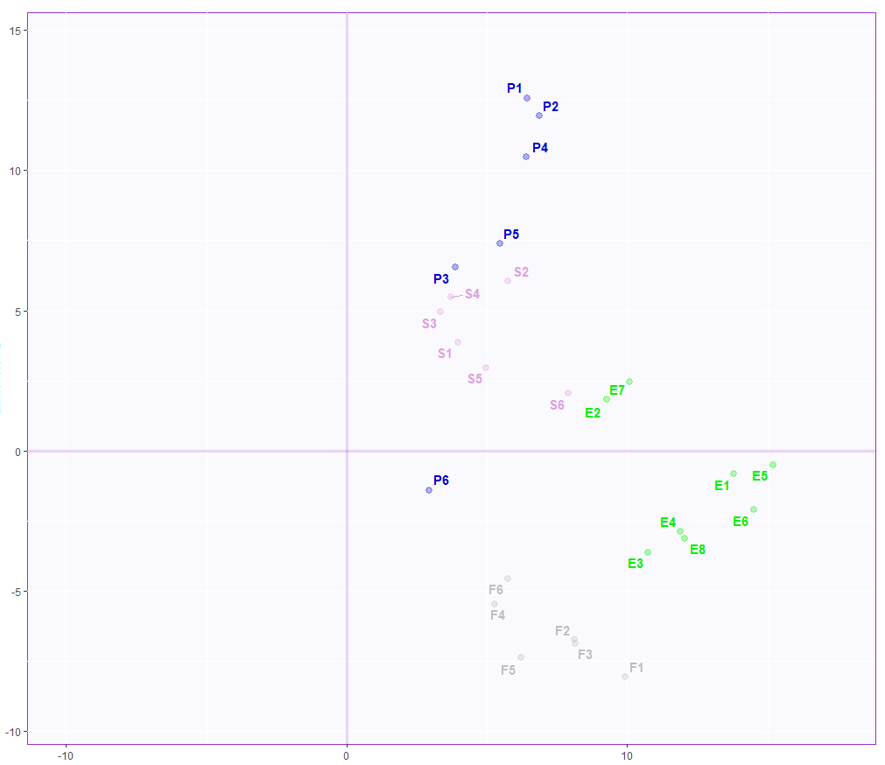
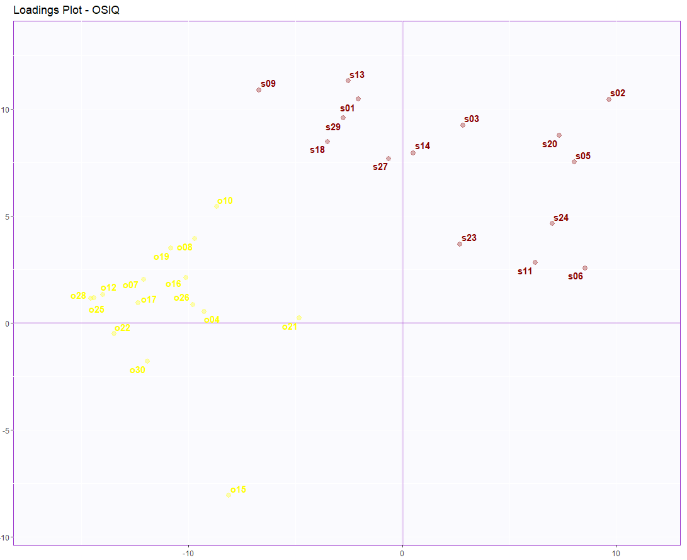
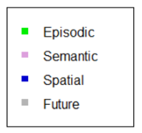
Results (PCA): Loadings
Loadings Plot - SAM
Spatial Imagery
Object Imagery
Component 2 Inertia: 15.17%
Component 1 Inertia: 30.85%
SAM Dataset
OSIQ Dataset

Slide 9
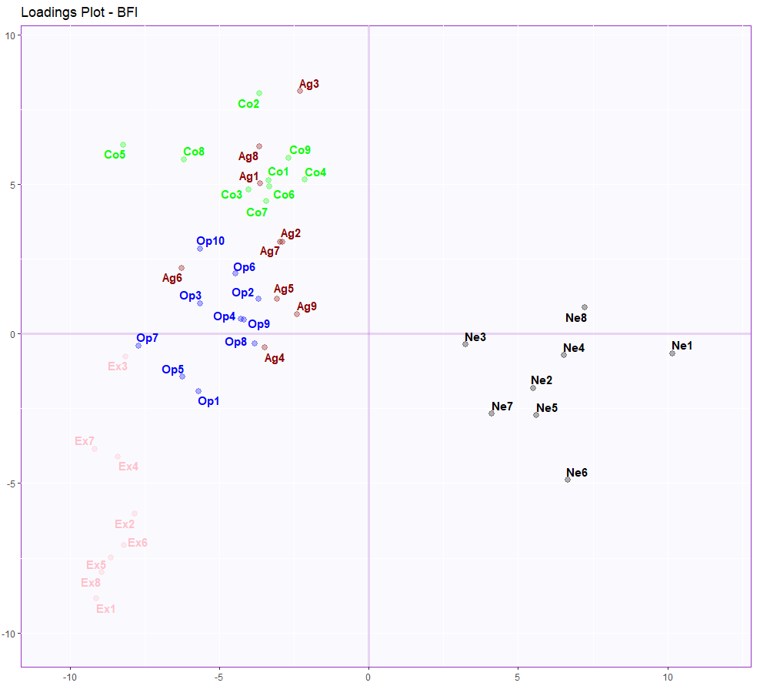
Results (PCA): Loadings
Agreeable
Openness
Extraversion
Conscientiousness
Neuroticism
Component 2 Inertia: 9.78%
Component 1 Inertia: 17.61%
BFI Dataset

Slide 10
PCA Conclusions
Component 1
Row: Normal versus High Memory group for all the three datasets
Column:
Normal versus High Memory scores (SAM)
Object versus Spatial Imagery (OSIQ)
Neuroticism versus all other personality traits.
Component 2
Column: Spatial & semantic versus episodic & future memory
Shows negative correlation between spatial and future memory ratings.

Slide 11
Data Analysis
BADA
MFA
Multiple Correspondence Analysis (MCA)

Slide 12
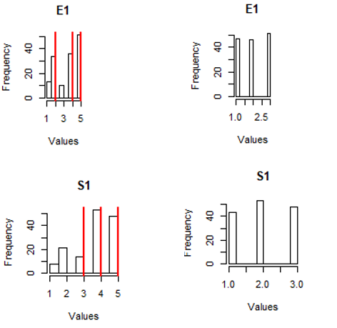
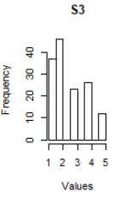
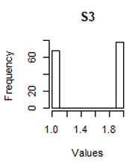
Variable Binning

Slide 13
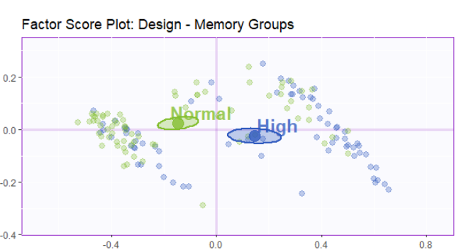
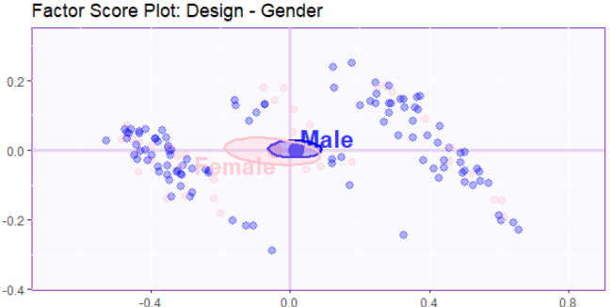
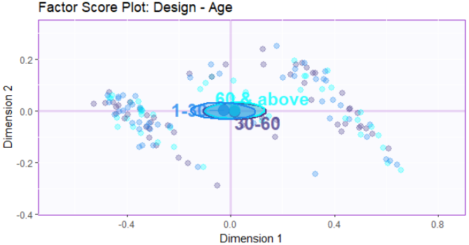
Results (MCA): Factor Scores
Component 2 Inertia: 7.35%
Component 1 Inertia: 84.76%
Component 2 Inertia: 7.35%
Component 2 Inertia: 7.35%
Component 1 Inertia: 84.76%
Component 1 Inertia: 84.76%

Slide 14
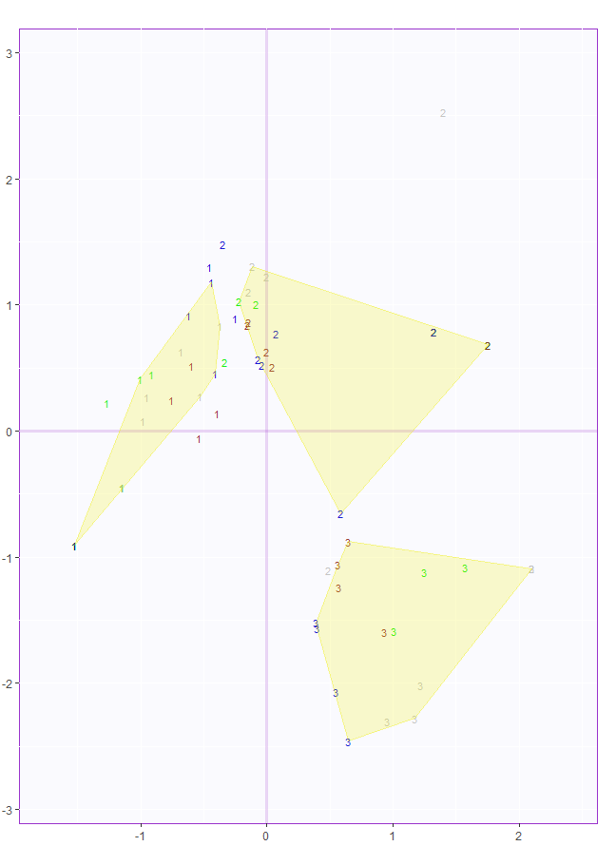
Results (MCA): Loadings
Component 2 Inertia: 7.35%
Component 1 Inertia: 84.76%

Slide 15
MCA Conclusions
Component 1
Row: Normal versus High Memory group
Column: Normal versus High Memory scores
So Component 1 mainly distinguishes people with high versus normal memory group
Component 2
Isn’t really explaining much in loadings or factor score plot.

Slide 16
Data Analysis
BADA
MFA
PLS
Barycentric Discriminant Analysis (BADA)

Slide 17
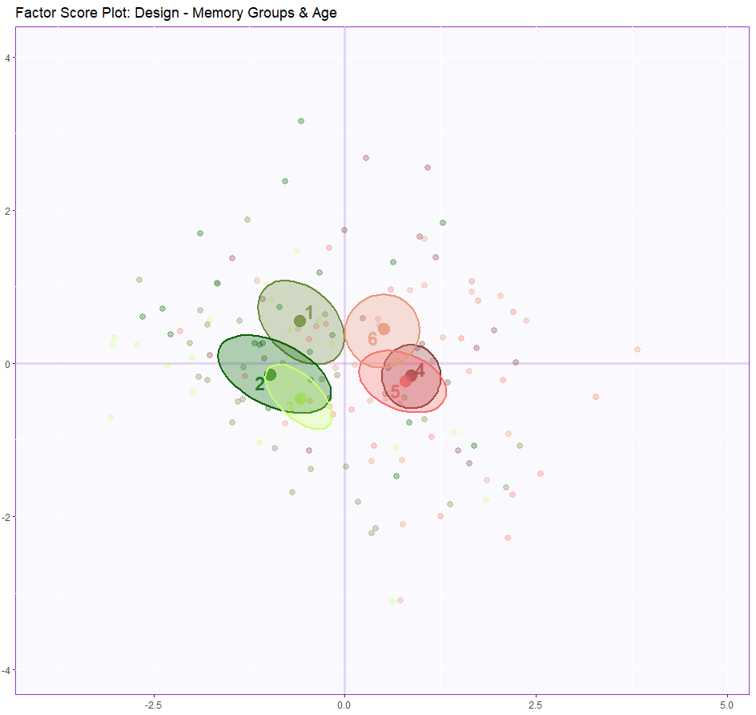
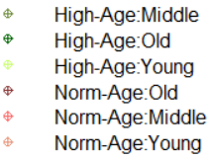
Result (BADA): Factor Score Plots
Component 2 Inertia: 16.46%
Component 1 Inertia: 75.80%

Slide 18
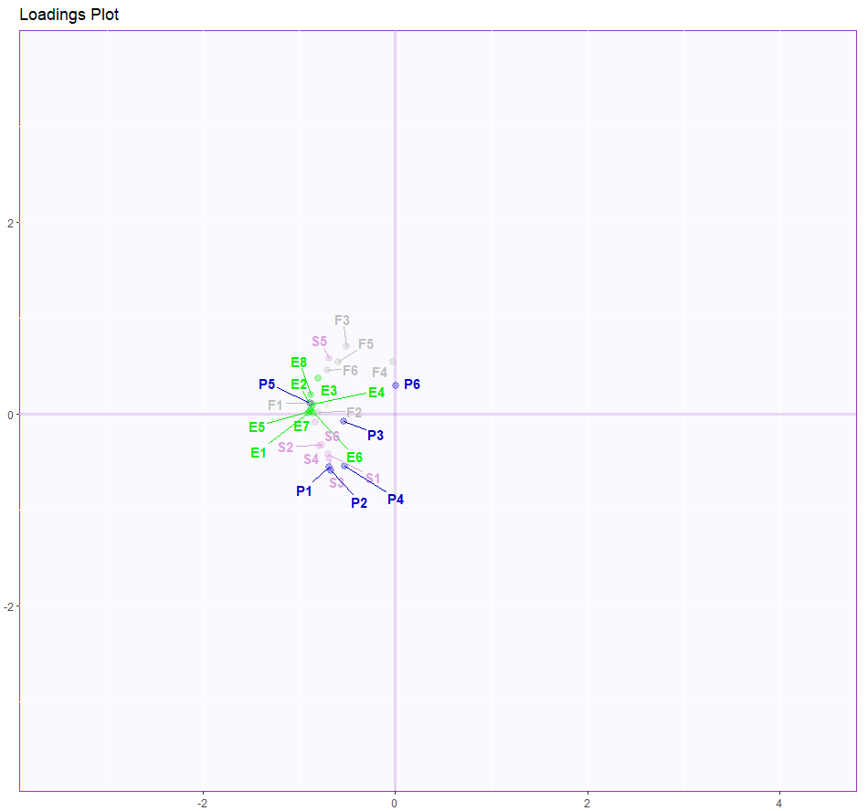
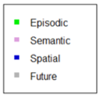
Result (BADA): Loadings Plot
Component 2 Inertia: 16.46%
Component 1 Inertia: 75.80%

Slide 19
BADA Conclusions
Component 1: The latent structure of the SAM data as revealed by BADA indicated that the first component characterized good versus poor memory. In other words, when people reported having high or low abilities for one category of memory, they tended to do the same for other categories.
Component 2: Mainly composed of Spatial memory variable. People who are generally good at Spatial memory task have a poor future thinking ability as they are negatively correlated.
Combining the loading with the factor score plots we can infer that age and gender have no effect on memory.

Slide 20
Data Analysis
BADA
MFA
PLS
Partial Least Square Analysis (PLSC)

Slide 21
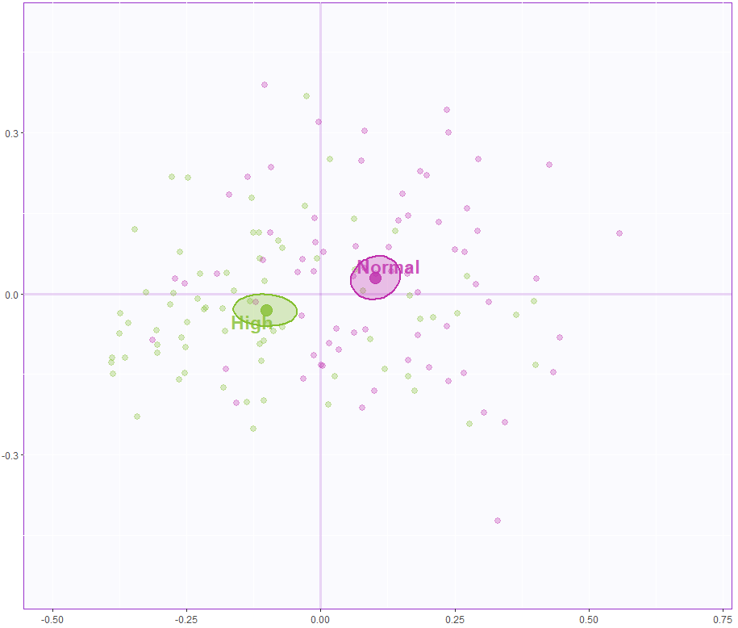
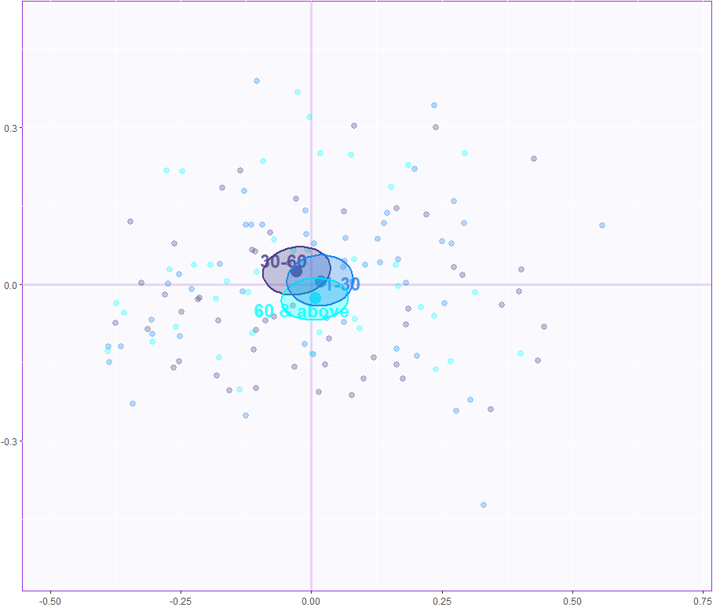
Result (PLS): Latent Variable Plot Component 1
Result (PLS): Latent Variable Plot Component 1
The X-latent variables for Dimensions 1 and 2 – Design Memory Groups
The X-latent variables for Dimensions 1 and 2 – Design Age
The X-latent variables for Dimensions 1 and 2 – Design Memory Groups
The X-latent variables for Dimensions 1 and 2 – Design Age
Component 2 Inertia: 11.27%
Component 2 Inertia: 11.27%
Component 2 Inertia: 11.27%
Component 2 Inertia: 11.27%
Component 1 Inertia: 82.37%
Component 1 Inertia: 82.37%
Component 1 Inertia: 82.37%
Component 1 Inertia: 82.37%

Slide 22
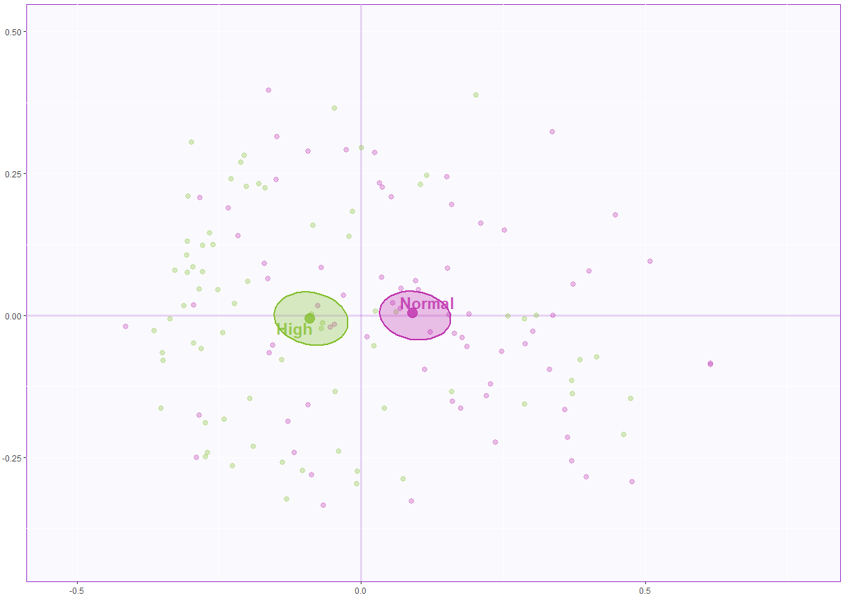
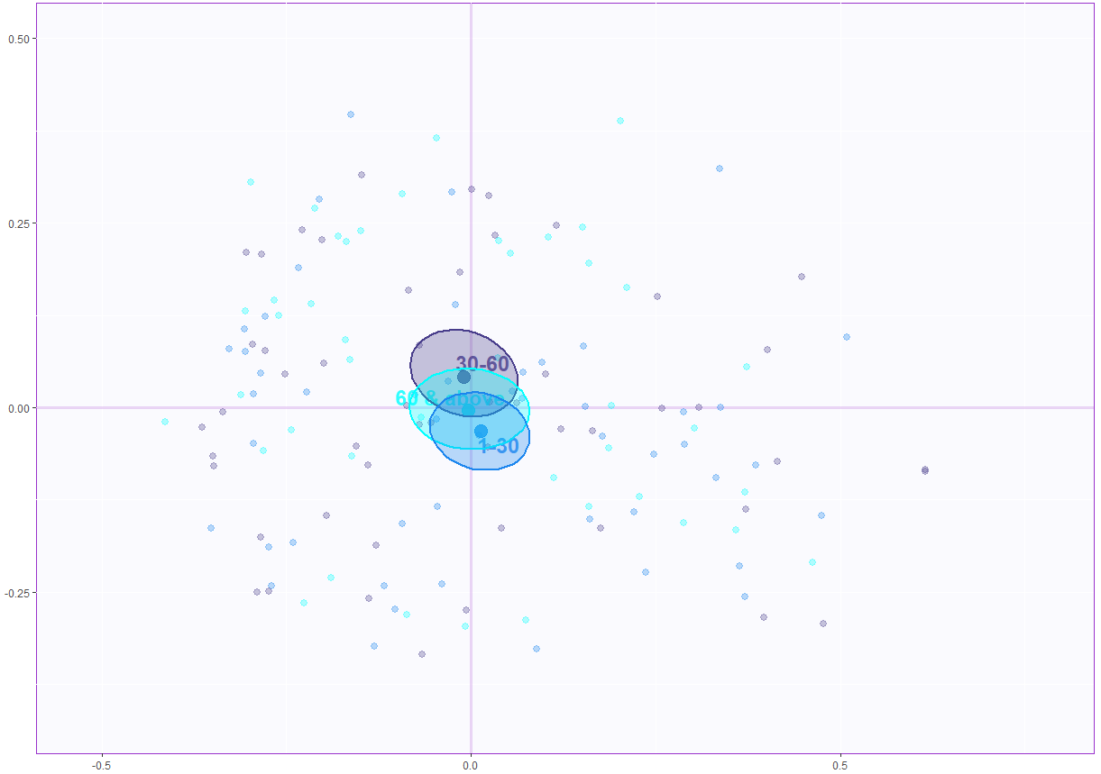
Result (PLS): Latent Variable Plot Component 2
The Y-latent variables for Dimensions 1 and 2 – Design Memory Groups
The Y-latent variables for Dimensions 1 and 2 – Design Age
Component 2 Inertia: 11.27%
Component 2 Inertia: 11.27%
Component 1 Inertia: 82.37%
Component 1 Inertia: 82.37%

Slide 23
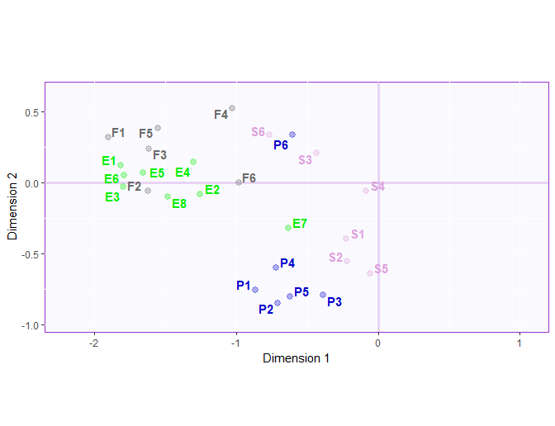
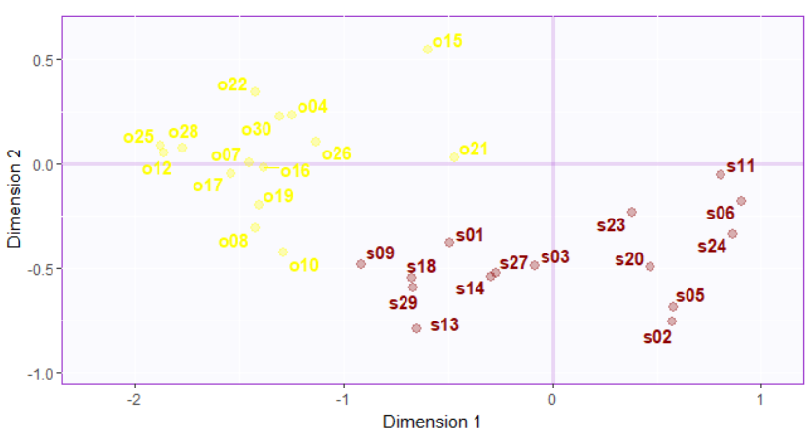
Result (PLS): Salience Plot
Result (PLS): Salience Plot
OSIQ Variables
SAM Variables
OSIQ Variables
SAM Variables
Spatial Imagery
Object Imagery
Component 2 Inertia: 11.27%
Component 2 Inertia: 11.27%
Component 1 Inertia: 82.37%
Component 1 Inertia: 82.37%

Slide 24
PLS Conclusions
Component 1
Row: Normal versus High Memory group
Column: Normal versus High Memory scores
Column: Object imagery versus spatial imagery (OSIQ)
So Component 1 mainly distinguishes people with high versus normal memory group
Component 2
Column: Spatial versus future memory
Distinguishes questions relating to spatial memory versus future memory. Also shows negative correlation between spatial and future memory ratings.

Slide 25
Data Analysis
BADA
MFA
PLS
Multiple Factor Analysis (MFA)

Slide 26
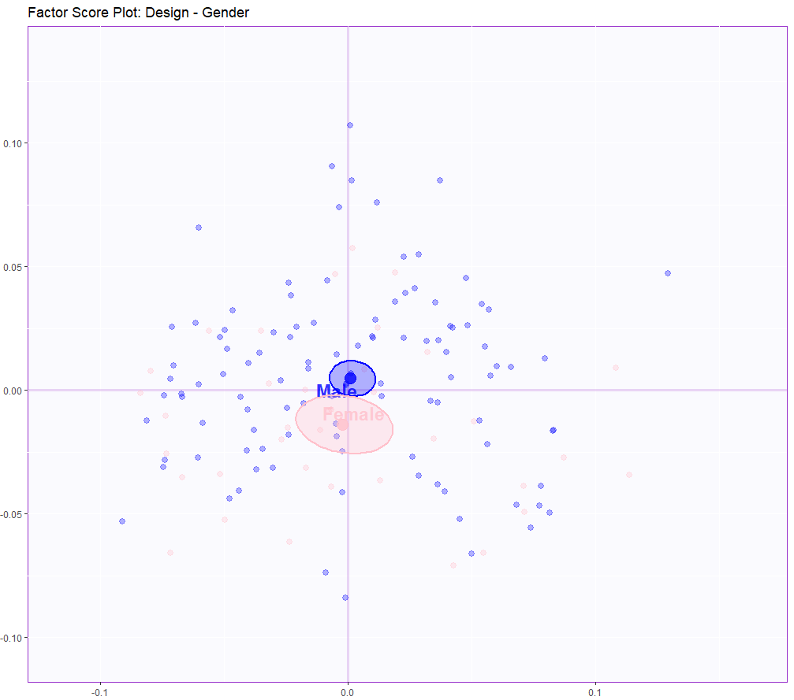
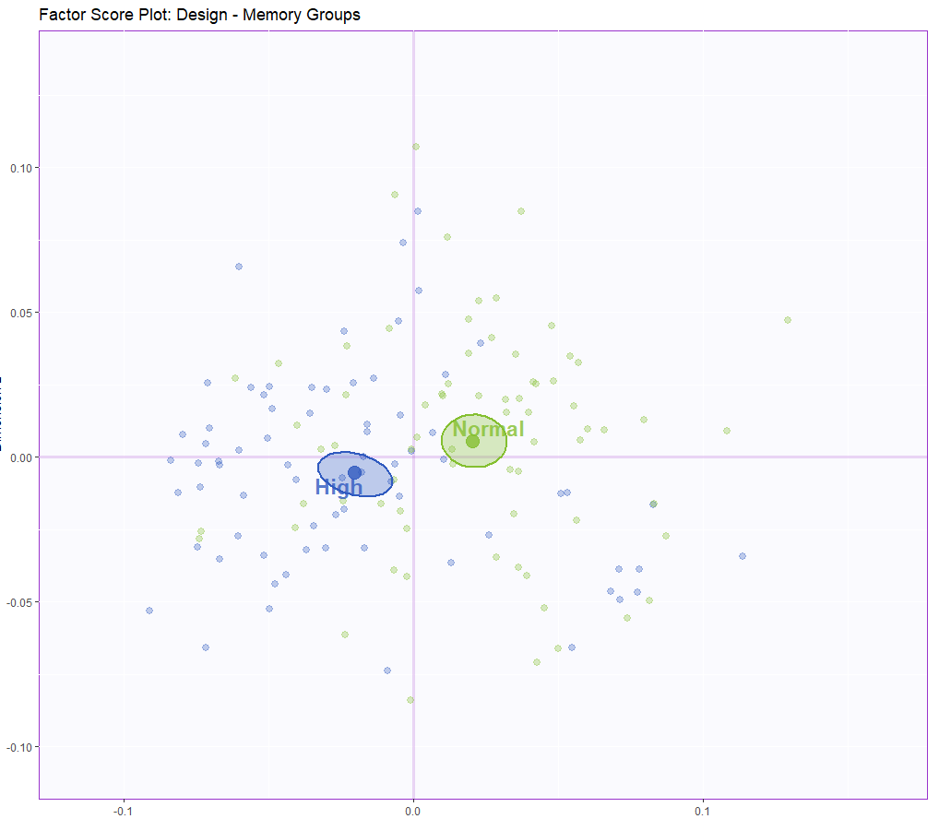
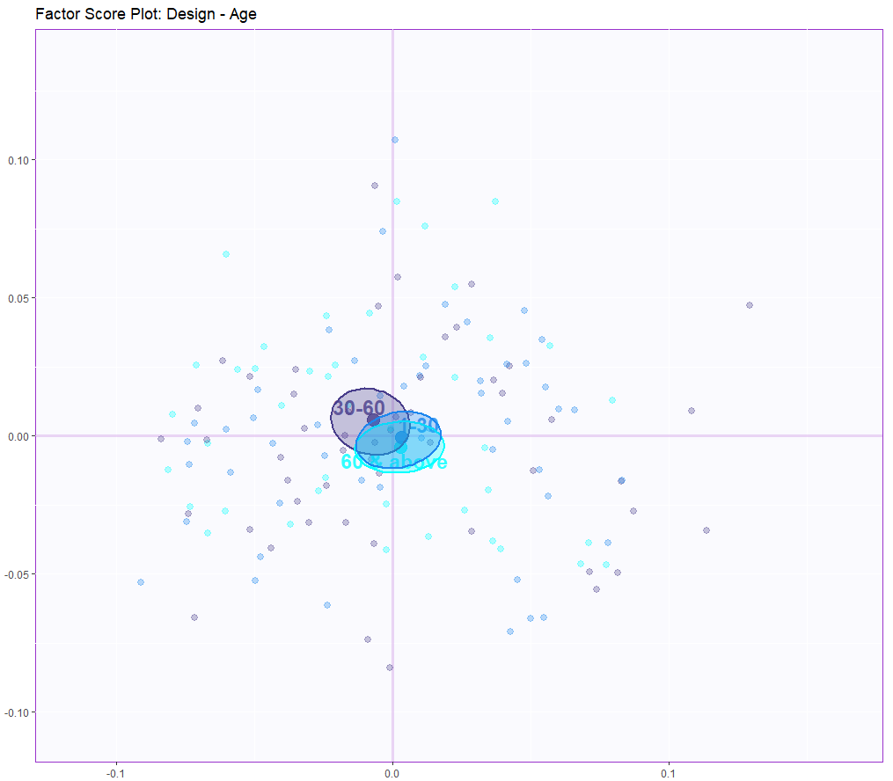
Result (MFA): Factor Score Plots
Result (MFA): Factor Score Plots
Component 2 Inertia: 7.67%
Component 2 Inertia: 7.67%
Component 1 Inertia: 17.03%
Component 1 Inertia: 17.03%

Slide 27
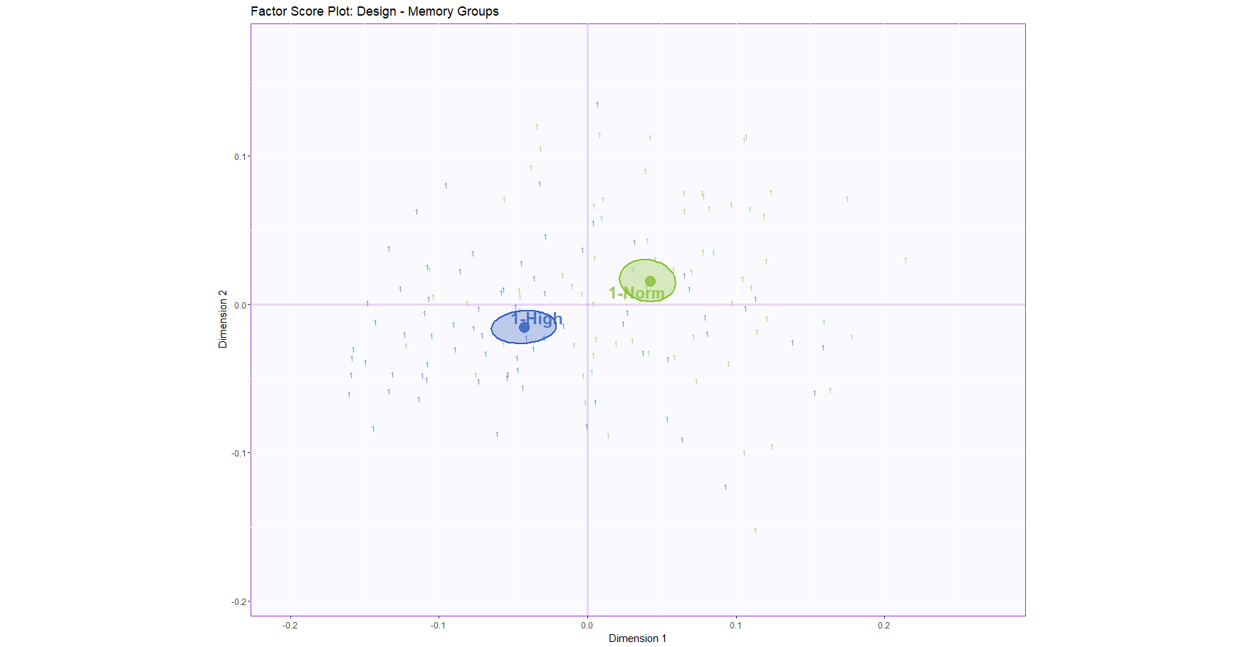
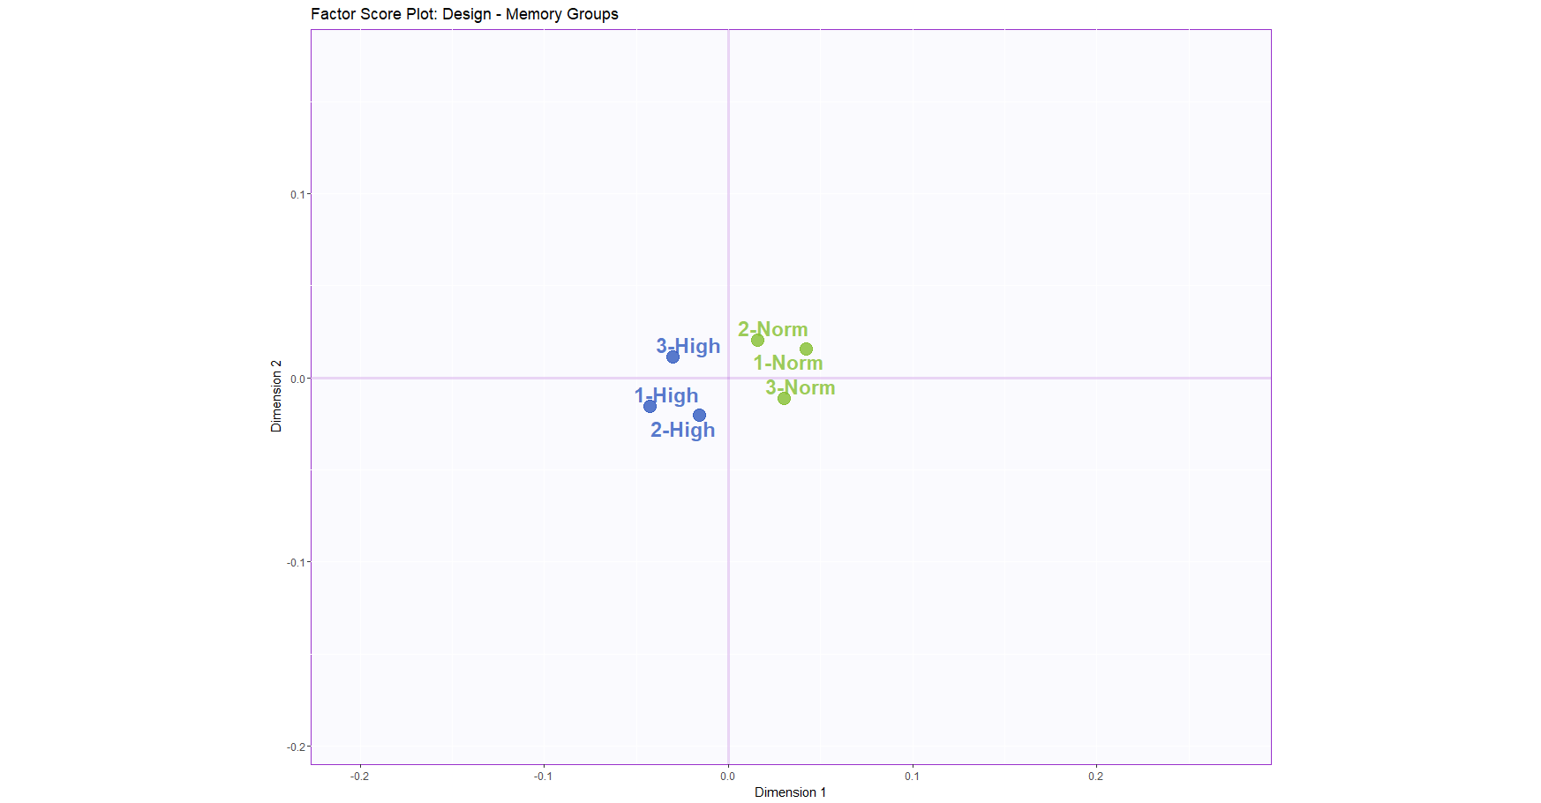
Result (MFA): Partial Factor Score Plots
Result (MFA): Partial Factor Score Plots
Partial factor score plot – Table 1
Partial factor score – Plotting Mean of each table with Design – Memory Groups
Partial factor score – Plotting Mean of each table with Design – Memory Groups
Partial factor score plot – Table 1
Partial factor score – Plotting Mean of each table with Design – Memory Groups
Partial factor score plot – Table 1
Component 2 Inertia: 7.67%
Component 2 Inertia: 7.67%
Component 1 Inertia: 17.03%
Component 1 Inertia: 17.03%

Slide 28
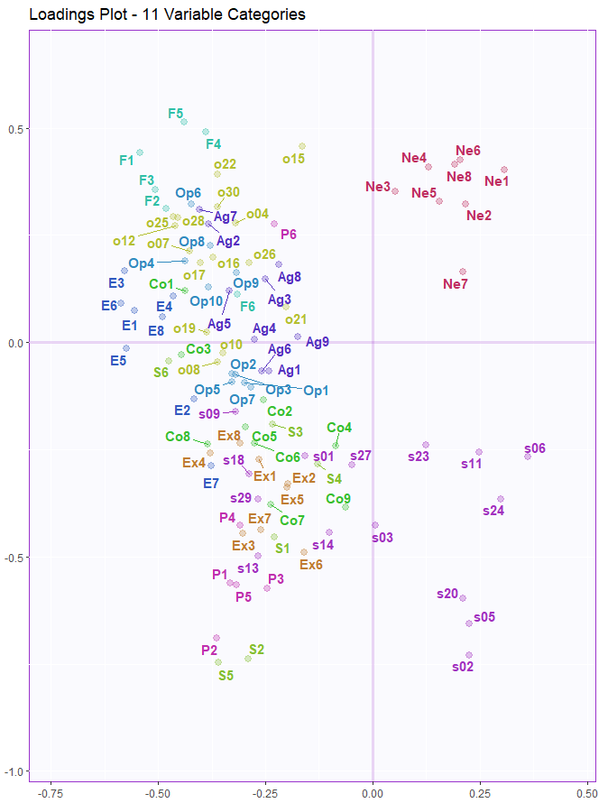
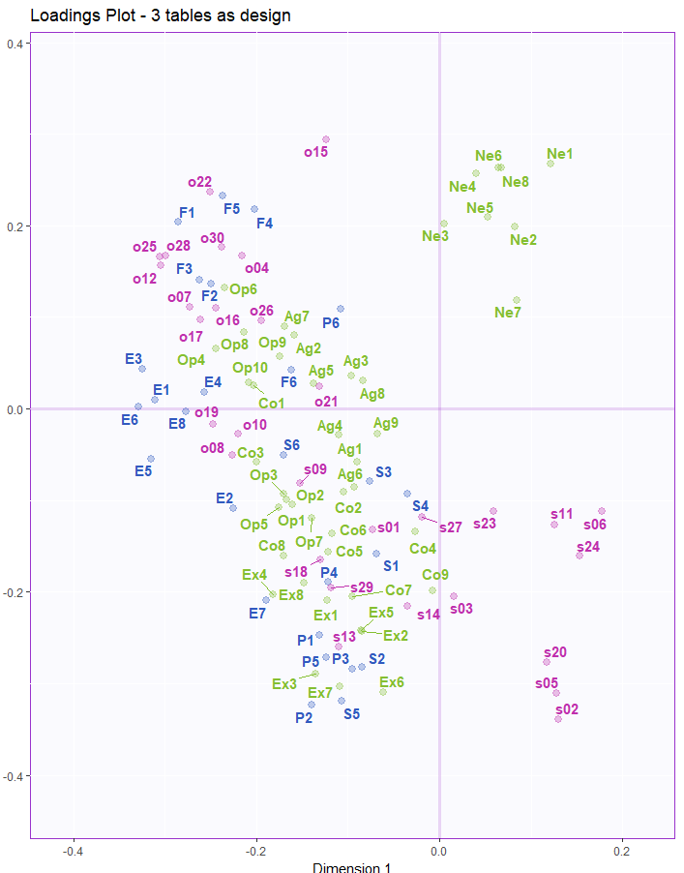
Result (MFA): Loadings Plot
Component 2 Inertia: 7.67%
Component 2 Inertia: 8.11%
Component 1 Inertia: 17.03%
Component 1 Inertia: 14.69%

Slide 29
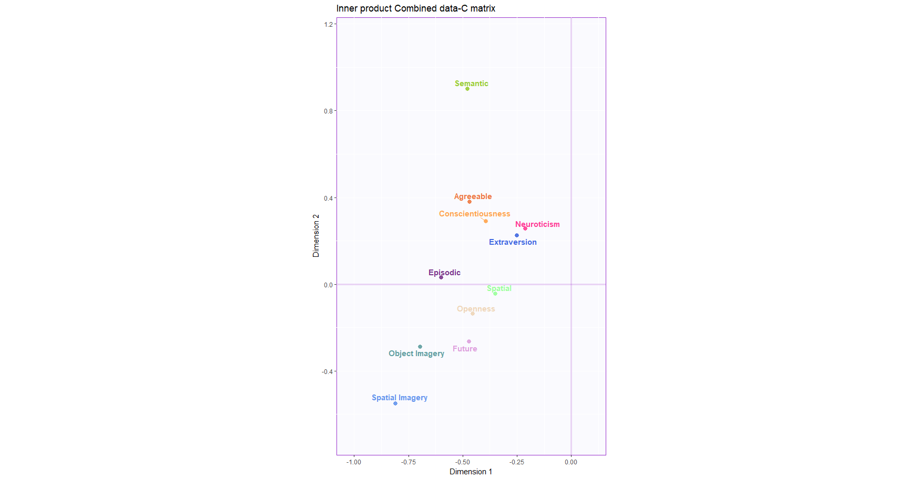
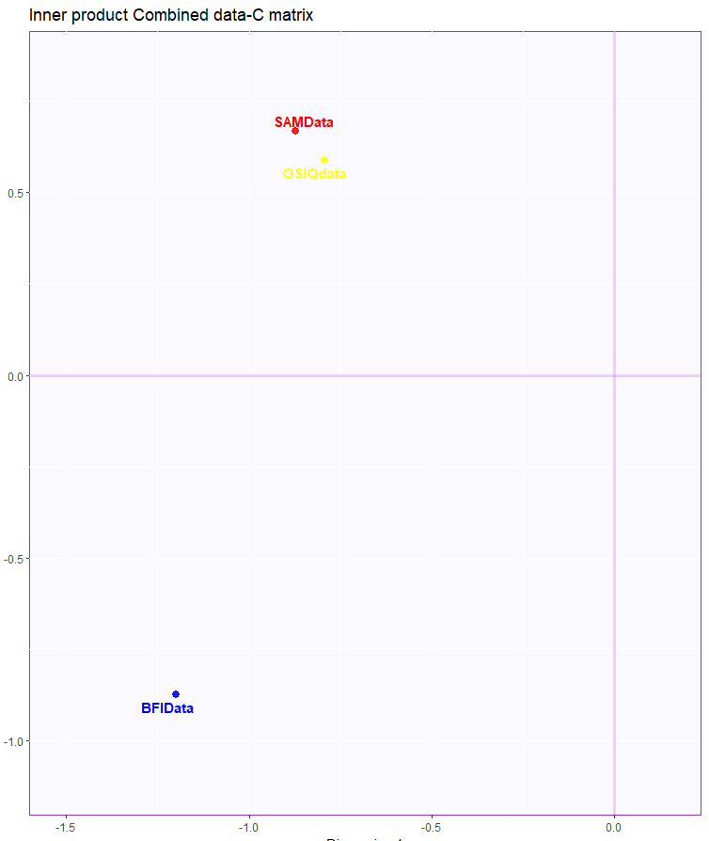
Result (MFA):Inner product C matrix factor Score plot
Component 2 Inertia: 7.67%
Component 2 Inertia: 8.11%
Component 1 Inertia: 17.03%
Component 1 Inertia: 14.69%

Slide 30
Overall Conclusions
Component 1 distinguishes High versus Normal Memory Groups across all the three datasets.
It mainly comprises of Neuroticism questions from all others in the Combined Dataset. Also Inner Product Combined Data, we see that component 1 separates Memory versus behavior datasets.
Component 2 mainly distinguishes between spatial and object memory (OSIQ) and also future versus spatial memory components (SAM).
Also there is an effect of Gender but it is not very significant on Component 2. Gender is also imbalanced variable as
male count is 107 & female count is 37 which might affect the results.
There is also no effect of age on memory or behavior as per the analysis.

Slide 31
Questions ??
Data Analysis
Thank You!!

