Slide 1
Cyberbullying Among Adolescents: The Role of Affective and Cognitive Empathy, and Gender
Child Psychiatry Hum Dev (2010)
Rebecca P. Ang
Dion H. Goh

Slide 2
Problem Statement & Hypothesis
Problem statement: Cyberbullying is becoming common due to ease of accessibility to technology which has potential hindrance effect on adolescents social and emotional development.
Research Hypothesis : It is hypothesized that affective empathy, cognitive empathy and gender, with their interaction will significantly predict Cyberbullying ratings among adolescents.

Slide 3

Statistical Methods
Sample statistics: n = 396, M = 173, F = 219 (Age: Mean = 14.88, SD = 1.79)
Centering of Affective and cognitive Empathy
Factor analysis: EFA, CFA (Two steps)
Satorra-Bentler rescaled
Correlation & Hierarchical regression analysis

Slide 4
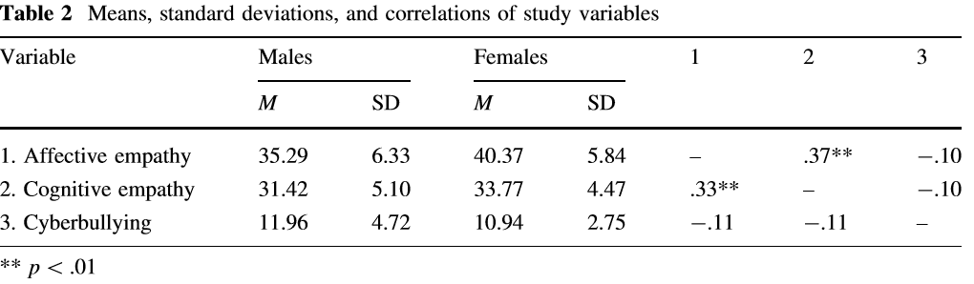
Results - I

Slide 5
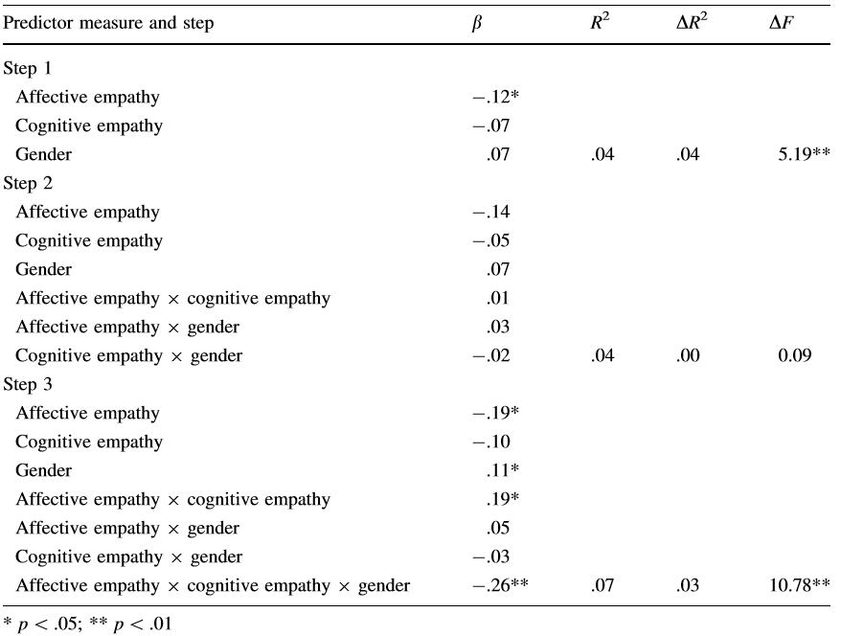
Results - II

Slide 6
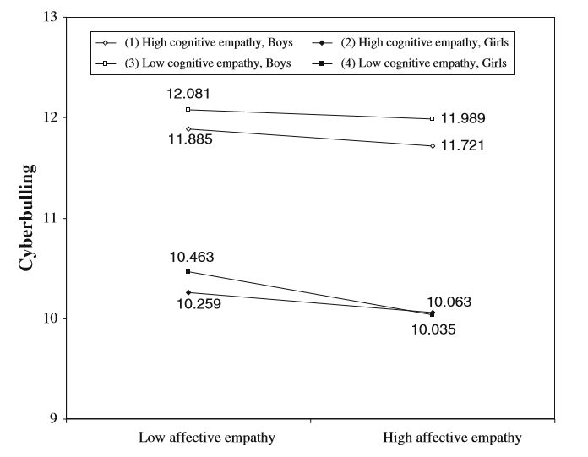
Results - III

Slide 7
Conclusion
Results from hierarchical multiple regression analysis indicated a signiﬁcant three-way interaction (Cognitive empathy * Affective empathy * Gender)
Implications of these ﬁndings include the need for empathy training and the importance of positive caregiver-child relationships in reducing cyberbullying behavior among adolescents.
Some thoughts about the paper:
When there is missing data in samples, then how do we default values for such samples?
The author writes about ethnic identification where he mentions that 60.4% samples were Chinese population. Though we are not considering ethnic identification as one of our estimating variable, will this unequal ratio amongst the sample have any impact in our model?

