Slide 1
Demonstrating Bias in a Face Attribute Model
Race×Gender (14-class) classification • Biased vs more balanced training
• Goal: show how training distribution choices create measurable performance gaps across demographic subgroups.
• Method: same architecture + same training recipe; only the sampling distribution changes.
• Evidence: subgroup accuracy on a held-out test set + before/after mitigation comparison.
Models: A (biased sampling) vs U (original / more balanced)

Slide 2
2) Controlled experiment: same model, different data
Biased training split
(race×gender caps)
Unbiased/original
training split
Control variables: same preprocessing (224×224 + ImageNet normalization), same architecture (ResNet50), same optimizer.
Interpretation: performance differences are driven by training data distribution.
Model A: ResNet50
(identical setup)
Model U: ResNet50
(identical setup)
Predictions
(race×gender classes)
Predictions
(race×gender classes)
Held‑out test set
(same for both)
Compute accuracy by
• race
• gender
• race×gender
Notes:
[Sources] - https://arxiv.org/abs/1512.03385 (ResNet paper) [/Sources]

Slide 3
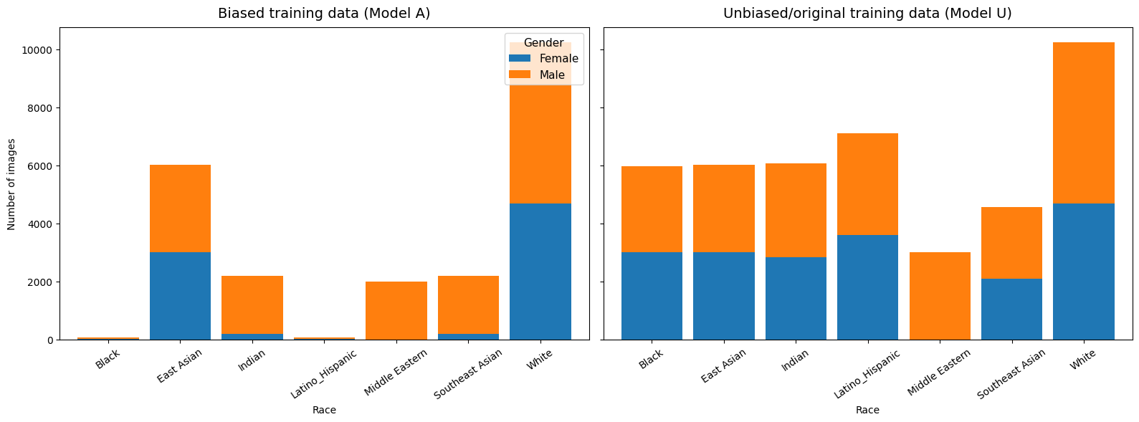
2) Create a biased training distribution (data imbalance)
• We manipulate subgroup representation via sampling caps per (race, gender).
• Overrepresented intersections get many training examples; underrepresented intersections get few.
• This simulates real-world collection bias and historical under-sampling.
Reading the plot: the left panel (Model A) is intentionally skewed; the right panel (Model U) is more balanced.

Slide 4
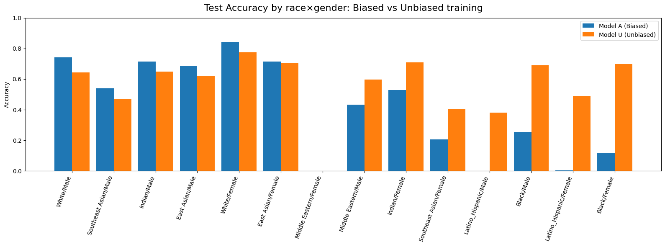
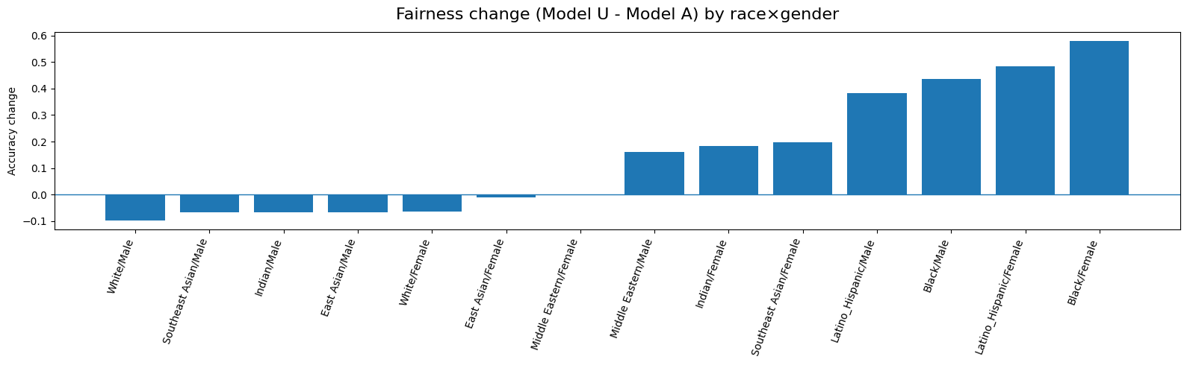
3) Bias evidence: subgroup accuracy gaps on the test set
Overall accuracy can look acceptable while hiding large errors on underrepresented intersections.
• Left: accuracy by race×gender for Model A vs Model U.
• Right: Δ = (Model U − Model A). Positive bars indicate improvement after rebalancing.
• Takeaway: mitigation helps many minority intersections but can trade off on majority groups.
Takeaway: Data imbalance can push predictions toward overrepresented classes; balancing training data improves minority intersection performance (but may reduce majority accuracy).

Slide 5
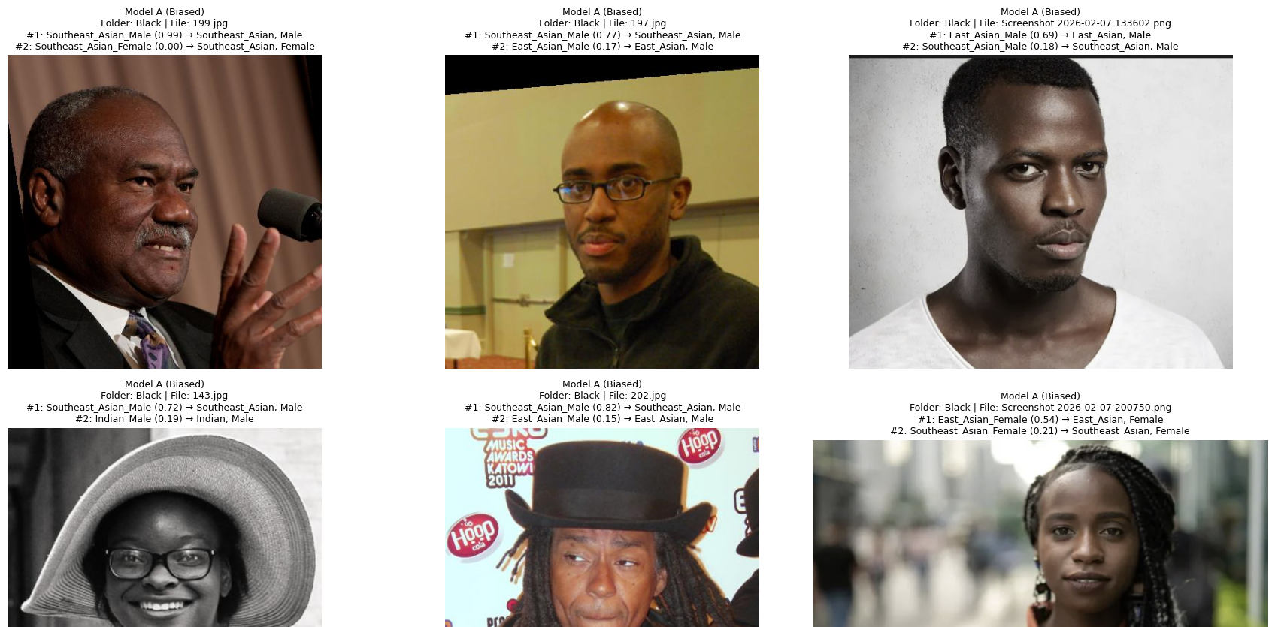

4) Qualitative check: what each model predicts
Model A (Biased) — sample images from “Black” test folder
Model U (Unbiased) — same sample images
Takeaway: Data imbalance can push predictions toward overrepresented classes; balancing training data improves minority intersection performance (but may reduce majority accuracy).
Notes:
[Sources] - https://arxiv.org/abs/1908.04913 (FairFace dataset; label schema used in the demo) - https://arxiv.org/abs/1810.03993 (Model Cards; recommends subgroup reporting) [/Sources]

Slide 6
Takeaways for an AI audience
• Causal story: subgroup exposure in training → systematic subgroup performance differences at test time.
• Intersectional reporting is necessary: race-only or gender-only can hide failures at race×gender intersections.
• Mitigation is not “free”: improvements may come with trade-offs; measure worst-group accuracy and gaps.
• Limitations: predicting sensitive attributes has ethical risk; results depend on dataset labels and image conditions.
• Recommended extensions: calibration by subgroup (ECE), balanced accuracy/macro-F1, and error analysis via confusion matrices.
Educational/research demo only • Do not use for high-stakes decisions without governance and validation.

