Slide 1
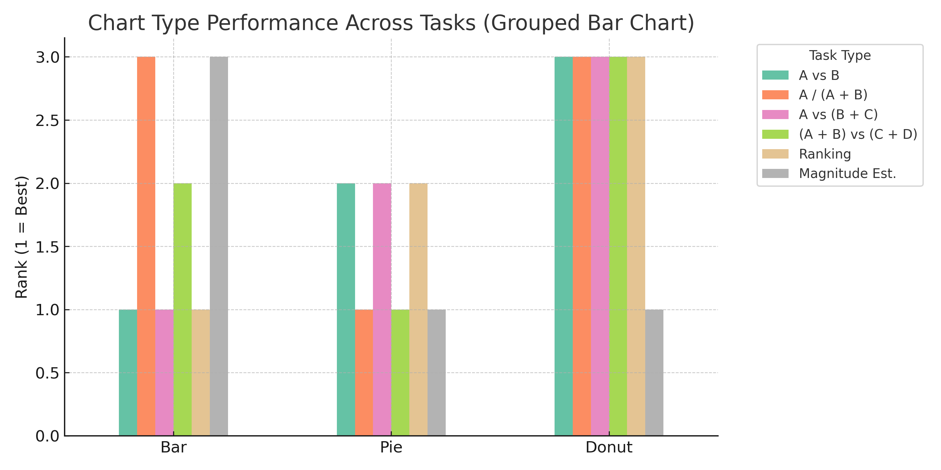
100 Years of Pies vs. Bars
Maksuda Toma, Susan Vanderplas
Statistics Department, University of Nebraska Lincoln
Abstract
Result
The debate between pie charts and bar charts has persisted for over a century, yet no definitive consensus has emerged regarding which is more effective. This poster offers a comprehensive summary of the historical and empirical literature, analyzing the strengths and limitations of each chart type. Pie and bar charts were introduced by William Playfair in the early 1800s. By the early 20th century, strong criticisms of pie charts appeared in textbooks and design manuals. Brinton (1914) and Karsten (1923), for example, labeled pie charts as cognitively inefficient and even insulting to the reader's intelligence. Eells (1926) noted that while the sector method (pie chart) was common, horizontal bar charts were favored for speed and accuracy. Despite longstanding criticism, pie charts remain widely used today. This work synthesizes findings from early visual perception studies through to modern experiments (e.g., Spence & Lewandowsky, 1991), highlighting that chart effectiveness often depends on task complexity. Our aim is to bridge historical insights with current empirical evidence to provide design guidance on when pie or bar charts are most appropriate.
Which chart works best really depends on the task. When people are asked to simply compare two values (A vs B), bar charts consistently come out on top—they’re faster and more accurate, and participants tend to prefer them for that reason (Spence & Lewandowsky, 1991; Simkin & Hastie, 1987; Hill, 2025). But when the task shifts to estimating what proportion one part is of the whole (A / A+B), pie charts do better, likely because they align with how we naturally think about part-whole relationships (Cleveland & McGill, 1984; Simkin & Hastie, 1987).
For more complex comparisons—like A vs B+C or A+B vs C+D—the results are more mixed. Bar charts have a slight edge when comparing a single value to a sum (A vs B+C), but when comparing two grouped values (A+B vs C+D), pie charts perform better (Spence & Lewandowsky, 1991). This might be because it's easier to visually group adjacent slices than non-aligned bars (Kosara & Skau, 2016).
When it comes to ranking multiple parts, like identifying the top three largest values, bar charts win again, as their alignment allows for quicker visual scanning (Hill, 2025; Kosara & Skau, 2016). And in magnitude estimation tasks (e.g., “If A is 100, what is B?”), both pie and donut charts tend to outperform bars, though people are more likely to misjudge values slightly in those formats (Kosara & Skau, 2016; Hill, 2025).
In the end, there’s no universal winner—the best chart depends on the specific task and what kind of judgment you're asking the reader to make.
Experiment Description
This poster synthesizes findings from a series of historical and modern experiments comparing pie and bar charts for interpreting proportional data. Early studies, such as Eells (1926) and Croxton & von Huhn (1927), focused on accuracy and speed in estimating single or dual-category proportions (e.g., A vs. B or A / (A + B)). These experiments typically asked participants to identify which portion of a chart was larger or to estimate ratios between components.
Spence & Lewandowsky (1991) expanded task complexity by asking participants to compare single components (A vs. B), a component versus a pair (A vs. B + C), and two pairs (A + B vs. C + D). These tasks were tested across pie, bar, and table formats, with varying exposure times, number of components, and the use of color or ordering. Accuracy and speed were measured, revealing that pie charts outperformed others in complex comparisons, while bar charts performed best in simpler tasks.
Peterson & Schramm (1954) evaluated proportion estimation across eight chart types: circle, disc, single bar, multiple bar, multiple cylinder, multiple square column, multiple area column, and partial osmograph. Each chart displayed the same five proportions and was paired with a decoy version to mask repetition. A total of 112 U.S. Air Force personnel estimated component values from randomized charts, generating 3,440 judgments. This study allowed for direct comparisons across multiple chart styles.
Cleveland & McGill (1984) conducted theory-driven experiments to rank the perceptual accuracy of elementary visual tasks—such as position, length, and angle—used in common chart types. Participants viewed bar charts, pie charts, and divided bars, making quantitative judgments. Results revealed a perceptual hierarchy: position along a common scale yielded the highest accuracy, followed by length, with angle (used in pie charts) being least accurate for decoding numerical values.
To validate this hierarchy empirically, Cleveland & McGill (1986) ran a controlled experiment where 127 participants judged proportions using seven types of visual stimuli, each requiring a specific perceptual judgment: position (aligned and non-aligned), length, angle, slope, and area (circle and blob). Participants made 210 comparisons across 70 randomized displays. Results reinforced the original ranking, confirming position as most accurate and angle and area as less reliable.
Simkin & Hastie (1987) examined how position, length, and angle affect different visual judgment tasks. Two hundred undergraduates viewed pie charts, bar charts, and divided bars and were asked to make either comparison judgments (e.g., A vs. B) or proportion-of-the-whole judgments. Bar charts supported faster and more accurate comparison judgments, while pie charts were better suited for proportion tasks—highlighting an interaction between visual encoding and task type.
More recently, Kosara & Skau (2016) tested how distortions in pie chart design affect accuracy. Participants on Mechanical Turk estimated proportions from five chart types: standard pie, exploded pie, larger-slice pie, elliptical pie, and square pie. Despite identical angles, distortions in area and arc length led to significantly higher judgment errors—particularly in the elliptical and square conditions—indicating that design variations meaningfully impact visual interpretation.
In Hill (2025), three online experiments assessed how bar, pie, and donut charts support part-whole estimation and ranking tasks. In Experiment 1, participants viewed randomized chart sets (10 bar, 5 pie, 5 donut) generated from multinomial data. Experiment 2 tested charts where two components were nearly equal in size, probing discrimination accuracy. Experiment 3 asked participants to estimate relative magnitudes (“If A is 100, what is B?”) in pie and donut charts. Forty-two participants completed the study via Qualtrics, contributing new evidence to the evolving debate.
Task Type | Description / Example | Best Performing Chart | Supporting Studies | User Preference
A vs B | Direct comparison (Which is larger?) | Bar | Spence & Lewandowsky (1991), Simkin & Hastie (1987), Hill (2025) | Bar (quicker, more precise)
A / (A + B) | Proportion judgment (What % is A?) | Pie | Simkin & Hastie (1987), Cleveland & McGill (1984) | Pie (intuitive for part-whole)
A vs (B + C) | Single vs combined value | Bar (slight edge) | Spence & Lewandowsky (1991) | Mixed
(A + B) vs (C + D) | Multi-part visual aggregation | Pie | Spence & Lewandowsky (1991), Kosara & Skau (2016) | Pie (easier perceptual grouping)
Ranking | Rank multiple parts (e.g., top 3) | Bar | Hill (2025), Kosara & Skau (2016) | Bar (faster scan order)
Magnitude estimation | “If A = 100, what is B?” | Pie = Donut > Bar | Hill (2025), Kosara & Skau (2016) | Donut/Pie (but more error-prone)

