Slide 1
User Interface Group
Susan Vanderplas & Alison Kleffner
University of Nebraska, Lincoln

Slide 2


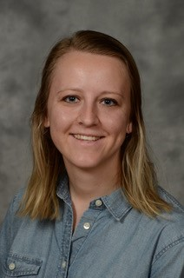
Introductions
Susan Vanderplas
Assistant Professor
Statistics Department
Extension Specialist
Research interests:
Visualization and Perception
UI Design
Statistical Forensics
Alison Kleffner
PhD Student
Statistics Department
Research Interests:
Spatial & Environmental Statistics
Visualization
UI Design

Slide 3
Research Plan
Develop a UI prototype in Shiny
Start with the analysis software (already in RMarkdown - thanks Taro Mieno!)
Work on integrating databases (currently using static files)
Once we have a minimal viable prototype, move on to the trial design portion
Explore ways to visualize spatial correlations between variables
Primary challenge of this research from a vis standpoint is to visually associate management decisions with yield/economic variables
Need to make sure the charts are user-friendly and require relatively little explanation
This will likely involve user testing

