Slide 1

CodeBasis Resume Project Challenge 10
IPL Data Analysis Project

Slide 2
Table of Content
Problem Statement
IPL: Indian Premier League
Objective
Datasets
Data modelling
Primary Insight
Secondary Insight
Dashboard

Slide 3
Problem Statement
"Sports Basics" is a sports blog company that entered space recently. They wanted to get more traffic to their website by releasing a special edition magazine on IPL 2024. This magazine aims to provide interesting insights and facts for fans, analysts and teams based on the last 3 years' data.

Slide 4
IPL: Indian Premier League
IPL is a men's Twenty20 (T20) cricket league held annually in India
Founded by the BCCI in 2007, the league features ten city-based franchise teams
IPL usually takes place during the summer, between March and May each year
The IPL is the most popular cricket league in the world, in 2014 it ranked sixth in average attendance among all sports leagues
In 2022, the league's brand value was estimated at ₹90,038 crore (US$11 billion)
According to the BCCI, the 2015 IPL season contributed ₹1,150 crore (US$140 million) to India's GDP

Slide 5
Objective
The objective of this project is to analyse the last 3 years’ historical data. The project aims to provide insights into player performance, team strategies, match analysis, and fan engagement. The project would enable users to track key performance indicators such as batting averages, bowling averages, strike rates, economy rates, and other metrics to evaluate player and team performances.

Slide 6
Datasets
dim_match_summary
dim_players
fact_bating_summary
fact_bowling_summary
dim_players_2024 (additional research)

Slide 7
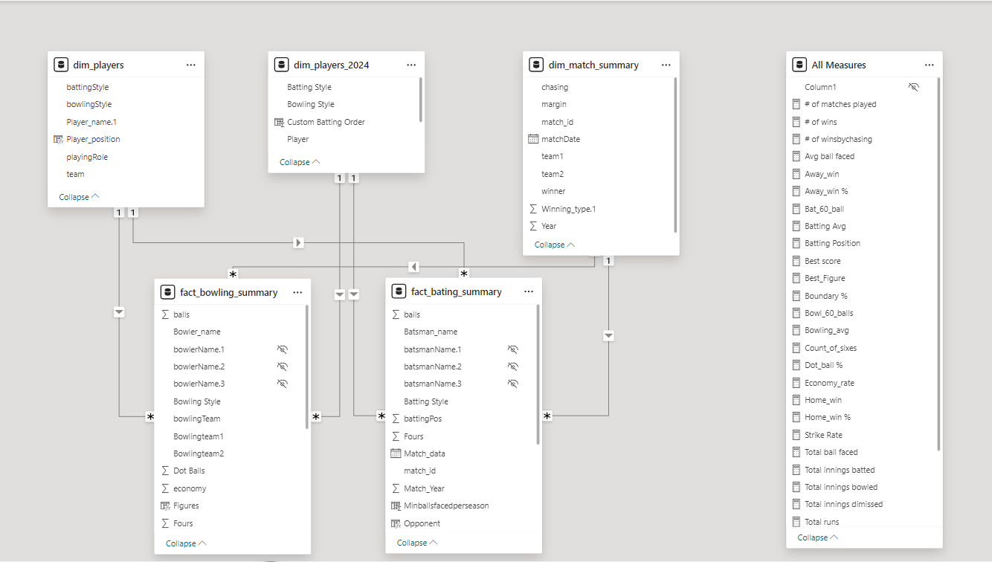
Data modelling

Slide 8
Primary Insights
Top 10 batsmen based on past 3 years total runs scored.
Top 10 batsmen based on past 3 years batting average. (min 60 balls faced in each season)
Top 10 batsmen based on past 3 years strike rate (min 60 balls faced in each season)
Top 10 bowlers based on past 3 years total wickets taken.
Top 10 bowlers based on past 3 years’ bowling average. (min 60 balls bowled in each season)
Top 10 bowlers based on past 3 years economy rate. (min 60 balls bowled in each season)
Top 5 batsmen based on the past 3 years boundary % (fours and sixes).
Top 5 bowlers based on the past 3 years dot ball %.
Top 4 teams based on past 3 years’ winning %.
Top 2 teams with the highest number of wins achieved by chasing targets over the past 3 years.

Slide 9
Secondary Insights (Predictions)
Predict the following for the season 2024 using available data and by doing additional research
1. Orange and purple cap player
2. Top 4 qualifying teams
3. Winner and runner-up
Your Picks
4. Pick your team selecting the Best 11 players based on their positions, 3 years of performance data and additional research
5. Pick your top 3 all-rounders

