Slide 1





ENTERPRISE AI · TECHNICAL PROJECT DEMO
Retrieval-Augmented
Generation
A production-shaped RAG reference application — grounding a large language model in your own private documents for accurate, cited answers.
FastAPI
Elasticsearch
OpenAI
React + TypeScript
Northwind Gadgets · Knowledge Assistant
Project Demonstration · 2026
Notes:
Title. Introduce the project: a production-shaped RAG reference app that grounds an LLM in Northwind Gadgets' own documents. Stack shown as chips.

Slide 2






WHAT WE'LL COVER
Agenda
01
04
The problem
Ingestion pipeline
Why standalone LLMs fall short for enterprise knowledge
Turning documents into searchable knowledge
02
05
What RAG is
Query & grounding
Retrieval + generation, explained end to end
Retrieval, citations, and hallucination control
03
06
System architecture
Business value & roadmap
How the reference application is built
Outcomes, use cases, and the path to production
Retrieval-Augmented Generation · Enterprise Reference Application
2
Notes:
Agenda. Six parts: the problem, what RAG is, architecture, ingestion, query & grounding, then value & roadmap.

Slide 3



THE PROBLEM
Why a plain LLM isn't enough
A powerful language model still can't see your documents — so when it's asked about them, it guesses.
Hallucination
No private knowledge
Models invent plausible-sounding but false answers when they don't know — with total confidence and no warning.
Your handbooks, policies, and product data were never in the training set. The model simply can't see them.
No sources
Stale & costly to retrain
A bare answer can't be trusted or audited — there's no citation to verify where a claim came from.
Retraining a model on every document change is slow and expensive. Knowledge goes out of date fast.
Retrieval-Augmented Generation · Enterprise Reference Application
3
Notes:
The problem. Plain LLMs hallucinate, can't see private data, give no sources, and are costly to retrain. RAG addresses all four.

Slide 4

THE CONCEPT
What is Retrieval-Augmented Generation?
RAG connects a language model to a searchable library of your own documents. Before answering, it retrieves the passages most relevant to the question, then generates an answer grounded only in what it found — with citations.
RETRIEVAL
GENERATION
Find the right context
+
Answer, grounded & cited
The question is turned into a vector and matched against an index of document chunks. The closest passages are pulled back as evidence.
The LLM writes an answer using only the retrieved passages, citing each fact inline — and says "I don't know" when the answer isn't there.
The result: the fluency of an LLM, anchored to facts from your knowledge base — no retraining, always current, fully auditable.
Retrieval-Augmented Generation · Enterprise Reference Application
4
Notes:
What is RAG. Two moves: retrieve the most relevant passages from your docs, then generate an answer grounded only in them, with citations.

Slide 5





END TO END
How RAG works — two flows
① INGEST — build the knowledge index (offline)
Ingest
documents → index
Load files
Split into chunks
Embed vectors
Store in index
② ASK — answer a question, grounded & cited (online)
Ask
question → answer
Embed question
kNN search
Build context
LLM answers
Both flows are driven by one class — RagPipeline (backend/app/rag/pipeline.py)
Retrieval-Augmented Generation · Enterprise Reference Application
5
Notes:
How it works. One RagPipeline class drives both flows: offline ingest (files→index) and online ask (question→grounded answer).

Slide 6




PART TWO
The Reference Application
Architecture, pipelines, and the enterprise use case in detail.
Architecture
Ingestion
Retrieval
Notes:
Section divider — the reference application.

Slide 7


THE USE CASE
Northwind Gadgets — Knowledge Assistant
A single chat assistant that answers employee and customer questions from the company's own documents — instantly, and always with a source.
KNOWLEDGE SOURCES
A GROUNDED ANSWER
Employee Handbook
How many days can I work remotely?
Hours, PTO, remote work, expenses, IT support
Employees may work remotely up to 3 days per week. More than that requires director approval, reviewed quarterly [1].
Product FAQ
GlowMug setup, charging, troubleshooting
Return & Warranty Policy
1
company_handbook.md · similarity 0.91
Return window, warranty terms, refund process
“Employees may work remotely up to 3 days per week…”
Retrieval-Augmented Generation · Enterprise Reference Application
7
Notes:
Use case. Northwind Gadgets assistant answers from 3 real docs (handbook, FAQ, return policy). Example: a remote-work question answered with a citation.

Slide 8
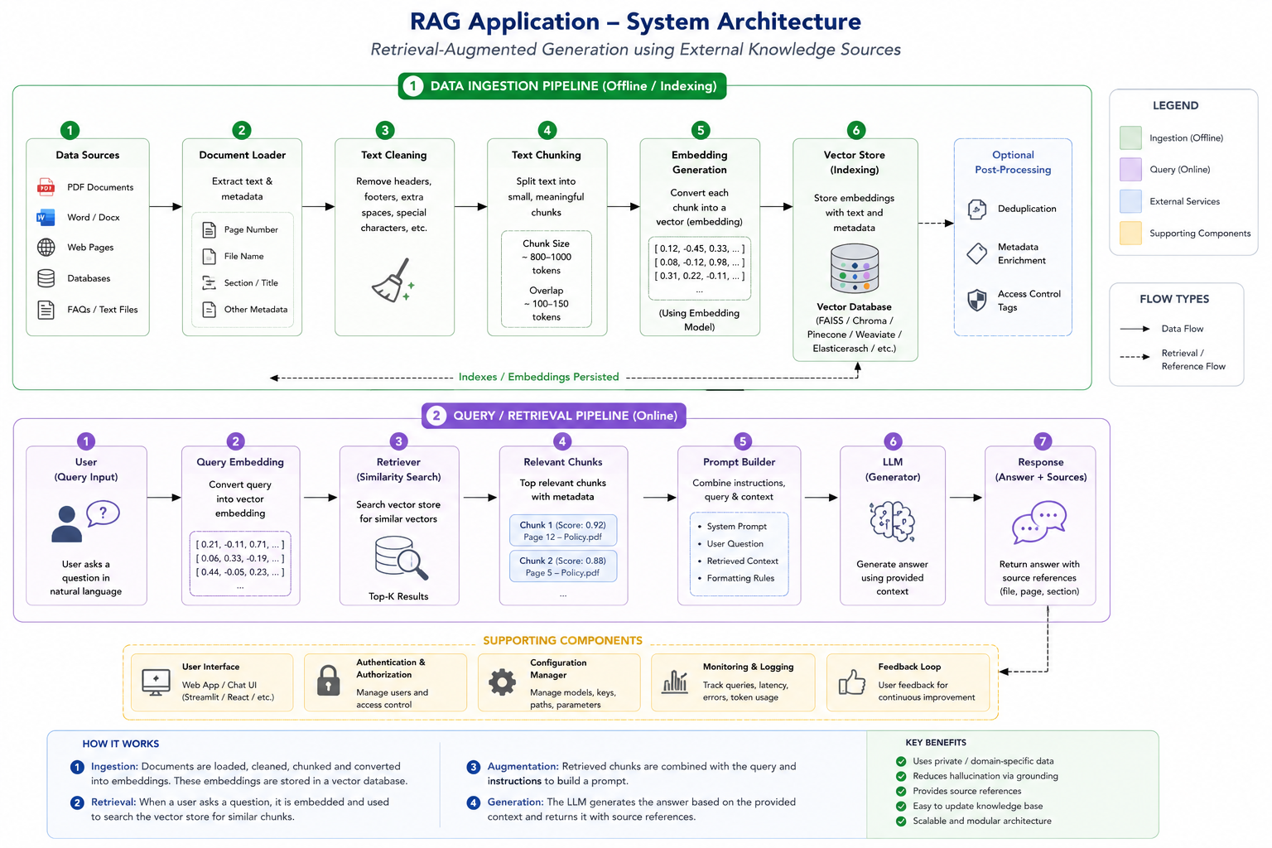
SYSTEM ARCHITECTURE
One pipeline, two lifecycles
Offline indexing
Documents are loaded, chunked, embedded and persisted to the vector store.
Online retrieval
Each question is embedded and matched against the index to fetch context.
Grounded output
The LLM answers from retrieved context and returns sources with every reply.
Retrieval-Augmented Generation · Enterprise Reference Application
8
Notes:
Architecture. Walk the canonical diagram: offline indexing pipeline on top, online retrieval pipeline below, grounded output.

Slide 9




INGESTION PIPELINE
From files to a searchable index
POST /ingest rebuilds the index end to end from backend/data/documents/.
1
2
3
4
Load
Split
Embed
Store
Read every .txt / .md / .pdf on disk into content units.
Long text → overlapping word windows so nothing exceeds the embed limit.
Each chunk becomes a 1536-dim vector via text-embedding-3-small.
Bulk-index vectors + metadata into an Elasticsearch dense_vector field.
180
30
1,536
cosine
WORDS PER CHUNK
WORDS OVERLAP
VECTOR DIMENSIONS
SIMILARITY METRIC
Retrieval-Augmented Generation · Enterprise Reference Application
9
Notes:
Ingestion detail. Load → split (180-word chunks, 30 overlap) → embed (1536-dim) → store in Elasticsearch dense_vector with cosine similarity.

Slide 10


BEYOND PLAIN TEXT
Multimodal ingestion — text, tables & images
PDFs rarely hold only prose. The pipeline preserves three kinds of evidence, each treated as an equally valid source at answer time.
Text
Tables
Images
Page text is split into overlapping word windows.
extract_tables() serializes each table to Markdown.
Embedded images ≥80px are pulled out as PNG.
One or more chunks per section — clean, embeddable prose.
Kept as one atomic chunk — a table is never split mid-row.
A vision model writes a caption; decorative logos are skipped.
Every chunk carries metadata — source, page, content_type — so answers can cite the exact file, page and evidence type.
Retrieval-Augmented Generation · Enterprise Reference Application
10
Notes:
Multimodal ingest. Text is word-chunked; tables kept atomic as Markdown; images captioned by a vision model (decorative ones skipped).

Slide 11

QUERY PIPELINE
Answering a question, step by step
STEP 1
STEP 2
STEP 3
Question
Embed
kNN search
User asks in natural language via the chat UI.
The question is embedded with the same model as the documents.
Elasticsearch returns the top_k = 4 closest chunks.
STEP 4
STEP 5
STEP 6
Build context
Generate
Respond
Chunks become a numbered [1]…[4] context block.
The LLM answers from context + last 6 turns of history.
Answer + ranked sources returned to the UI.
Retrieval-Augmented Generation · Enterprise Reference Application
11
Notes:
Query pipeline. Embed question → kNN top_k=4 → numbered context → LLM answers with last 6 turns of history → returns answer + ranked sources.

Slide 12

TRUST BY DESIGN
Grounded answers, not guesses
THE GROUNDING CONTRACT
Answer only from retrieved context
SYSTEM PROMPT (excerpt)
The model is instructed to use nothing but the numbered passages.
You answer using ONLY the numbered context passages below. Rules: • If the answer isn't in the context, say you don't know — never make something up. • Cite every fact inline using its
passage number, e.g.
[1]. • Reproduce relevant table rows as Markdown when useful. • Keep answers concise.
Cite every fact inline
Each claim carries its passage number — [1], [2] — traceable to a source.
Say “I don't know”
If the answer isn't in the context, the model refuses to invent one.
Low temperature (0.2)
Deterministic, faithful phrasing over creative embellishment.
Retrieval-Augmented Generation · Enterprise Reference Application
12
Notes:
Grounding. System prompt forces context-only answers, inline citations, 'I don't know' behavior, and low temperature (0.2).

Slide 13



UNDER THE HOOD
Technology stack
FastAPI
Elasticsearch
OpenAI
React + TypeScript
BACKEND & API
VECTOR STORE
EMBEDDINGS & LLM
FRONTEND
Typed Python service. Pydantic schemas are the contract; every route wires to RagPipeline.
Native kNN over a dense_vector field. Bulk indexing, aggregations, cosine similarity.
text-embedding-3-small for vectors; gpt-4o-mini for answers and image captioning.
Vite SPA, Tailwind UI. A typed client mirrors the backend; chat renders answers with cited sources.
Retrieval-Augmented Generation · Enterprise Reference Application
13
Notes:
Stack. FastAPI backend, Elasticsearch vector store, OpenAI embeddings+LLM, React+TypeScript frontend.

Slide 14
THE INTERFACE
A small, typed API surface
/ingest
Rebuild the index from data/documents/ end to end.
POST
/documents/upload
Save an uploaded .txt / .md / .pdf to disk.
POST
/documents
List indexed files with per-file chunk counts.
GET
/chat/start
Open a chat session and return its id.
POST
/chat/send
Ask a question — returns the answer plus ranked sources.
POST
/health
Index status and chunk / table / image counts.
GET
Retrieval-Augmented Generation · Enterprise Reference Application
14
Notes:
API surface. Small typed API — ingest, upload, documents, chat start/send, health.

Slide 15
WHY IT MATTERS
Business value
24/7
100%
0
3
INSTANT ANSWERS
ANSWERS CARRY A SOURCE
MODEL RETRAINING NEEDED
EVIDENCE TYPES INDEXED
Deflect support load
Trust & auditability
Employees and customers self-serve answers from policies, FAQs and handbooks — instantly.
Every answer is grounded and cited, so claims can be verified against the source document.
Always current
Governed & private
Update a document and re-ingest — no retraining, no waiting. Knowledge stays live.
Answers are confined to your own approved documents — not the open internet.
Retrieval-Augmented Generation · Enterprise Reference Application
15
Notes:
Business value. 24/7 instant answers, every answer sourced, no retraining, governed to your own private documents.

Slide 16


THE PATH FORWARD
From reference app to production
The demo deliberately keeps some things simple. Here's what hardening for production looks like.
Today — Reference app
Next — Hardening
Later — Scale
Dense-vector kNN retrieval
Multimodal ingest (text/table/image)
Grounded, cited answers
Typed API + React UI
Hybrid search (BM25 + vector)
Persistent session & chat store
Auth, roles & access control
Incremental re-indexing
HyDE & multi-query expansion
Re-ranking & evaluation harness
Monitoring, logging & feedback loop
Multi-tenant knowledge bases
Retrieval-Augmented Generation · Enterprise Reference Application
16
Notes:
Roadmap. Today's reference app → hardening (hybrid search, auth, persistence) → scale (HyDE, re-ranking, monitoring, multi-tenant).

Slide 17




THANK YOU
Answers you can trust,
from knowledge you own.
Retrieval-Augmented Generation pairs the fluency of a language model with the authority of your own documents — grounded, cited, and always current.
Grounded
Cited
Always current
Auditable
Northwind Gadgets — Knowledge Assistant
srvknd59@gmail.com
Notes:
Close. Answers you can trust, from knowledge you own. Q&A.

