Slide 1
STEPS FOR CREATING WEBSERVICES IN PLM-TCE

Slide 2
1. Create a working directory in your Linux environment <Work_dir> plmpapp2c3 omf9dev [rsm] $ mkdir webservice_partRevdetails
plmpapp2c3 omf9dev [rsm] $ cd webservice_partRevdetails
2. Copy following files to <Work_dir> soapcpp2 wsdl2h stdsoap2.c stdsoap2.h
vzluvdev01 arai [linux386] $ pwd
/home/people/arai/vaibhav/gsoap-2.8/gsoap/bin/linux386
plmpapp2c3 omf9dev [webservice_partRevdetails] $ pwd
/user/omf9dev/devgroups/rsm/webservice_partRevdetails
plmpapp2c3 omf9dev [webservice_partRevdetails] $ scp arai@172.22.97.92:/home/people/arai/vaibhav/gsoap-2.8/gsoap/bin/linux386/wsdl2h .
plmpapp2c3 omf9dev [webservice_partRevdetails] $ scp arai@172.22.97.92:/home/people/arai/vaibhav/gsoap-2.8/gsoap/bin/linux386/wsdl2h .
plmpapp2c3 omf9dev [webservice_partRevdetails] $ scp arai@172.22.97.92:/home/people/arai/vaibhav/gsoap-2.8/gsoap/bin/linux386/CALC/stdsoap2.c .
plmpapp2c3 omf9dev [webservice_partRevdetails] $ scp arai@172.22.97.92:/home/people/arai/vaibhav/gsoap-2.8/gsoap/bin/linux386/CALC/stdsoap2.h .
1

Slide 3
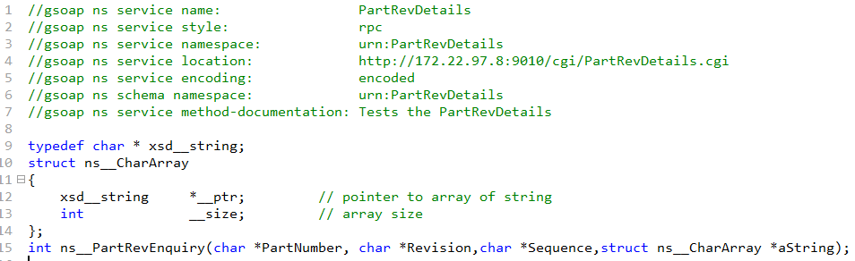
3. Writing WEB SERVICES Code
i) Create a header file “PartRevDetails.h” with following parameters
//gsoap ns service name: PartRevDetails
//gsoap ns service style: rpc
//gsoap ns service namespace: urn:PartRevDetails
//gsoap ns service location: http://172.22.97.8:9010/cgi/PartRevDetails.cgi
//gsoap ns service encoding: encoded
//gsoap ns schema namespace: urn:PartRevDetails
//gsoap ns service method-documentation: Tests the Simple Web service
Server Address
ii) Write your intended function in header file
int ns__PartRevEnquiry(char *PartNumber, char *Revision,char *Sequence,struct ns__CharArray *aString);
Input parameter for Web Services
Output of Web Services
2

Slide 4
iii) Use soapcpp2 tool to compile header file and create supporting files. Command for compiling header file :-
soapcpp2 -1 -e -c PartRevDetails.h
iv) Create C file that will contain the definition of the function. Please include below header files.
#include "soapH.h"
#include "PartRevDetails.nsmap" // your nsmap file
v) Replace following line in def file
### $CC_ANSI -o $PROG_NAME $PROG_NAME.o $* -lmalloc_cv -lmalloc_ss $LIBS <----------- line to be replaced
$CC_ANSI -o $PROG_NAME.cgi $PROG_NAME.o soapC.c soapServer.c stdsoap2.c $* $LIBS <----------- new line to be added
vi) In case of client code use normal compilation procedure. (make binclobber, cnvdef, make init ,make all)
In case of pure c code use following compilation
cc -o PartRevDetails.cgi PartRevDetailsc soapC.c soapServer.c stdsoap2.c
vii) To test exe file use following command.
PartRevDetails.cgi < PartRevDetails.getResponse.req.xml
Before running above command we need to modify PartRevDetails.getResponse.req.xml
based on passed input parameter.
After successful execution of above command ,we will get the output.
3

Slide 5
viii) Copy PartRevDetails.wsdl file to ROOT directory in apache
application_server/apache-tomcat-6.0.29/webapps/ROOT/
Copy PartRevDetails.cgi, PartRevDetails.PartRevEnquiry.res.xml and PartRevDetails.PartRevEnquiry.req.xml to following directory
application_server/apache-tomcat-6.0.29/webapps/ROOT/WEB-INF/cgi
ix) After copy of *.wsdl and *.cgi ,go to bin directory of apache
application_server/apache-tomcat-6.0.29/bin
Run shutdown.sh and then startup.sh to restart apache server.
4

Slide 6
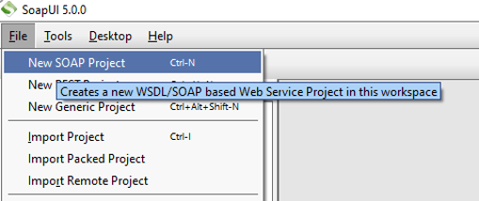
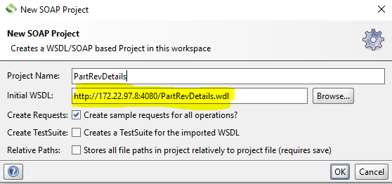
4. Download and install SoapUI Tool for web service testing on PC
A window will open. Click option “
A window gets opened as shown below. Enter the given URL http://172.22.97.8:9010/PartRevDetails.wsdl on “Initial WSDL”. After entering “Initial WSDL” click on “OK”
Enter WSDL Address
5

Slide 7
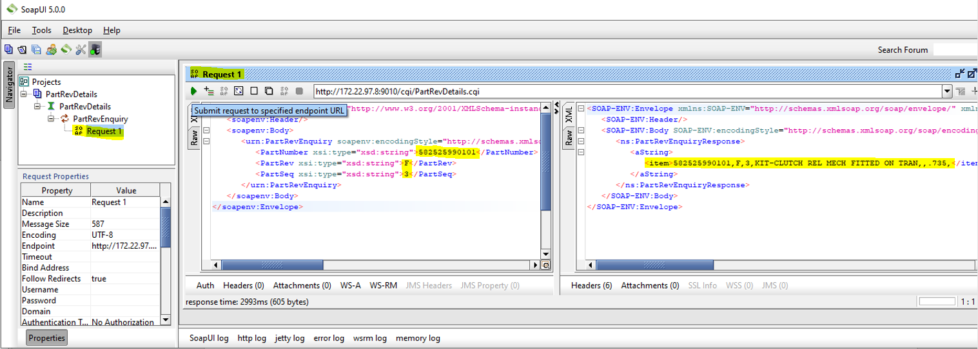
Double click on option “Request 1” from Project tree. Request 1 window will appear in right. Fill all input details and click on green arrow to execute web service.
Input Response of webservice
Output Response of webservice
6

Slide 8
Thank You

