Slide 1
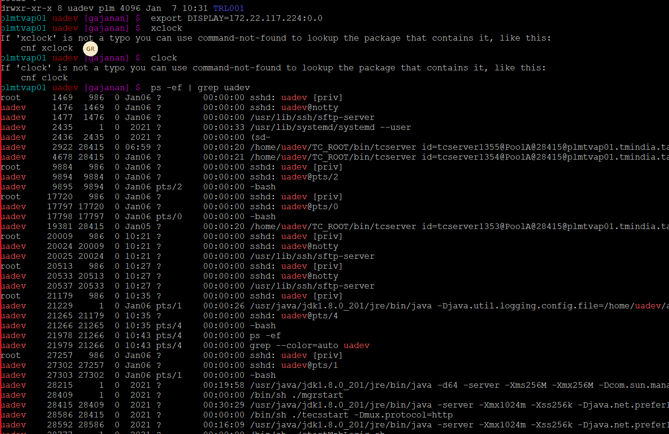
UADEV BMIDE Deployment Steps
1. Open Putty and login uadev env:
2. Enter our local system IP Adress
EX: export DISPLAY=172.22.117.224:0.0
3. Put the below cmd for check the services which is running or stops
ps -ef | grep uadev

Slide 2
4. Go to cd /home/uadev/TC_ROOT/install directory take backup configuration.xml file
cp configuration.xml configuration.xml_07_Jan_2021_working
5. Go to /home/uadev/TC_ROOT/lib directory and take backup tm_dfc_tct.so file
mv /home/uadev/TC_ROOT/lib/tm_dfc_tct.so
6. Stop WebLogic Service
Go to cd /home/uadev/Oracle/Middleware/Oracle_Home/user_projects/domains/uadev/bin
./stopWebLogic.sh
7. Stop Pool Manager Services
Go to cd /home/uadev/TC_ROOT/pool_manager/confs/uadev
./mgrstop
8. Stop fsc service : cd /home/uadev/TC_ROOT/fsc
.

Slide 3
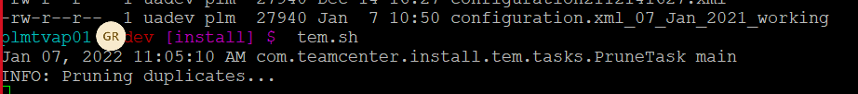
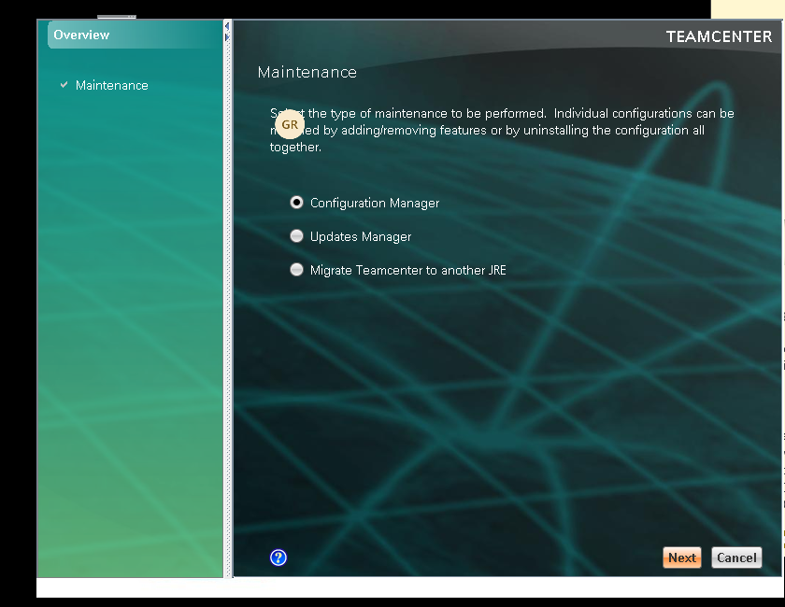
9. Launch tem.sh
Go to /home/uadev/TC_ROOT/install Directory
execute :tem.sh
After executing tem.sh showing below window
Click : Next

Slide 4
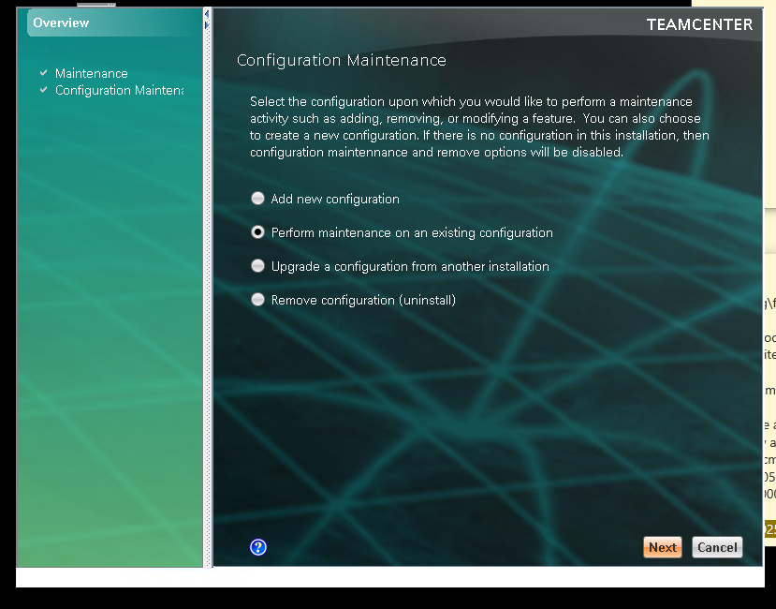
Click Next

Slide 5
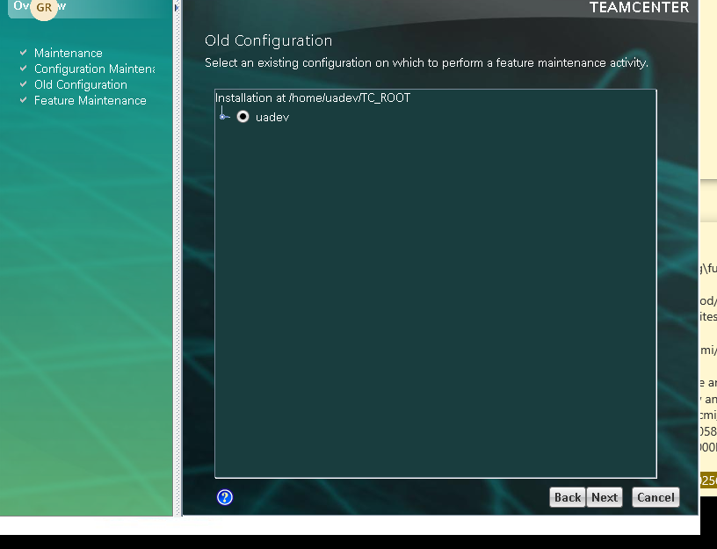
Click Next

Slide 6
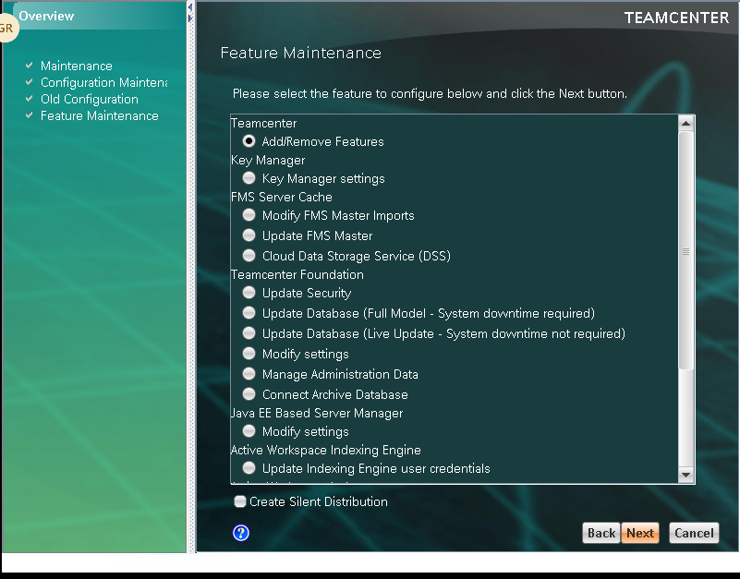
If you are first time deployment select Add/Remove feature
Other wise go to Next slide

Slide 7
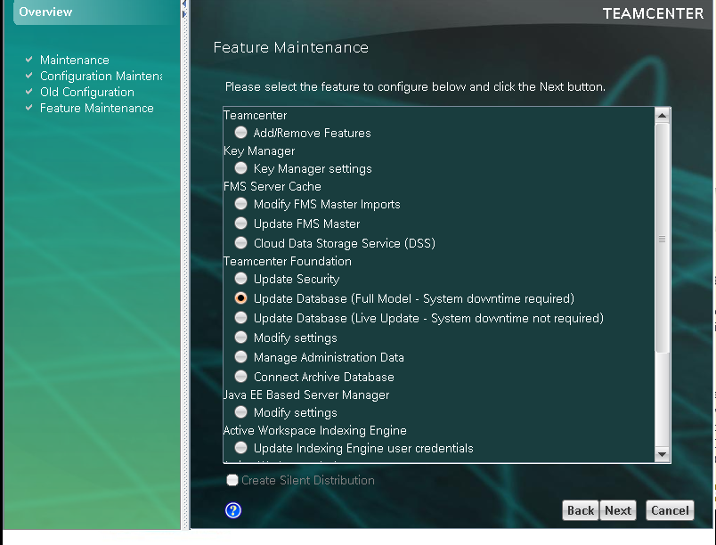
If you are second time deployment you project then select update database ( Full Model )

Slide 8
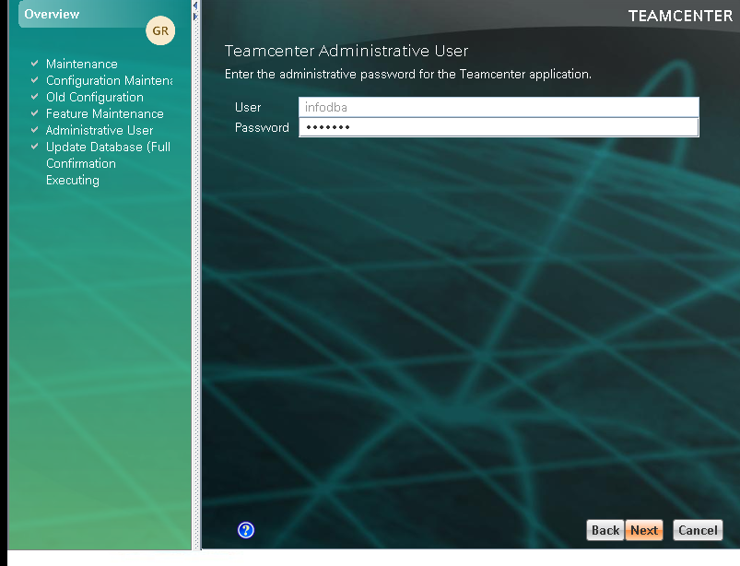
Enter password: infodba
Click Next

Slide 9
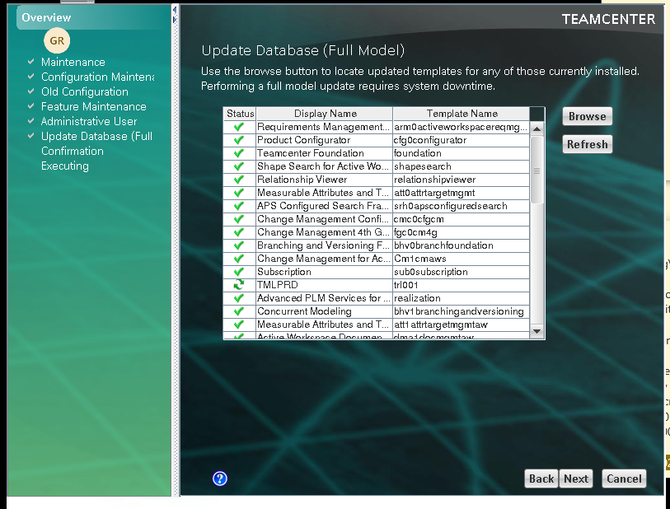
Update you project file like: TMLPRD
Click on Browse and select feature file
Click Next and click start

Slide 10
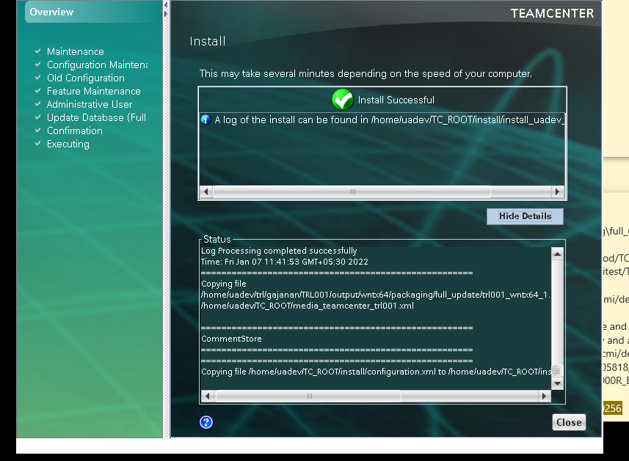
uadev BMIDE Deployment successful

Slide 11
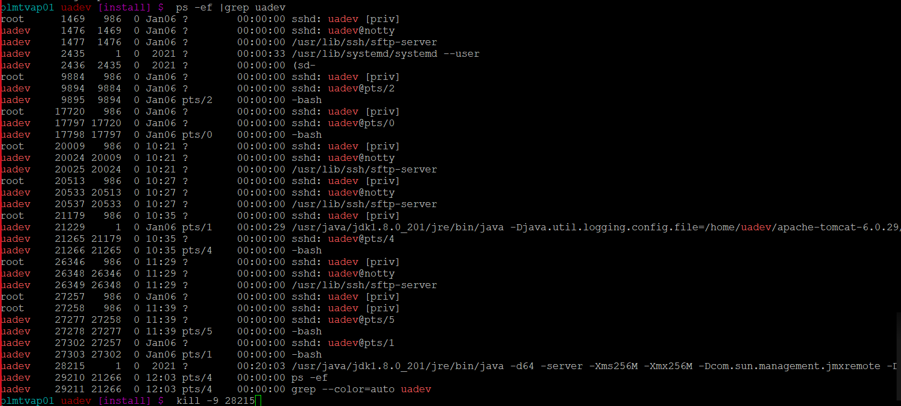
Stop FMS Service: kill -9 service number

Slide 12
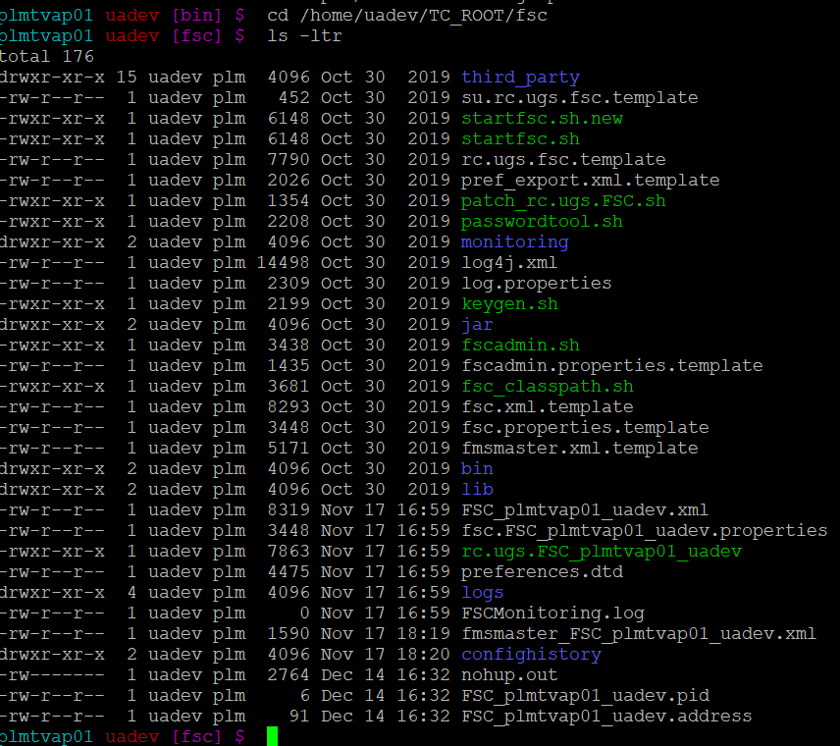
Start FSC Service : Go to cd /home/uadev/TC_ROOT/fsc Directory
nohup rc.ugs.FSC_plmtvap01_uadev &

Slide 13
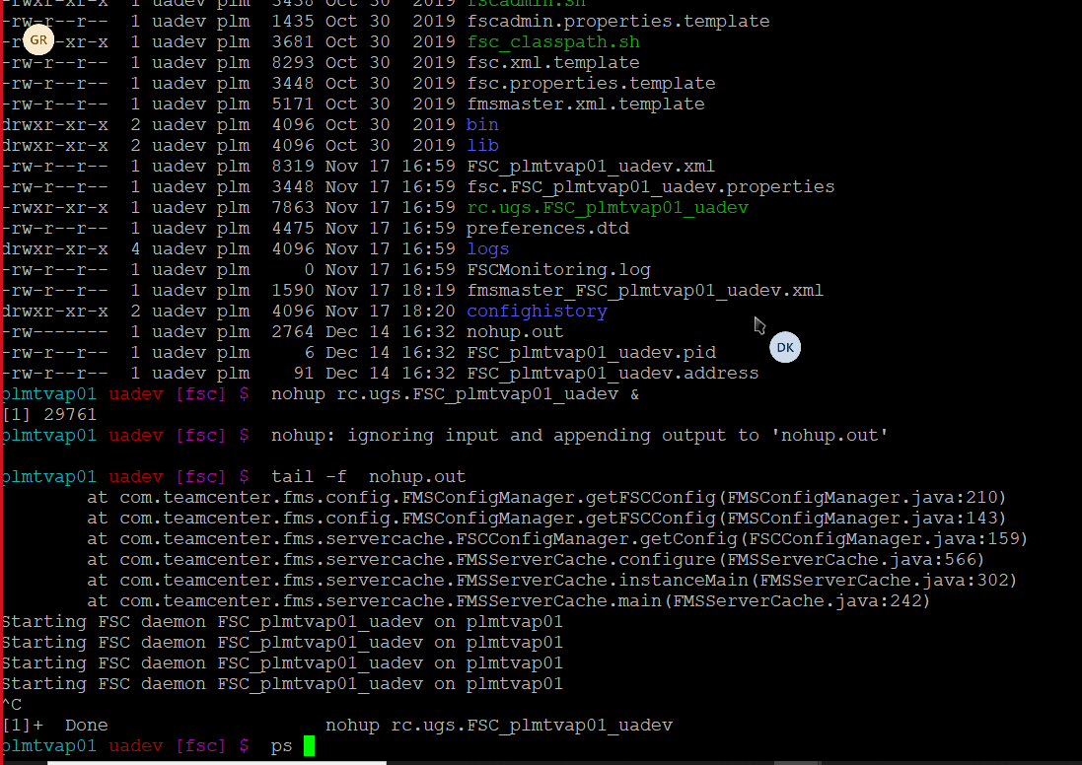
Cmd : : tail –f nohup.out = for showing error

Slide 14
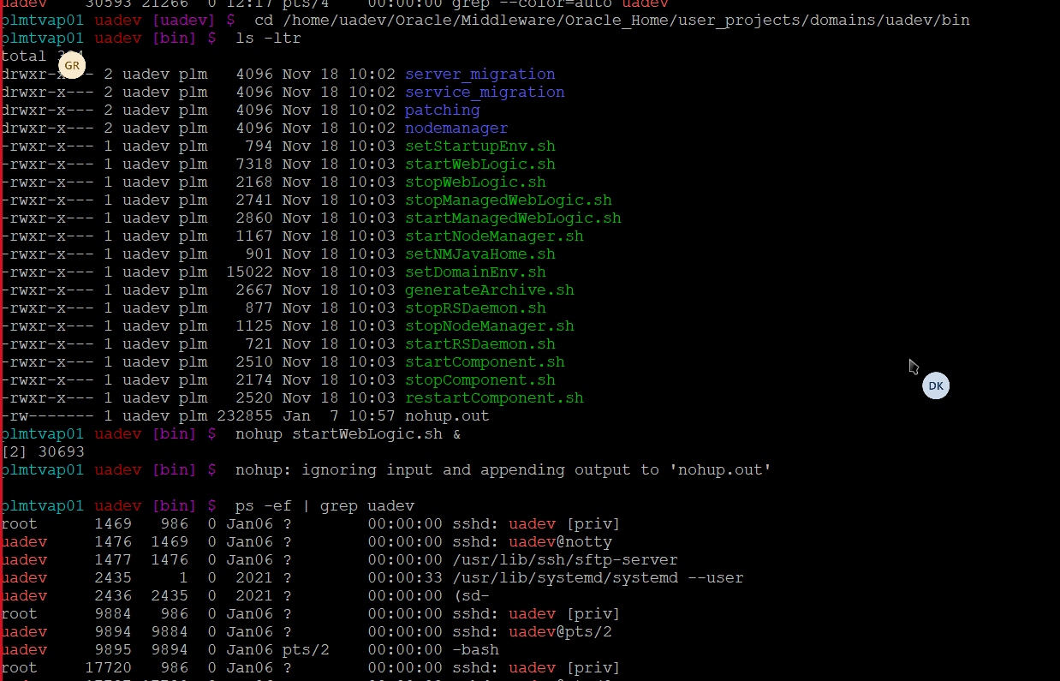
Start Pool manager service: Go to /home/uadev/TC_ROOT/pool_manager/confs/uadev Directory
Execute : nohup mgrstart &
Start WebLogic service: Go to /home/uadev/Oracle/Middleware/Oracle_Home/user_projects/domains/uadev/bin Directory
Execute : nohup startwebLogic.sh &

Slide 15
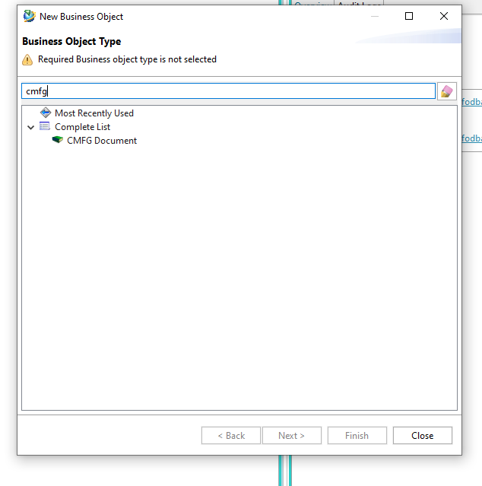
Launch your uadev client check your changes

