Slide 1
INDIAN INSTITUTE OF COMPUTING AND TECHNOLOGY
AI-Driven Phishing Email
Detection Using NLP
A comparative machine-learning study across Logistic Regression, Random Forest,
Naive Bayes, and a Neural Network classifier
Project Notebook • 18,650 Labeled Emails • 4 Models Compared

Slide 2
Objective
Design and implement a machine-learning system that automatically detects phishing emails using text analysis and metadata features — built from scratch through data preprocessing, feature extraction, model training, and evaluation.
DATASET AT A GLANCE
18,650
total labeled emails
✓
Why it matters
60.7%
39.3%
Phishing relies on language tricks — fake urgency, deceptive wording, malicious URLs — that NLP is well suited to detect.
Safe Email
(11,322)
Phishing Email
(7,328)
✓
Approach
Combine linguistic features (TF-IDF) with structural metadata (URLs, punctuation, casing) for stronger signal than text alone.
4
97.1%
Outcome
Models
compared
Best model
accuracy
✓
A validated, comparative pipeline ready for deployment as a real-time email classifier.
AI-Driven Phishing Email Detection Using NLP
2

Slide 3
Methodology Pipeline
1
2
3
4
5
Data
Collection
Data
Cleaning
Feature
Engineering
Model
Development
Evaluation
→
→
→
→
Gather phishing & legitimate email samples
Strip HTML, URLs, punctuation & stopwords
TF-IDF + word patterns + metadata
Train & tune 4 classifiers
Accuracy, precision, recall, F1, ROC
Data cleaning removed HTML tags, URLs, email addresses, punctuation, and digits, then lowercased text. Stopword removal used scikit-learn's built-in English list during TF-IDF vectorization.
AI-Driven Phishing Email Detection Using NLP
3

Slide 4
Feature Engineering
Two complementary feature families feed every model:
LINGUISTIC FEATURES
STRUCTURAL FEATURES
TF-IDF Vectorization
Metadata Signals
▸
5,000 most informative terms
has_url / num_urls
presence & count of embedded links
▸
Unigrams + bigrams (captures phrases like “click here”)
num_exclaim
urgency cues (“!!!”)
▸
English stopwords removed automatically
uppercase_ratio
SHOUTING text ratio
▸
Reveals vocabulary that distinguishes phishing from safe email
text_length / num_words / num_digits
message shape
AI-Driven Phishing Email Detection Using NLP
4

Slide 5
Model Comparison
RANKED BY F1-SCORE
1
Neural Network
0.976
2
Logistic Regression
0.974
3
Random Forest
0.971
4
Naive Bayes
0.956
Neural Network delivers the best balance of precision and recall, narrowly ahead of Logistic Regression.
AI-Driven Phishing Email Detection Using NLP
5

Slide 6
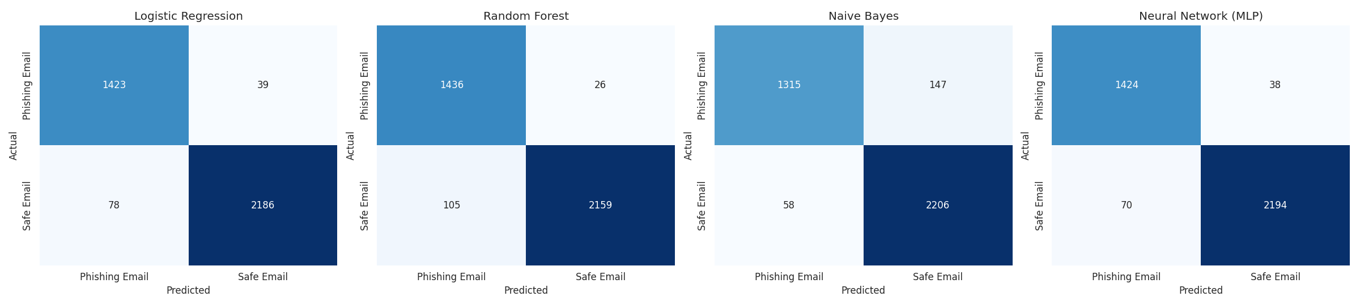
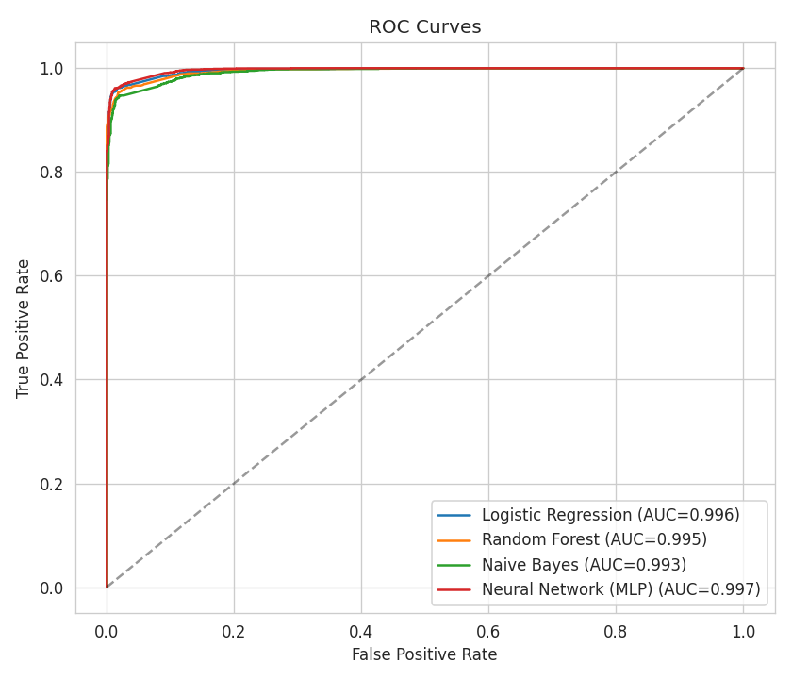
Evaluation: Confusion Matrices & ROC
AI-Driven Phishing Email Detection Using NLP
6

Slide 7
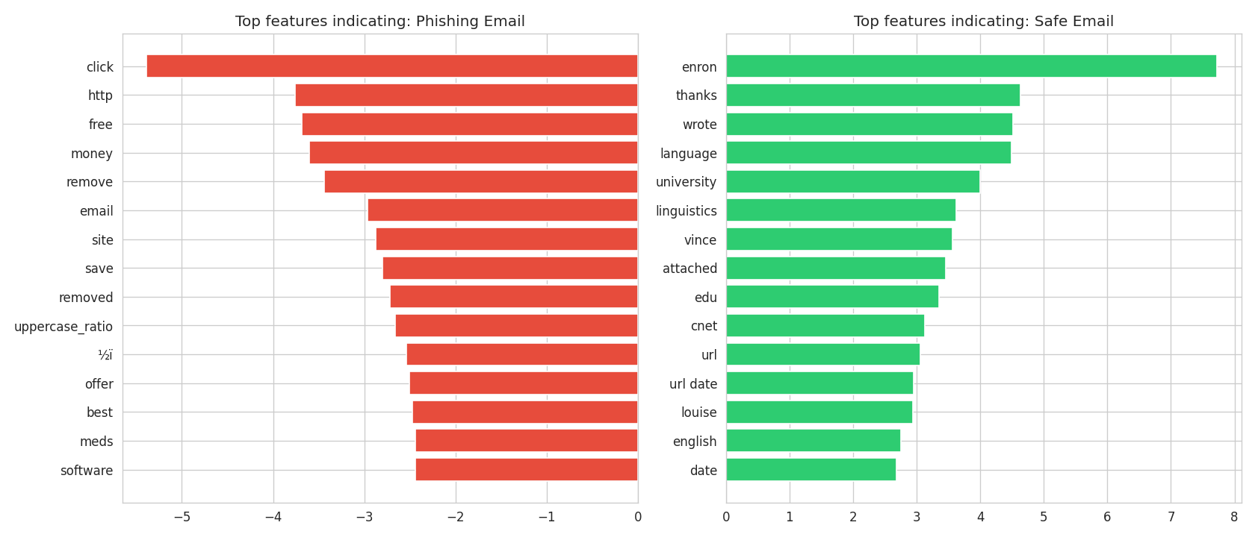
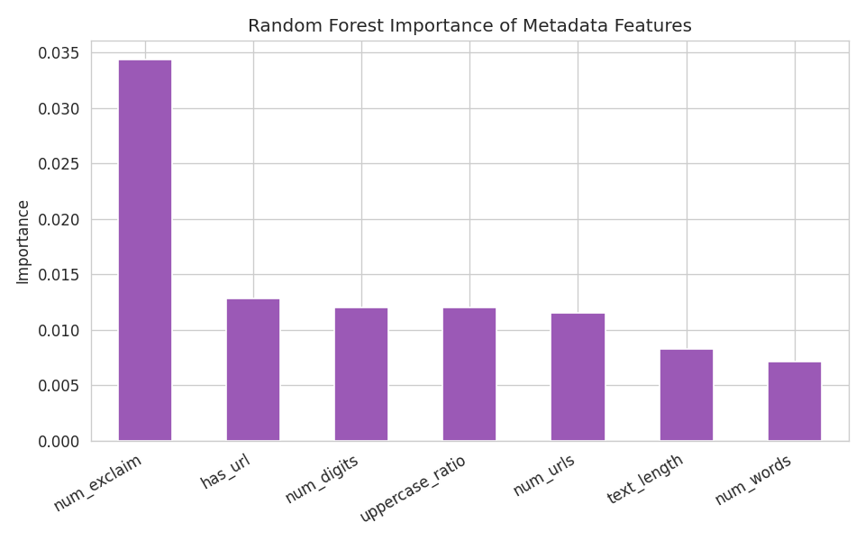
What Drives the Predictions?
Logistic Regression coefficients (left) show the specific words that push a prediction toward Phishing or Safe. Metadata features (right) confirm that URL presence, exclamation marks, and uppercase ratio carry real predictive signal on top of vocabulary.
AI-Driven Phishing Email Detection Using NLP
7

Slide 8
Conclusions & Recommendations
1
Deploy the Neural Network model
Best F1-score (0.976); balances precision and recall for production use.
2
Keep Logistic Regression as a lightweight fallback
Nearly matches MLP performance, trains fast, and is fully interpretable.
3
Combine text + metadata features
Structural cues (URLs, urgency punctuation, casing) add signal beyond vocabulary alone.
4
Plan for retraining
Phishing language evolves — refresh the dataset and retrain periodically.
Deliverables: executed notebook • raw & cleaned datasets • comparative analysis report • this presentation
AI-Driven Phishing Email Detection Using NLP
8

