Slide 1


Final CF:G Data Science & SQL Project
Prosecutions and Convictions
By Sarvenaz Moradi

Slide 2

What does the project do?
Creates and uses the database
Creates 9 different tables
Inserts data into 4 tables
The data import wizard was used to import data for 5 tables
Sets Primary and Foreign Keys
Queries:
Subqueries
Joins
Create/use a stored function
Creating views
Group by
Create/use a stored procedure

Slide 3
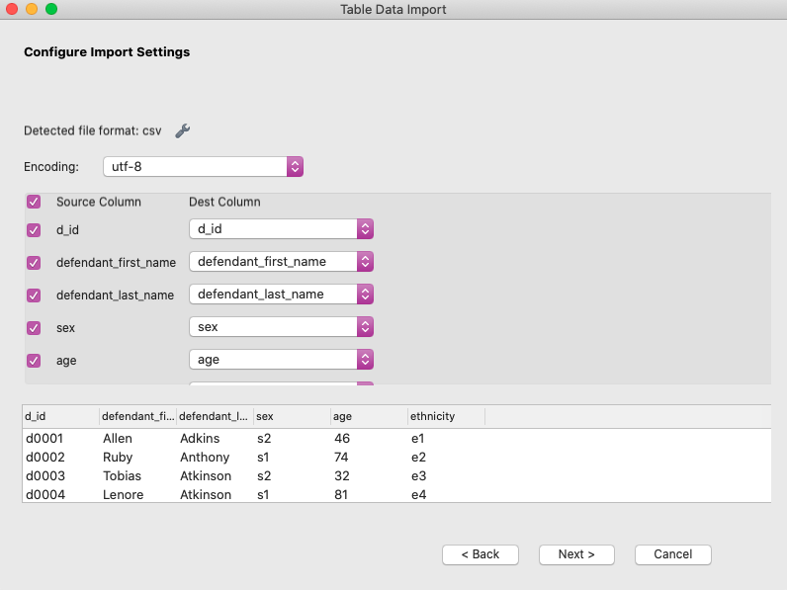
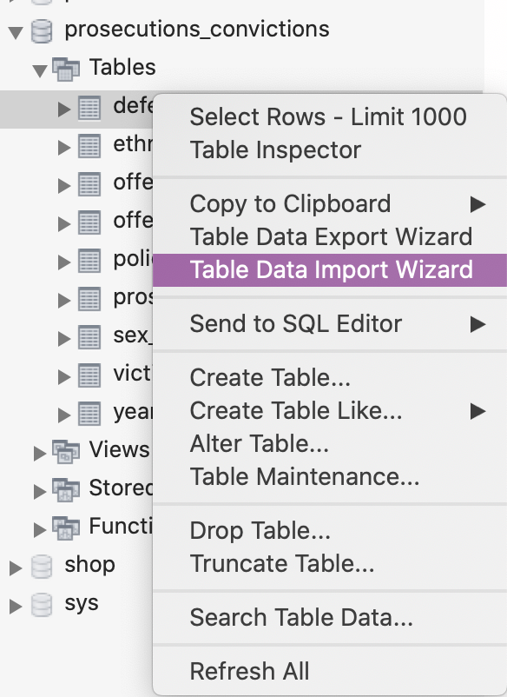
‘LOAD DATA INFILE’ problem..
‘LOAD DATA INFLIE’ command would return a ‘secure-file-priv’ error
Locating the ‘my.cnf’ file in order to manually configure the ‘secure-file-path’ was not possible due to having problems installing MySQL SHELL on my Mac..
Hence,
The data import wizard was used for 5 tables

Slide 4
What is the database about?
Defendants:
Name, age, ethnicity, sex
Prosecution date, conviction date
Victims:
Name, age, ethnicity, sex
Offences:
Name, where it happened, when it happened

Slide 5

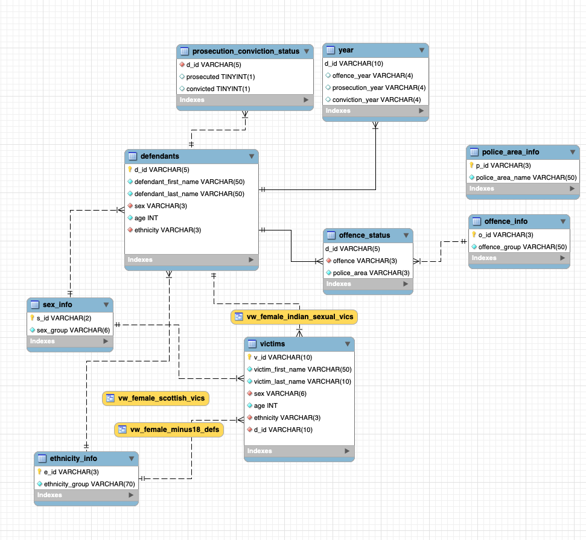
What does the database look like?

Slide 6

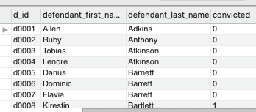
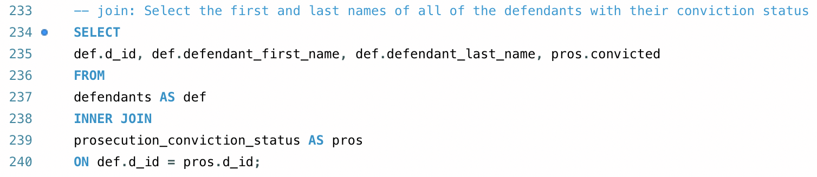
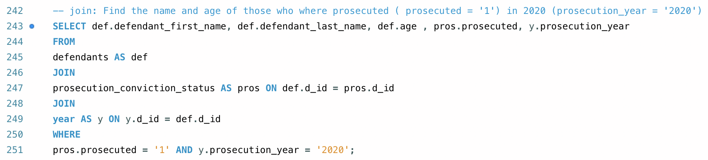
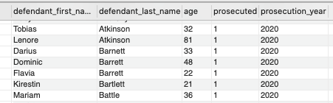

‘Join’
Finding names of all the defendants with their conviction status
Finding name & age of those who were prosecuted in 2020

Slide 7
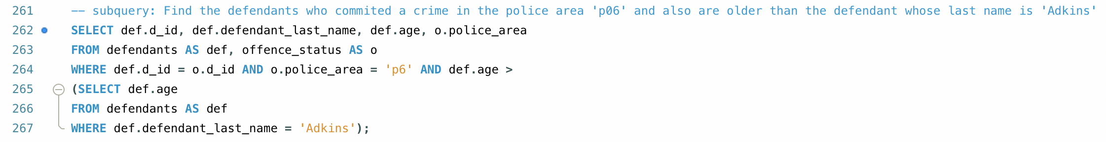
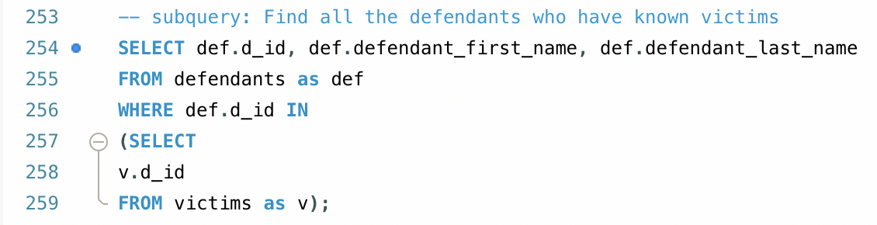
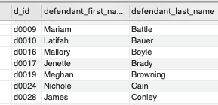

‘Subquery’
Finding the defendants who committed a crime in the police area ‘p6’ & are older than the defendant named “Adkins”
Finding the defendants who have known victims

Slide 8
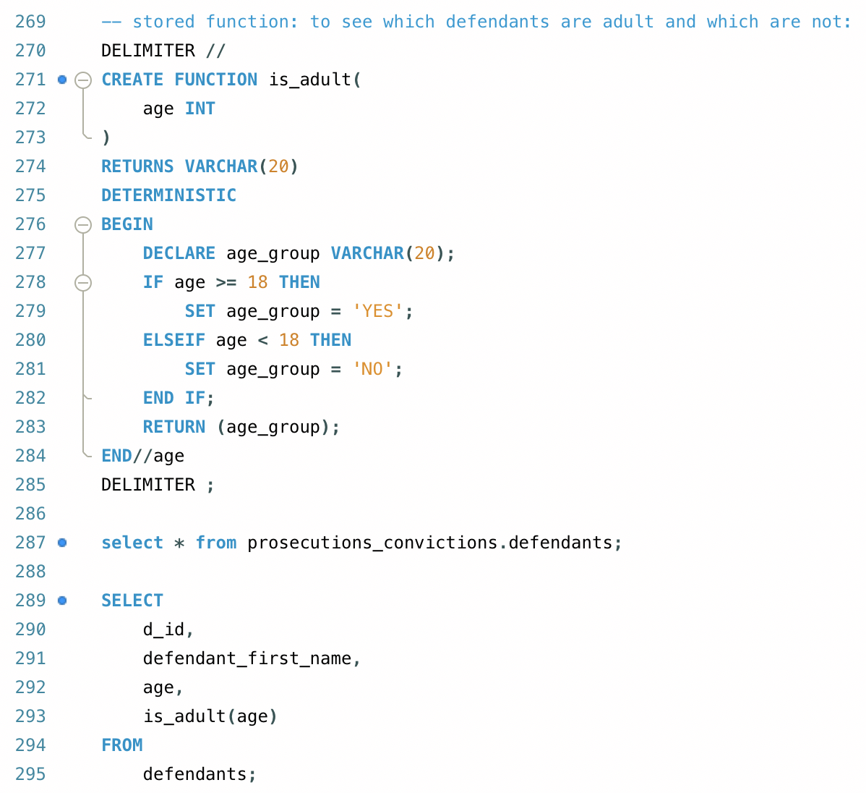
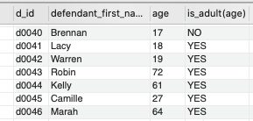
Stored function ‘is_adult’
Find out which defendants are adult and which ones are not

Slide 9
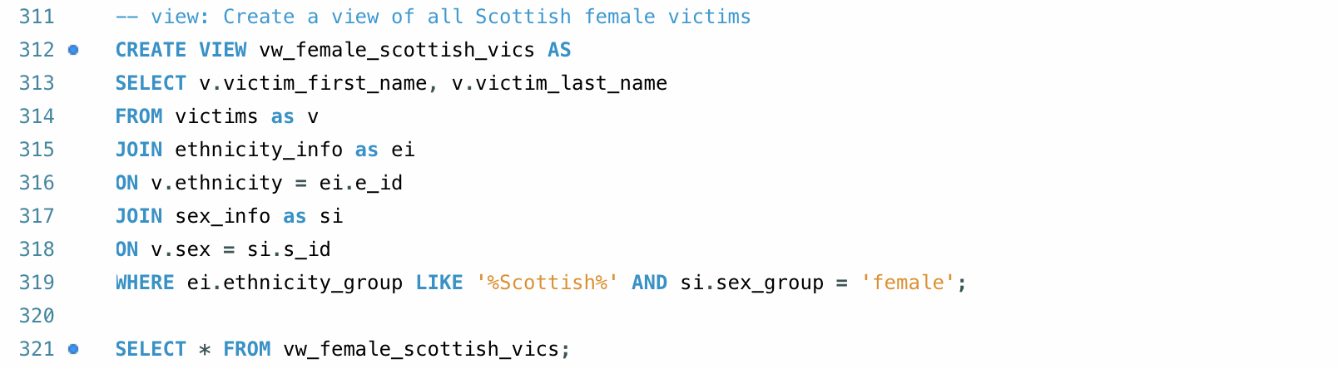

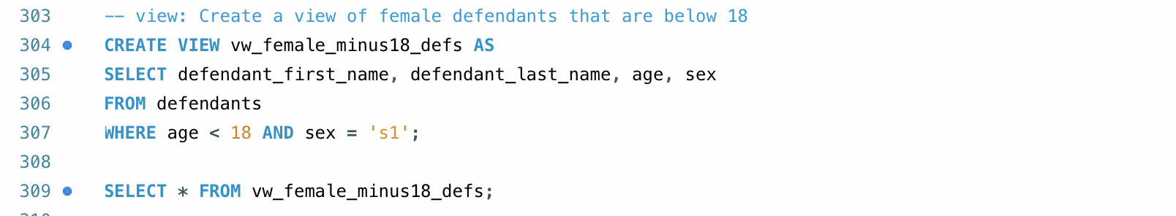

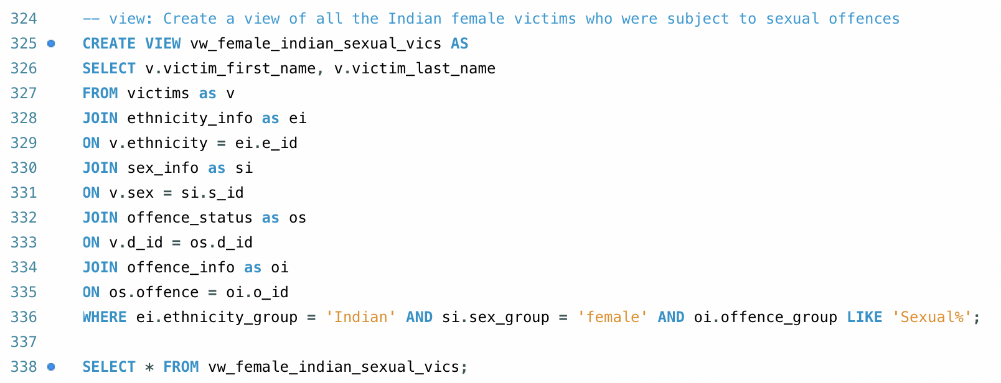

Creating views:
Female defendants that are below 18
Scottish defendants that are female
Indian female victims who were subject to sexual assault

Slide 10
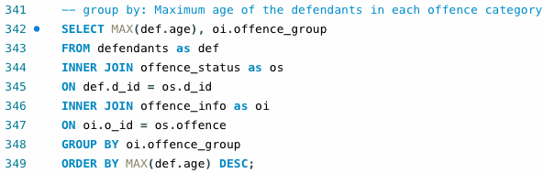
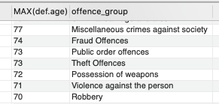
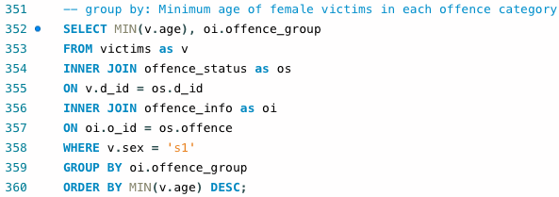
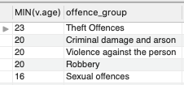
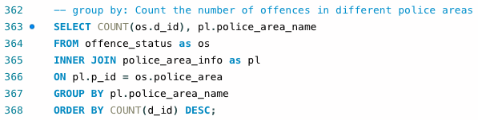
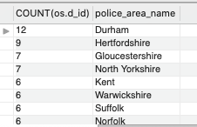
‘GROUP BY’
Maximum age (defendants) in each offence category
Minimum age (female victims) in each offence category
Offence count in each police area

Slide 11
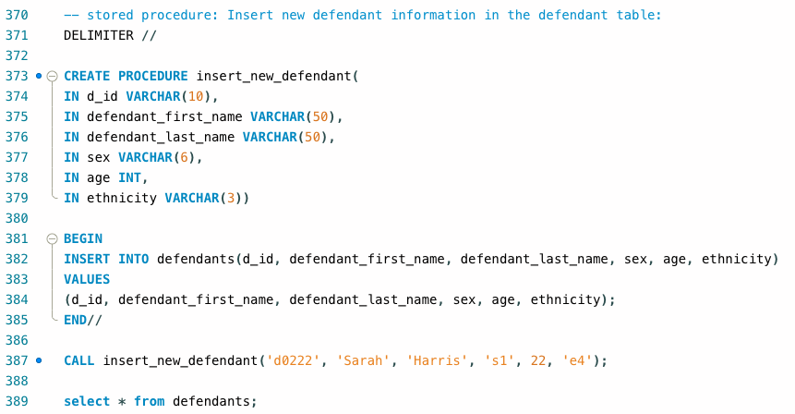

Stored procedure ‘insert_new_defendant’

Slide 12
The end..

