Slide 1
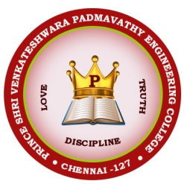


Price shri venkateshwara padmavathy engineering
college
MINISTRY NAME: MINITRY OF POWER
PROBLEM
STATEMENT NO:OF POWER
LN-382
TEAM NAME: TECHNOWIZARD

Slide 2
PSVPEC
Techno wizard
Team members
S R VIKNESH
A YOGESWARI
S V VARSHAA
A JOHN SAMUEL
A JOEL HENDRY
K MERVEEN JACOB
Mentors
Dr.P Kapilavani PhD, Associate Professor
Department of Information Technology
Dr. Senthil Kumar PhD, Associate Professor
Department of Electronics and Communication Engineering

Slide 3
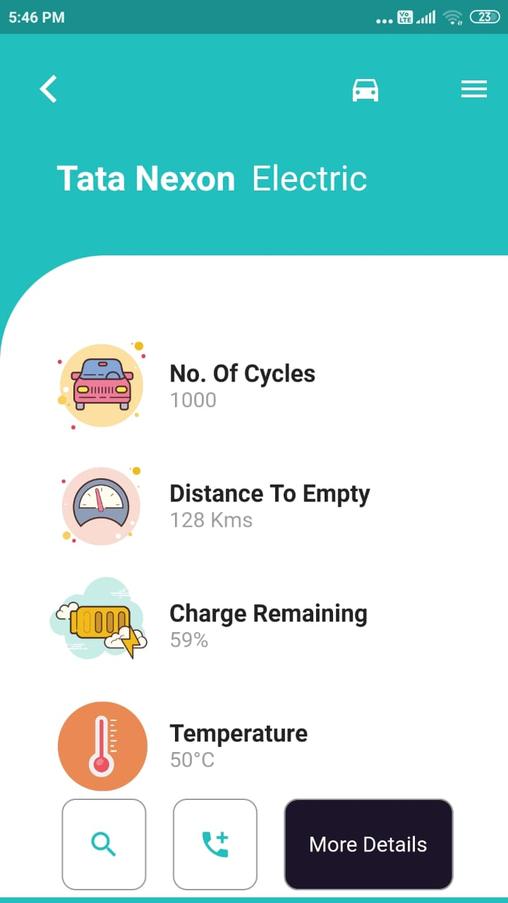
MONITORING
GETTING ALL THE NEEDED VALUES FROM THE BATTERY USING OUR MODULE
TRANSMIT THE DATA TO CLOUD AND TO USER MOBILE USING NODEMCU.
DISPLAY TO USER AND AUTHORITY. FURTHER PROCESS USING THIS DATA CAN BE MADE.

Slide 4
MAINTANANCE
(WE CAN MAINTAIN AS WELL AS INCREASE THE LIFE OF BATTERY BY MAINTAINING CERTAIN PARAMETERS: HERE WE HAVE LISTED SOME MAJOR PARAMETERS)
CCHARGE IN BATTERY
DURATION
TEMPERATURE
CAN BE CONTROLLED USING SOFTWARE
STEADY CHARGING– CAN REGULATE V
ACTIVE COOLING SYSTEM

Slide 5
INNOVATIVE SOLUTION
S2. V MEASUREMENT
V
CONTROLLER
AUTHORITY
C1
S3
DETERMINATION
USER
S4.RECTIFICATION
V
S1.INTIAL OBSCREATION

Slide 6
EXPLANATION
STAGE ONE 1-INITIAL OBSERVATION
STAGE TWO – MESUREMENT
STAGE THREE - DETERMINATION
STAGE FOUR-RECTIFICATION

Slide 7
CONCLUSION
WE ARE MONITORING THE CAR BATTERY BY COLLECTION THE PARAMETERS LIKE VOLTAGE, CURRENT, TEMPERATURE , REMAINING AMOUNT OF BATTERY, DISTANCE THAT CAN BE TRAVELLED WITH REMAINING BATTERY.
EFFECTIVE MAINTANANCE OF BATTERY LIFE
THE IDEA TURNED INTO A VENTURE OF PRODUCT (CMU)
FINALLY ENRICHED USER EXPERIENCE CAN BE PROVIDED BY THE APP TO THE USER AND ORGANISATION
BATTERY AND ITS CELL MONITORING UNIT FORMS A SMART CELL
IF CELL’S LIFESPAN IS INCREASED WE CAN EXTEND THE BATTERY LIFE.

