Slide 1
FFmpegInterOpExt
IPStreamingCPP App (written in C++ UWP)
  Rtsp-streaming IP camera
  Using FfmpegInterop
  With extensions as follows:
    Time out behavior (rtsp-no connect timeout)
    Recording ffmpeg debug output
    Recording in files in local folder storage
      Remuxing input stream to file
      Muxing input to output format(mp4,...), variable in size,fps
    Streaming input to node.js listener in mpegvideo format (640x480)
    Node.js listener not yet checked in
    Starting MJPEG Video Server for clients and streaming input in mpeg video format
OnVifUniversal Library (written in .Net UWP)
  Adding / Removing / Editing OnVif Cameras
  Interface for Onvif capable IP cameras (for testing I use AMCREST 1080P camera)
  Reading Stream Url for using in IPStreaming App
  Reading / Writing OnVif-Camera Profiles
  PTZ- Camera function, using while IP-Streaming
  Event-Handling not yet implemented
  Using OnVifUniversal Library in IPStreaming App
  To do: Discovery local network for finding OnVif capable Cameras

Slide 2
FFmpegInterOpExt
Actual Problems IPStreaming CPP in Release Version
  .Net Native OnVifUniversal Library cannot used in IPStreamingCPP C++ App
    Using OnVifUniversal Library in C++ UWP: OnVif Connection to Camera does not function
  Using the same OnVifUniversal Library in .Net native UWP: OnVif Connection runs without problems
  In the moment no Idea wath can be the reason for that. Library missing while compiling/linking ??
IPStreaming CPP in Debug Version
  Full running

Slide 3
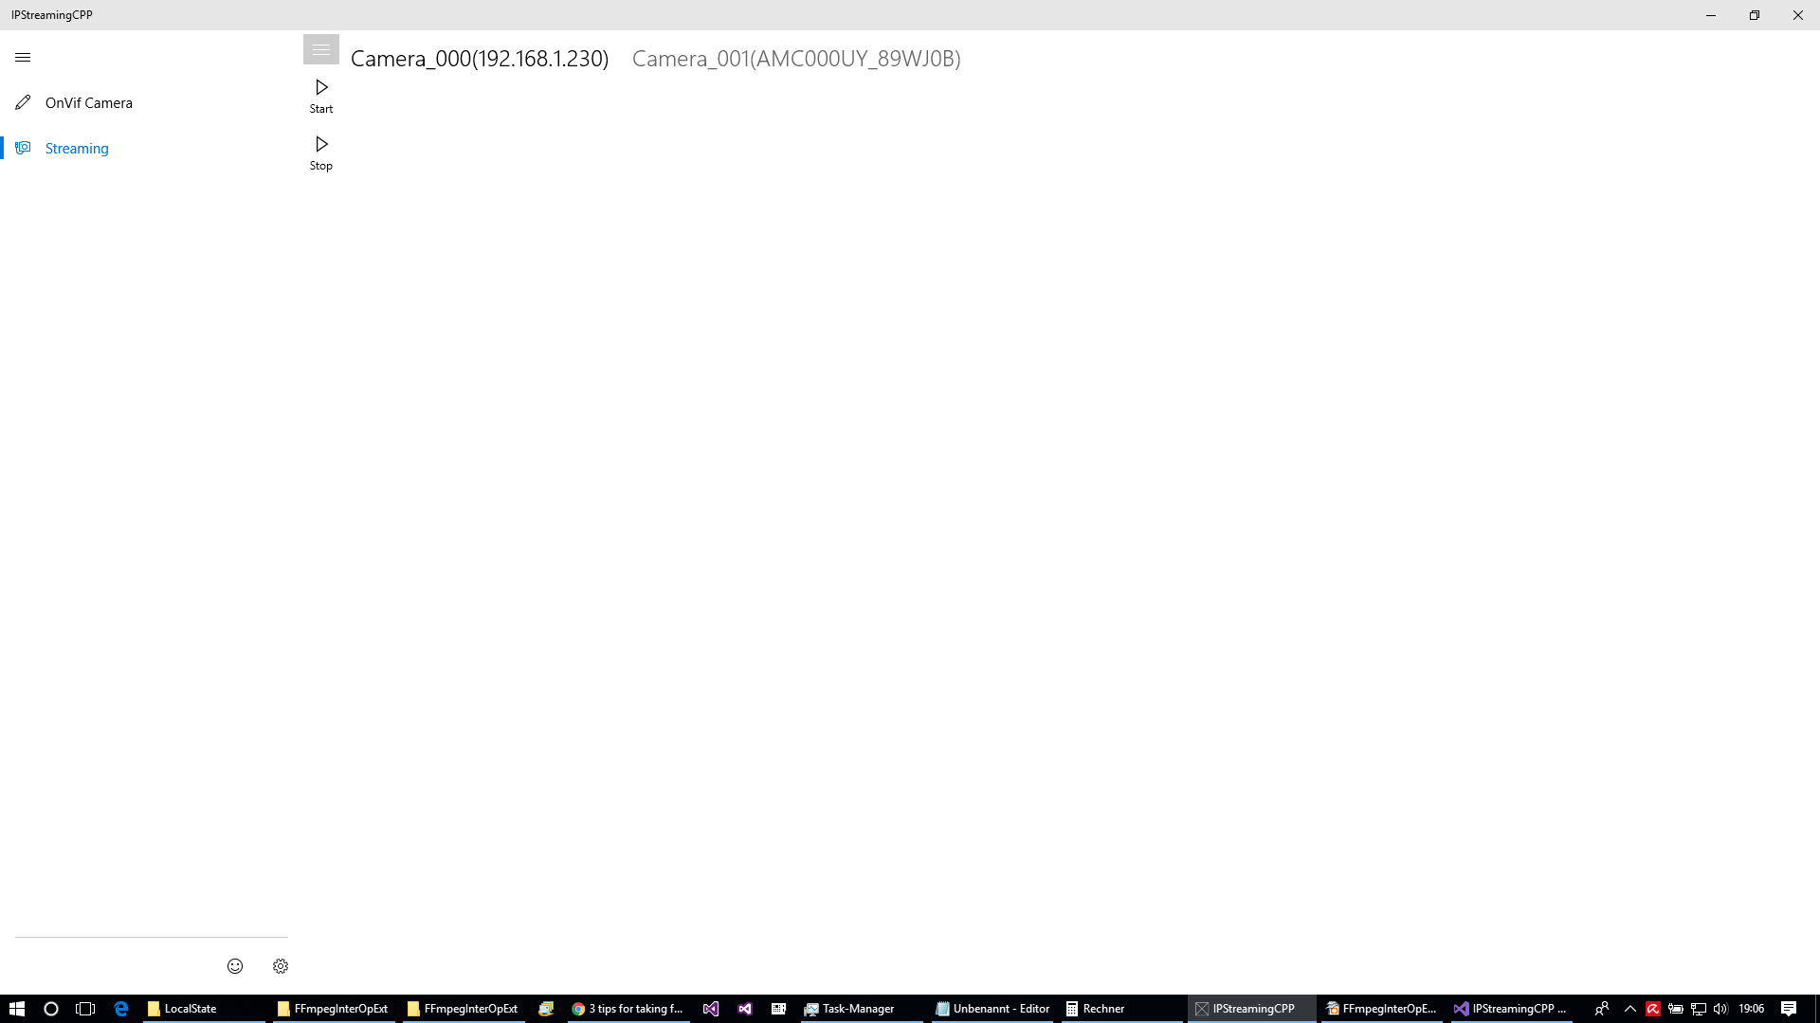
IPStreaminCPP
Camera 1...n
APP Overview
Navigation IP Streaming
OnVif Camera Add

Slide 4
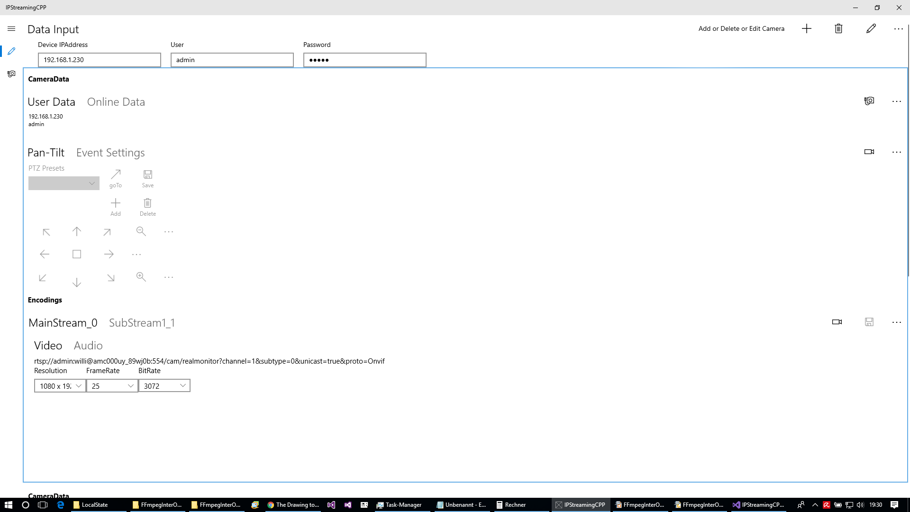
IPStreaminCPP
Add/Remove OnVif Camera
User/Password
admin/admin (often)
Initialize camera
PZT function
Reading / Writing Camea Profile
Reading Streming Url
Saved in IP Streaming
Parameters

Slide 5
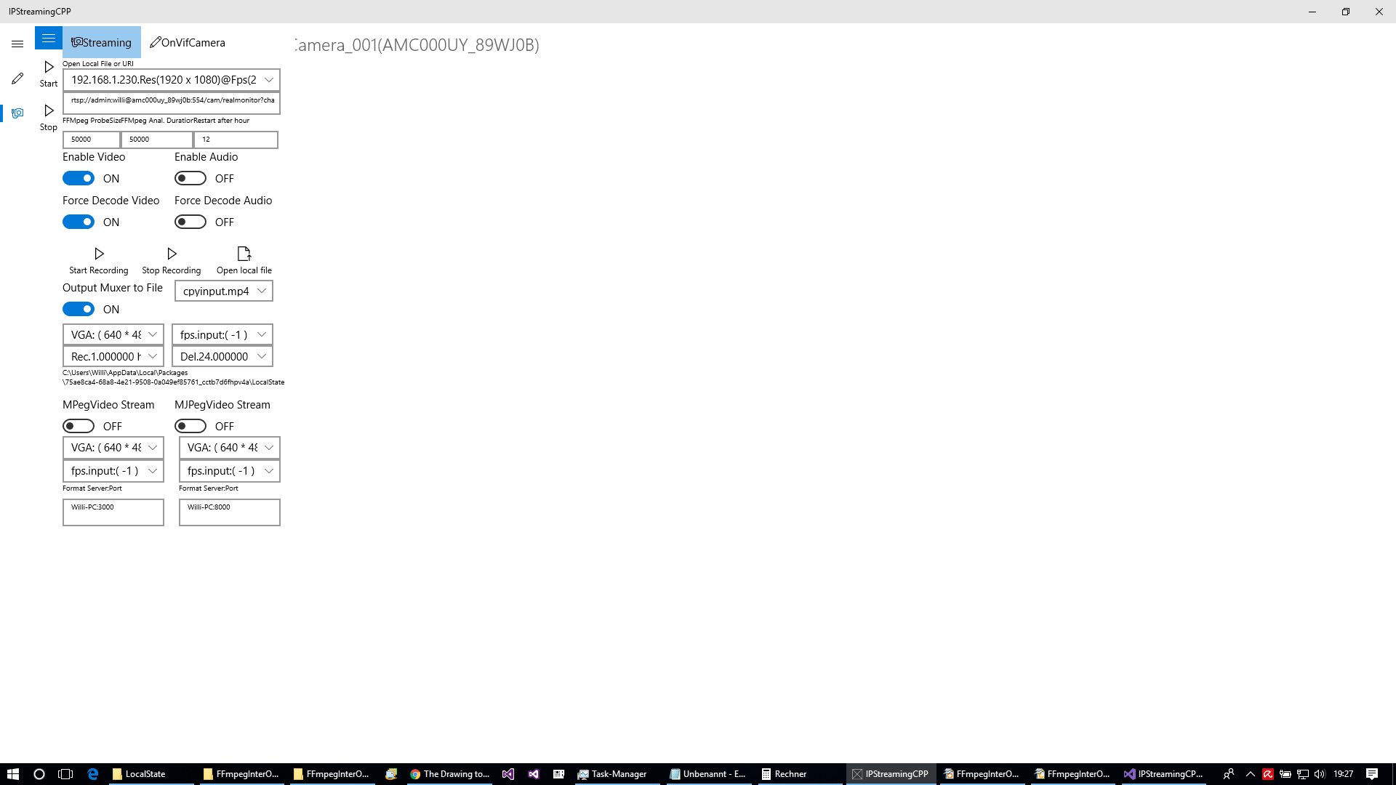
IPStreaminCPP
„Hamburger“ opens Settings
Start/Stop Streaming
Cpyinput.mp4: means remuxing input to output file
Deleting older recorded files after xx hours
Write new file after xx hours for better file organization
Start/Stop Streaming
Muxing input to MJPeg Video over Server for supporting browser clients
Muxing Mpegvideo to node.js server for supporting browser clients

Slide 6
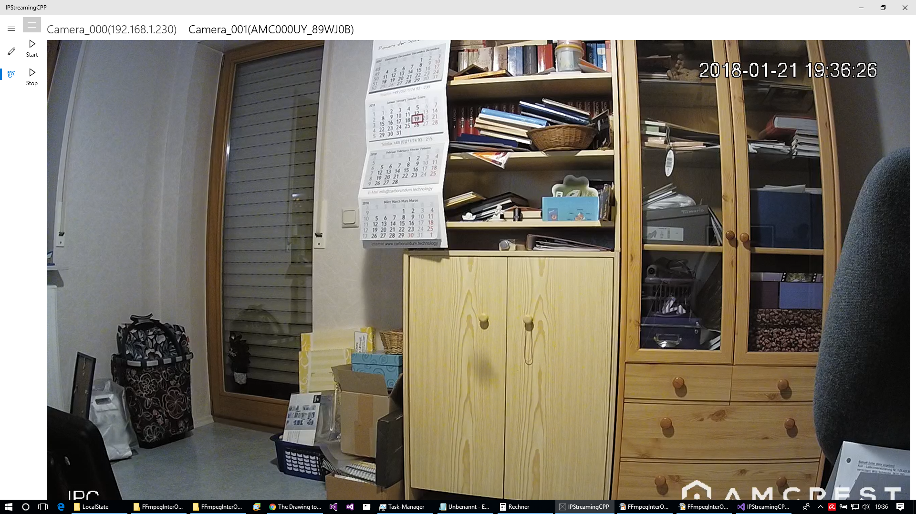
IPStreaminCPP
Camera 1 Streaming
Navigation
Camera 2 Streaming

Slide 7
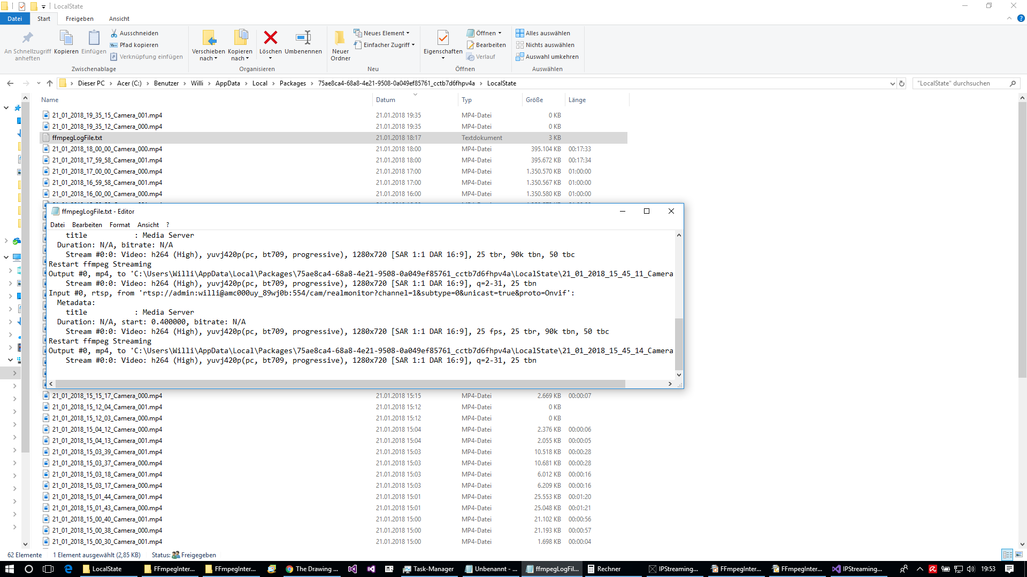
IPStreaminCPP
Each camera produce on streaming file
Streaming Result in local storage of APP
ffmpegLogFile.txt: DebugFile for ffmpeg logging

