Slide 1


CESSNA 172-R
Pilot and Flight Crew
Familiarization
Presented by
Headquarters Texas Wing CAP/DO
and the
Lone Star Composite Squadron

Slide 2

Purpose...
To provide our flight crews with a standardized program of training on the similarities and differences between the new Cessna 172-R and the preceding models of the same aircraft.
To help our flight crews obtain the maximum usefulness from these new aircraft.
To enhance flight safety.

Slide 3

We are going to review four (4) key areas...
General information about the C172-R.
Preflight inspection procedures.
Engine starting procedure.
Miscellaneous information about the airplane.

Slide 4
General Information on the C172-R...
Aircraft dimensions are unchanged from previous C172 models.
However, it has a new panel, new engine, and new Bendix-King avionics.
Max Ramp weight has increased from 2407 lbs to 2457 lbs.
Max Takeoff weight has increased from 2400 lbs to 2450 lbs.

Slide 5
General Information on the C172-R...
The Basic Empty Weight has also increased to an average of 1685 lbs from 1512 lbs in the 1986 standard C172.
The airframe is just that much heavier.
As a result, full-fuel Useful Load is reduced dramatically to only about 447 lbs, down from 648 lbs in the 1986 model.
Weight and Balance is even more critical.

Slide 6
General Information on the C172-R...
The new wet-wings hold a total of 53 useable gallons of 100LL avgas.
That new total represents an increase of some 78 lbs in fuel load over the standard 40 gallon tanks in the 1986 model.
Good news, there are fuel tank “tabs” which are marked for 17.5 gallons per side.
Fueling only to the tabs can increase useful load by 108 lbs.

Slide 7


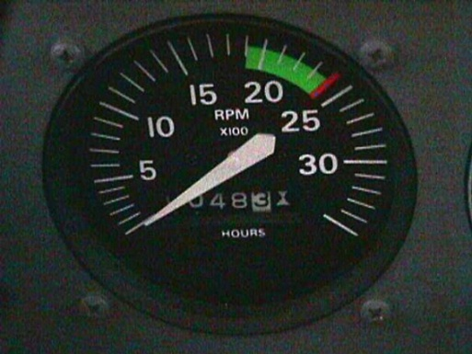
The Engine...
Has been changed from a Lycoming O-320 to an IO-360.
It is fuel injected. No longer a need for carburetor heat.
Now has dual vacuum pumps.
The horsepower has not changed, but the propeller RPM has decreased from 2700 RPM to 2400 RPM.

Slide 8

Remember, The Engine
Red Line is at 2400 RPM:
Not at 2700 RPM as with previous C172s

Slide 9
Performance Statistics...
C172P/160 C172P/Q/180 C172R/160
Engine Lycoming Lycoming Lycoming
0-320-D2J 0-360-A4N IO-360-L2A
Horsepower 160@2700rpm 180@2700rpm 160@2400rpm
Range** 440nm/3.8 hrs. 460nm/3.9 hrs. 630nm/5.4 hrs.
Speed** 118 knots 119 knots 117 knots
Take-off
Ground Roll 893 feet 960 feet 945 feet
Landing
Ground Roll 540 feet 575 feet 550 feet
** Range and speed are based upon a 6000’ altitude, 75% power and 45 min. reserve.

Slide 10

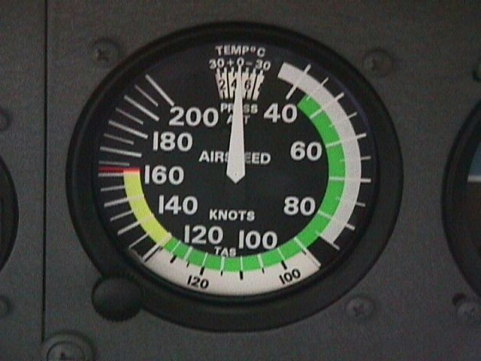
Speeds in the C172-R...
The operating speeds are different in the airplane...
???

Slide 11
Speeds in the C172-R...
The GREEN ARC is from 44 KIAS to 129 KIAS.
???
Normal Operating Range

Slide 12
Speeds in the C172-R...
The “Clean” Stalling Speed is 44 KIAS.
???

Slide 13
Speeds in the C172-R...
The YELLOW ARC is from 129 KIAS to 163 KIAS.
???
Caution Range

Slide 14
Speeds in the C172-R...
The WHITE ARC is from 33 KIAS to 85 KIAS.
???
Full Flap Operating Range.
This speed range is unchanged from previous C172 models.

Slide 15
Speeds in the C172-R...
The Stall Speed In landing configuration is 33 KIAS.
???

Slide 16
Speeds in the C172-R...
The RED LINE is at 163 KIAS.
???
Never-Exceed Speed

Slide 17
Climb Speeds...
The Best Rate of Climb speed (VY) is 79 KIAS.
???

Slide 18
Climb Speeds...
The Best Angle of Climb speed (Vx) is 60 KIAS.
???

Slide 19
Gliding...
The Best Glide Speed is 65 KIAS.
???

Slide 20
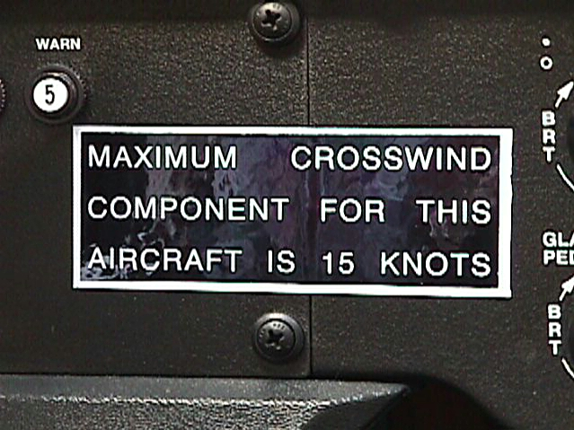


Crosswinds...

Slide 21

Any questions????

Slide 22
The Preflight Inspection...

Slide 23
Cabin Preflight Inspection...
Master Switch - ON.
Fuel Quantity Check - Check quantity (L Low Fuel R) and ensure that LOW FUEL annunciator lights are extinguished.
Remove pitot tube cover.
Pitot Heat - ON (Check that the pitot tube is warm to touch within 30 seconds).
Avionics Master Switch - ON.

Slide 24
Cabin Preflight Inspection (part 2)...
Avionics Cooling Fan (listen to audibly confirm operation).
Avionics Master Switch - OFF.
Static Pressure and Alternate Air Source Valve - OFF.
Annunciator Panel Switch - Place and hold in “TST” position and ensure that all annunciator lights illuminate.

Slide 25
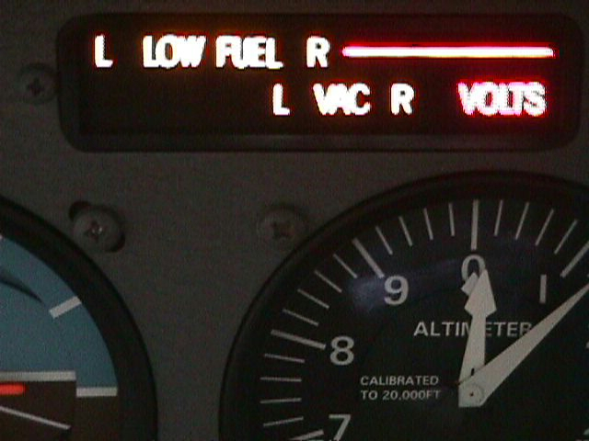
Cabin Preflight Inspection (part 3)...
  Annunciator Panel Test Switch - RELEASE. Check that appropriate annunciator lights remain on.
When Master Switch is turned ON, some annunciators will flash for approximately 10 seconds before illuminating steadily. When TST switch is toggled up and held in position, all remaining lights will flash for approximately 10 seconds before illuminating steadily.

Slide 26
Cabin Preflight Inspection (part 4)...
Fuel Selector Valve - BOTH.
Flaps - FULLY EXTEND.
Pitot Heat - OFF.
Master Switch - OFF.
Pitot Tube _ Check for heat (surface of tube should be hot).
Fuel Shutoff Valve - ON (push full in).
Baggage Door - CHECK (lock with key).

Slide 27
Exterior Preflight Inspection...
Empennage:
  Trim Tab (check security).
  Antennae - (check for security of attachment and general condition).
Right Wing:
  Flap - (check for security and condition).
  Fuel Tank Vent Opening - (check for stoppage).

Slide 28
Exterior Preflight Inspection (part 2)...
Fuel Tank Sump Quick Drain Valves - There are five (5) separate quick drain sumps under each wing. The chart in the flight manual doesn’t show you their location. The instructions for sampling fuel are the same as for previous C172s EXCEPT that there is now a warning in the checklist regarding contamination and the mandatory inspection of the tanks by qualified maintenance personnel.

Slide 29
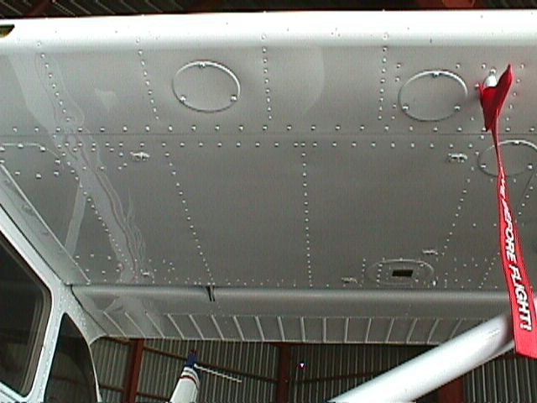
Under Wing Fuel Drains...
2
1
3
5
4
Fuel must be drained from all Five (5) separate drains.

Slide 30
Exterior Preflight Inspection (part 3)...
Nose:
  Fuel Strainer Quick Drain Valve (located on the bottom of the fuselage) - There are three (3) separate quick drain fuel valves located underneath the forward section of the aircraft. The fuel strainer knob in the cowling has been removed. The quick drains on the bottom are for the fuel selector valave, the reservior and the normal fuel strainer quick drain.

Slide 31
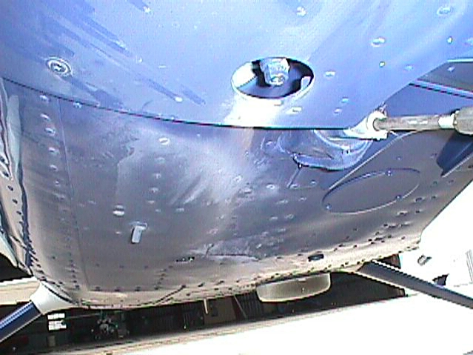
Belly Fuel Drains...
1
3
2

Slide 32
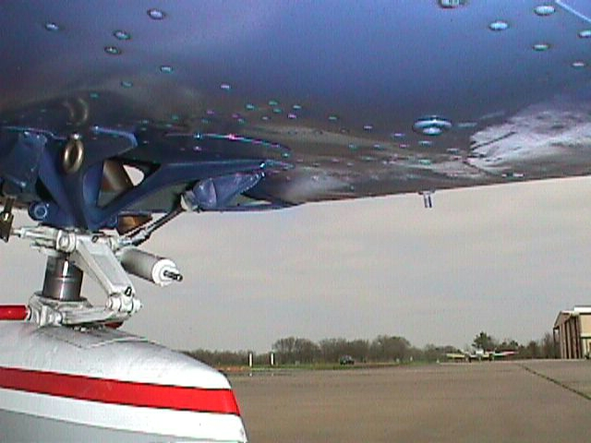
Belly Fuel Drains...

Slide 33
Exterior Preflight Inspection (part 4)...
Left Wing:
  Same as right wing with five (5) fuel sumps to drain.
  Leading Edge:
    Stall Warning Opening - THIS IS MANDATORY - Test system must be tested. Use a clean handkerchief.
  Trailing Edge:
    Flap - (check for security and condition).
THIS COMPLETES THE PREFLIGHT INSPECTION OF THE C172-R.

Slide 34

Any Questions So Far???

Slide 35
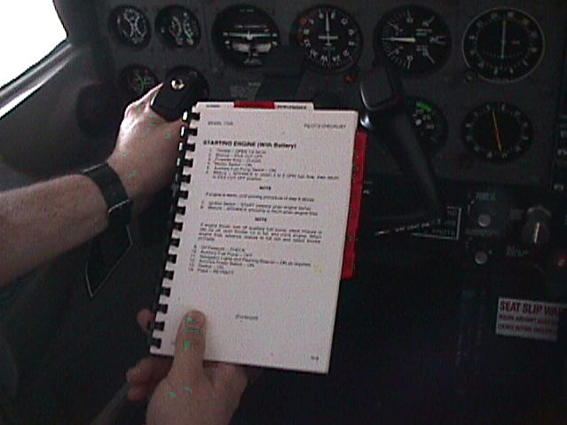
Starting The Textron-Lycoming IO-360-L2A Engine...
FOLLOW THE CHECKLIST EXACTLY!!!

Slide 36
Engine Start Checklist...
Open the Throttle 1/4 of an inch.
Set Mixture back to IDLE CUT OFF.
Propeller area…CLEAR!!!
Master Switch…ON.

Slide 37
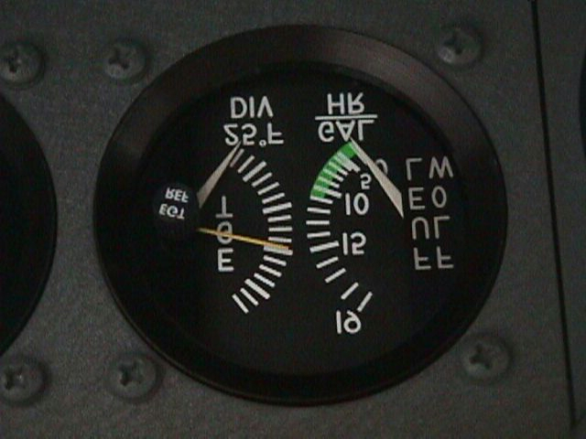
Engine Start Checklist...
Auxiliary Fuel Pump Switch…ON
Mixture…ADVANCE until FF just starts to rise. THEN return to idle cut off position.
Auxiliary Fuel Pump Switch…OFF
OMIT this step if engine is warm.

Slide 38
Engine Start Checklist (Part 2)...
Ignition Switch…START (release when engine starts).
Mixture…ADVANCE smoothly to RICH when engine starts.
NOTE
If engine floods, turn OFF auxiliary fuel pump, place mixture in idle cut off, open throttle 1/2 to full, and crank engine. When the engine fires, advance mixture to full rich and retard throttle promptly.

Slide 39
Engine Start Checklist (Part 3)...
After the engine starts...
Oil Pressure…CHECK.
Auxiliary Fuel Pump…OFF.
Navigation Lights and Flashing Beacon …ON as required.
Avionics Power Switch…ON.
Radios…ON
Flaps…RETRACT.

Slide 40


Let’s Review The Engine Starting Procedure...

Slide 41
Let’s Review The Engine Starting Procedure...
Throttle --- Open 1/4 inch.

Slide 42
Reviewing The Engine Start...
Throttle --- Open 1/4 inch.
Mixture --- Idle Cut Off.

Slide 43
Reviewing The Engine Start...
Throttle --- Open 1/4 inch.
Mixture --- Idle Cut Off.
Propeller Area --- CLEAR!!!.

Slide 44
Reviewing The Engine Start...
Throttle --- Open 1/4 inch.
Mixture --- Idle Cut Off.
Propeller Area --- CLEAR!!!.
Master Switch --- ON.

Slide 45
Reviewing The Engine Start...
Throttle --- Open 1/4 inch.
Mixture --- Idle Cut Off.
Propeller Area --- CLEAR!!!.
Master Switch --- ON.
Auxiliary Fuel Pump --- ON

Slide 46
Reviewing The Engine Start...
Throttle --- Open 1/4 inch.
Mixture --- Idle Cut Off.
Propeller Area --- CLEAR!!!.
Master Switch --- ON.
Auxiliary Fuel Pump --- ON
Mixture…ADVANCE until FF just starts to rise. THEN return to idle cut off position.
Auxiliary Fuel Pump Switch…OFF

Slide 47
Reviewing The Engine Start...
Mixture --- Idle Cut Off.
Propeller Area --- CLEAR!!!.
Master Switch --- ON.
Auxiliary Fuel Pump --- ON
Mixture…ADVANCE until FF just starts to rise. THEN return to idle cut off position.
Auxiliary Fuel Pump Switch…OFF
Ignition Switch --- START.

Slide 48
Reviewing The Engine Start...
Master Switch --- ON.
Auxiliary Fuel Pump --- ON
Mixture…ADVANCE until FF just starts to rise. THEN return to idle cut off position.
Auxiliary Fuel Pump Switch…OFF
Ignition Switch --- START.
Mixture --- ADVANCE smoothly to RICH when engine fires.

Slide 49
If The Engine Is Already Warm...
DELETE THE FOLLOWING STEPS (PRIMING) FROM STARTING SEQUENCE:
Auxiliary Fuel Pump --- ON
Mixture…ADVANCE until FF just starts to rise. THEN return to idle cut off position.
Auxiliary Fuel Pump Switch…OFF
DO NOT PRIME A WARM ENGINE

Slide 50
If The Engine Floods...
?????

Slide 51
If The Engine Floods...
Turn off the auxiliary fuel pump.

Slide 52
If The Engine Floods...
Turn off the auxiliary fuel pump.
Place mixture in idle cut off.

Slide 53
If The Engine Floods...
Turn off the auxiliary fuel pump.
Place mixture in idle cut off.
Open throttle 1/2 to full.

Slide 54
If The Engine Floods...
Turn off the auxiliary fuel pump.
Place mixture in idle cut off.
Open throttle 1/2 to full.
CRANK ENGINE.

Slide 55
If The Engine Floods...
Turn off the auxiliary fuel pump.
Place mixture in idle cut off.
Open throttle 1/2 to full.
CRANK ENGINE.
When engine fires...

Slide 56
If The Engine Floods...
Turn off the auxiliary fuel pump.
Place mixture in idle cut off.
Open throttle 1/2 to full.
CRANK ENGINE.
When engine fires…
Advance mixture to full RICH.

Slide 57
If The Engine Floods...
Turn off the auxiliary fuel pump.
Place mixture in idle cut off.
Open throttle 1/2 to full.
CRANK ENGINE.
When engine fires…
Advance mixture to full RICH.
Retard throttle promptly.

Slide 58



QUESTIONS...
CLARIFICATIONS...

Slide 59
Miscellaneous Information...
The auxiliary fuel pump is used for starting only, both on the ground and in flight for restart (per the emergency checklist).
The seat rails are new (right out of the Cessna Caravan turboprop) and operate much more smoothly, there is no latch to undo as in earlier models.

Slide 60
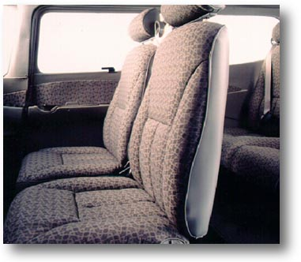
Interior Accommodations...
The new seats are high backed and very comfortable. They are crashworthy to 26 G’s. Unfortunately, the high backs make it very difficult in flight to reach objects placed on the back seat.

Slide 61
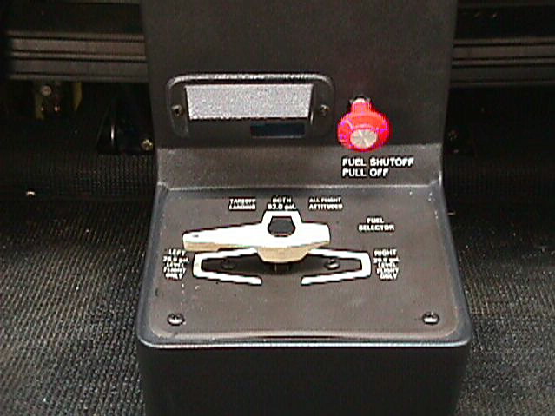
The Little Red Knob...
There is a red fuel shut off valve located on the center pedestal above the fuel selector valve. Push-in to turn fuel ON, and Pull-out to shut fuel OFF.
Please ensure that this knob has been pushed-in BEFORE engine start.

Slide 62
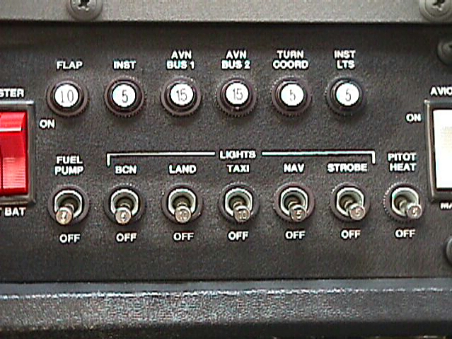
More Miscellaneous Information...
Many of the electrical switches have been replaced with metal toggle switches.

Slide 63
More Miscellaneous Information...
The new Bendix-King KAP-140 single-axis autopilot operates in “wing-leveler” mode only.
The new KX-155A nav/coms have many new features including a built-in electronic CDI and digital VOR radial display.
There is no DME installed.
Headset jacks are placed just forward of the pilot and copilot armrests.

Slide 64
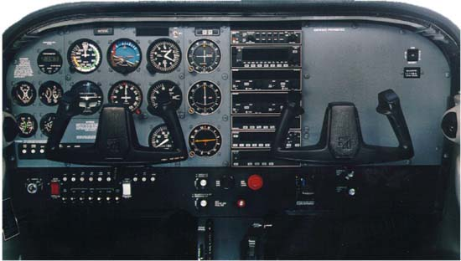
Our New Avionics...

Slide 65
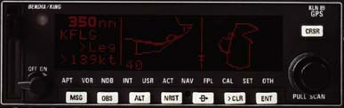
More Miscellaneous Information...
KLN-89B GPS
The new Bendix-King KLN-89B GPS receiver can be IFR certified, however, we will not keep it IFR certified. Too expensive.
The GPS has a moving-map display.
Sadly, this GPS is not very user friendly.

Slide 66

Any Final Questions???

Slide 67

The End!!!
© 1998. Lt Col Donald R. Brown, CAP. All Rights Reserved.

