Slide 1
Data Analytics Portfolio
Deepa Sury

Slide 2
Data Analytics Projects
GameCo International Marketing Budget 2017
Analyzing global video game sales from 1980 to 2016 to inform marketing strategies for the upcoming year.
Influenza Prevention Report 2018
Using historical data to prepare for upcoming influenza season.
Rockbuster Stealth LLC Launch Strategy
Gathering insights on customer behaviour and preferences to adapt to the current video streaming market.
Instacart Grocery Basket Analysis
Determining customer profile groups for targeted marketing strategies.
Pig E. Bank – Customer Retention
Data-mining analysis to improve customer retention at global financial institution.
Airbnb Amsterdam 2019
Exploratory analysis of Airbnb listings in Amsterdam for the year 2019.
ClimateWins Weather Prediction
Using machine-learning techniques to predict and classify changing climate conditions in Europe.

Slide 3
GameCo: International Marketing Strategy 2017
Project Goals
Data Used
Methods Used
GameCo is a video game company interested in using insights from data to inform the development of new games as well as to optimize their marketing campaigns.
This project aims to answer key questions such as the geographical distribution of video game sales, the popularity of certain game titles and genres, and which publishers are likely to be the main competitors in certain markets.
The data used for this project was collected from VGChartz and consists of historical sales data of video games across the world from 1980 to 2016. The data-set contains information on games across a variety of genres, platforms and publishers, having sold 10,000 or more copies.
Basic data sorting, cleaning and filtering techniques in Microsoft Excel
Pivot Tables
Descriptive analysis
Data visualization with Excel

Slide 4
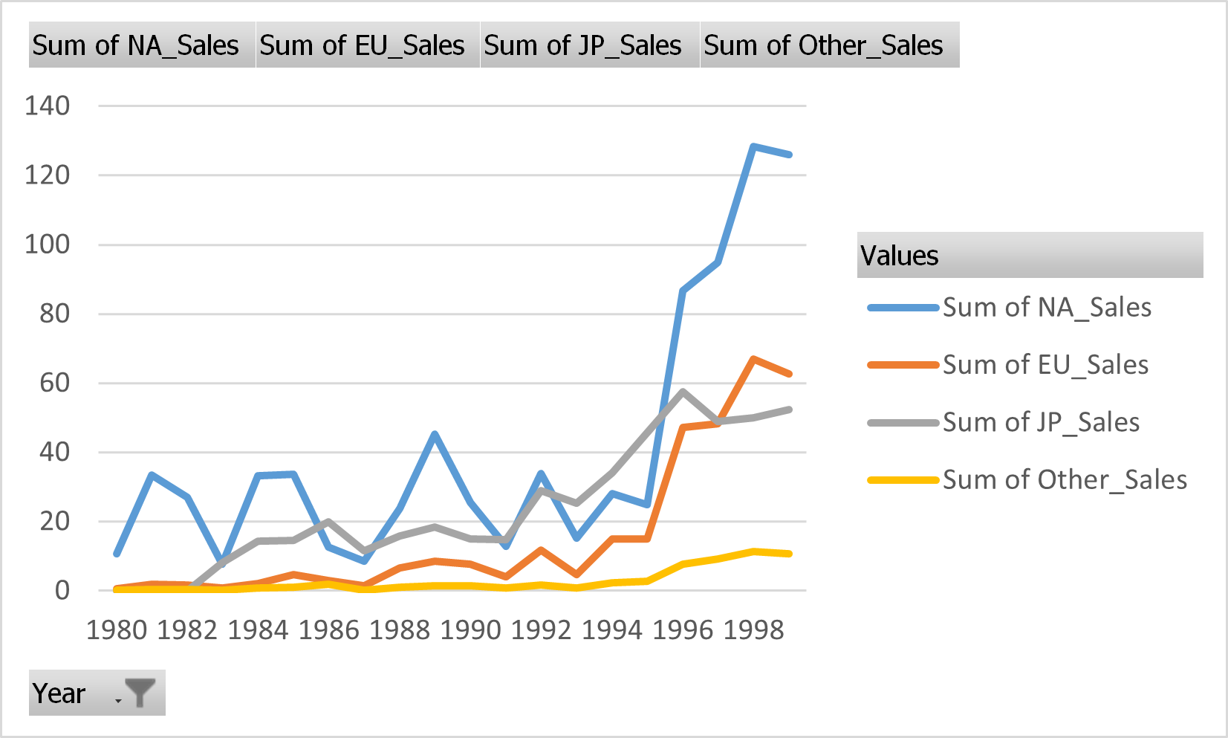
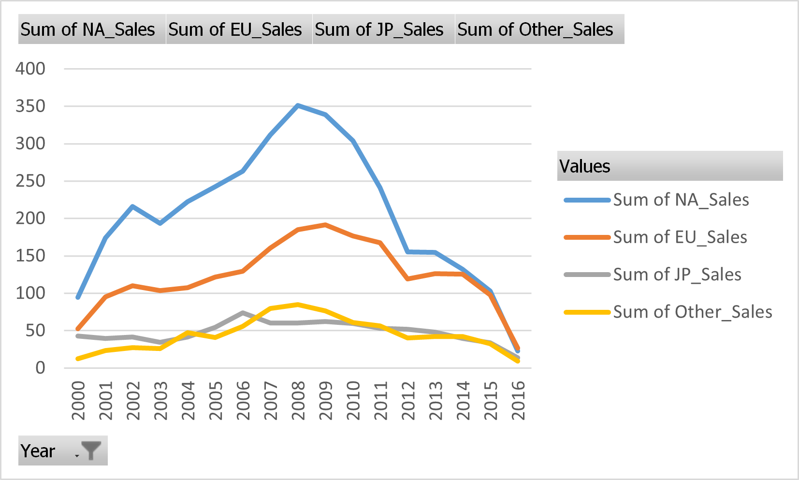
Analysis
Total annual video game sales by region, 1980-1999.
Sales in all regions except Japan sharply increased in the mid 1990s.
EU sales begin to surpass Japanese sales after 1996.
Total annual video game sales by region, 2000-2016.
Sales in all regions except Japan continue to increase until 2008.
Japanese sales remain relatively stagnant, at one point showing the lowest numbers out of all regions.
From 2015-2016, sales across all regions appear to be decreasing sharply.

Slide 5
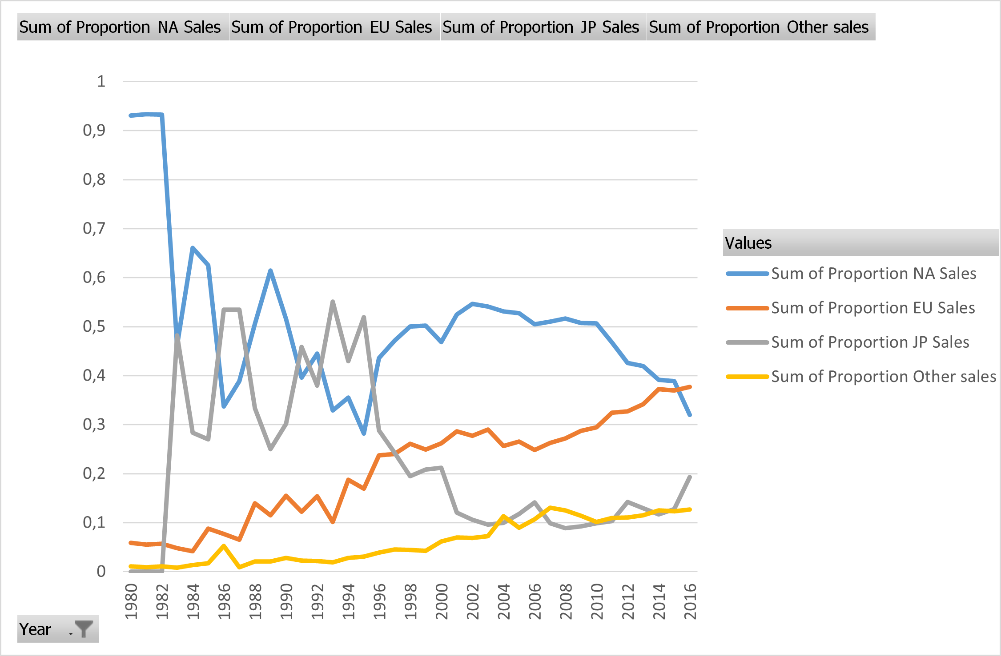
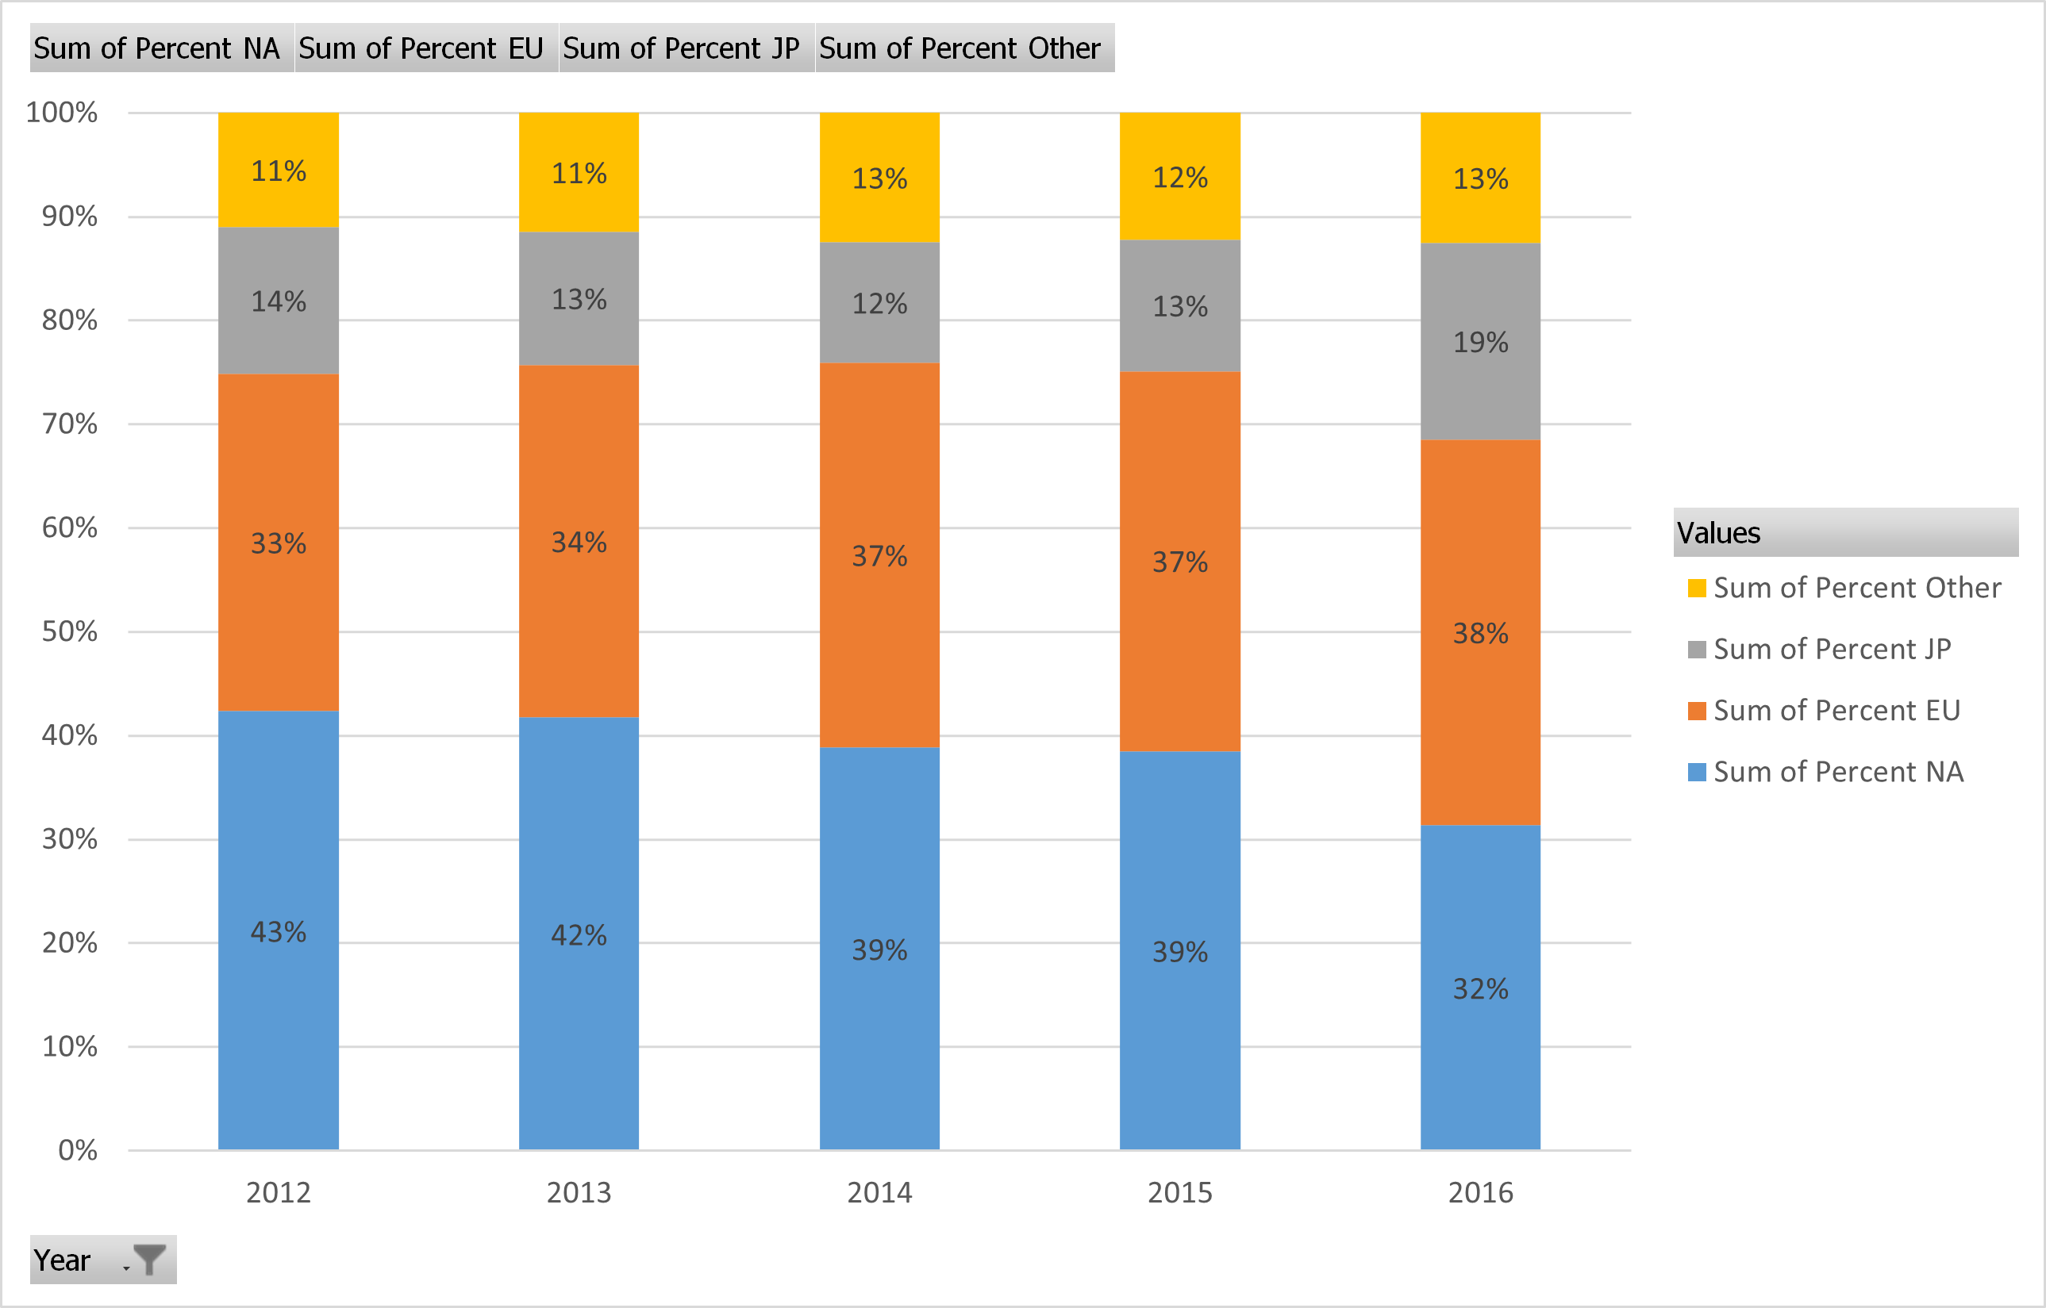
Analysis
Regional proportion of global video game sales, 1980-2016.
Between 1980-1982, North America dominated global sales.
The proportion of Japanese sales peaked in 1982, 1986-1988 and at various points in the 1990s.
EU and other regions have shown a steady overall increase in their share of global video game sales.
Regional distribution of global video game sales, 2012-2016.
Japanese proportion of global sales increased 6% in 2016.
Proportion of EU sales have steadily increased, proportion of North American sales have steadily decreased.
Proportion of sales from other regions remains relatively constant.

Slide 6
Insights
Recommendations
The largest share of sales comes from Europe (38%) and not North America (32%)
The biggest changes to the regional makeup of global video game sales can be seen in the mid-2000s.
As in previous years, European sales, as well as sales from other parts of the world, continue to steadily increase.
Japanese sales, after several years of decline and stagnation, have begun to increase once again.
Sales of video games are challenged across regions by the rise of digitally-downloaded software.
Allocate more of the budget towards overseas marketing.
Focus especially on regions outside of North America, Europe and Japan (listed under the “Other” category in the sales data), as many countries known to be emerging markets are in these regions.
Develop strategies to revive customer interest in physical video game media.
Focus these efforts on the North American market at first, as it continues to make up a significant enough share of global sales, despite declining numbers in recent years.

Slide 7
Influenza Prevention Measures for 2018
Project Goals
Data Used
Methods Used
The objective of this project is to help a medical staffing agency allocate temporary workers to hospitals ahead of the upcoming influenza season.
Using insights from historical influenza data, this project helps identify areas that are likely to need additional staffing with factors such as high rates of mortality and large numbers of inhabitants aged 75 and older.
Influenza deaths by geography, 2009-2017 (CDC).
US Census data by geography, time, age and gender (US Census Bureau).
Data profiling, checking data for integrity and applying additional quality measures.
Transforming and integrating data-sets from different sources (using tools such as Microsoft Excel vlookup and other functions).
Conducting statistical analyses (calculating variance and standard deviation, testing for correlation).
Formulating and testing statistical hypotheses.
Data visualization and storytelling using Tableau.

Slide 8
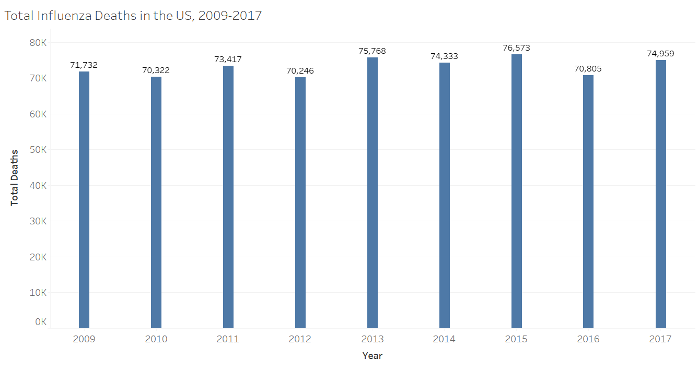
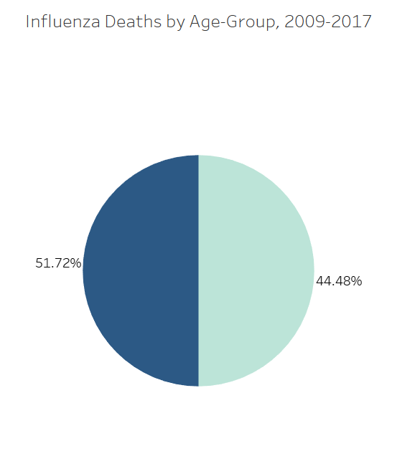
Analysis
Full visual presentation here: https://public.tableau.com/app/profile/d.s5411/viz/Exercise2_9_17259903842140/Story1
Total influenza-related deaths per year in the US, 2009-2017.
Proportion of total deaths attributable to persons aged 75 and older (darker portion).

Slide 9
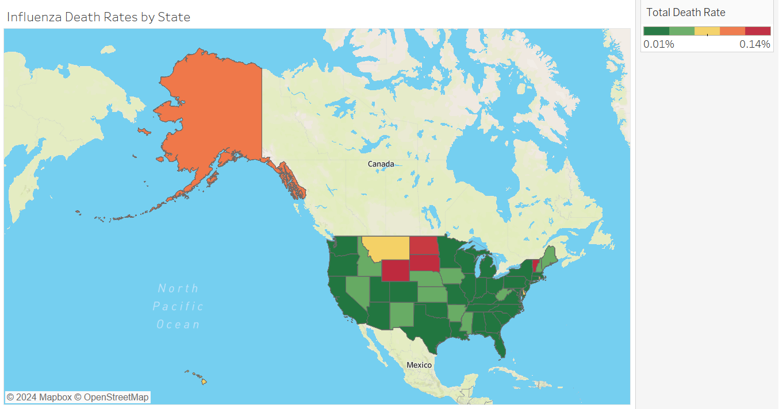
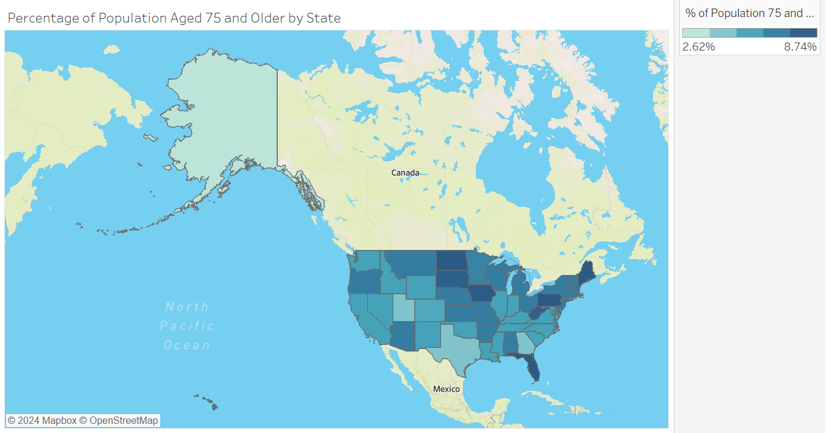
Analysis
Full visual presentation here: https://public.tableau.com/app/profile/d.s5411/viz/Exercise2_9_17259903842140/Story1
Maps depicting the distribution of death rates and percentage of the population aged 75 and older across states.
These maps aim to visualize regions which are more likely to be affected by seasonal influenza and where more medical staff should be allocated during influenza season.

Slide 10
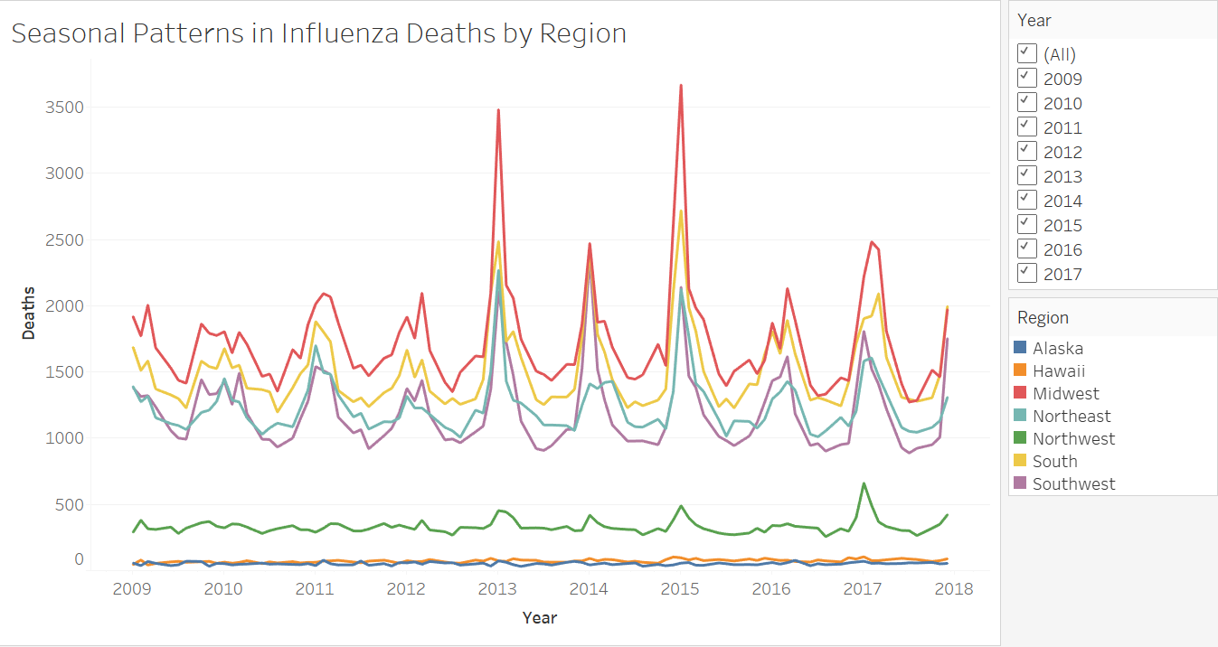
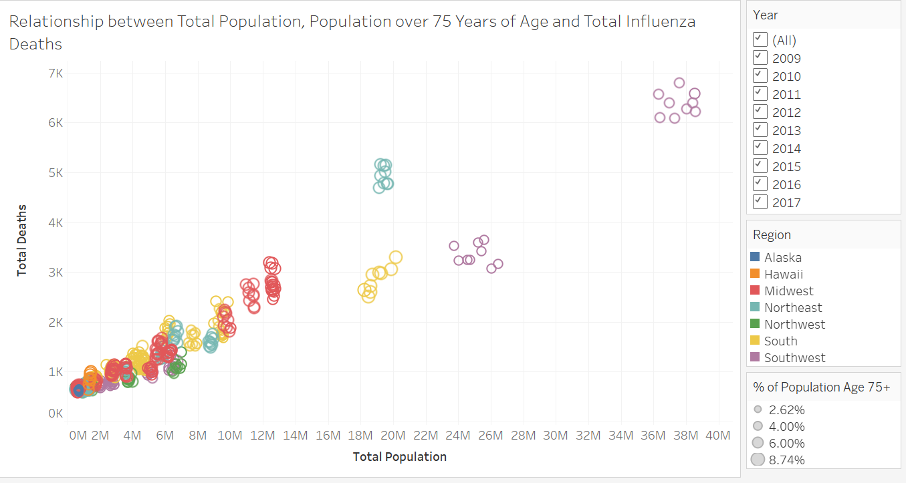
Analysis
Full visual presentation here: https://public.tableau.com/app/profile/d.s5411/viz/Exercise2_9_17259903842140/Story1
Monthly influenza deaths by region, 2009-2017.
This chart shows the seasonal pattern in the numbers of influenza deaths over the years.
Comparing the total number of influenza deaths and the percentage of the population aged 75 and over between 2009 and 2017.

Slide 11
Insights
Recommendations
Individuals aged 75 and older accounted for just over half of all influenza deaths between 2009 and 2017.
States with the largest populations also had the highest number of deaths.
States with the highest death rates (number of deaths divided by the population) also showed the largest percentage of inhabitants aged 75 and older.
Large populations and a high percentage of elderly inhabitants can both significantly increase a region’s vulnerability to seasonal influenza.
More medical staff should be allocated to regions with higher death rates (Alaska, Vermont and certain states in the Midwest).
Highly-populated states like New York and California showed the highest death counts. Because influenza is a highly-transmissible disease, these states should have more medical staff on hand to deal with the higher number of severe infections.
Promotion of preventative hygiene measures, such as routine vaccination, hand-washing and masking, aimed at the elderly and anyone in close contact with them.

Slide 12
Rockbuster Stealth LLC Launch Strategy
Objective
Data Used
Methods Used
Assist Rockbuster LLC with the launch strategy of their online streaming service.
Use data to determine which titles contributed to revenue gain, how long movies are rented on average, sales figures and customer numbers across geographic regions.
Rockbuster Stealth LLC data on customers, inventory, sales and payments contained in a RDBMS (relational database management system) and analyzed using SQL.
Extracted an entity relationship diagram (ERD).
Database querying, filtering, summarizing and cleaning data; joining tables, performing subqueries and using common table expressions (CTEs) with SQL using PostgreSQL.
Visualizing insights using Tableau.
SQL queries and data dictionary can be viewed on GitHub.

Slide 13
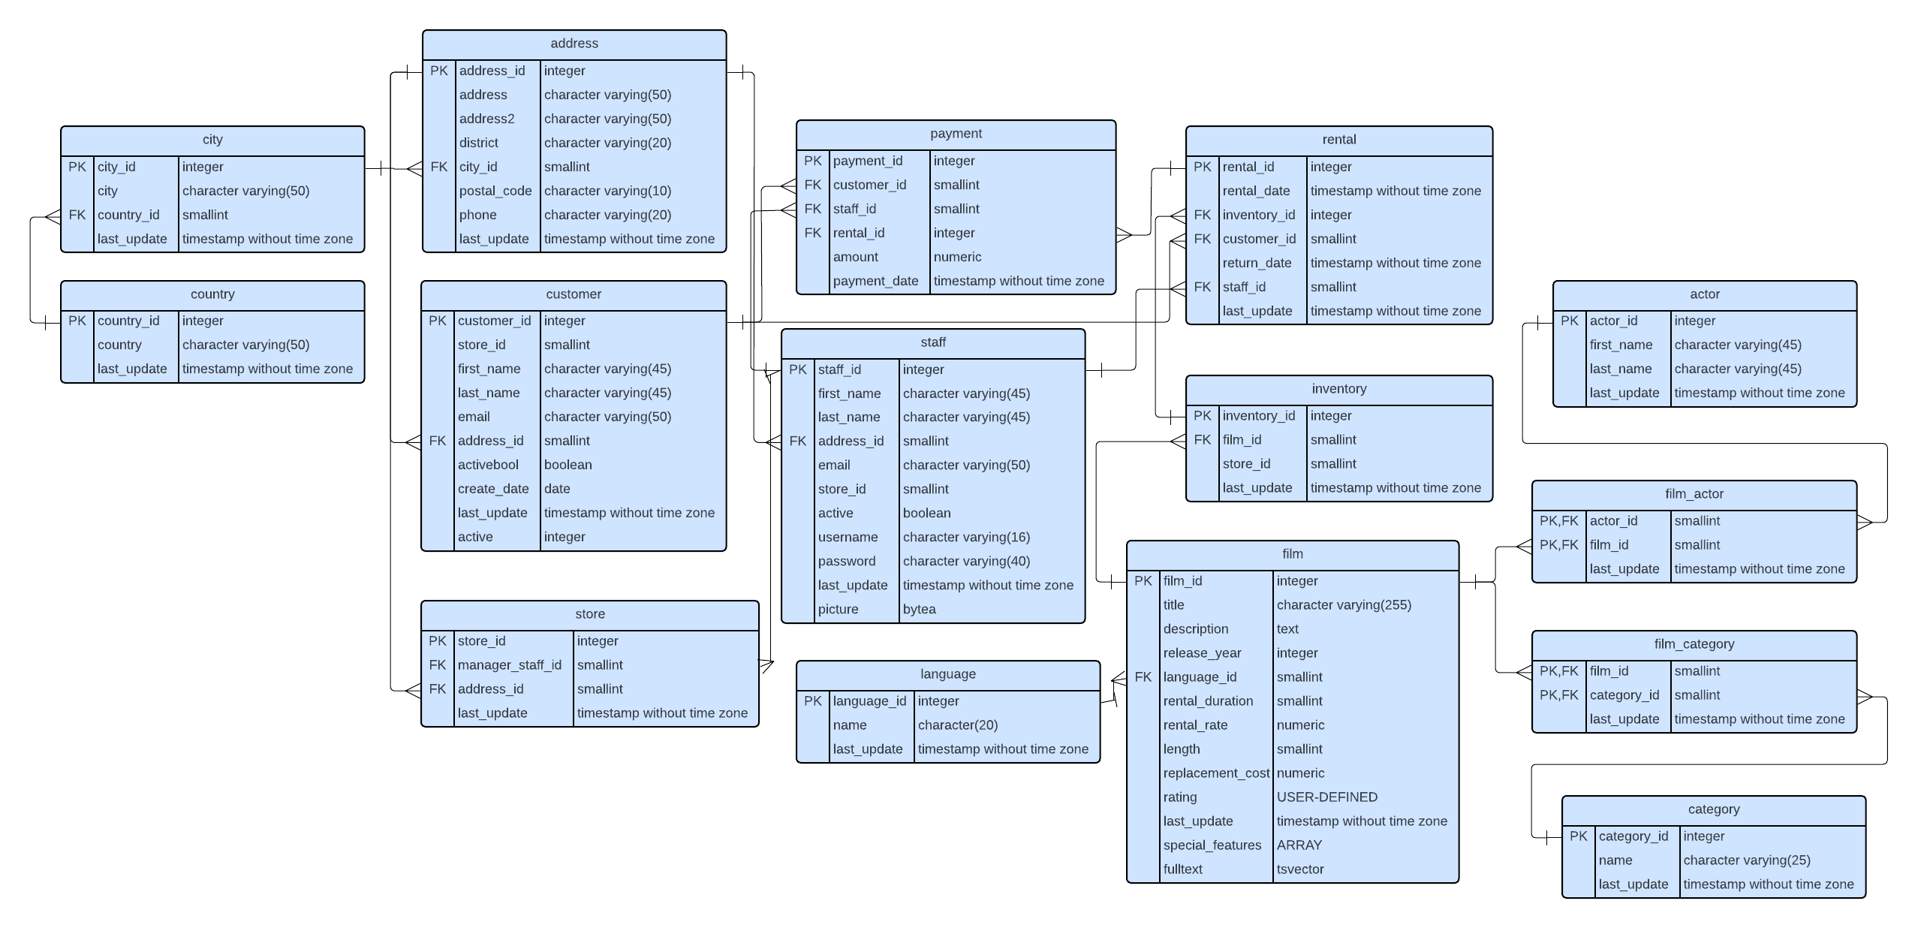
Entity Relationship Diagram (ERD)
Entity Relationship Diagram (ERD) of the complete Rockbuster LLC database.
This links all the tables of data using common key columns.

Slide 14
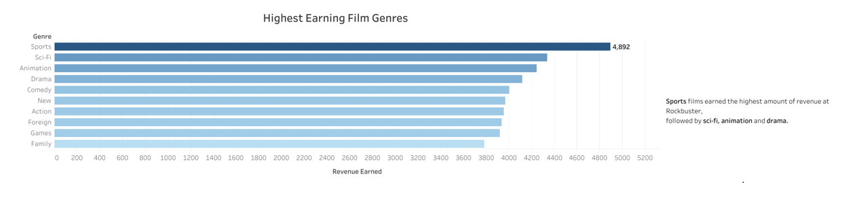
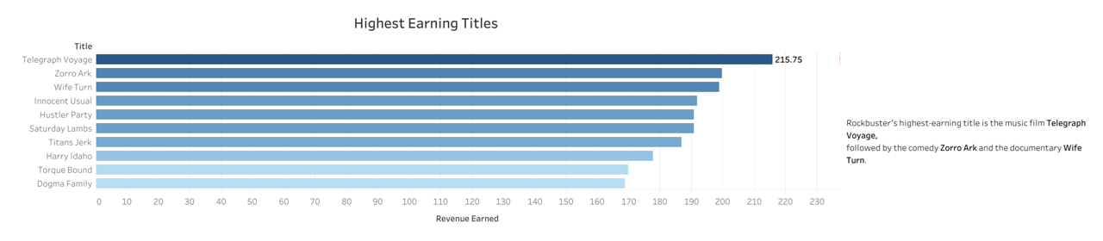
Analysis

Slide 15
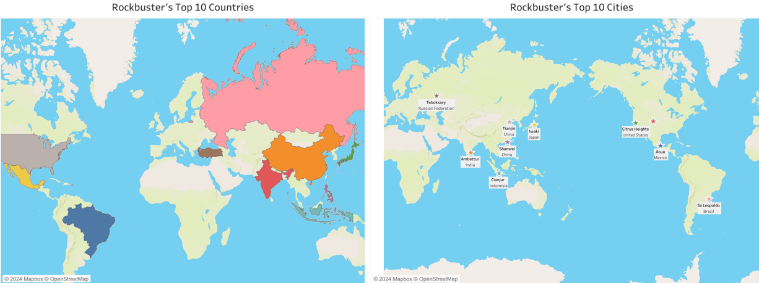
Analysis
The top 10 countries with the most Rockbuster customers are: India, China, United States, Japan, Mexico, Brazil, Russian Federation, Philippines, Turkey and Indonesia.
The top 10 cities within the top 10 countries with the most Rockbuster customers are: Aurora (United States), Acua (Mexico), Citrus Heights (United States), Iwaki (Japan), Ambattur (India), Shanwei (China), So Leopoldo (Brazil), Teboksary (Russian Federation), Tianjin (China) and Cianjur (Indonesia).

Slide 16
Insights
Recommendations
Rockbuster generated a total of 61312.04 in rental revenue.
Rockbuster's customers can be found in 109 countries around the world.
India is home to the largest number of Rockbuster customers (60).
Customers have an inventory of 1000 films to choose from.
Sports is the best-performing film genre, followed by sci-fi, animation and drama.
Films are rented from Rockbuster for an average of 4.99 days, at an average rate of 2.98 per day.
Expand the film inventory to include films in languages other than English, as this is a crucial step towards establishing and maintaining an international customer base.
Research the customer preferences within the top 10 countries and develop localization strategies based on these findings.
Develop and implement customer loyalty programs to encourage more frequent rentals and to reward existing top customers.

Slide 17
Instacart Grocery Basket Analysis
Objective
Data Used
Methods Used
Derive more information about Instacart sales patterns through the analysis of customer, order and product data.
Inform decisions regarding customer profiling and market segmentation.
“The Instacart Online Grocery Shopping
Dataset 2017”, Accessed from www.instacart.com/datasets/grocery-shopping-2017
via Kaggle on 25 November 2024.
Note that, while Instacart is a real company, the data used for this project is fictional.
Data wrangling, subsetting, merging, grouping, aggregating; checking for consistency and deriving new variables, using Python with pandas, NumPy and os libraries.
Data visualization using Python with matplotlib, scipy and seaborn libraries.

Slide 18
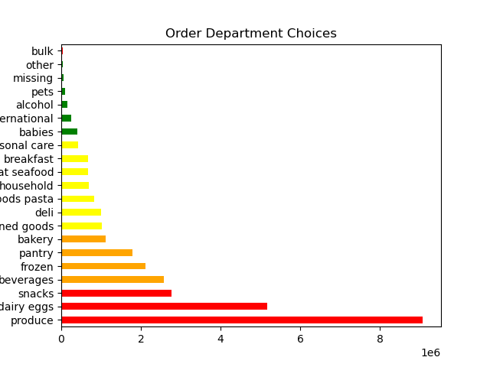
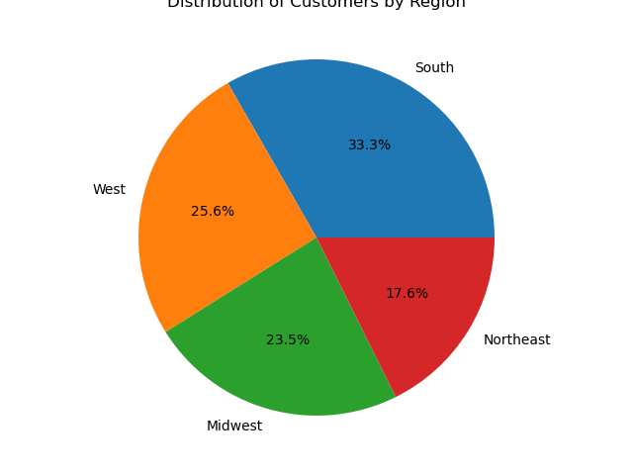
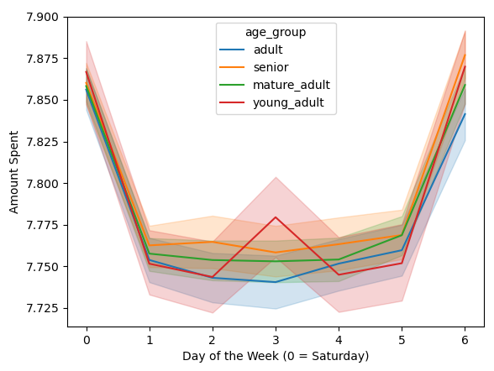
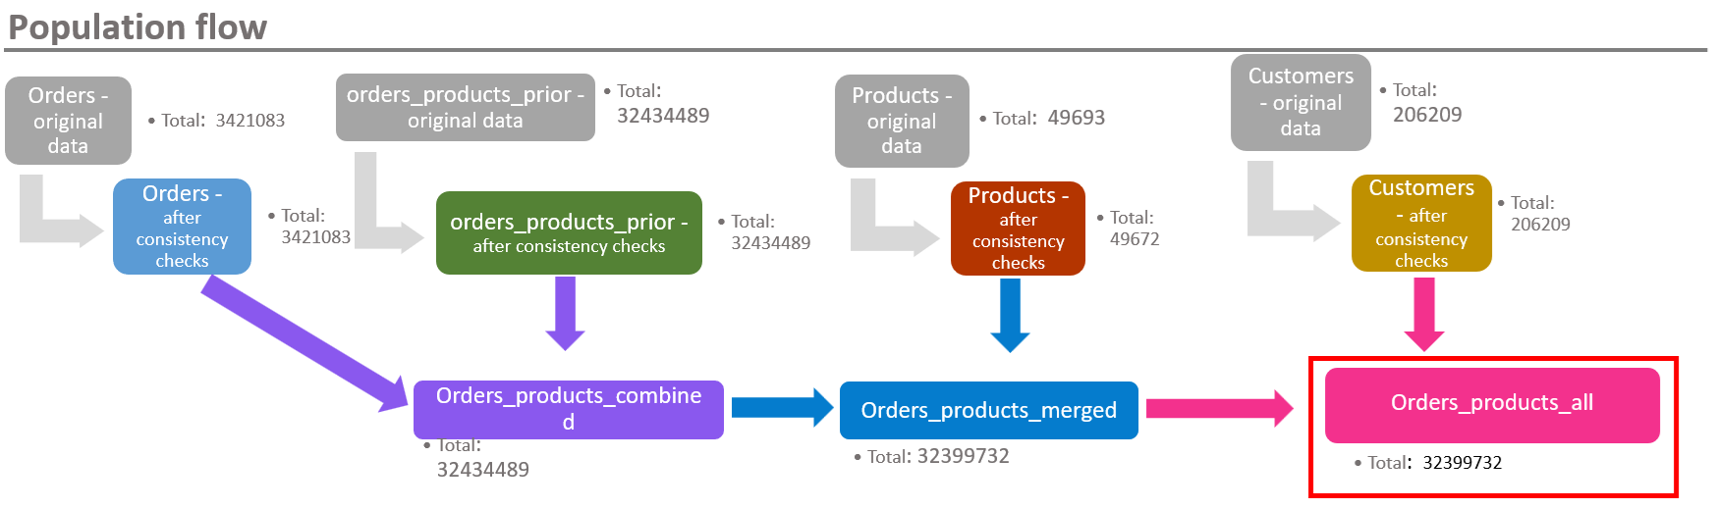
Analysis
Some examples of visuals created for this project.
Full project, including scripts and visuals, can be viewed on GitHub
Distribution of Customers by Region

Slide 19
Insights
Recommendations
Instacart receives the highest number of orders between 10:00 AM and 4:00 PM, and on weekends.
This can be observed across all customer profiles.
Customers spend the most money in the evening and at night.
Perishable grocery items, such as produce and dairy/eggs, are the most ordered items among all customer profiles.
The South is the region with the largest number of customers.
Married, mature adults between age 40 and 64 make up the largest group of customers.
The majority of customers earn at least a middle-level income ($50,000 or more per year).
Increase promotions and offer discounts on Thursdays and Fridays, as this is when new customers are most active.
Increase promotion and marketing efforts towards younger customers (between age 18 and 39).

Slide 20
Pig E. Bank – Customer Retention
Data ethics and security principles
Identifying and dealing with bias
Data cleaning and descriptive statistics for data-mining
Decision-tree models
Linear and logistic regression
Time-series analysis and forecasting
Objective
Data Used
Methods Used
Determine the characteristics of customers that exit Pig E. Bank and compare them with those of remaining customers.
Identify factors that make a customer more likely to exit the bank and develop retention strategies based on these findings.
Fictional data provided by CareerFoundry.

Slide 21
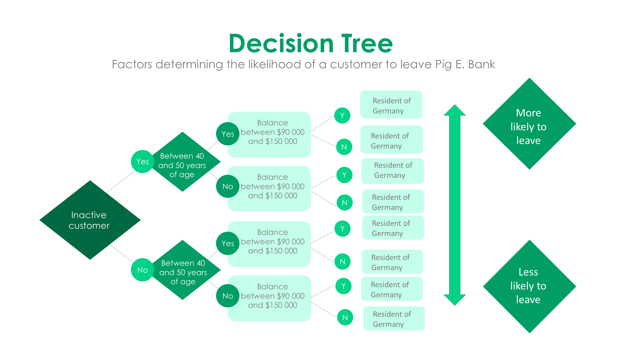
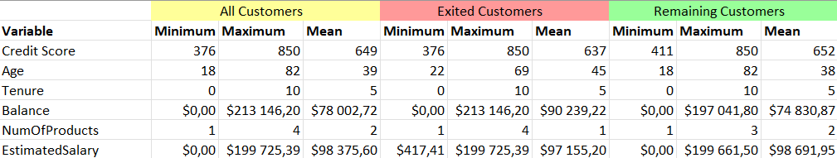
Analysis

Slide 22
Insights
Recommendations
The majority of customers who exited the bank (70%) were listed as inactive.
Germany has a higher proportion of customers leaving the bank compared to total customers and customers remaining.
Customers who exited have an overall higher average age (45)
More women (59.3%) than men exited the bank
The biggest age group among customers who exited the bank were between 42 and 51
Customers exiting the bank have a higher average balance compared to those remaining and to total customers.
Do further research into the customer groups most likely to leave (inactive customers, female, age 42-51, resident of Germany) to determine their reasons for exiting the bank. This could take the form of, for example, a customer satisfaction survey, or analyzing existing customer feedback if possible.
Develop targeted strategies to retain customers belonging to any of these groups based on the findings of this research.

Slide 23
Airbnb Amsterdam 2019
Objective
Data Used
Methods Used
Identify different characteristics of neighbourhoods and boroughs in Amsterdam through the analysis of Airbnb rental listings for the year 2019.
Determine which criteria are most important to Airbnb guests when choosing their accommodation in Amsterdam.
“Airbnb Amsterdam”. Retrieved from Kaggle on 21 December, 2024. https://www.kaggle.com/datasets/erikbruin/airbnb-amsterdam/
“Boroughs of Amsterdam”, Wikipedia: https://en.wikipedia.org/wiki/Boroughs_of_Amsterdam
Data-cleaning, wrangling, subsetting, aggregating and merging with Python, using pandas and NumPy libraries.
Application of structured (linear regression) and unstructured (k-means clustering) machine-learning algorithms, using SciKitLearn library.
Time-series analysis: decomposing time-series data, checking for and adjusting stationarity, using statsmodels library.
Geospatial visualization of GEOJSON data, using folium library.
Visualizing data relationships using matplotlib and seaborn libraries.
Creating interactive dashboards on Tableau.

Slide 24
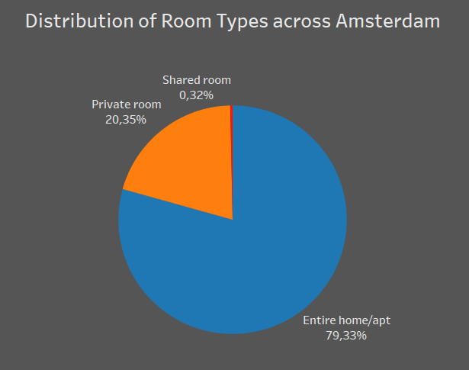
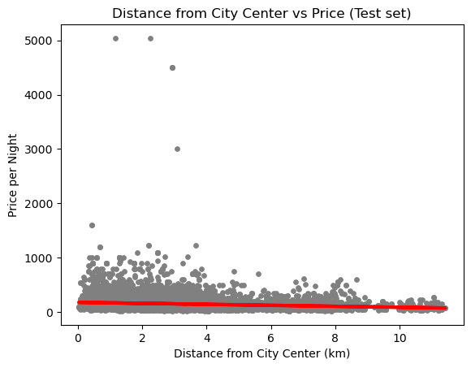
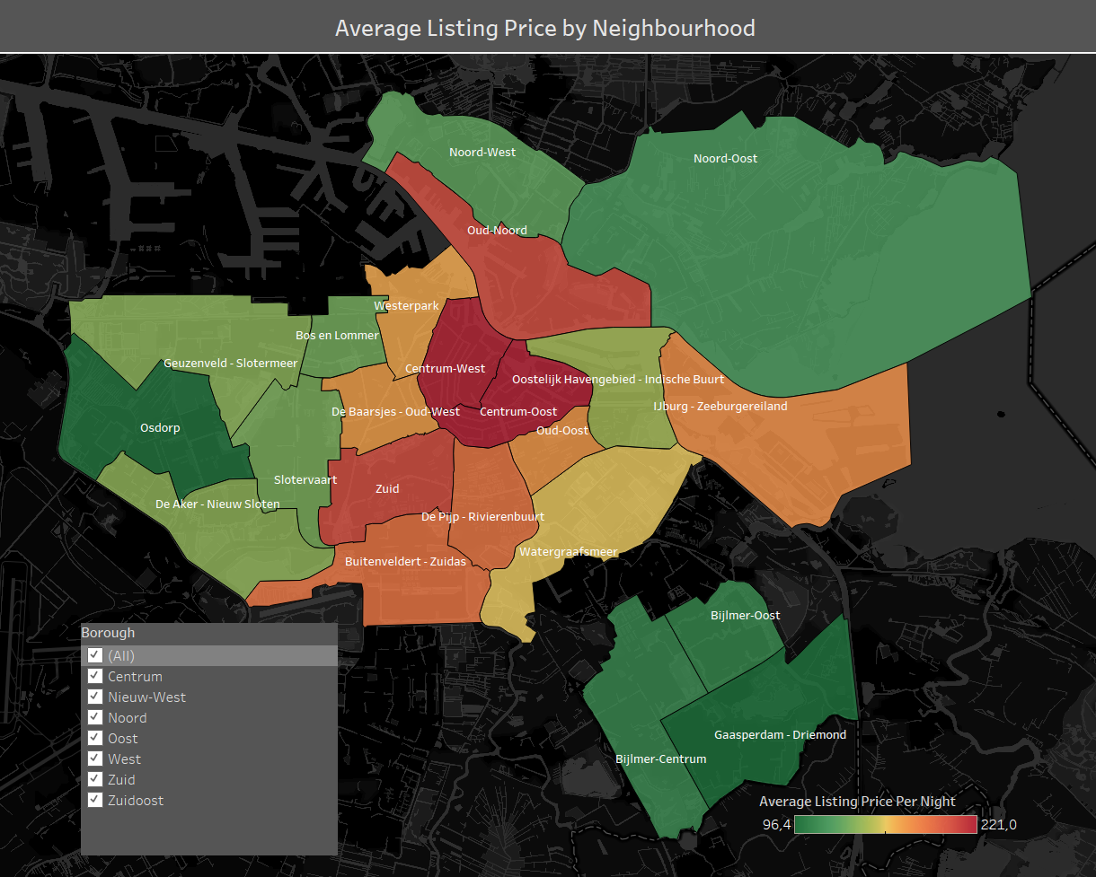
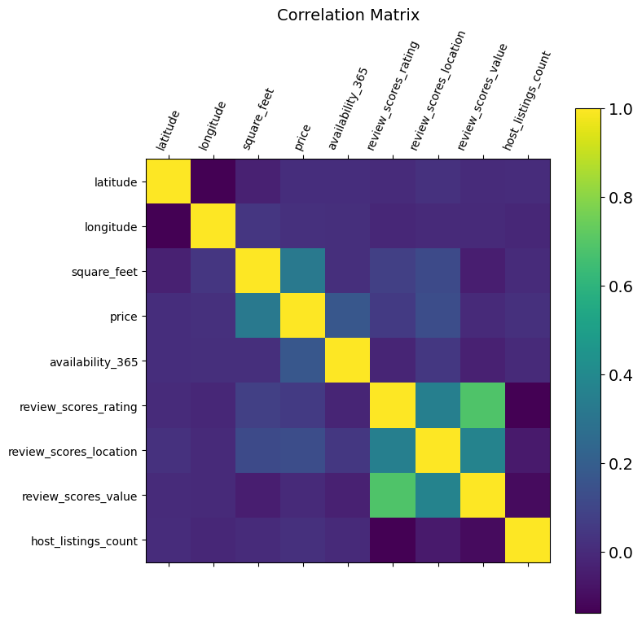
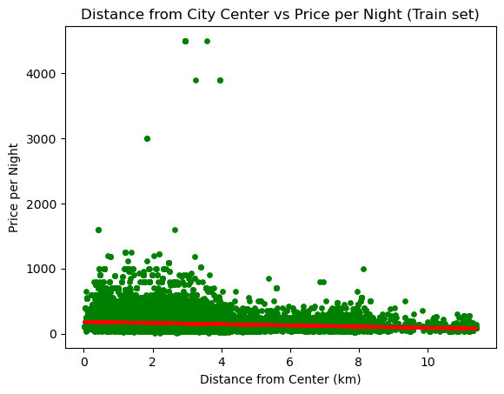
Analysis
Some examples of visualizations created for this project.
See GitHub for complete project scripts and visualizations.
See Tableau Public for interactive data dashboards.

Slide 25
Recommendations
Insights
The most popular neighbourhoods in Amsterdam for short-term guests are located in the boroughs of Amsterdam-West and Amsterdam-Zuid.
The center of the city has higher rates of vacancy than surrounding areas likely due to its higher-than-average prices.
Listings are more likely to be available across the city during the months of January and February.
The vast majority of Airbnb listings advertise entire homes and apartments. Shared rooms make up less than 1% of total Amsterdam listings.
Listings offered by hosts with multiple listings are more likely to receive a low review score from guests.
Visitors can plan to visit Amsterdam during the winter months.
Visitors should be aware of the higher prices if they choose to stay in the city center.
Visitors should consider staying in less-popular and less-central neighbourhoods if they are interested in saving money.
Hosts listing multiple accommodations for rent should put more effort into maintaining and caring for their properties in order to provide the best experience they can for their guests.
Residents of certain neighbourhoods with particularly high demand can consider becoming an Airbnb host if they wish to.

Slide 26
ClimateWins: Predicting Weather Conditions and Climate Change
Objective
Data Used
Methods Used
Identify abnormal weather patterns in Europe and their increase in frequency over recent years.
Generate predictions for climate conditions in Europe over the next 25 to 50 years.
Determine which machine-learning techniques (or combinations thereof) are best suited for these purposes.
Climate Data extracted from the European Climate Assessment and Data Set Project: https://www.ecad.eu/
“Pleasant Weather Data”, answers to a fictional survey regarding weather conditions, created for the purpose of this project.
Data-cleaning, wrangling, subsetting, aggregating and merging with Python, using pandas and NumPy libraries.
Optimization techniques for data and hyperparameter values, such as gradient descent and Bayesian optimizer.
Supervised machine-learning algorithms such as k-nearest neighbours, decision trees and ANNs (artificial neural networks).
Unsupervised machine-learning techniques such as random forest classifier using SciKitLearn.
Deep-learning models using Keras, such as convolution neural networks (CNNs) and generative-adversarial networks (GANs).

Slide 27
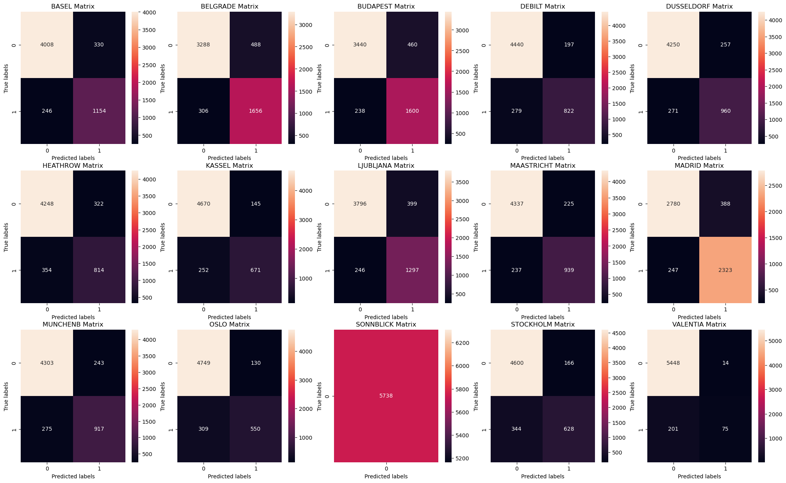
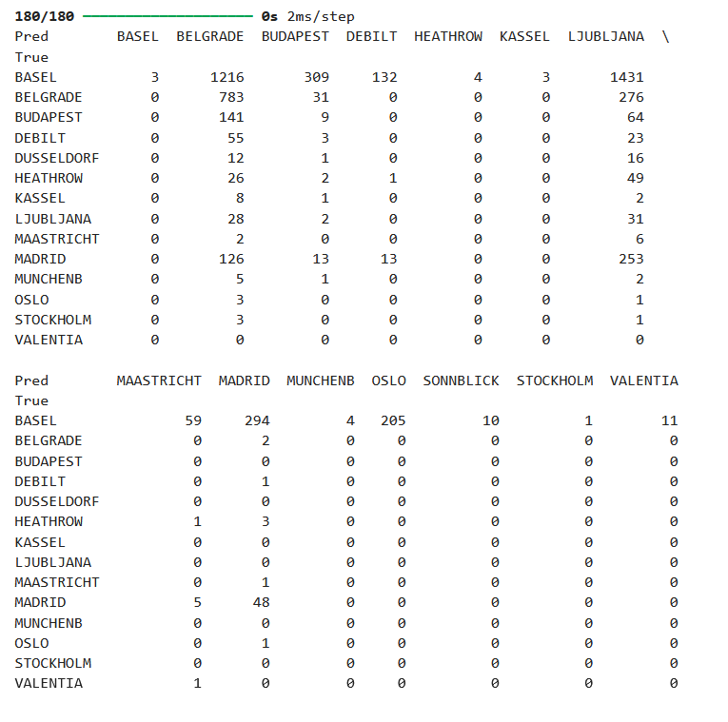
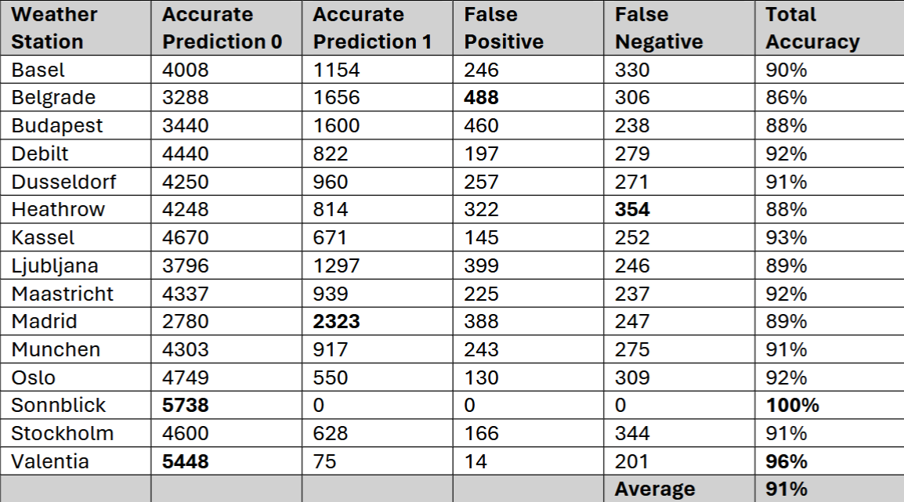
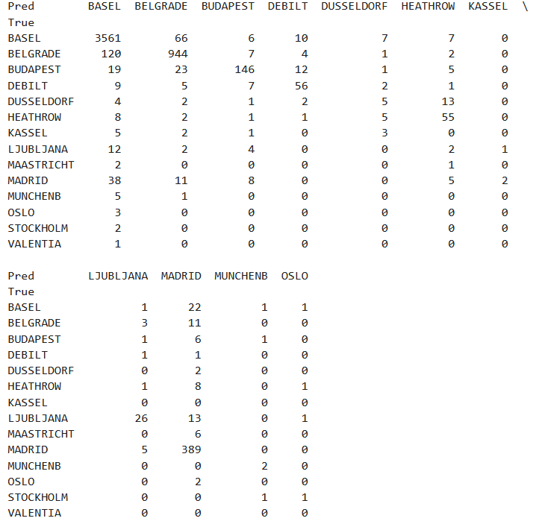
Analysis
Some examples of visualizations and analysis performed for this project.
Full set of Python scripts, visualizations and reports can be found on GitHub.

Slide 28
Recommendations
Insights
Classification algorithms such as k-nearest neighbours are the most suitable for identifying and predicting changing weather conditions within a region.
Unsupervised classification models, such as random forests, work best when applied to a smaller, less-varied set of data, e.g. climate data from a single city or region.
Optimized data and hyperparameter values ensure that a machine-learning model performs as intended and generates accurate results.
Visual data can be accurately interpreted using a convolutional neural network (CNN) and may be the most effective way to identify and predict changing weather conditions in Europe.
Use a generative adversarial network (GAN) consisting of at least one CNN to analyze weather satellite and radar images and create accurate visual predictions of future weather conditions in Europe.
Use a random forest model to identify weather patterns within a smaller region and, using a second set of data such as survey answers or healthcare data, determine the impact of these weather conditions on the local population.

Slide 29
Contact
E-mail: suryd@protonmail.com
GitHub: https://github.com/sryds

